Slide 1
Adapting teaching and learning for children and young people with special educational needs
Mel Warren, Portage Strategic Coordinator
Suzie Allen, Senior Learning and SEND adviser (Primary)
Anna Harvey, Learning and SEND adviser (Secondary)
Notes:
We will consider how educators can adapt learning activities to ensure that they are making their sessions inclusive and welcoming to all children and young people from birth to 16 by using a small-steps approach.
Mel Warren will look at the ‘Portage Small Steps to Learning’ ethos and how they adapt teaching to the individual child, considering periods where the child may be poorly, in hospital, or learning differently and how we can achieve best outcomes for them regardless, whilst recognising that parents are the best first educators of their child.
Anna and Dawn will then consider how the ‘small steps approach’ can be continued in mainstream primary and secondary settings through robust Support Plans, both for children at SEN Support and with EHCPs.

Slide 2


Melanie Warren
Portage Strategic Coordinator

Slide 3

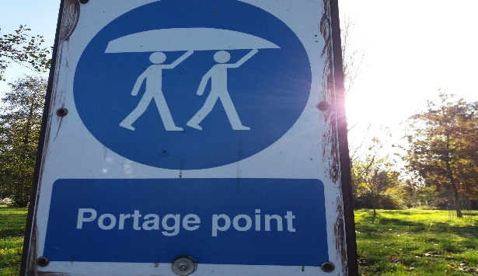

But…. What IS Portage ?!

Slide 4
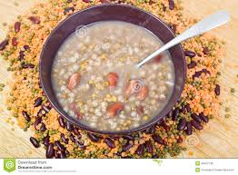
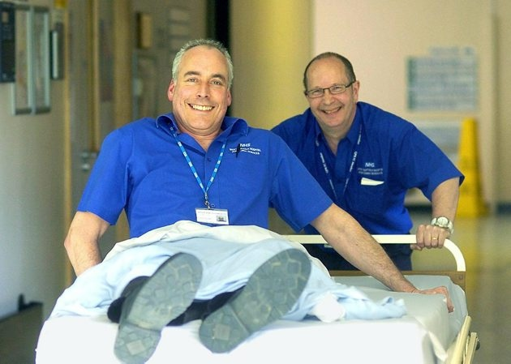
Or perhaps…..?

Slide 5


National Portage Association
The name Portage comes from a town in Wisconsin, USA where the first home teaching scheme began.
Portage has been established in the UK since 1976. There are approximately 120 services across the UK and it is a world-wide intervention.

Slide 6
The following slides illustrate Portage intervention perfectly…..

Slide 7

“Portage really gave me the confidence and the knowledge to draw out the very best from my child.”
Parent Quote:

Slide 8
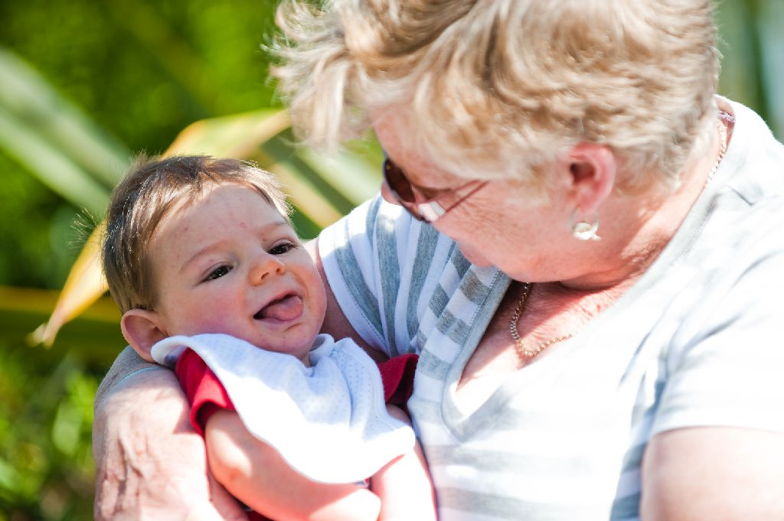
“I cannot speak highly enough of the service and the benefits it has given to us as a family.”
Parent Quote:

Slide 9
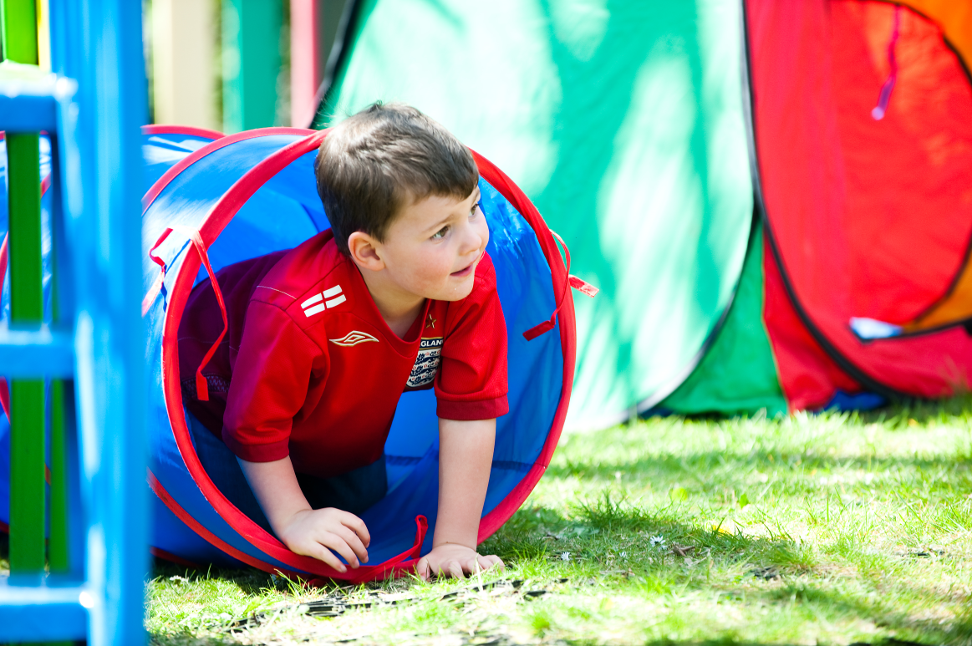
“It has helped me because I can see the improvements and it has given me confidence in my ability to help him”
Parent Quote:

Slide 10
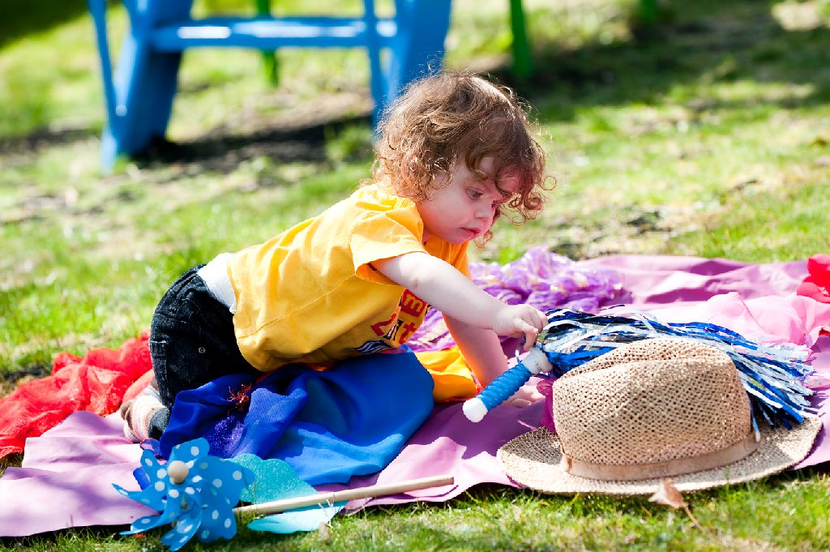
“It is done at home within the best environment for one-to-one teaching. Everyone is relaxed which makes things so much easier”
Parent Quote:

Slide 11
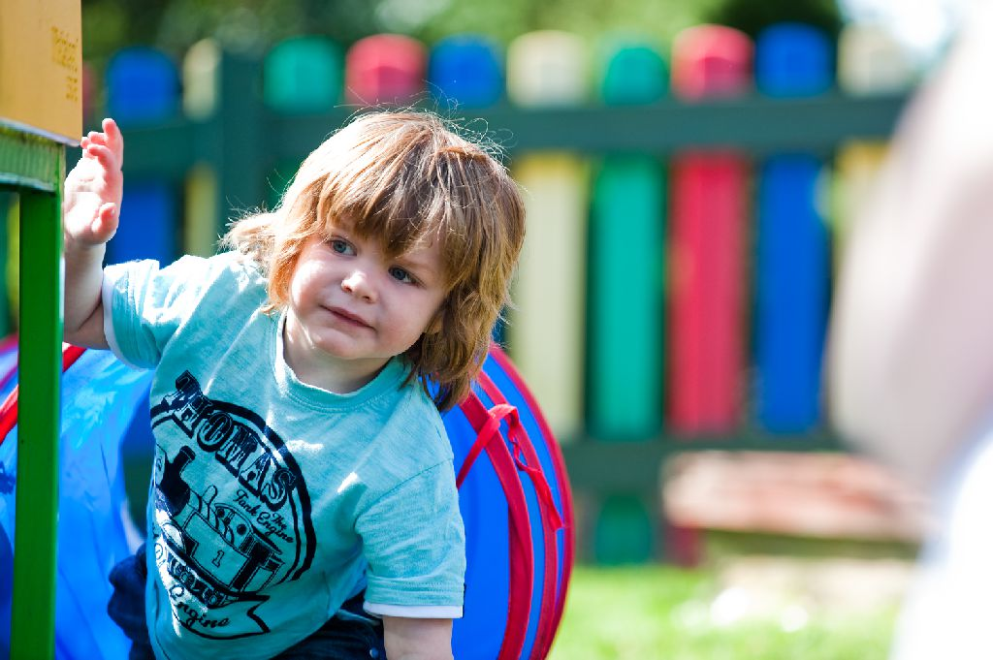
“It has taught me to take things gradually. Before Portage, I expected to see an immediate response to certain things. Now I accept the little things which will add up to succeeding in one big thing later”
Parent Quote:

Slide 12

“I look forward very much to my weekly visit. You don’t feel isolated and you know that if you have anything you’re worried about, you can discuss it.”
Parent Quote:

Slide 13
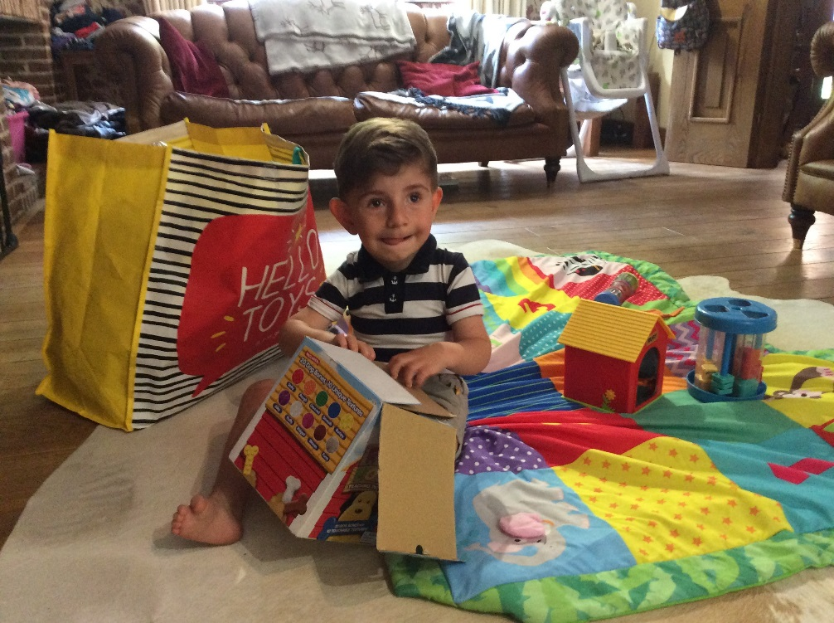

Portage is a home visiting, educational service for pre-school children with a significant delay of 6 months or more, in two or more areas of the EYFS and is a world-wide intervention, delivering a Small Steps to Learning ethos

Slide 14
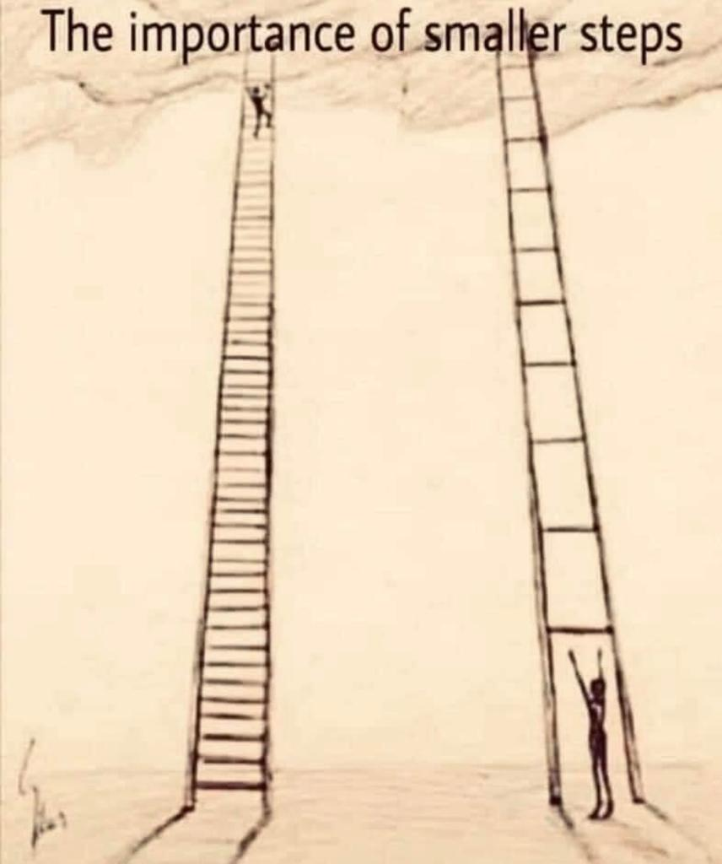
Getting a foothold…. to obtain an initial, stable position from which one can progress in a particular industry or area

Slide 15
partnership
generalising skills
celebrating success
inclusion
celebrating diversity
small steps
PORTAGE PRINCIPLES
enabling
being positive
supporting
looking forward
whole child, family and community
practical, immediate, relevant

Slide 16

Portage is Effective Early Intervention
‘Early support for families …….can take a number of forms, including …home based programmes, such as Portage, which offer a carefully structured system to help parents support their child’s early learning and development.’ (5.15 & 5.16)
‘Portage workers also identified as appropriate specialists…able to identify effective strategies, equipment, programmes or other interventions to enable the child to make progress..’ (5.48)
SEND Code of Practice 2015

Slide 17
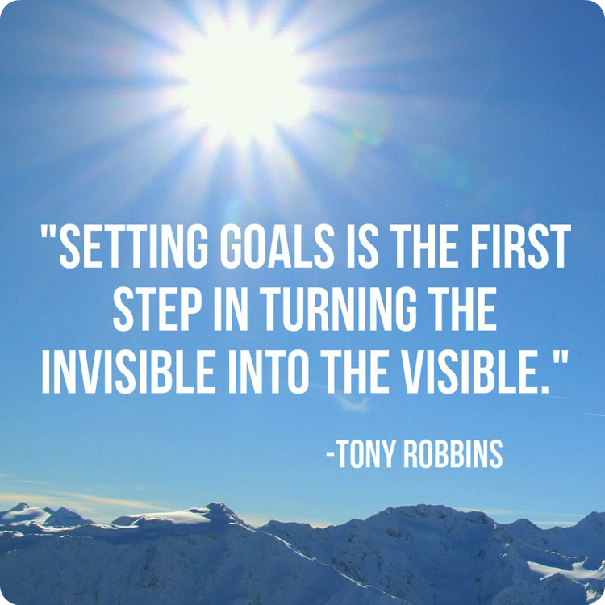

Slide 18
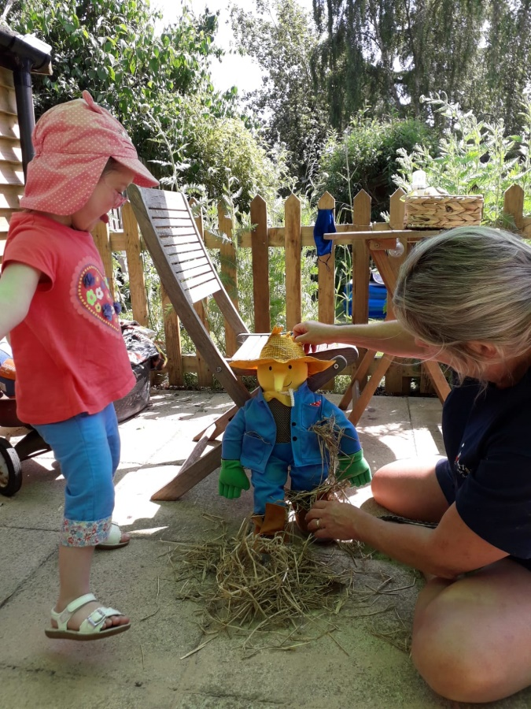
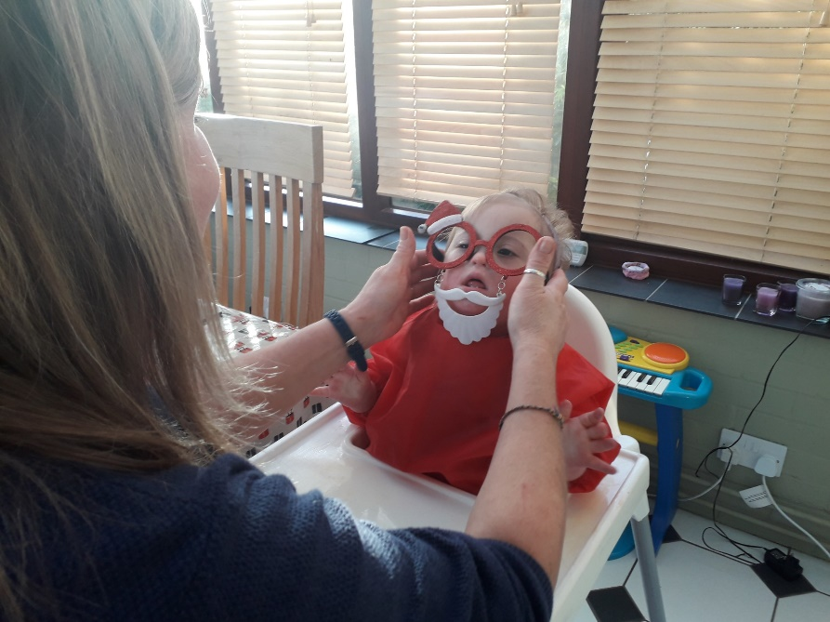
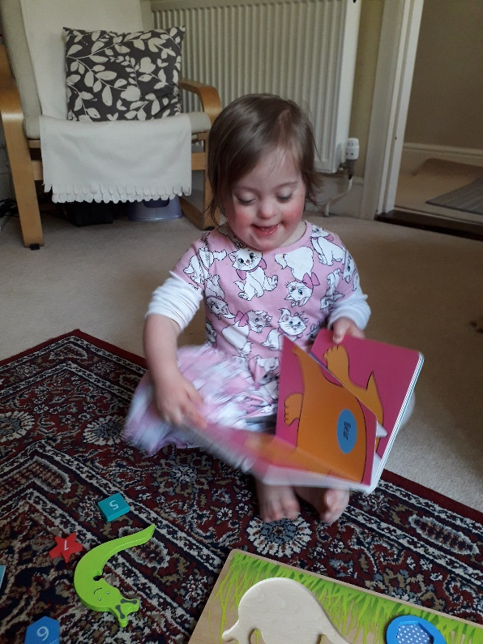
*** Introducing Edith and her Small Steps journey ***

Slide 19
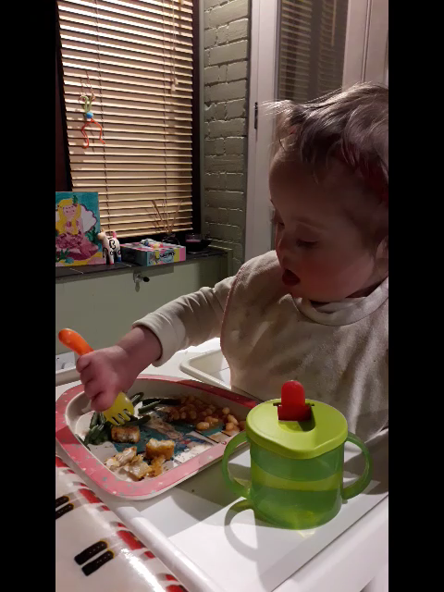

Slide 20
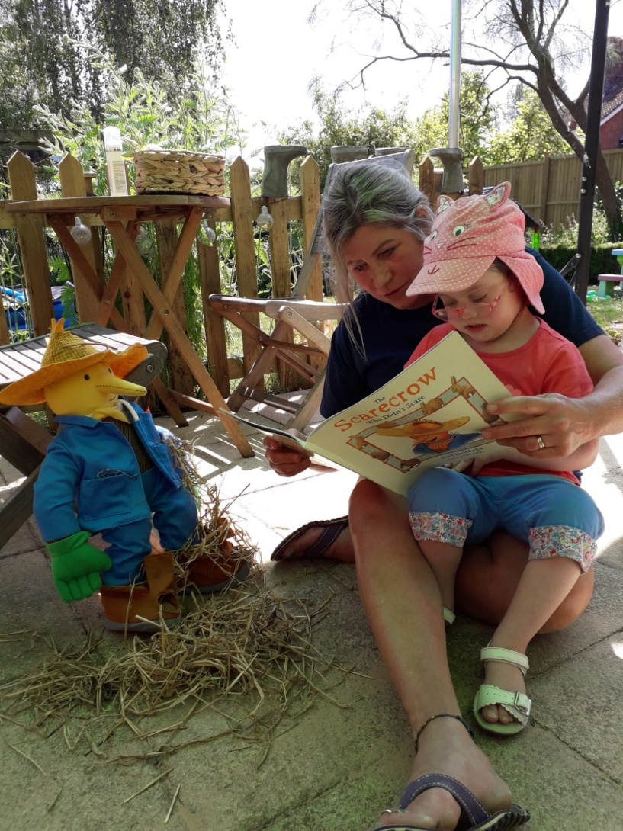
..and here she is at 4 !

Slide 21
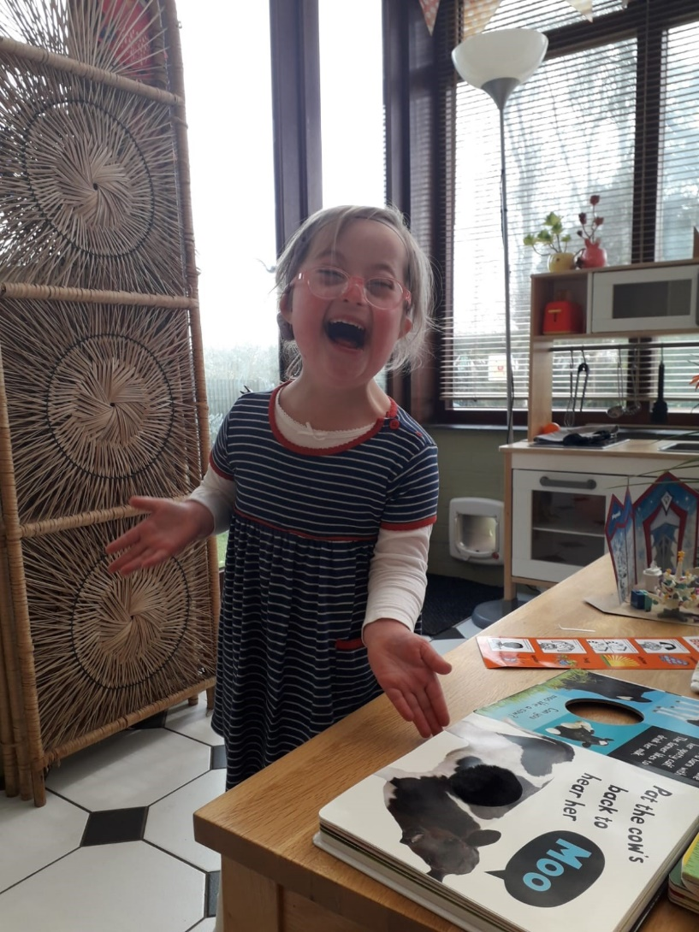
An absolute love of reading- 4 years

Slide 22
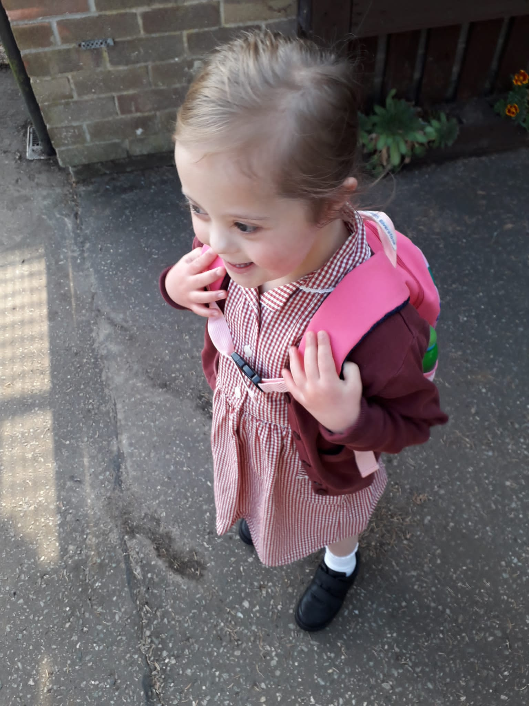
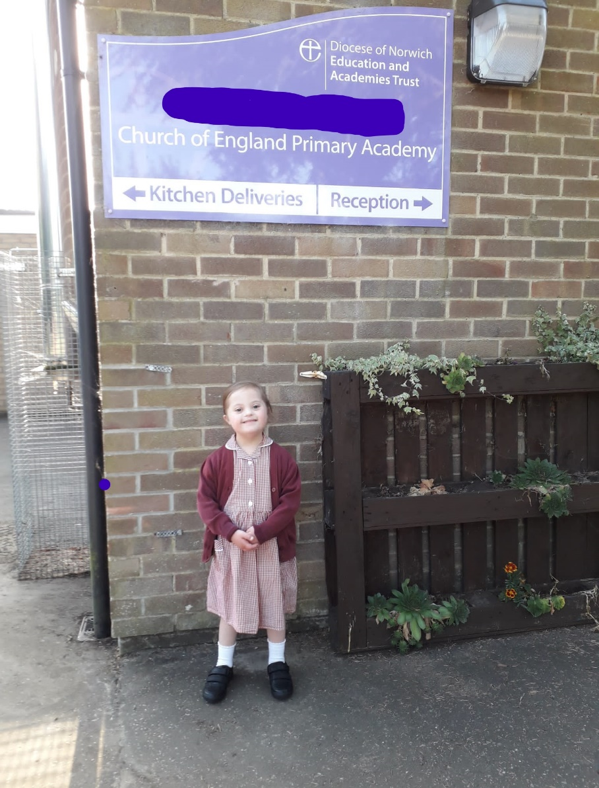
Happy school days !

Slide 23
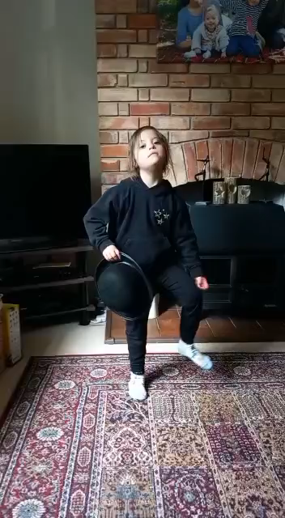
Edith the Entertainer – 7 years

Slide 24
Inclusive practice and why it’s important…
It is important that children with additional needs and disabilities are able to see representation of themselves wherever possible
It gives their peers opportunities to learn about differences, within a safe environment that may initiate conversation and learning opportunities.
It gives siblings a chance to talk about their siblings if they want to

Slide 25
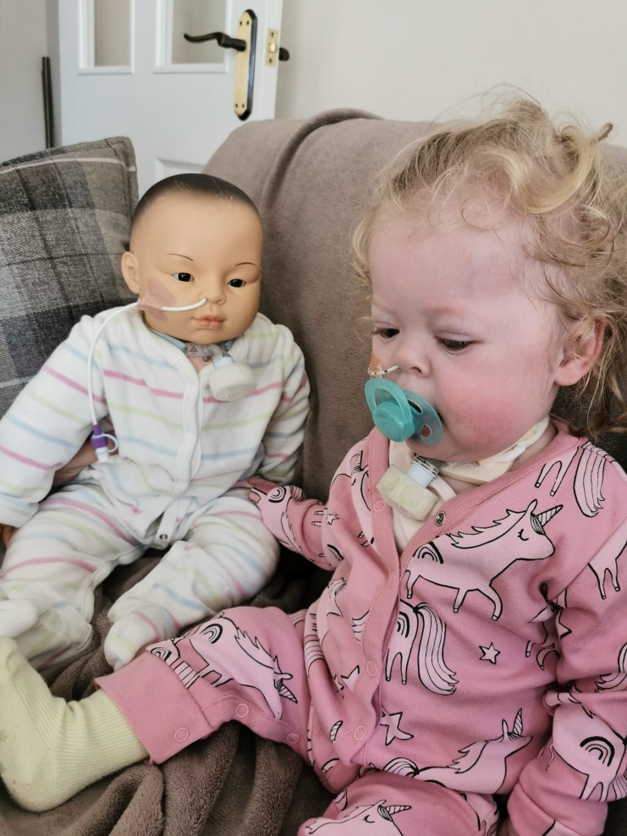
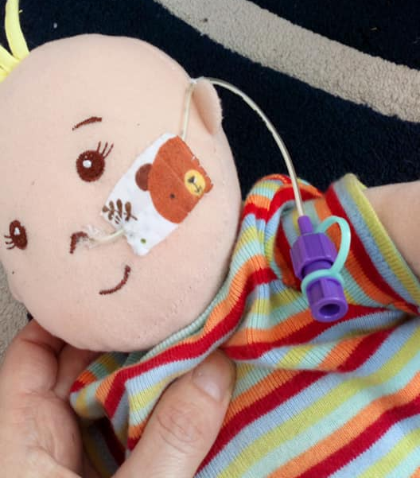
Medical Adaptations
Nasogastric (NG) tubes -The NG tube is placed in the nose and slid into the stomach. The formula is put into the tube and flows to the stomach

Slide 26
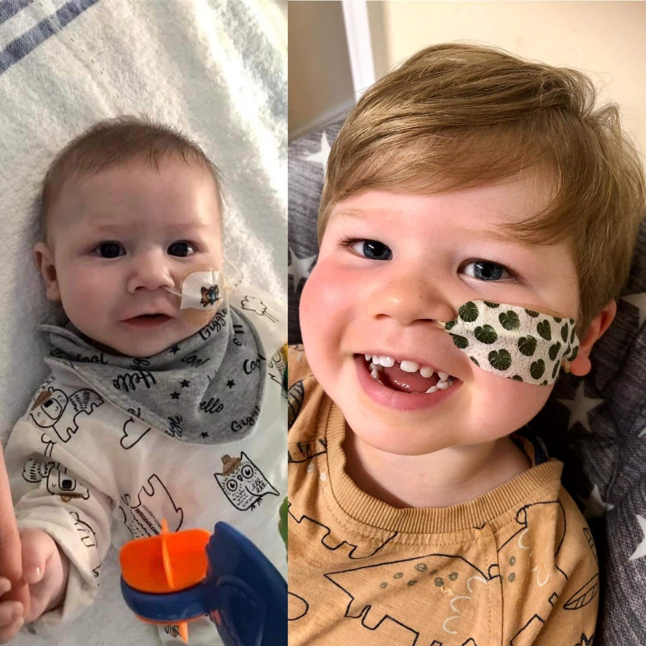
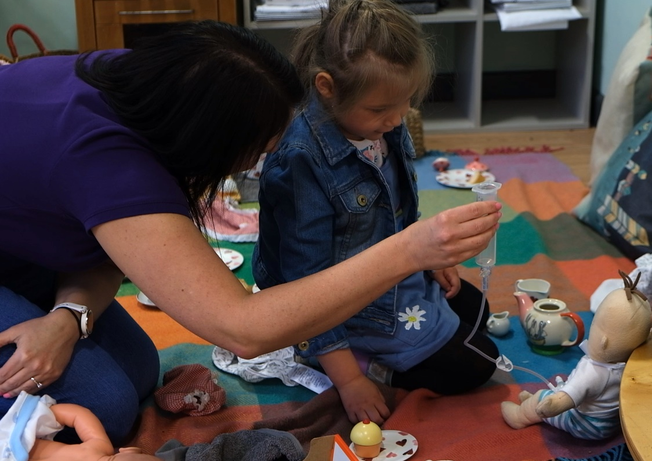

Slide 27
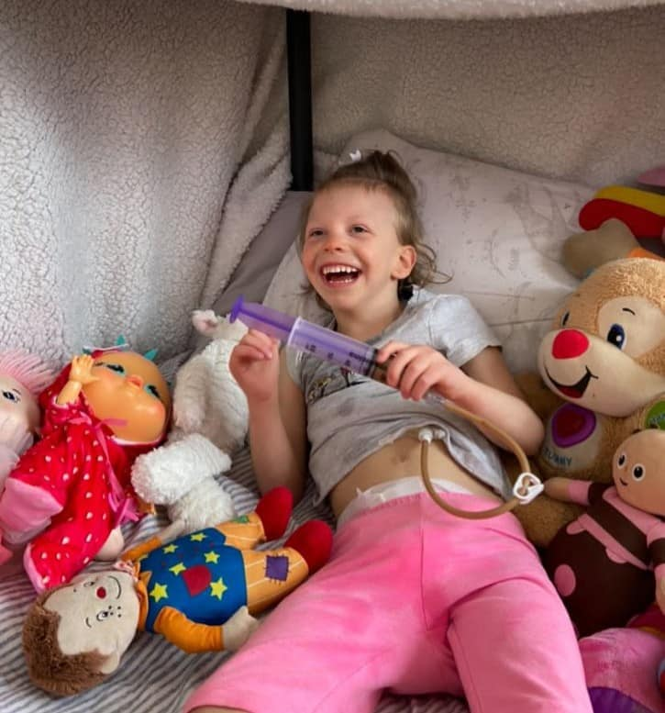
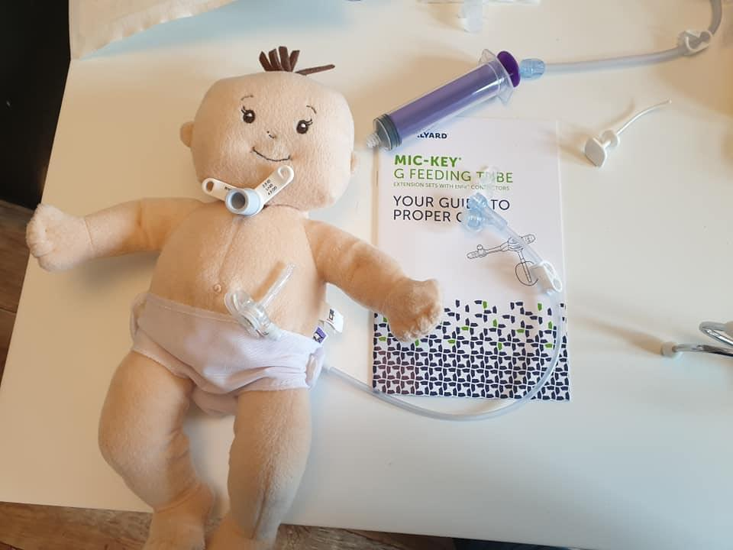
Gastrostomy –
A gastrostomy is a tube which is inserted through the abdominal wall (tummy) into the stomach. There are two common types of gastrostomy, Percutaneous Endoscopic Gastrostomy devices (PEGS) and low-profile 'Buttons'.

Slide 28
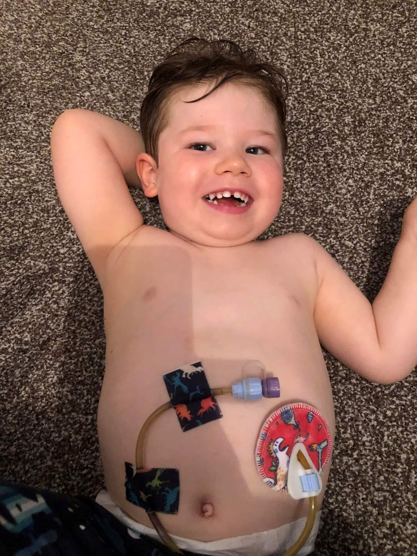
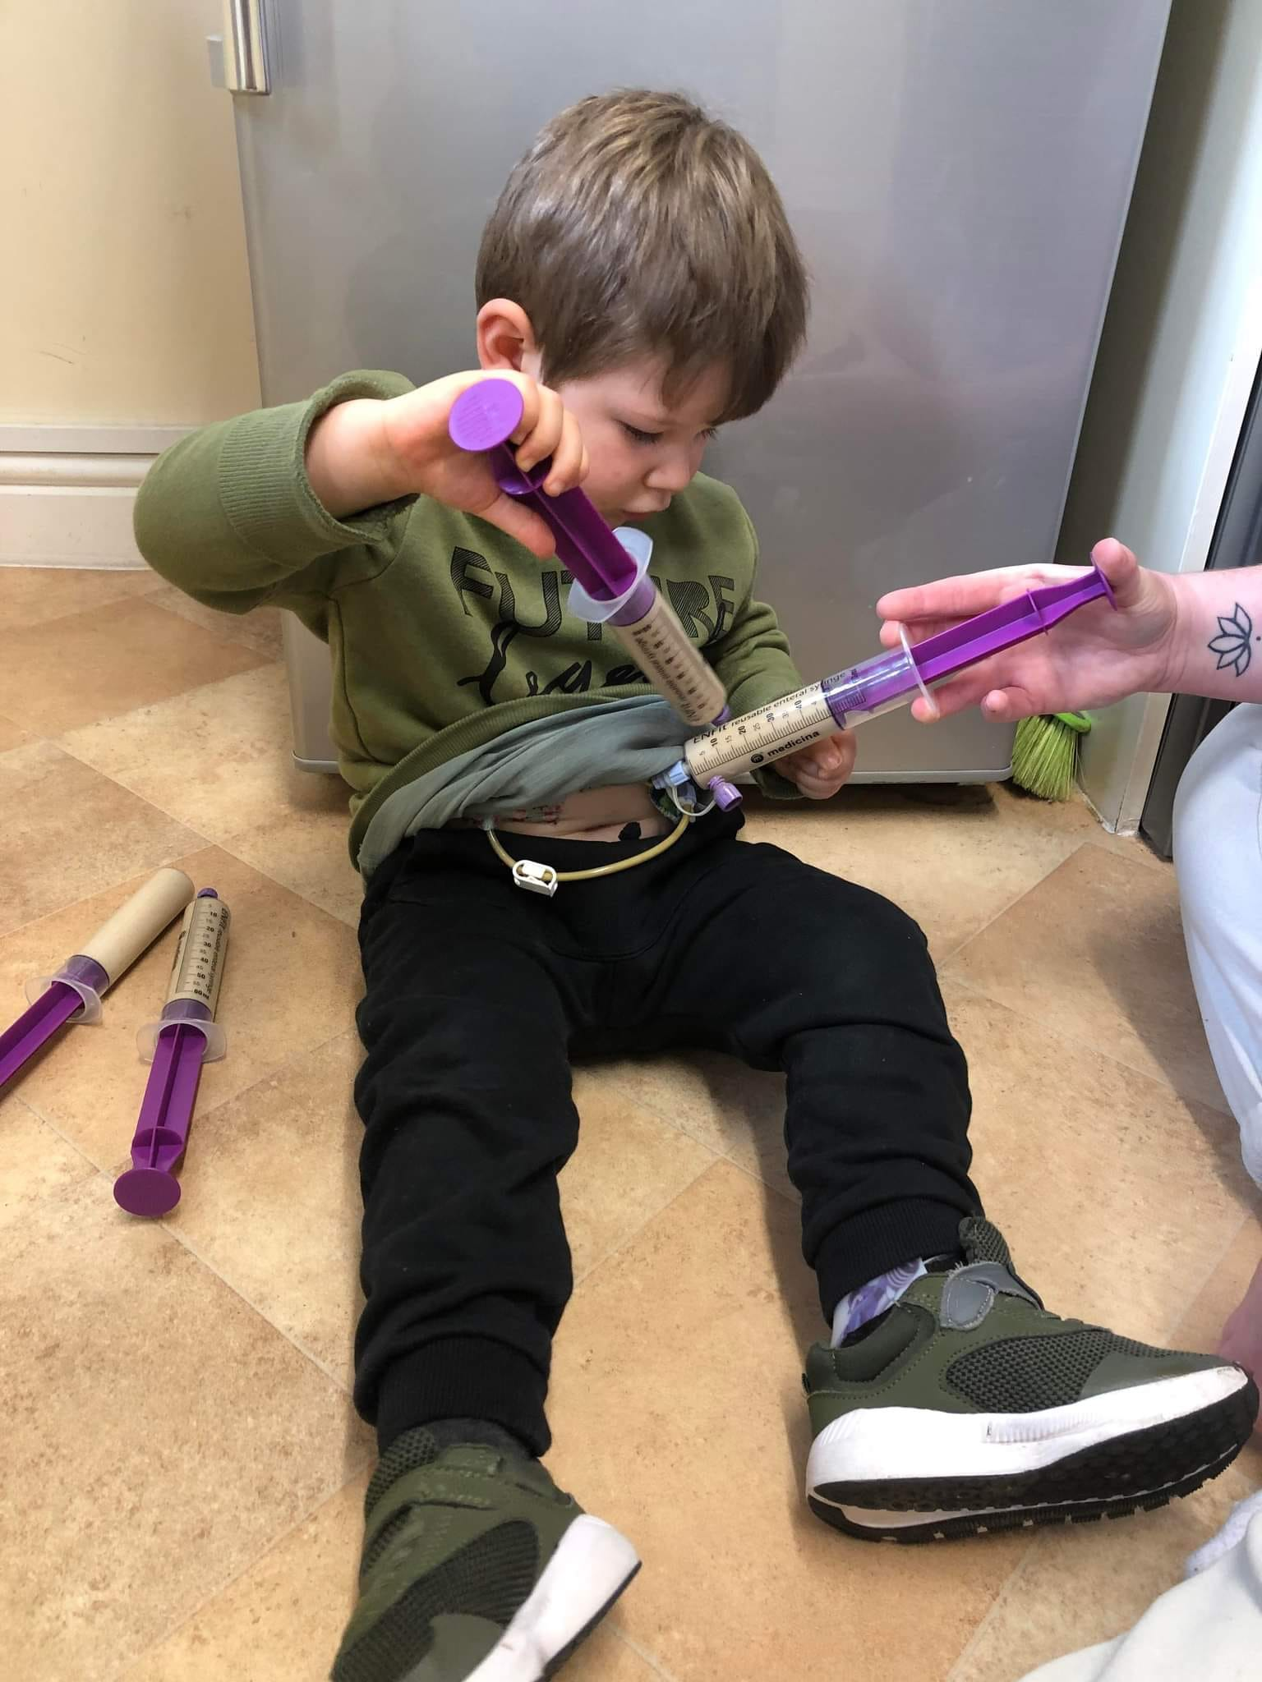

Slide 29
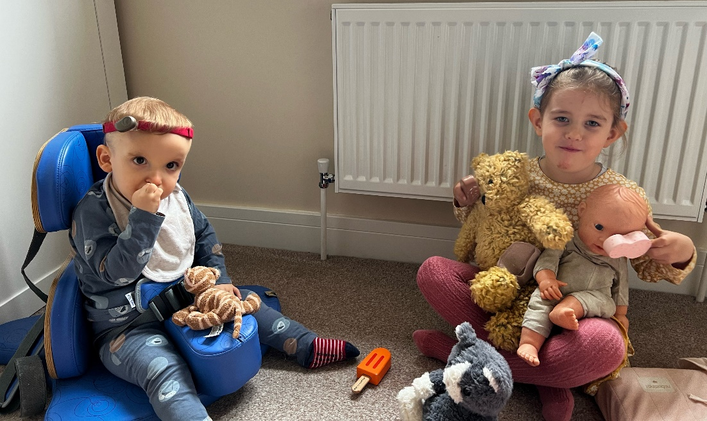
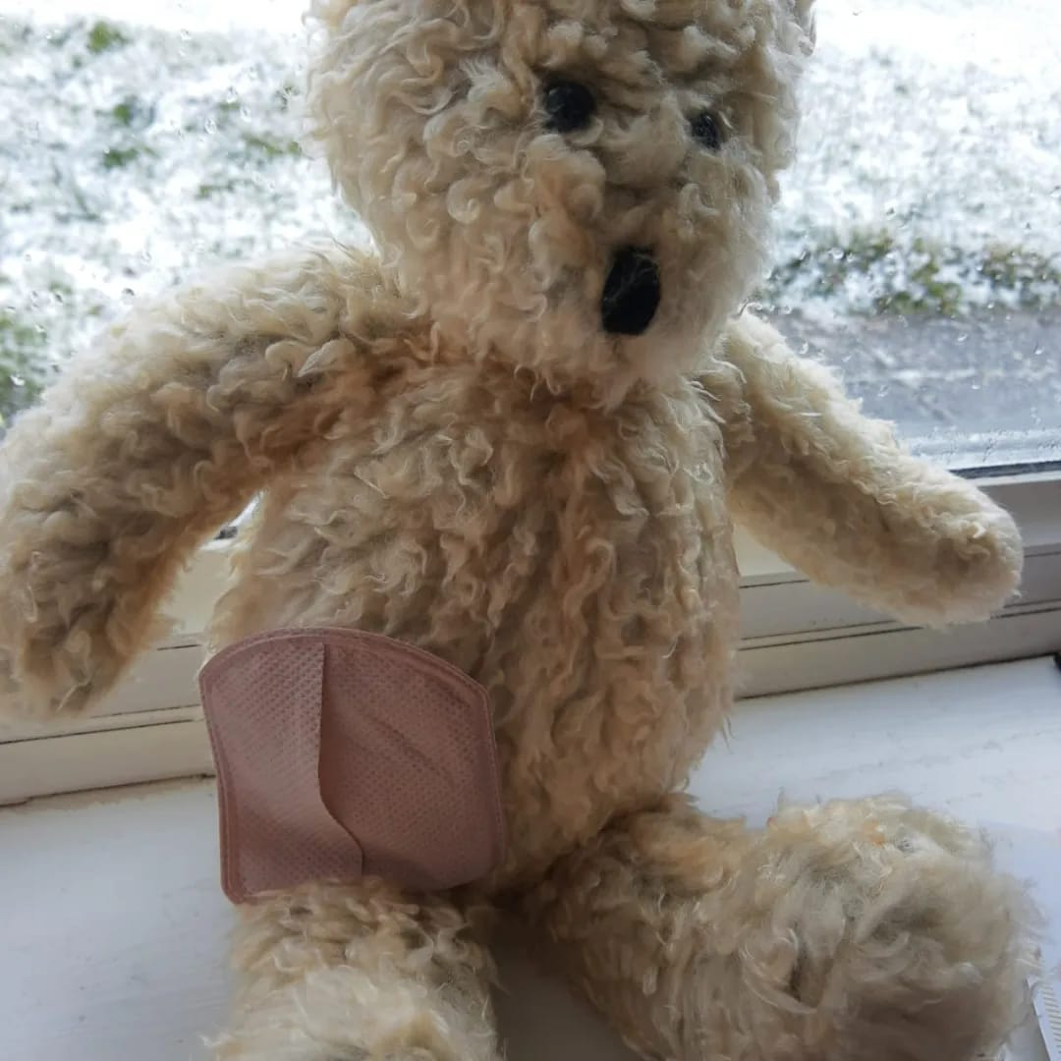

Stoma Bag – A colostomy is an operation that connects the colon to the abdominal wall, while an ileostomy connects the last part of the small intestine (ileum) to the abdominal wall.

Slide 30
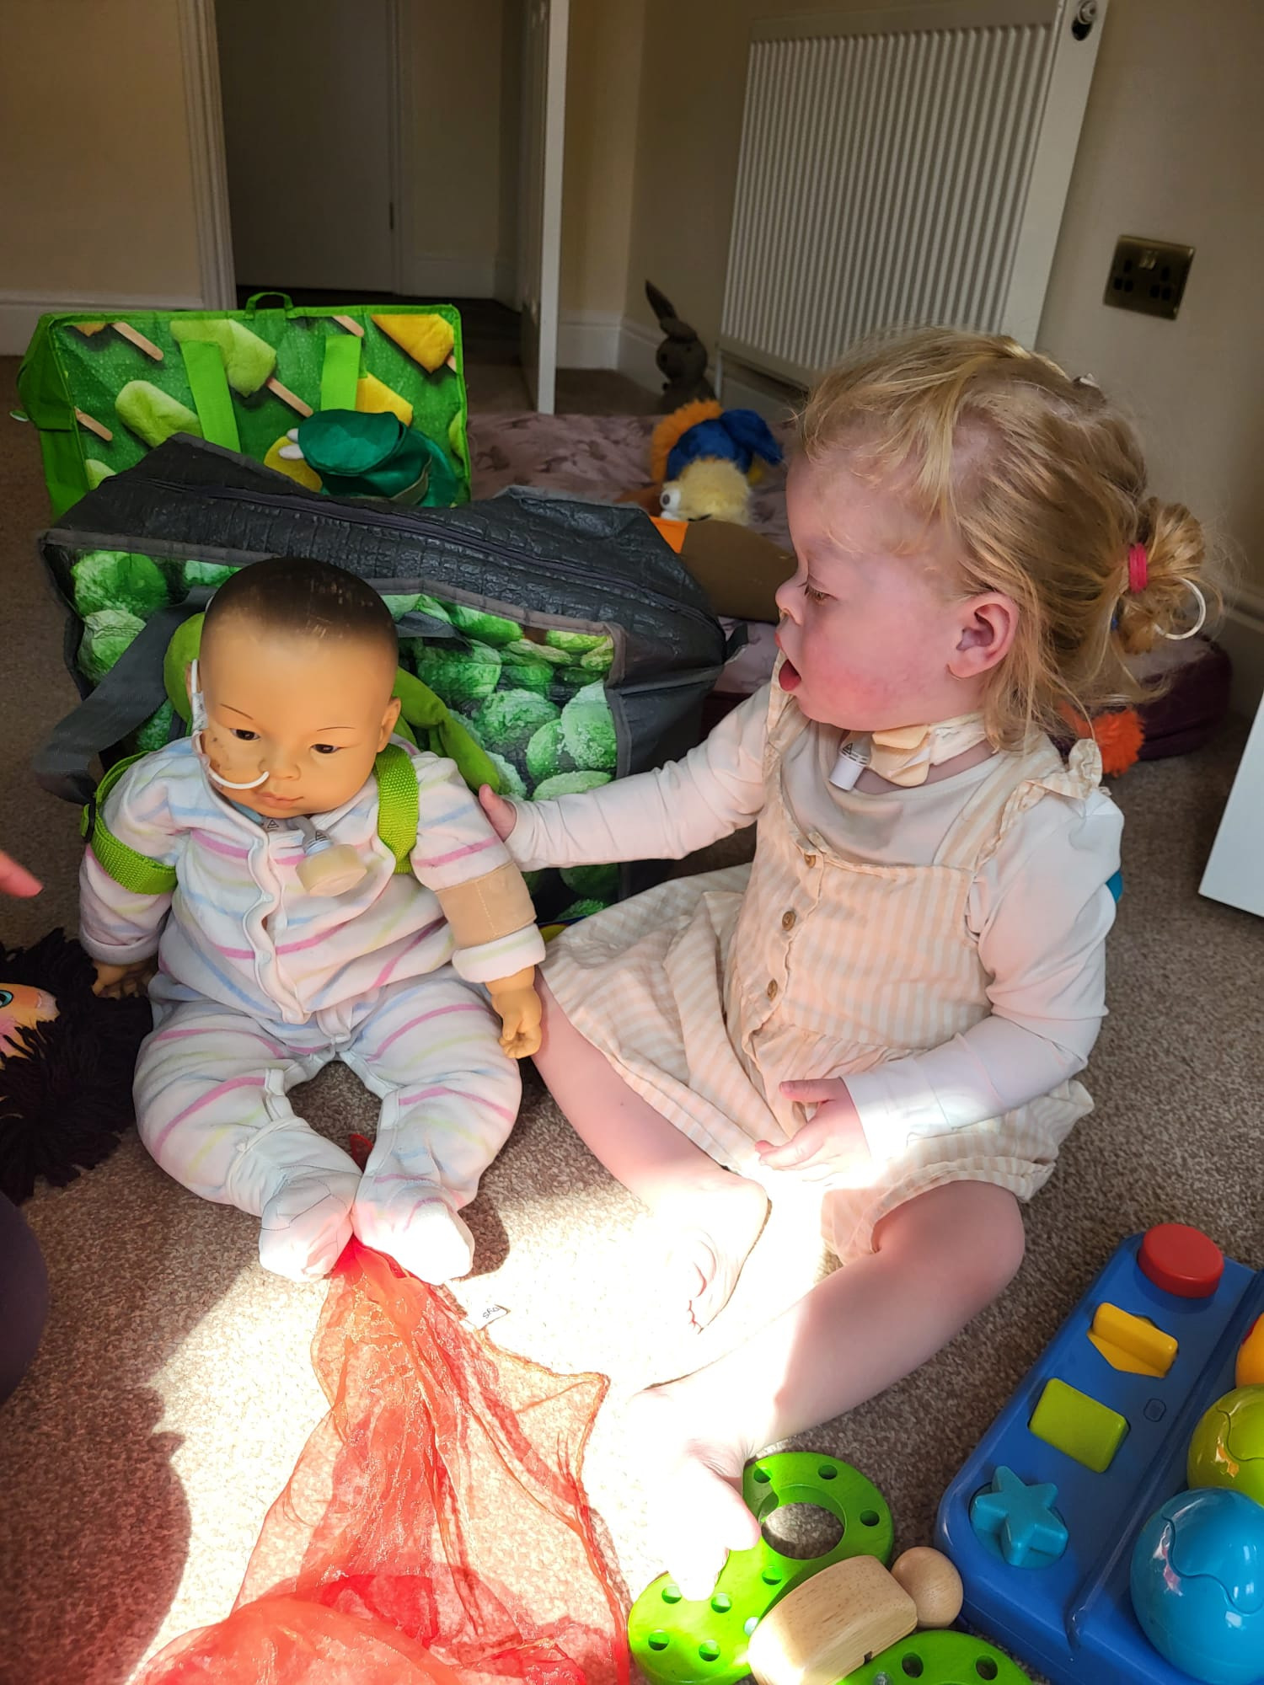
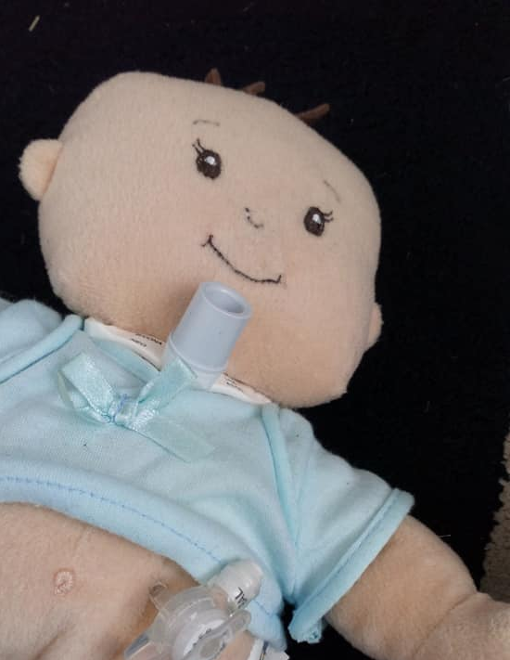
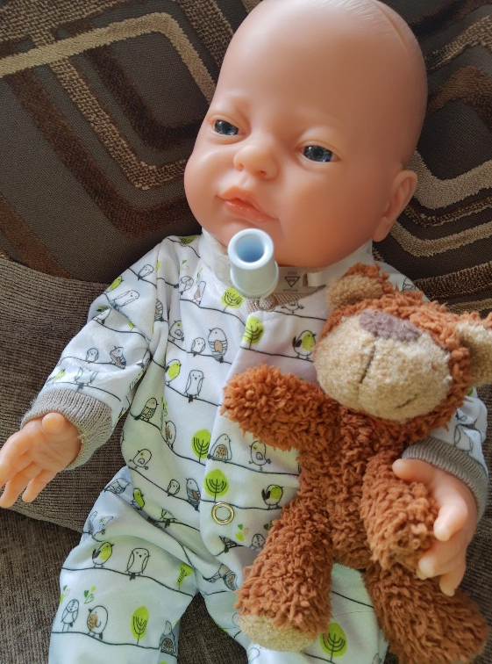
Tracheostomy - A tracheostomy is an opening created at the front of the neck so a tube can be inserted into the windpipe (trachea) to help you breathe. If necessary, the tube can be connected to an oxygen supply and a breathing machine called a ventilator.

Slide 31


Parent Quote
“Lottie has enjoyed a doll like her. It would be brilliant if a doll like this could have been introduced into her preschool environment to give her peers a chance to ask questions, to explore and understand. So it didn’t feel as daunting when Lottie arrived and with all the equipment that comes with her. In particular at meal times with her feeding routines and syringes etc. I think it would be great if the children could have the opportunity to play with things like syringes and the doll etc. So they understand what they do and to work on boundaries to know what they can and cannot touch.” Tara - Lottie’s mum.

Slide 32
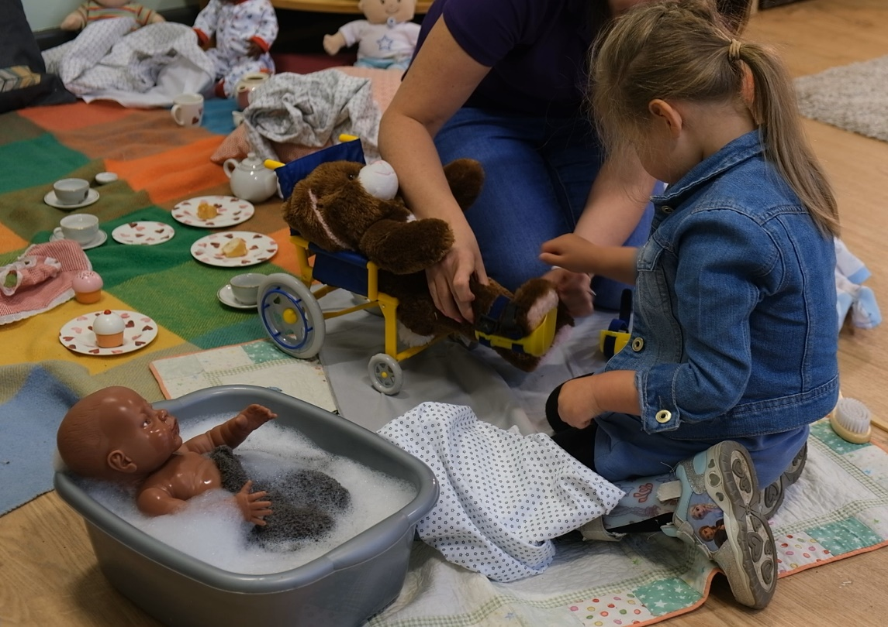
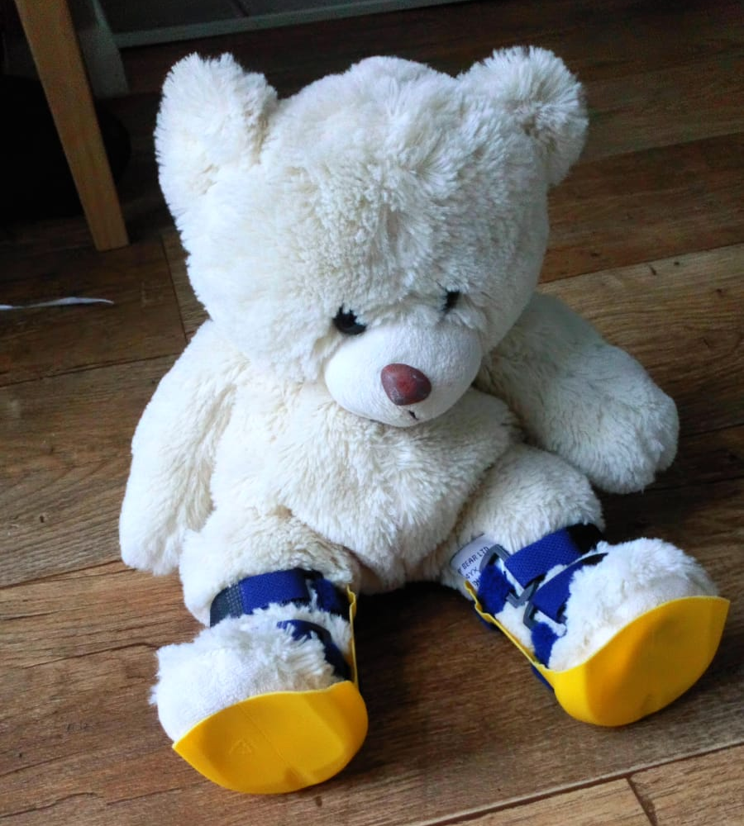
Physical Disabilities Adaptions
AFO/Splints - AFO/Splints are a crucial piece of equipment for many children with spastic diplegia. The main function of the AFO is to maintain the foot in a certain position. This then provides a stable base of support that facilities the function.

Slide 33
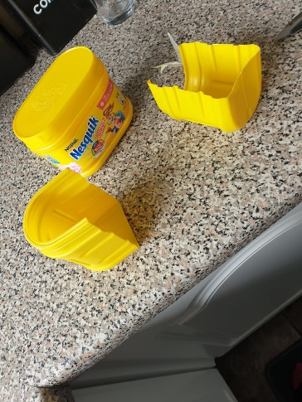
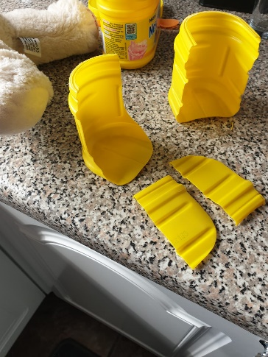
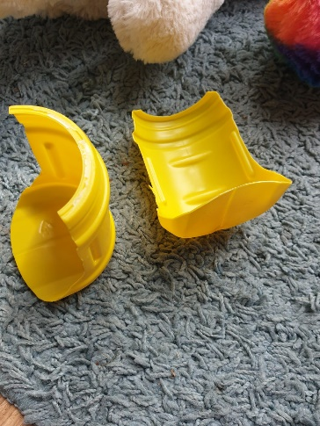
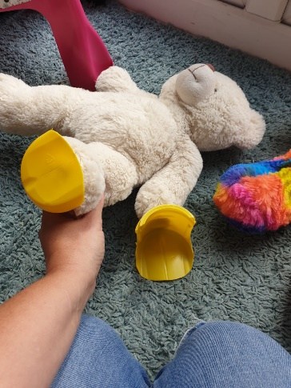
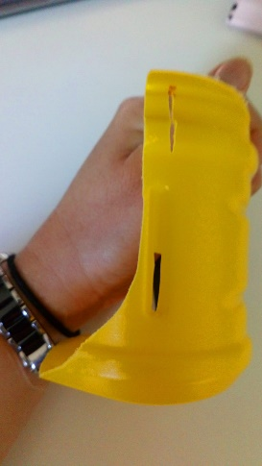
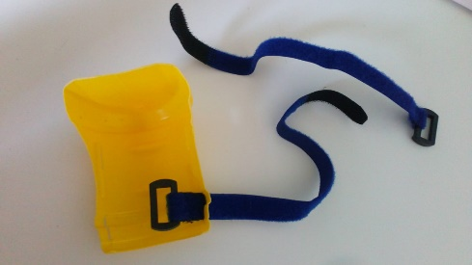
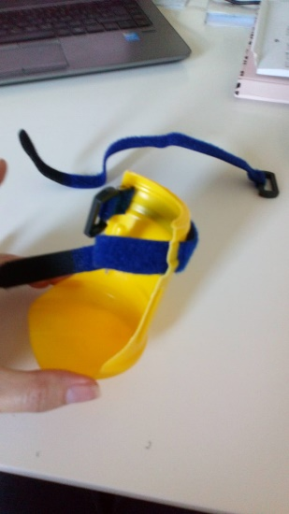
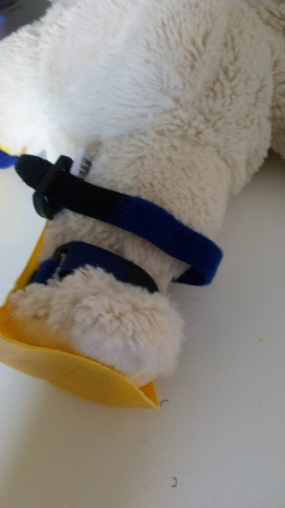
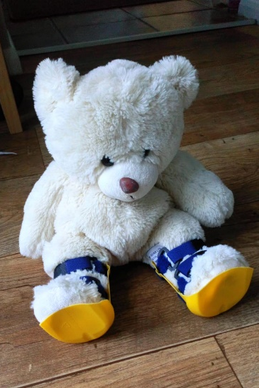
Step by step to make splints

Slide 34
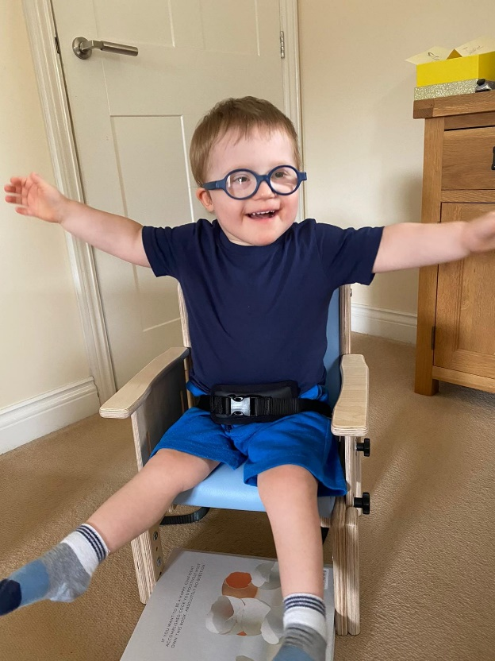

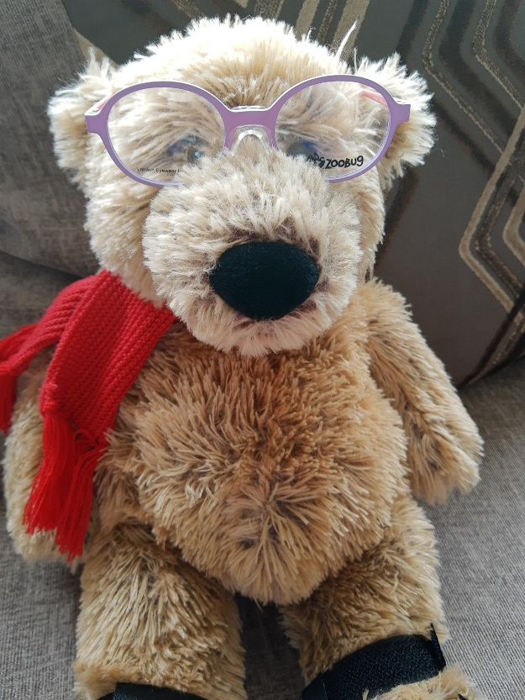
Sensory Impairment: Vision

Slide 35
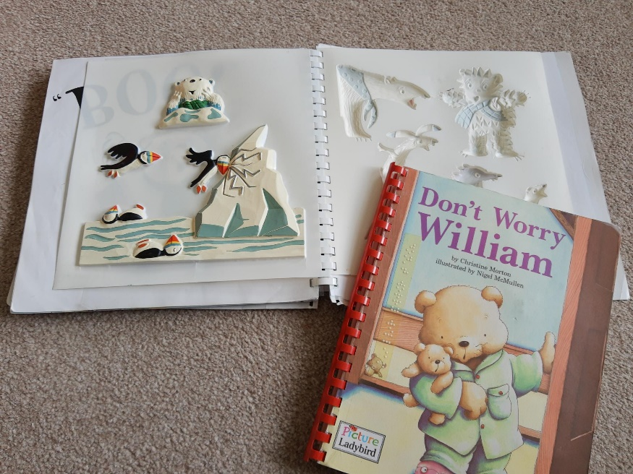


There are different ways to introduce books for children with visual impairments. These include textured books, ones with braille and ones from Living Painting, that raise the pictures for children to feel. There are also audio books.

Slide 36

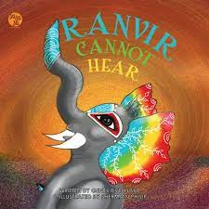



It is so important for children to see themselves and their siblings represented positively and books are a great way to do this. It also gives other children a chance to ask questions in a safe way.

Slide 37
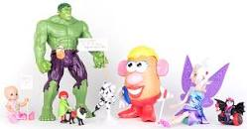


Websites
www.Toylikeme.org.uk
#ToyLikeMe is an arts and play not-for-profit organisation starting playful conversations with children about disabilities. They have also developed a programme of workshops to teach inclusion and diversity to primary schools. If you would like to know more about bringing the ToyLikeMe-tastic magic to your school hall with a pop-up event, get in touch: toylikeme@gmail.com
www.3dtoy.shop
3D ToyShop uses 3d design and printing to make accessible toys for children to take away the fear from medical devices through play.

Slide 38
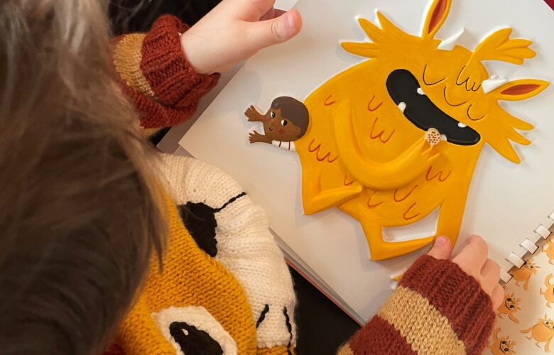

https://livingpaintings.org
Living paintings provides audio and tactile books for blind children and adults. They offer a free postal library of ‘Touch to see’ books, which provide access to the visual world for blind and partially sighted children.
www.buttonybear.com
A Bear Named Buttony supports children and young people who have a stoma.
For children, they gift a bear with a stoma and a book and for young adults, a wash bag full of non-medical items to help adjust to life with a stoma.

Slide 39
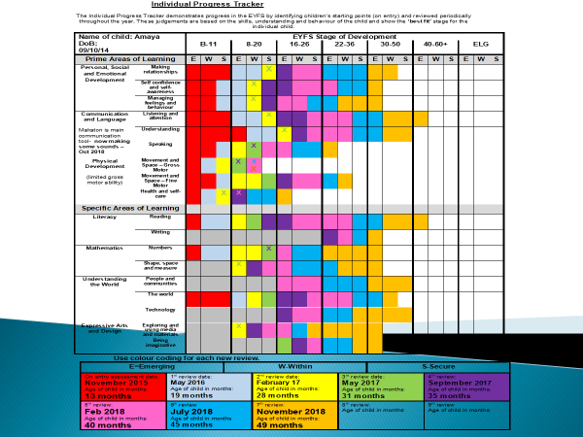

Slide 40
Transitioning from Portage
When a child is settled with regular hours within their funded education provision
Accompanied visits to settings
Meetings with SENCO/Keyperson to share long term goals and recent activities
Settle sessions if required
Observation visits and reports
Concluding report including the Voice of the Child

Slide 41


Portage Small Steps Training Workshop for Early Years
A Small Steps Approach to Learning for Children with Special Educational Needs and Disabilities
Melanie Warren and
Sarah Worlidge - Accredited NPA Trainers

Slide 42

Structure of the course
Day 1
The Portage Model and its Relevance for Early Years Providers
Helping Children Learn: Using Clear Language
Baby Brain
Helping Children Learn: Planning for Success
Day 2
Helping Children Learn: A Small Steps Approach
Parent’s Perspective
Helping Children Learn: Examples of Planning, Recording and Sharing
Supporting the Development of Play
Plenary
Follow up session:
Positive Approaches to Children’s Behaviour
Sharing experiences: successes and challenges
Next steps

Slide 43

Referral Form
You can call 01603 704049 for a referral form, or find us on the Local Offer website where there is a link, or email Helen.hall2@norfolk.gov.uk
We have a Facebook page :
https://www.facebook.com/NorfolkPortageService
Loads of stories, songs and merriment ☺

Slide 44
Watch our ‘Voice of the Child’ YouTube video !
https://www.youtube.com/watch?v=xMh8-ouEiGc

Slide 45


Slide 46


Slide 47

Thank you for listening
Any questions?

Slide 48

SEN Support
Notes:
What is SEN support in settings, and this video from Norfolk’s Local Offer explains it. This can be used with CYPs, Families etc, or linked to school websites.

Slide 49

SEN Support Plans
Notes:
The views of children and young people (CYP) and families must be at the centre of how we plan effective support for CYP with special educational needs and/or disabilities (SEND).
Coproduction - This means working together and communicating as equals, understanding and valuing one another’s unique insights and expertise to create a plan to bring about positive change.

Slide 50

The Graduated Approach
Enhanced
Targeted
Notes:
Universal provision
This is the provision available to all children and young people. It forms the foundation for all other provision or support in settings and comprises high-quality teaching that is made available to all. When there is a comprehensive universal offer of inclusive provision, most children will have their learning needs well met. This will reduce demand for more targeted intervention and provision.
“Universal provision is based on inclusive approaches to teaching and learning which benefit all children but are essential for those with SEND. Reasonable adjustments for individual needs are made to ensure settings are, for example, dyslexia-friendly, communication-supportive and adaptive for any sensory and physical needs that pupils may have.” (Supporting SEN, Universal Provision nasen, 2020).
Targeted provision
Even when high-quality universal provision is in place, additional support or targeted provision will be required for some children to support them to make progress. This may include small group or one-to-one support using evidenced-based interventions, for example, from 'What works?' Whole School SEND or the Education Endowment Foundation (EEF).
Enhanced provision
For a few CYP, personalised and bespoke support may be required to meet their needs in addition to what is offered through universal and targeted provision.

Slide 51




The Graduated Approach
Provision expected at SEN support (PEaSS)
Notes:
The Provision expected at SEN support (PEaSS) contains a huge range of universal level support, from whole setting best practice to suggested strategies for SEN support in the classroom. This can be used, in collaboration with the child or young person and their family, to plan for the most appropriate level of adaptive teaching approaches that can support the child or young person during lessons or social time activities.

Slide 52

What do CYP say?
Notes:
We asked Norfolk SEND Youth Forum (a group of young people with SEND 11-25) about how they want to be supported. As always, their insights were brilliant.

Slide 53

Top tips for adults who support us
Notes:
Their key message was the importance of people REALLY listening to them – finding out what works best for them as a unique individual.
Also important to ensure CYP are aware what kinds of support are available to them – adults can then support them to try out different things and find out what works best for them (rather than adults making assumptions about what will work best!)

Slide 54
The Graduated Approach
Clear routines and explicit expectations
A safe learning environment
Structure, organisation and predictability
CYPs are sitting in the best place
Enhanced
Staff training and CPD
A range of learning approaches
Support with charts, diagrams and pictures
Targeted
Use of assessment to identify gaps and misconceptions
Day to day interactions
Notes:
The universal level of support may not specifically designed to support children and young people with SEND alone but all CYPs, however having inclusive practices, high quality adaptive teaching and reasonable adjustments at the core of all the settings activity children and young people with SEND will benefit from this culture and ethos.
The list of support that is on offer at this universal level is vast and on screen we can see a few examples of ways in which setting can support their children and young people with SEND to flourish both inside and outside the classroom.
When a setting has a solid universal offer the need for higher levels of support and intervention, in many cases may be reduced, would fall into this universal level of support.
It is important to consider these approaches for children and young people with SEND and that these are clearly articulated to all the adults in the setting who work with that child or young person to ensure that the experience throughout the school day Is consistent.

Slide 55
The Graduated Approach
Time bound intervention
Provision of a key person
Learning aids or assistive technology
Enhanced
Enhanced
Targeted
Specialist Assessment or external referral
In class grouped support
Targeted
Timeout/ sensory breaks/
Notes:
At the targeted level of support the CYP is accessing support that is additional to and different from their peers, and at this stage should be on the setting’s SEND register.
Any targeted support should be clearly linked to outcomes sought by the CYP, their family and school and linked to a SMART outcome, this answers the questions
Who is the target for
What do they need to be able to do
When should they be able to do it
How will they be supported to achieve this.
In terms of intervention, both NASEN and EEF have a range of research about the effectiveness of different types of interventions. The EEF also has research data outlining that support through time limited interventions delivered by TAs has more impact than a TA supporting in the classroom (5 months progress compared to 0 months progress for in class support)

Slide 56
The Graduated Approach
Pupil specific staffing such as identified TA or physical assistant
Personalised adaptations to the curriculum
Enhanced
Membership in Enhanced SEN Provision
Access to therapeutic support
Targeted
Notes:
Enhanced provision is the top of the tier of support, and usually, although not always, the CYPs accessing support in a mainstream school in this area will have an EHCP.
Provision here, just like at the targeted level should be evidence informed and based on professional reports or a CYPs EHCP, such as Educational Psychologists, specialist teachers or health practitioners. For the majority of these CYP it is not about a 1:1 TA in the classroom, rather the range of support being offered and the expertise of these delivering that provision, such as therapeutic support, which a setting may wish to commission for the CYP.

Slide 57
SEN Support Plans
Child and parent/ carer voice
Holistic description of SEND
Reasonable Adjustments/ Access Arrangements led by the class teacher
Quantifiable provisions additional to and different from responsive High Quality Teaching linked to APDR
Details of external support being provided for the CYP
Review of impact of all provision towards student specific outcomes
Links to any additional "must know" information
Notes:
It is important for everybody who works with the child or young person and their family understands what support and provision is being put in place to work towards the child or young person's individual outcomes.
This is best done through an SEN support plan, settings may call these something different, such as learning plan, individual education plan or something else.
The SEN support plan should communicate clearly what support is in place at each part of the graduated approach.
This could include support that the teacher or teaching assistant put in place during classroom activities, it might be more targeted intervention such as sensory circuits, reading interventions or a social communication group, for a smaller number of children and young people they require a more enhanced level of support which would be very specific to their set of presenting needs.
The SEN support plan should be drawn up between the family, the child or young person and the school. In the diagram on the slide, you can see the important information that is needed to ensure that the SEN support plan is robust and detailed enough without being too wordy to ensure that the child or young person's SEN is well supported in the classroom and beyond into the whole school community.
Reasonable adjustments
This is likely the universal offer and adapting teaching and learning to support the CYP in the classroom
Quantifiable
This is the level of targeted support where the CYP is accessing provision that is additional to and different from their peers, and therefore should be on eh SEND register.
Review- It is at this point that the small steps of progress towards the outcome can be recorded, how has the support and adaptive teaching strategies worked? Do we need to continue with these, or consider alternative options? As albert Einstein said- “the definition of madness is repeating the same action, over and over, hoping for a different result.

Slide 58
Small steps to success
Specific
Measurable
Achievable
Relevant
SMART
Time bound
Billy will be able to give the names and sounds of the letters A-M in the alphabet orally, with 100% accuracy after 6 weeks of daily precision teaching​.
Jamila will be able to spell the words, 'said,' 'here,' 'there,' 'where,' and 'were,' with four out of five correct by the sixth session.
Notes:
• Specific - clearly state what the goal is - What do you want to achieve? - Why is it important? - How does it link to longer-term outcomes? - Does it build on previous targets?
• Measurable - clearly identify how progress towards the target will be measured • Quantitively, for example - Standardised score - Reading age - Attendance - Behaviour points - Number of high-frequency words learned • Qualitatively, for example - Observations - CYP class work feedback - Feedback from the CYP, teachers or family
• Achievable - make sure that you set goals that can realistically be achieved and that build on previous successes or longer-term outcomes - Who needs to support the CYP with the target? - What is the CYPs responsibility in the success of the target? - How can parents/carers support with success? - Are there any material constraints that need to be considered/accounted for?
• Relevant - set goals that matter to the CYP and their longer-term aspirations - Is this something the CYP recognises the importance of? - Is this a worthwhile target? - Is now the right time for focus on this target? - Are there other factors that should or could be addressed first?
• Time-bound - set start and end dates to retain focus and build in a review. Any target can be continued or adapted based on the review - When will the target be reviewed? - How often will the associated provision/support be delivered?

Slide 59


Cycles of support
Notes:
Cycles of support (APDR), building on each small step of success over time for all CYP to flourish.

