Slide 1


Supporting young carers to flourish in education
Weds 22 May 2024

Slide 2



We are young carers
Norfolk’s young carers speaking out for you! -
Young Carers Videos | Support and Advice | Carers Matter (youngcarersmatternorfolk.org)

Slide 3


Our focus on young carers
Focus on identifying and supporting children and young people that are young carers at the earliest opportunity
Listening to the voice of children and young people with partners and acting on what they say.
Children, young people and their families can access the right support that reduces or removes excessive and inappropriate care being undertaken so they can FLOURISH.

Slide 4

What do we want to see in Norfolk?
Engagement and support with children and young carers and their families remains key to ensuring that as a county we understand their needs and can respond at earliest opportunity as a partnership based on the strong relationships that already exist.
Why?
We want to identify all children and young people that are young carers to ensure that we understand their needs and so they can access information, advice and support.
What?
Ensuring that all partners including schools, education providers, health partners, local government and voluntary sector providers are confident engaging with children and young people that care for others and confidently know how to enable them to access appropriate support
How?
Use all available tools available including DfE school census returns, young carer champions (linked to tick friendly award) and FLOURISH pledges by partners alongside offers of training and development to practitioners to support young carers.

Slide 5

Norfolk Young Carers……
Putting our ambition into practice:
Norfolk Carers Charter for work, education and community.
3rd best LA for primary and 7th for secondary YC identification
Joint protocol between Children & Adult’s services
Co-production and promotion activities with young carers
Young carers and family service with Carers Matters Norfolk.

Slide 6





Identifying young carers
In addition to the collaboration between adult & children’s services identifying young carers, there really is no wrong door:
Young carer and families service 2024-2027. Support and guidance for carers (parent carers, young carers, young adult carers).
Delivers NCC commissioned support service for young carers and their families.
Can support request for young carers needs assessments from Children’s Services.
Awareness raising programme developed by young carers forum.
Curriculum resource packs for education providers.
Provides standards for education, health, communicates and employers for the support they provide to carers.
Family Hub workforce asking curious questions to identify need, inc young carers.
Takes a ‘think family’ approach to identify the needs of whole families.
Providing information, advice and support to young people and families including links with a range of service.
A collaboration facilitated by our district councils, that brings local services together to respond to resident's needs.
The opportunity to call-in services family hubs, & carers matters. Including the request for a young carers needs assessment.

Slide 7
Outcomes
1. Consider how to best support young carers
2. Share existing good practice

Slide 8
1. Consider how best to support young carers
What do you do to support young carers?

Slide 9
1. Consider how best to support young carers
Create an environment where young carers and their families feel safe to identify their situation
Ensure senior leadership are on board
Young Carers champion
Provide trusted adults
Raise awareness
Find ways to support the family network
Support the CYP’s mental health
Aim to reduce barriers to learning and plan bespoke support
Monitor progress, attainment and attendance

Slide 10
2. Sharing existing good practice
How do you enable and encourage young carers to flourish in their learning?

Slide 11
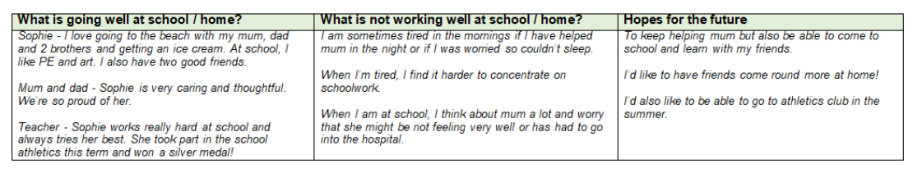
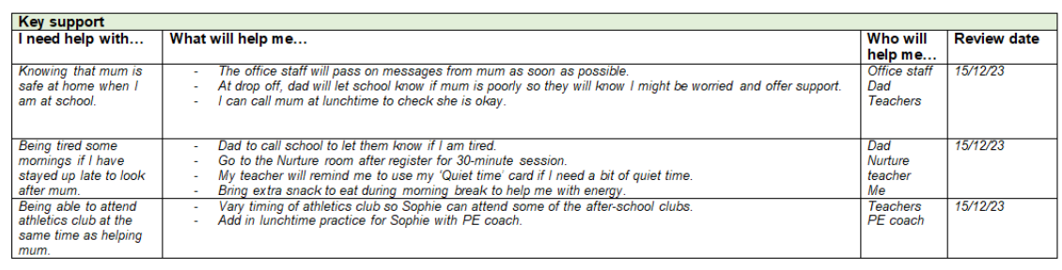
Young Carers Education Support Plan
Thematic Toolkit padlet - Young Carers

Slide 12






Collecting the voice of young carers
How do you collect the voice of young carers?
Do you feel you get the information and support you need as a young carer?
What is your school doing well to raise awareness about young carers?
What would you like your school to do to raise awareness in a better way?
What would you like your school to do to support young carers better?

Slide 13
Supporting disabled parents….
Why & how we do this
The “whole family approach” section of the Care and Support Statutory Guidance (6.65- 6.73) places a responsibility on the Local Authority to identify how an adult’s care and support needs impact on their family and to also recognise child/young carers.
‘Carrying out any caring responsibilities the adult has for a child’ is an eligibility outcome in the Care Act and so consideration must be given to this where a person with care and support needs is identified as a parent / guardian’
Identify
Request for
Assessment
Joint Assessment: Children’s focus on Young Carers & parenting support. Adults focus upon care & support plan.
Resource
Adults provide indicative budget; Children’s provide the funding that is focused on parenting support.
Care Act Assessment from either Children’s or Adult Services
Young Carer or

Slide 14

Supporting education transitions for young carers
Named staff member for the student to link with
Early identification
Communication between education providers
Having an agreed plan with the student and their family

Slide 15

Transition Assessment….
Responds to Chapter 16 of the statutory guidance on the Care Act 2014 sets out the requirements of a transition assessment.
County young carers forum members co-produced the first Transition Assessment and Plan called ‘My TAP’ to support young people by the age of 14 be made aware of and access support in their transition into young adulthood from 18+.
Compliments any assessment at the time (Early Help, Social Work, Young carers needs assessment) that focuses upon education, training & employment; health & well-being; social life, interests & activities.
Young Carers Videos | Support and Advice | Carers Matter (youngcarersmatternorfolk.org)
Co-produced and awarded the together, you said, we did quality mark.

Slide 16

We need your support – Resources and next steps!
The Challenge:
We are yet to enable all children and young people that are young carers to be offered an assessment of their needs and support provided.
Schools and education providers are really well placed to identify young carers and enable them to access help and advice.
Consider establishing a young carer champion in your school or setting by taking the young carer challenge (Education - Caring Together)
Consider how you currently identify young carers and whether this is working – is there something different you could be doing with your students? Young carers toolkit - Norfolk Schools and Learning Providers - Norfolk County Council
Guidance from Young Carers in Schools - YCiS Guide – Young Carers in Schools
Helping children, young people to access high quality advice is key – you can help them access this by promoting and linking with young carers matters
Young Carers & Family Support - Carers Matter Norfolk : Carers Matter Norfolk
Pathways for Support
Please make use of the professionals toolkit for young carers available -
Supporting young carers in Norfolk A toolkit for professionals Digital (youngcarersmatternorfolk.org)
If you know a child or young person is a young carer then you can either enable them or request on their behalf a young carer needs assessment
Young carers and families - Norfolk County Council
Please support children and young people you think could be a young carer to access the advice, guidance and support they may need as your assistance really could make a big difference to their lives and ensure they are identified and supported sooner.

Slide 17

Questions / ideas / thoughts?

Slide 18
Thanks for letting us share with you!
Charlotte Mason – Inclusion Advisor
charlotte.mason@norfolk.gov.uk
Philip Beck - Head of Service for Communities, Schools and Partnerships
philip.beck@norfolk.gov.uk

