Slide 1





Mind the Gap:
a practical guide to working with parents and effective communication
School and Community Team
Ben Wilson: South Team Manager
Steph Dickson: North Team Manager

Slide 2
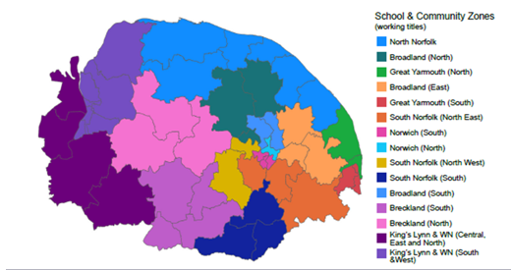
Who we are…
School and Community Teams work across Norfolk’s 15 School and Community Zones supporting schools, early years providers and families locally in helping to meet the Special Educational Needs and Disabilities (SEND) of children who would benefit from earlier SEND support. They work as part of the countywide SEND offer within Norfolk’s Local First Inclusion Programme.

Slide 3
Aims of the session:
Consider different approaches to support engagement with parents
Consider reviewing current approaches
Improved awareness of Literary reviews
Improved awareness of approaches adopted by partners & settings
Opportunity to share own experiences

Slide 4
What does the evidence show…
Working with parents to support children's learning
Parental involvement on student academic achievement
Mobile Technology and engagement
Engaging parents in parenting programmes

Slide 5
Working with parents
Critically review how you work with parents
Provide practical strategies to support learning at home
Tailor communications
Offer sustained & intensive support where needed
Working with Parents to support children’s learning
Education Endowment Foundation (EEF)

Slide 6

Parental invovement
Strong associations when families have high academic expectations for their children
Maintain communication with their children about school activities
PARENTAL INVOLVEMENT IS MULTIFACETED & MULTIIMENSIONAL
Parental involvement on student academic achievement
Educational Research Review
Homework
Globally
Holistic

Slide 7
Texting Parent Carers was effective at:
Driving up parental engagement in home learning.
Supporting Fathers to engage with home learning activities.
Mobile technology & family engagement
Harvard Family Research Project
Supporting parent carers of boy to engage with more home learning activities.

Slide 8
Engaging parents
Key areas to consider:
HOW to communicate the intervention/ programme best?
WHO is best to communicate about the intervention/ programme?
Engaging parents in parenting programs
Children & Youth Services Review

Slide 9
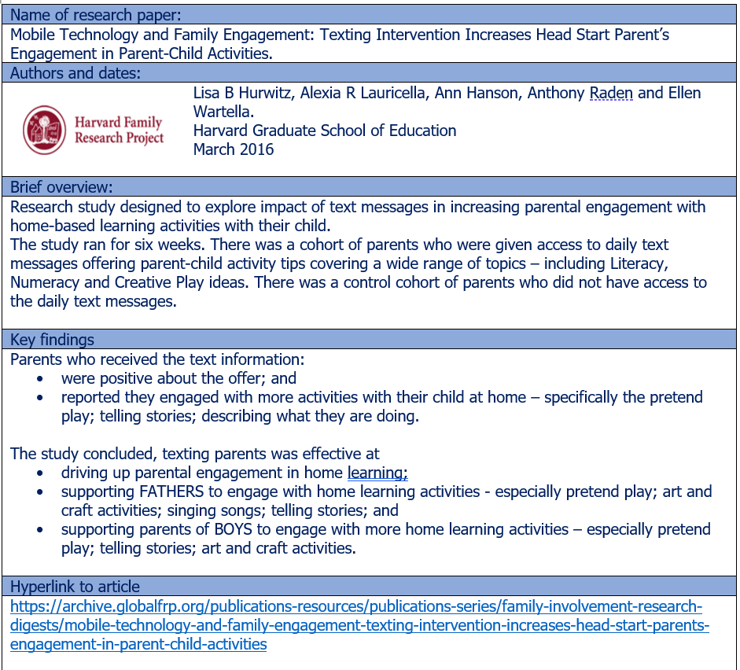
Literature Review handouts

Slide 10
Practical Strategies and Approaches
What have you tried?
What was the outcome?
Why do you think it was successful or not?

Slide 11
Practical Strategies and Approaches
Top Tips
Consult and ensure 2 way
Be prepared to change approaches
Remain positive & build on parents' efficacy
Targeted
Have you considered?
Literacy levels
Ethnicity and cultural awareness
What the research and evidence reports
Location & accessibility
Breadth of strategies

Slide 12
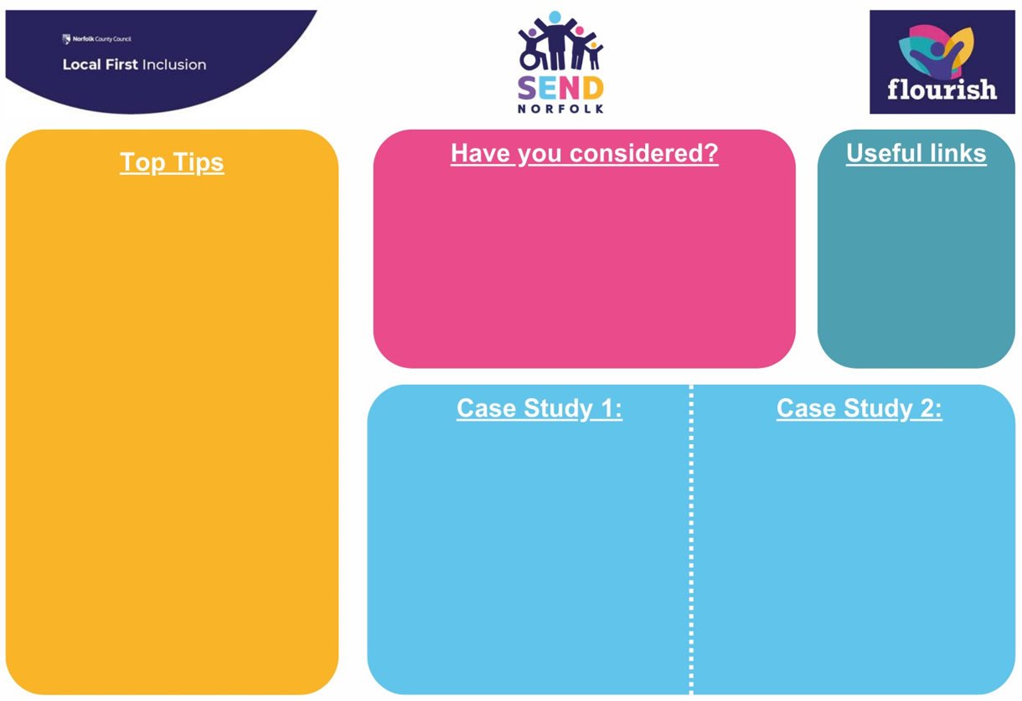

Practical Strategies and Approaches

Slide 13
Case Study: School
Primary
Secondary
Face-to-Face offer
Settling in Evenings
Parent Evenings
GCSE Choices Evening
Celebration Assemblies
PTA Meetings
Website offer
Full curriculum overview
SEND information
Policies and Procedures
Updates about ‘WOW’ moments
Upcoming events
Face-to-Face offer
Transition Evenings
Settling in Evenings
Parent Evenings
SEND Cafes
Parent Cafes
Class assembly
PTA Meetings
Friends of Meetings
Sports Day
Parent Workshops
Fete
Fun Day
Website offer
Full curriculum overview
SEND information
Policies and Procedures
Twitter Updates about great learning/ trips etc
Calendar of events
Interactive learning portal (student)
Interactive learning portal (parent carer)
Paper offer
Newsletter
Student Reports
Therapy Dog ‘diary’
Paper offer
Newsletter
Student Reports
Student Newspaper

Slide 14

Case Study: ECFS
On-line offer
Accessible to working parents
Webinars: to meet demand & needs (toilet training, car sea safety)
Multi-agency (Health Visitors co-deliver)
Interactive
Parents Forum
Accessible, face to face
Alongside other events already planned
Use of Social Media
Dedicated manager to over see
Consistent reply to ‘comments’
Gather and use feedback to inform offer
Advertise services available and able to use to book on events
Other considerations
Incentives e.g. refreshments
Agreements shared between service users & staff of expectations during 1:1 & group work, which helps engagement

Slide 15

Next steps…
Review today, what can you introduce that will have an immediate impact?
Can you reflect on anything that you will now do differently?
Is there anyone else you need to tell?
Constantly review and listen to feedback!

Slide 16

Final thoughts…

Slide 17
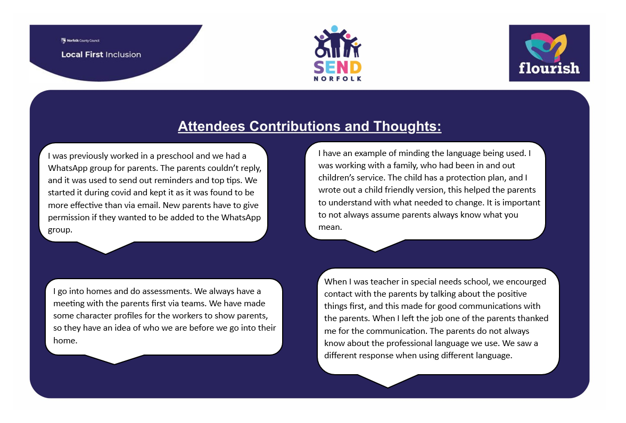

Attendees thoughts

