Slide 1


Breaking the Cycle:
Effective Measures for Combatting ASB and Youth Nuisance

Slide 2

What is anti-social behaviour?
Antisocial behaviour is defined as 'behaviour by a person which causes, or is likely to cause, harassment, alarm or distress to persons not of the same household as the person' (Antisocial Behaviour Act 2003 and Police Reform and Social Responsibility Act 2011 ).
Most common examples of anti- social behaviour include:
Neighbour disputes
Vehicle nuisance
Area misuse
Rowdy or inconsiderate behaviour
Street drinking
This is not an exhaustive list

Slide 3
District Council responsibility towards anti-social behaviour and the Operational Partnership Team (OPT)
The Breckland Operational Partnership Team (OPT):
Comprises of officers from Breckland Council’s Anti-Social Behaviour Team and Norfolk Constabulary.
Working closely with partner agencies. Such as:
Housing associations
Local District Council, Environmental health, food inspectors.
Immigration.
Local schools
Monitor high risk ASB
Implement ASB intervention and escalation, from low level to high risk.
Provide long term problem solving.
Identifying risk, vulnerability, safeguarding in particular high-risk cases.
District Councils must:
Take reasonable steps to prevent anti-social behaviour within their district,
Work in partnership with other agencies such as police, housing associations, YOT, Social Services.
District Councils have a range of powers to help address anti-social behaviour afforded to them under the:
Anti-Social Behaviour Act 2014
Environmental Protection Act 1990.

Slide 4

















Partnership Approach

Slide 5
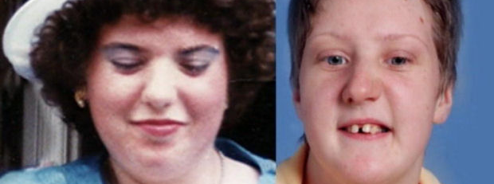
Why do we need an OPT?
23rd October 2007
Fiona Pilkington and Francesca Hardwick

Slide 6
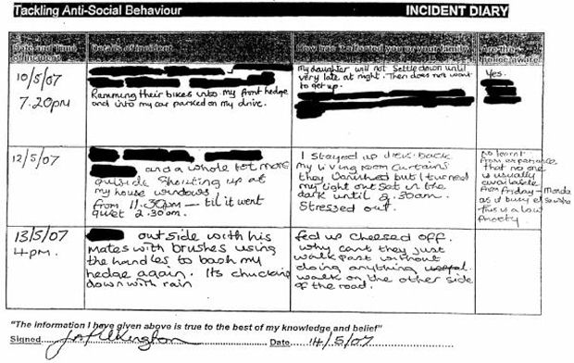
Family subjected to years of abuse in their Street in Leicestershire. Tormented by a gang of youths, pelting the home with eggs, lit fires in the front garden, locked the son at knifepoint in a shed.
Adds in the diary ‘’are the police aware’ column:
No. Learnt from experience that no one is usually available from Friday-Monday as is busy elsewhere. This is a low priority.
Suicide note: The street kids[,] well I have just given up,” she wrote. “I am just not cut out to take this much harassment.”
IPCC report reveals missed opportunities to identify the Pilkington as vulnerable, failing to link individual reports of anti-social behaviour as part of a wider campaign of harassment.
33 complaints made to the police only. Each dealt with in isolation

Slide 7
Evolution of ASB legislation
1990
Environmental Protection Act 1990
Statutory noise and nuisance
1999
Crime and Disorder Act 1999
ASBOs and youth offending measures
Parenting orders
Curfews
2003
Anti-Social Behaviour Act 2003
Enhancement of council asb powers
Dispersal Orders
Social landlords
2014
Anti-social Behaviour, Crime and Police Act 2014

Slide 8

Tool and powers
Early intervention
Non-Legal tools
Legal Tools
Mediation
Problem Solving Plan
Words of Advice
Staged Warning Letters
Acceptable Behaviour Contract
Good Neighbour Agreement
Parenting Contract – YOT
Community Remedy
Police Dispersal Order- s.35
Fixed Penalty Notice
Community Protection Warning/ Notice
Criminal Behaviour Order
Civil Injunction
Closure Order
Public Spaces Protection Order – Council
Parenting Order – YOT
Section 59 – Police (Vehicles)
Noise Abatement Notice- Council
Referrals to Collaboration, Youth Services, Mental Health Services
Safer Schools
Engagement and education events
In addition to the above, social housing tenants’ engaging in asb or criminal activity could result in tenancy action

Slide 9
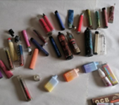
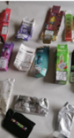
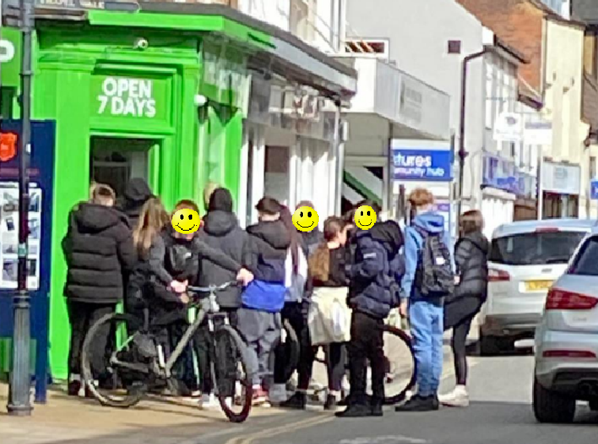
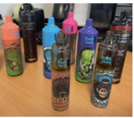
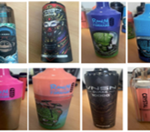
Sale of Illegal Vapes
ASB (littering) in the community
ASB (disruption/ nuisance) in the community
Complaints made to police, Trading Standards and Breckland Council
ASB (disruption/ nuisance) in schools

Slide 10
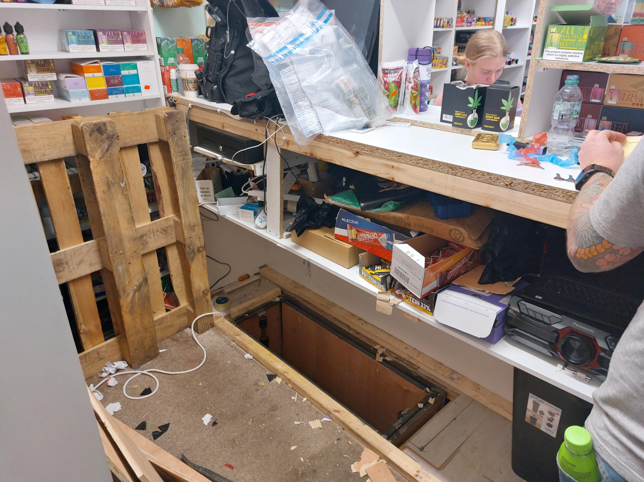
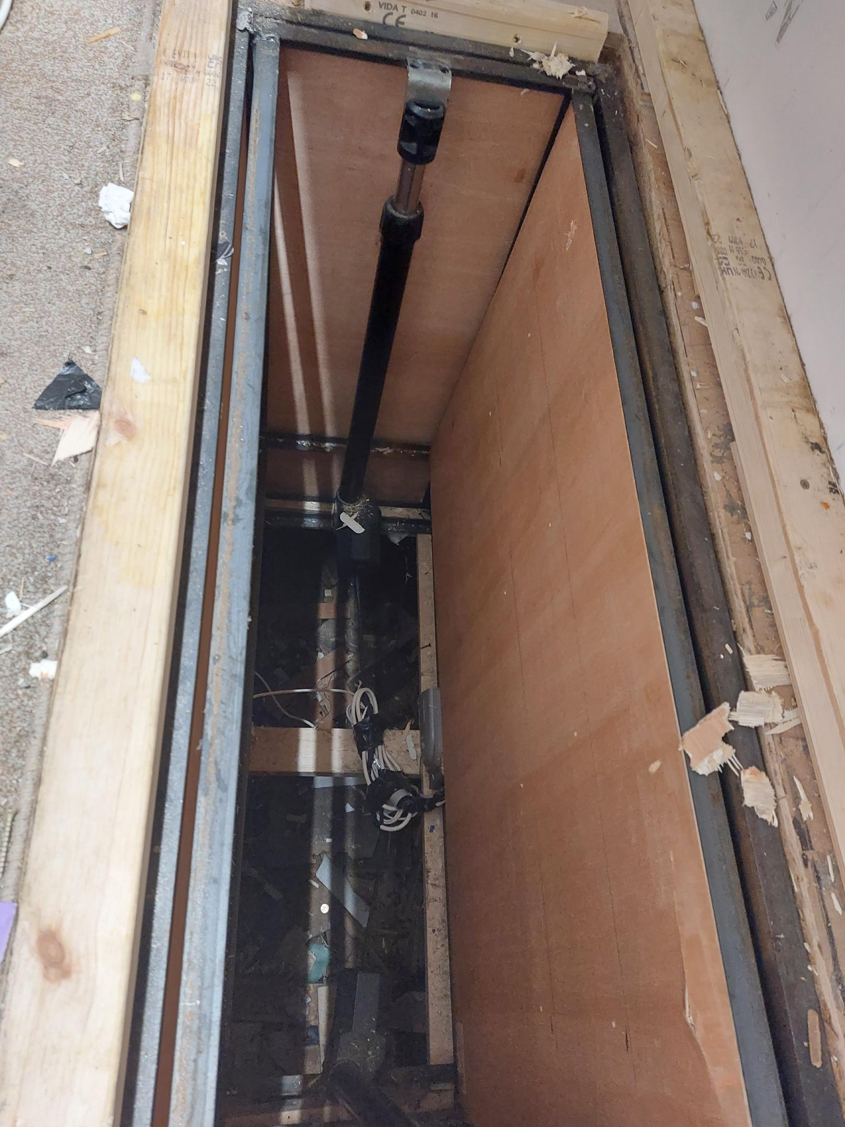
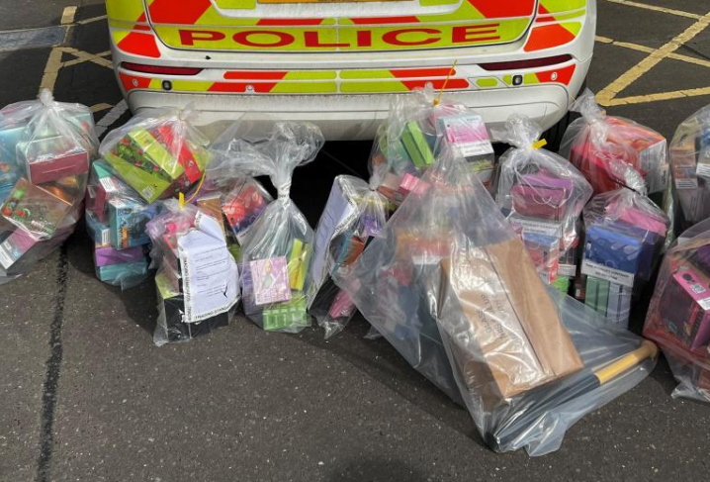
Joint Visits

Slide 11
EARLY HELP HUBS/ COLLABORATION
RECOGNISING UNDERLYING ISSUES WHERE EARLY INTERVENTION/ HELP AND SUPPORT CAN HELP SITUATIONS FOR THE LONG TERM.
BEHAVIOUR – (what is the cause? Alcoholic, drug user, homelessness)
LONELINESS – (Isolated, recently bereaved, socially restricted, new to the area)
CRIMINALITY - (Financial issues, Jobless, house arrears, made redundant, cost of living crisis)
DOMESTIC VIOLENCE – (underlying issues, children misbehaving, hiding undiagnosed disabilities, financial constraints, DV counselling)
REPEAT CALLERS – MH, Isolated, Lonely.

Slide 12
Useful links
Useful links
ASB Help https://asbhelp.co.uk/
Neighbourhood watch https://www.ourwatch.org.uk/norfolk
Breckland Social Prescribers https://www.breckland.gov.uk/social-prescribing
How to report:
Report anonymously via Crimestoppers https://crimestoppers-uk.org/
or Fearless for under 18s https://crimestoppers-uk.org/fearless
StreetSafe https://www.police.uk/pu/notices/streetsafe/street-safe/
Report ASB or environmental issues to your Social Housing provider or district council. https://www.breckland.gov.uk/article/2964/Report
Contact the police at https://www.norfolk.police.uk/ro/report or by calling 101
In an emergency call 999

