Slide 1




Practice Week:
Early Childhood Communication

Slide 2




Early Speech, language & Communication (SLC)
Why is communication vital?
The communication landscape
Early developmental stages in communication
Research into practice
Just 1 small thing
Accessing support for communication needs
Notes:
In the next hour we will be focusing in on early speech, language and communication (SLC). We'll be thinking about why communication is vital, understanding the communication landscape, exploring the early developmental stages in communication, considering how research translates to everyday practice. We'll be asking you all to reflect on the content of the session to commit to just one small thing that you will take away from today and finally, we'll be signposting to resources and support for communication needs.

Slide 3
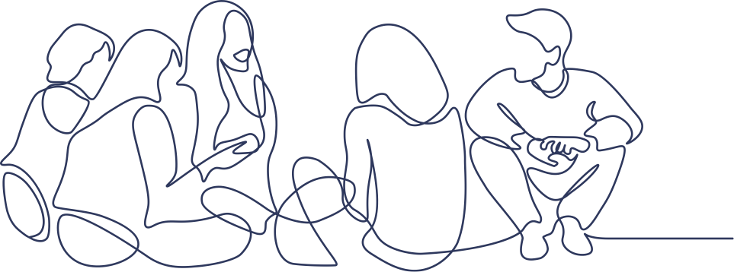
Speech, Language and Communication (SLC)
Speech Language Communication
Making needs known
Expressing likes or dislikes
Interacting with others
Building relation-ships
Speech that is difficult to understand
Struggle to say words or sentences
Not understand words or instructions
Difficulties knowing how to talk and listen to others
ICAN Charity, 2024
Notes:
Speech, language and communication underpins everything we do – making our needs known, expressing our likes and dislikes, interacting with others and building relationships.
We often take these skills for granted, but many children struggle to communicate. They have speech, language and communication needs or SLCN.
A child with speech, language and communication needs:
Might have speech that is difficult to understand
They might struggle to say words or sentences
They may not understand words that are being used, or the instructions they hear
They may have difficulties knowing how to talk and listen to others in a conversation
Children may have just some or all of these difficulties; they are all very different.
Speech, language and communication are crucial for reading, learning in school, for socialising and making friends, and for understanding and controlling emotions or feelings.
SLCN is often called a ‘hidden difficulty’. Many children with SLCN look just like other children, and can be just as clever. This means that instead of communication difficulties, people may see children having difficulties learning or socialising with others. Some children may become withdrawn or isolated. Their needs are often misinterpreted, misdiagnosed or missed altogether.

Slide 4
Early communication is everyone's business
'The development of children's spoken language underpins all 7 areas of learning and development...
Children's back and forth interactions from an early age form the foundations for language and cognitive development'
Early Years Foundation Stage, Learning & Development statutory requirements
January 2024
Early years foundation stage (EYFS) statutory framework
'Early language acquisition impacts on all aspects of babies’ and young children’s non-physical development and contributes to their ability to manage emotions, make friends, and learn to read and write'
The Family Hubs and Start for Life programme guide
August 2022
Family Hubs and Start for Life programme
Notes:
Communication is everyone's business.
'Early language acquisition impacts on all aspects of babies’ and young children’s non-physical development and contributes to their ability to manage emotions, make friends, and learn to read and write' The Family Hubs and Start for Life programme guide August 2022
'The development of children's spoken language underpins all 7 areas of learning and development...
Children's back and forth interactions from an early age form the foundations for language and cognitive development'
Early Years Foundation Stage, Learning & Development statutory requirements January 2024

Slide 5
Considering the impact of social inequality
‘The gap in the cognitive development and specifically oral language skills between children from different social backgrounds is widely acknowledged. This gap is identifiable very early in life and well established by school entry and can have long term consequences in terms of educational attainment and adult outcomes. Importantly, early communication difficulties may also be indicators of a wider range of neurodevelopmental conditions’
Identifying and supporting children’s early language needs (2020), Public Health England & DfE
'Improving language development in the early years is an important tool through which educational and social inequality between social classes can be tackled'
Centre for Social Justice (2014). Closing the divide: Tackling educational inequality in England.
Notes:
Considering the impact of social inequalty
In recent years there has been a growing body of evidence on early language development, which makes a powerful case for language as a primary indicator of child wellbeing due to its strong links with other social, emotional and learning outcomes. Gaps in early speech and language development can be recognised by the time children are 2 years old and they have a more visible impact by the time they enter school.
There is a strong evidence base linking SLC need to; educational outcomes, mental health & behaviour, and life chances...

Slide 6

Key Facts: Education outcomes
Gaps in language development between children from affluent and disadvantaged families open up by two years of age, contributing to social inequality
In areas of high social deprivation in the UK, between 40% and 56% of children start school with language delay, significantly increasing their risk of school exclusion
Children who have SLC needs at age five are six times more likely to fall behind in
English and eleven times more likely to fall behind in Maths
15% of pupils with SLC need achieved the expected standard in reading, writing and mathematics at the end of their primary school years compared with 61% of all pupils
20.3% of pupils with SLC needs gained grade 4/C or above in English and Maths at GCSE, compared with 63.9% of all pupils

Slide 7
Key Facts: Mental health & behaviour
Children with language disorders in pre-school and early primary years are about twice as likely to develop social, emotional and mental health difficulties.
81% of children with emotional and behavioural disorders have
unidentified speech and language challenges.
Children with vocabulary difficulties at age 5 are 3 times more likely to have mental health problems in adulthood

Slide 8
Key Facts: Life chances
Children with vocabulary difficulties at age 5 are twice as likely to be unemployed when they reach adulthood, with 88% of long-term unemployed young men found to have SLC need
Young people convicted of a criminal offence are much more likely to have another conviction within 12 months if they have an undiagnosed SLC need

Slide 9
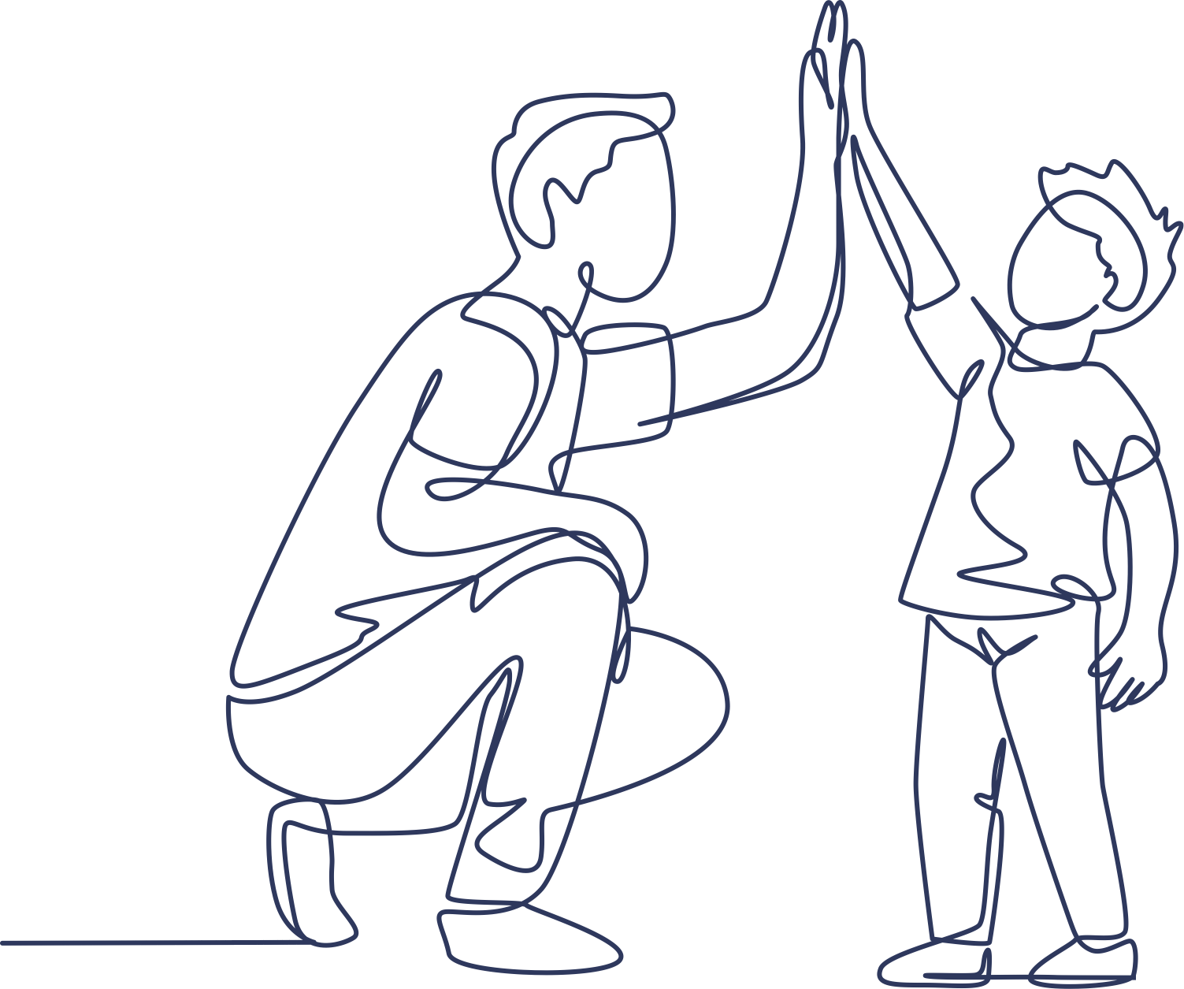
Why is communication central to early childhood?
Children’s speech develops from babble, to words, to simple sentences through
hundreds of hours of interactions with adults.
Studies show that once babies begin to understand words their vocabulary increases quickly:
by age 1, children recognise about 50 words
by age 3, children recognise about 1,000 words
by age 5, children recognise about 10,000 words
Having a large vocabulary helps children learn more. Words allow them to make sense of the world around them. Communication and language is a EYFS prime area which means that it’s one of the important building blocks for all the other areas. If it’s not developed early, it’s difficult to achieve later.
Children’s language skills are connected to their overall development and can predict their educational success. Children from more disadvantaged backgrounds may have fewer chances to develop their vocabulary. However, research shows that lots can be done in the early years to avoid inequalities in children’s language development.
Notes:
We understand why it's important, but why specifically in the early years? Read through slide.

Slide 10
What's the Norfolk picture?
1317 EY provider applications in Spring 2024 requesting additional funding for children with SLC needs
Communication & interaction is the most common primary need in EHCP's for our under 5's
74% of those children with an EHCP identifying SLC as primary need, are for boys
The highest number of EHCP's with SLC primary need is generated in the Reception Year
88% of EIN's submitted for children currently aged 0-5, identify SLC need
Notes:
Data to help illustrate the EY's SLC landscape in Norfolk

Slide 11
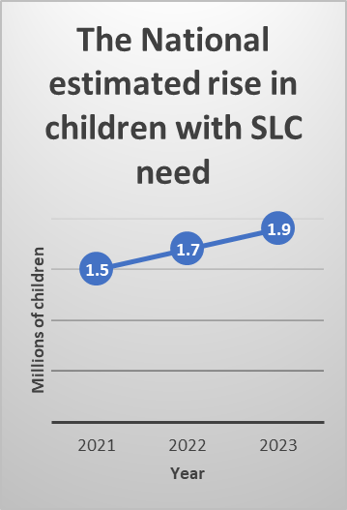
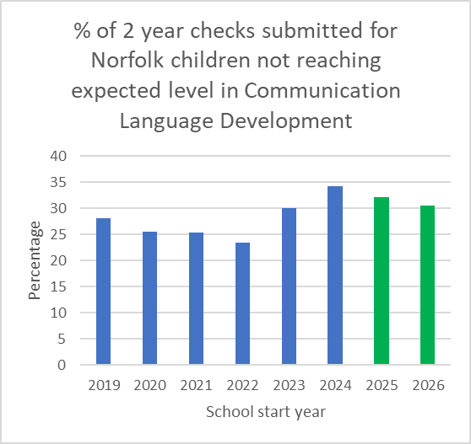
What's the early SLC need?
Notes:
Data to help illustrate the EY's SLC landscape in Norfolk

Slide 12
Early developmental stages
90% of children's brain growth happens before the age of 5. Right from the start, all those little moments spent together are building their brain
The ages and stages are based on the phase of development and not on chronological age. Support needs to be based on the child’s stage of development and their needs
Professionals who raise the profile of families are more likely to work together effectively.
Check points in the early years should reassure or validate a concern, enabling effective early intervention.
Notes:
Before we get into the early developmental stages of communication and language, some key reminders...
90% of your child's brain growth happens before the age of 5. Right from the start, all those little moments you spend together with your child are building their brain. Every smile, cuddle, chat and game makes a huge difference, helping them learn to communicate, develop confidence and make friends.
The ages and stages are based on phase of development and not on chronological age. Support needs to be based on the child’s stage of development and needs, rather than their age in months and years.
Families are facing real challenges, particularly those living in poverty. It's important that we acknowledge and accept the realities of parenting. Professionals who raise the profile of families and value communication with children are more likely to work together effectively, to improve SLC development.
There are check points within the early years that help to identify needs swiftly; hearing check at birth, 2 year old check, Baseline Assessment & Foundation Stage Profile in Reception. These should reassure or validate a concern, enabling effective prevention and early intervention.

Slide 13
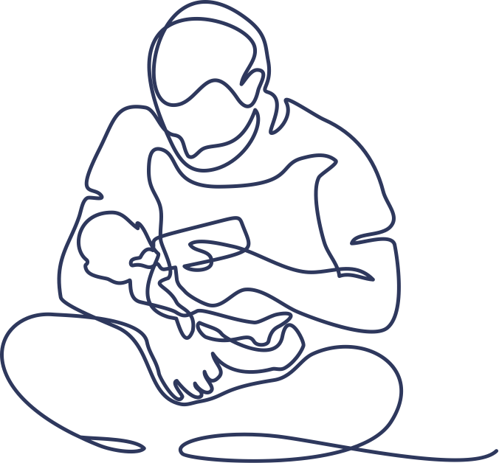
What to expect when: Babyhood
Turn towards a sound when they hear it
Be startled by loud noises, they make them jump
Watch your face and look into your eyes when you talk to them
Recognise your voice, smile and laugh when other people smile and laugh
Make sounds like cooing, gurgling and babbling to themselves or to gain your attention
Make noises when you talk to them & have different cries for different needs
Make noises, point and look at you to get your attention
Start to recognise some familiar words
Enjoy action songs and rhymes and get excited when sung to
Take turns in ‘conversations’ where you talk and they babble back to you
Turn to look where you’re pointing when you show them something and say ‘look’
Enjoy playing fun games and let you know they want to play again if you stop
Start to say one or two recognisable words although these are not spoken very clearly
Notes:
In the 0-2 year old stage babies will usually:

Slide 14
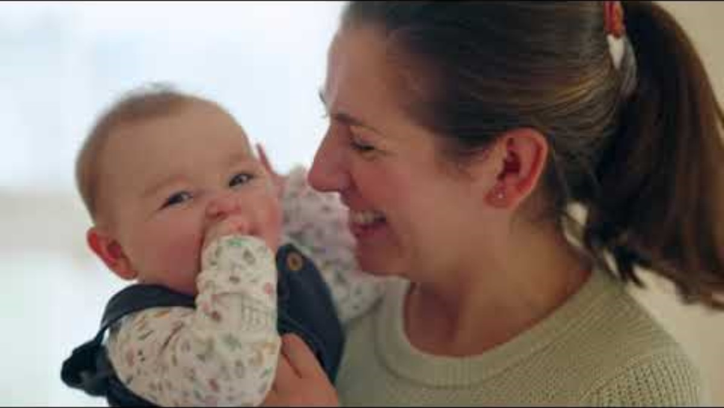
What to expect when: Babyhood
What is the carer doing & what is the baby doing?
Notes:
https://www.nhs.uk/start-for-life/baby/learning-to-talk/learning-to-talk-0-to-6-months/#video-singing-songs-with-your-baby
Better Health Start for Life: Sing songs and rhymes to your baby (youtube.com)
Carer:
Positioned face to face
Responds to baby & repeats back sounds
Uses a 'sing song' voice and the rhythm of the nursery rhyme
Uses movement & facial expressions to engage the baby
Takes time, follows pace of the baby, doesn’t rush
Provides nurture and comfort

Slide 15
What to expect when: Toddlerhood
Concentrate on their own activities for longer
Understands 200-300 words
Listen to and understand simple stories with pictures, can be easily distracted
Understand more simple questions and instructions. For example, ‘where is your shoe?’
Understand simple action words and copy words and sounds they hear
Say 50 or more single words, even though many of these are not very clear yet
Start to put short sentences together with 2-3 words, such as ‘more juice’ or ‘bye nanny’
Ask lots of questions like ‘what’s that?’ or ‘Where going?’
Enjoy pretend play with their toys, such as feeding teddy
Try out new things and explore the world around them more actively
Choose their own activities and may not always like being told what to do
Children will still make mistakes with how they say words at this stage
Families can usually understand their child about half the time
Start to be interested in other children's play and want to join in
Notes:
By 2 years, children will usually:

Slide 16
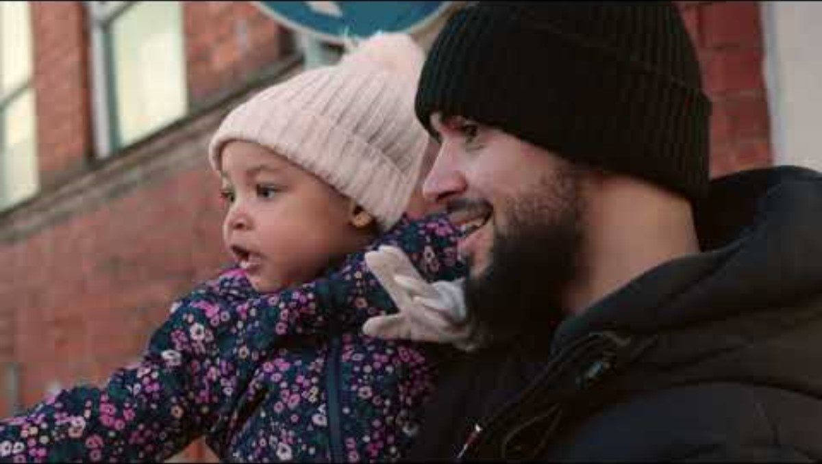
What to expect when: Toddlerhood
What is the carer doing & what is the toddler doing?
Notes:
https://www.nhs.uk/start-for-life/toddler/learning-to-talk/learning-to-talk-1-to-2-years/#video-sing-songs-and-rhymes-together
(4) Better Health Start for Life: Talk about the sounds around you - YouTube
Carer:
Highlights everyday sounds & sometimes repeats them
Encourages the child to have a turn at making new sounds and values their efforts
Responds to the child's interests and gives time to follow up
Looks at the child when talking
Initiates interaction
Points to guide focus
Asks questions, without bombarding the child, then respond to their reaction
Clearly repeats back words and phrases the child says
Joins in with singing
Introduces new vocabulary
Listens intently and tunes in
Follows their interest and attention
Does not rush the child

Slide 17
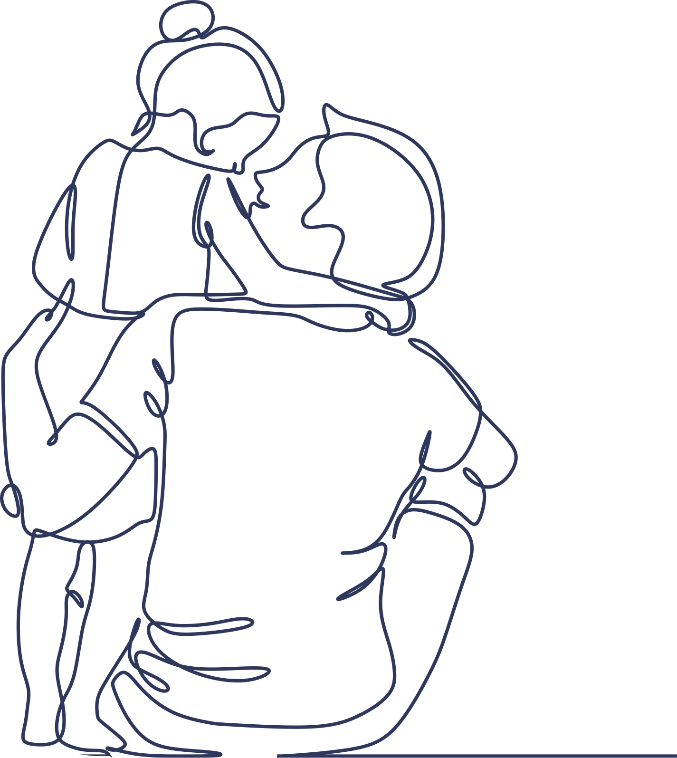
What to expect when: Pre-schooler
Listen to storybooks with pictures and answer some questions about it
Understand and often use words for colour, number and time
Start to be able to answer questions about ‘why’ something has happened
Talk about the future and the past
Use sentences with 4–6 words in them and start to link 2 sentences together by using ‘and’
Answer simple problem-solving questions
Tell a short story about something they have seen or experienced
Enjoy make-believe play and start to play cooperatively with others
Start to like simple jokes even if they don’t understand them
Start conversations with you and with other people
Use words instead of actions to argue with you or with their friends
Ask many questions using words like ‘what’, ‘where’, and ‘why’
Talk quite smoothly
Notes:
By 4 years old, usually children will...

Slide 18
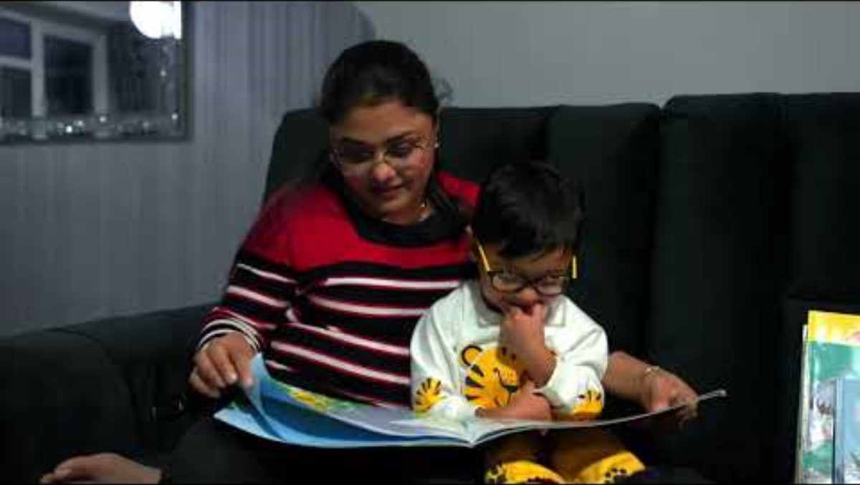
What to expect when: Pre-schooler
What is the carer doing & what is the child doing?
Notes:
Learning to talk 3 to 5 years - NHS (www.nhs.uk)
Better Health Start for Life: Read and talk about books together (youtube.com)
Carer:
Makes reading fun! Child chooses book and turns pages and points
Follows their interest and takes turns – the beginning of sustained shared thinking
Asks relevant questions
Encourages the child o finish sentences
Relates content to the child's own experiences for greater meaning and connection building
Uses the book to initiate imaginative and pretend play – shows how the child moves from concrete to abstract thinking
Introduces new vocabulary confidently
Uses hands to develop actions
Returns the focus to the book
Nurtures the child, sitting close and at their level so reading becomes a comforting shared experience right from babyhood.

Slide 19
Putting evidence into practice, together
Component | Approaches
1. Parent & Carers actively involved | Listen and talk to children Share books and read with children at home Engage children in daily routines and everyday interactions
2. Communication & language | Follow the child’s lead, commenting on what they are interested in Conversational turn-taking, sensitively encouraging children to elaborate Modelling a wide range of vocabulary in relevant contexts
3. Book sharing & reading | Start early and share books regularly and frequently Read widely – stories, rhymes, poems and non-fiction Use a dialogic reading style
4. Targeted approaches in EY settings | Training and professional development Early years practitioners to use high quality teaching and evidence-based interventions More intensive support for disadvantaged families
5. Start early years education early | Childcare provided from the second year of the child’s life onwards has been found to improve language development for socially disadvantaged children
Chat
Play
Everyday routines
Read
Best Start in SLC: Supporting evidence

Slide 20
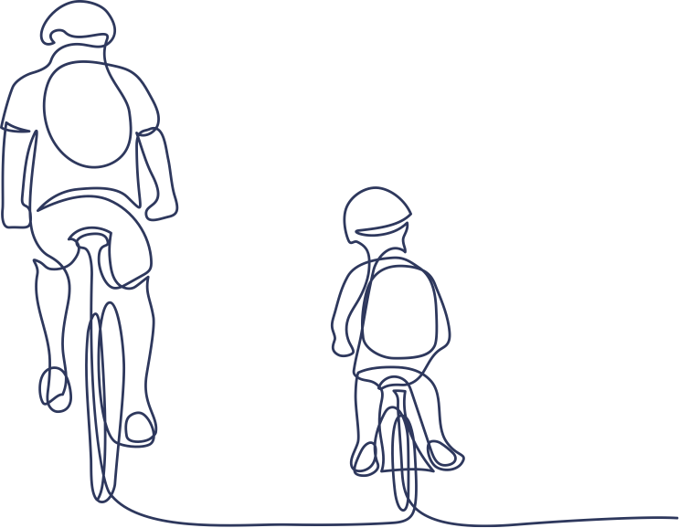
Just one small thing...
Individually consider what this might mean for your practice and how we can all take small steps to change habits, for families to flourish.
Early intervention is the most effective way of improving long term outcomes for children, but it is never too late and many of the approaches will benefit everyone.
What one small thing do you aim to do?
Thank you

Slide 21
Accessing SLC support
Health Advice & Support for Children & Families (justonenorfolk.nhs.uk)
Early Childhood and Family Service (ECFS) - Norfolk County Council
Family hubs - Norfolk County Council
School & Community Teams
SEND Local Offer
Early learning and childcare
Family Information Service
SLC Padlet of resources
Notes:
Highlight which documents are hosted on the Padlet

Slide 22
Useful resources
Best Start in Speech, Language and Communication: Supporting evidence
Early learning and development - Start for Life - NHS
Birth to 5 Matters
Early years foundation stage (EYFS) statutory framework for schools and childcare providers
NCC Early Years Padlet: Supporting Speech language & communication in the early years
Ages and stages - Speech and Language UK: Changing young lives

