Slide 1


Everyday counts!
Working together to improve school attendance
Katie Griffiths
The Attendance Service

Slide 2


Safeguarding
Pupil Attainment
Early Intervention
Social Development
Preparation for Adult Life
Notes:
So why is attending school so important?
attending school regularly can be a protective factor for children and young people, it falls under the wider umbrella of safeguarding but its also important for-
Pupil attainment: it is well documented that students with poor attendance do not reach their potential and achieve below their target grades
Early Intervention: Through monitoring we will notice patterns earlier and can intervene early by offering support as soon as it is needed
Social Development: If students are not in school, they are not interacting with their peers, and this can affect their friendships, emotional wellbeing and confidence and
Preparation for adult life: refusing school in early life can set a precedent within young persons expectations which is very much removed from the reality of adult life. Establishing good habits and routines in early life around school will positively equip a child for later life

Slide 3

Let’s begin with a fun quiz…

Slide 4
Education Act 1996
“The parent of every child of compulsory school age shall cause him to receive efficient full-time education suitable to his age ability and aptitude, and to any special educational needs he may have, either by regular attendance at school or otherwise”
Notes:
Section 7 of the Education Act 1996 is the piece of legislation that places a duty on all parents to ensure that their child of compulsory school age receives a suitable education either by regular attendance at school or otherwise. By otherwise it means elective home education.
Parental Engagement to support a child's attendance in school is not elective and is not consent based but a legal responsibility for all parents.

Slide 5
Attendance
95%
9.5 days or 2 weeks per year
23 weeks per school career
90%
19.5 days or 4 weeks per year
47 weeks per school career
80%
70%
50%
38 days or 8 weeks per year
91 weeks or 2.4 years per school career
57 days or 11 weeks per year
137 weeks or 3.6 years per school career
95 days or 19 weeks per year
228 weeks or 6 years per school career
Notes:
So, when we talk about school attendance particularly within an education context we often talk about percentages. As we talked about in question 4 of the quiz, persistent absence is 90% and below and with the issuing of the working together to improve school attendance document the department for education brought in another term of severely absent which means for any child whose attendance is 50% and below. Missing any school can negatively impact on a child’s progress and learning but when children are regularly not in school it can have a significant impact on family stress, children’s wellbeing and academic achievement. That’s why when we are thinking about attendance the message should be that every school day counts. You may have recently seen the Attendance Campaign launched by NCC and assets shared to all schools with that message.
Sometimes when looking at data and explaining to parents and professionals it is often useful to visualize the amount of absence in terms of school days and learning lost rather than percentages. This allows parents to relate to the amount of learning time missed. If you scored 90% on a test you would consider that to be a great achievement. However, in the terms of attendance 90% would be a cause for concern. As you can see from the chart when we start to move away from talking about percentages of attendance to thinking about the days or weeks or hours lost and what that equates to over a child's school career it then starts to have greater significance.

Slide 6
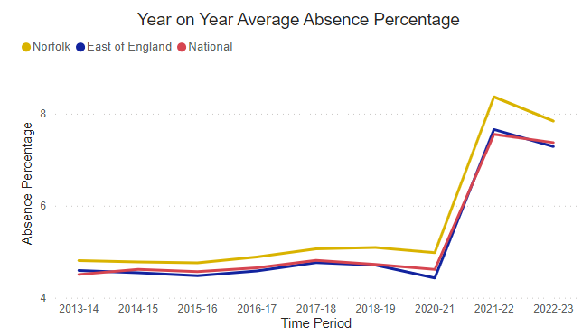
Year on year average absence percentages

Slide 7

'Absence rates by geographic level - autumn term' in England and Norfolk between 2021/22 Autumn term and 2023/24 Autumn term
Region | Absence Type | 2021/22 Autumn term | 2022/23 Autumn term | 2023/24 Autumn term
England | Authorised absence rate | 5.3% | 5.4% | 4.5%
 | Overall absence rate | 6.9% | 7.5% | 6.7%
 | Percentage of persistent absentees | 23.5% | 24.2% | 19.4%
 | Percentage of severe absentees | 1.4% | 1.7% | 2.0%
 | Unauthorised absence rate | 1.6% | 2.1% | 2.2%
Norfolk | Authorised absence rate | 6.2% | 5.9% | 5.0%
 | Overall absence rate | 7.7% | 7.9% | 7.2%
 | Percentage of persistent absentees | 27.7% | 25.8% | 20.9%
 | Percentage of severe absentees | 1.6% | 2.1% | 2.3%
 | Unauthorised absence rate | 1.6% | 2.0% | 2.1%

Slide 8
Children missing education
Children Missing Education
Children Missing Education | 517
Children Missing Education with AES | 309
Total | 824
Open to an AEO | 128
Awaiting Admission Placement | 24
Confirm Enrolment at school | 1
Establish whereabouts Abroad | 40
Establish whereabouts in Norfolk | 107
Establish whereabouts outside Norfolk | 30
Fair Access | 12
Refer to other LA | 80
Virtual School /LAC | 6

Slide 9


A School Attendance Strategy for Norfolk
School life provides a crucial platform where the critical components of healthy development can be nurtured. It is not just a place of academic learning; it is somewhere to belong, to achieve, to have meaning and purpose and is an arena for social and emotional development in preparation for adulthood. This SCR requires a culture shift both in terms of how multi-agency services value the multi-facetted benefits of school and a redesign of service intervention so that schools are placed at the very heart of multiagency provision.”
(NSCP Serious Case Review)
Notes:
Here in Norfolk before the new guidance was released we had already started work on developing a NCC Attendance Strategy..
Strategy is a product of work since July 2021, working group made up of reps from different teams and which has included consultation with schools and LSCGS, links with DfE and other LAs
We continue to be part of national learning sets to ensure that we share and incorporate best practice from across England. This Attendance Strategy has been developed to help the Local Authority, schools and other services understand what we need to do to work in a more coherent way, making the best use of resources available, in order to ensure that all children and young people can make the most of the opportunities provided by attending school

Slide 10


The importance of school attendance
Improving attendance is everyone’s business; a holistic approach is required by all staff in school, trust, Governing Board and LA including other partners.
At all stages of improving attendance, work should be undertaken to remove barriers, build strong relationships with parents and carers, work collaboratively to provide the right support at the right time.
Work in relation to school attendance cannot be seen in isolation.
Effective practice will include close interaction with schools’ efforts on curriculum, behaviour, bullying, special educational needs support, pastoral and mental health and wellbeing, and effective use of resources, including pupil premium.
Notes:
As a consequence of the covid 19 pandemic both locally and nationally there has been a real focus on school attendance. During the partial school closures we really saw the significance of school attendance, understanding and tracking children’s movement and how regularly some of our most vulnerable children were not in school. With that in mind the department for education published the WTISA guidance that is due to become statutory from 19th August 2024.
Working together to improve school attendance was published in May 2022 and stresses the importance of a collaborative working approach between schools, the Local Authority and other partners working with children and young people to have a holistic approach to tackling the barriers to school attendance. It highlights the need to build relationships with parents and carers but also relationships between schools and local authorities and the multi agency partnership to ensure that at all stages work is undertaken to remove barriers and the right support is provided at the right time. We can not see school attendance in isolation from other vulnerabilities. Highlighting that attendance really is everybody’s business.

Slide 11
An Emphasis on a Multi-agency response
Cross partnership ownership of attendance improvement (para. 87):
Attendance is understood by all frontline operational staff in attendance and associated teams and local partners including an understanding of which people and teams are responsible for each element of attendance delivery and how teams and professionals will work together;
Improving attendance needs to be a key feature of all frontline council services that work with children and families.
‘For more complex cases, the ethos of the Working together to improve school
attendance guidance is that pupils and families should receive holistic, whole-family
support to help them overcome the barriers to attendance they are facing. For these
more complex cases, a traditional linear or pathway process is unlikely to work. Instead, the guidance expects the best placed service to lead a ‘support first’ approach with schools working together with local authorities and wider partners, including the voluntary and community sector where needed.’
Notes:
Added emphasis to a multi-agency approach to school attendance, expectations including Youth Justice. Quote from summary of responsibilities. Key point also to note from the Summary of responsibilities:
Ofsted may consider the local area partnership’s approach to improving attendance of children and young people with SEND as part of the SEND Area Inspection (KW linked with NASAPS)

Slide 12



Quotes from new guidance
When systematically removing barriers to attendance, pupils’ anxieties are not dismissed but are sensitively analysed.
‘It’s about working out what is needed to break down the barriers’
Recognise parental anxieties but sensitively challenge them - ‘listen, understand, empathise and support – but do not tolerate’
‘Hard to reach’ families become reconceptualised as ‘too easy to ignore’, and therefore the ones who need the most attention.
The most effective schools go out of their way to make sure that they notice the pupils who are often not there and persist with them.
Notes:
Securing good attendance and tackling persistent absence - GOV.UK (www.gov.uk) was published earlier this year.
To complete this review Ofsted undertook a variety of research tasks from speaking to children and young people to include the voice of the child, looking at inspection outcomes, held focus groups. Many things they have reported fit with what has been published in the new guidance. Emphasising again that Schools that tackle persistent absence successfully tend to have all the basics in place to promote good attendance generally. That they are then really analytical about what is stopping individuals from attending. Understanding the barriers and having robust escalation procedures in place and initiated before it becomes a more severe problem. Getting the basics right!
Both the new guidance and the Ofsted thematic review highlight the need to consider our language when communicating with families ensuring that we are Quantifying attendance/absence in days, talking about lessons and learning lost rather than % and the impact there absence is having on achievement. Attendance data can so easily be misunderstood by parents and professionals – while 90% may be good as a mark in a test, in attendance terms it means one day a fortnight being missed
Its about building positive and honest working relationships, ensuring there are clear messages about attendance being consistent and clear about expectations for all children. That sentence on the slide ‘sometimes its about making sure parents understand it’s the child's right to attend, not their right to keep their child at home’
We need to ensure that schools, professionals and parents don’t underestimate the value of raising expectations for all children and that celebrating good attendance, or celebrating improvements and achievements can be altered to fit any cohort.
I think we see it and hear it from all colleagues whether in school or not, that fatigue can build when working with the same families time after time but it is about tenacity making sure that parents know we are not going to let it drop. And linking back to one of the quotes above ‘Hard to reach’ families become reconceptualised as ‘too easy to ignore’, and therefore the ones who need the most attention.’ and we need to avoid this we need to support schools and colleagues to keep going.
And I really like Ofsted’s statement ‘listen, understand, empathise and support – but do not tolerate’

Slide 13
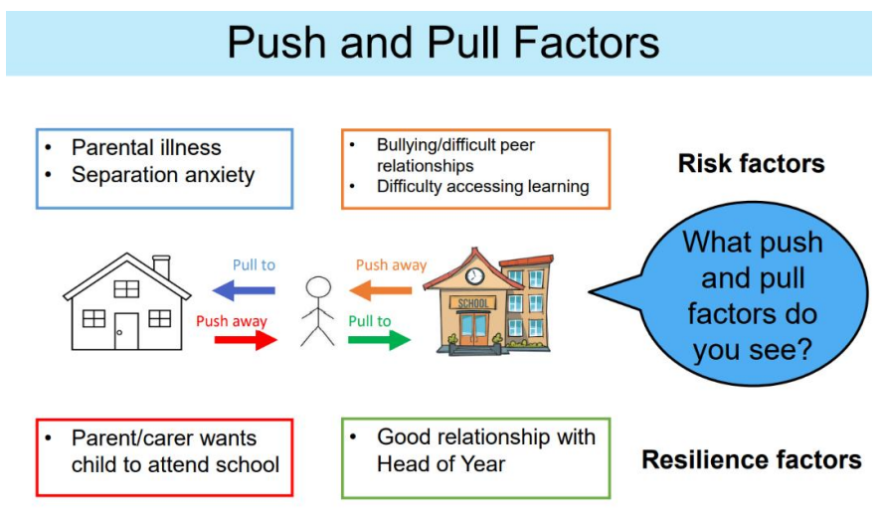
Push and pull factors
Notes:
The graphic illustrates some of the barriers and push and pull factors that might be impacting a child or young person’s attendance at school. Paragraph 84 of Working together to improve school attendance guidance requires schools to inform the social worker if a child is absent unexpectedly or without authorisation.
Developing an understanding of these push and pull factors can be an effective way to identify adjustments needed to support the child’s attendance. For example, an agreement for a young carer to be able to use their phone at school to check-in with an unwell family member might be an effective adjustment to allow them to attend school regularly.
Push and pull factors are likely to be present across all of the influences in a young person’s life its important these are mapped out as it can be really useful to identify and analyse them.

Slide 14
Grouping factors
Neighbourhood
Peer Group
Home
Child
School
Grouping factors into these broader domains is helpful for conceptualizing the problem but it's equally important that planning is informed by thorough examination of all the reasons for absence with actions tailored to meet all need.
Notes:
Next we have an activity to help you to think about some of those possible barriers that might affect a child being able to attend school regularly. This model has been taken from a contextual safeguarding point of view and has real merit in assisting us in terms of thinking about the different contexts that a child may experience in the barriers to school attendance.
Child: Illness, anxiety poor mental health, SEND, drug/alcohol misuse, trauma
Home: unemployment, neglect, young carer, impact of siblings, lack of parental involvement, conflict, housing issues, domestic abuse, isolation, financial barriers, parenting , low aspirations, parents health
Peer group: bullying, isolation, peer influences, stronger tied with peers outside of school than in school
School: poor relationship with staff, difficulties at transition, frequent changes of school, curriculum, impact of suspension, unmet needs
Neighbourhood: lack of transport, exploitation
This exercise has probably reinforced for you that the reasons for non-attendance are really varied and for some children there will be a complex interplay of a number of factors in and across these domains.
Grouping factors into these broader domains is really helpful for conceptualizing the problem but its equally important that planning is informed by thorough examination of all of the reasons for absence with actions tailored to meet all need.
For instance, if a primary reason appears to be driven by out of school factors planning still needs to actively consider what adjustments and response is needed to be made in school to support and effective return and address gaps in learning. In persistent and severe absence planning will almost always be effective if there is a multi-agency approach between professionals and the child and their family.

Slide 15
Activity: Case Study 1, Stephen
Stephen is 14 years old; he lives with his dad and younger sister who is at primary school. Stephen has been going to the youth group in his area for about a year but over the last 6 weeks he hasn’t attended as often and when he does, volunteers have noticed he seems more withdrawn and can be angry at times. One of the engagement workers from the group who knows Stephen well, finds a time to talk to him to try to find out if there is anything wrong.
Stephen seems embarrassed and says he is fine. The following week, the Engagement Worker checks in with Stephen again and he explains that he’s been in trouble at school for being late and leaving school early. Stephen explained that his dad has hurt his back and is currently not able to work or make sure that Stephen’s sister can get to school – she can’t walk alone as she has to cross a main road. Stephen said he is worried about his dad and his sister and he’s tired as he’s helping with all the jobs around the house. He’s also worried as his dad is self-employed and they don’t have much money at the moment. He says he feels guilty about coming to youth group, but his dad wants him to have some time to enjoy himself.
What do you think the Engagement Worker should do? What might you do in this situation?
Notes:
Stephen’s Engagement Worker talked through with Stephen what he could do to help and Stephen agreed for the worker to talk to his school and his dad. The Engagement Worker spoke to Stephen’s dad and then he talks to Stephen’s school. As a result:
The Engagement Worker and Head of Year help Stephen and his family to access financial advice and help to meet their living costs.
Stephen’s Head of Year makes contact with the Primary School and they arrange for another parent who lives close to Stephen to ensure his sister gets to and from school safely.
Pastoral support is offered in school and Stephen is offered support via Young Carers.
The outcome: as Stephen’s father recovers from his back injury, the family have access to support that addresses the barriers to school attendance. Stephen’s attendance and punctuality improve and he gradually feels less worried about the situation for his family.

Slide 16
Activity: Case Study 2, Claire
Claire is 5 and started school last Easter. Claire settled well into school, and she attended school every day. Claire’s teacher often talks to Claire’s mother, Christina at school drop-off and pick-up times. For the last few weeks, Claire has started to have odd days absent from school, Christina always contacts the school to inform them of the absence and explains these are due to illness. The class teacher catches Christina at the beginning of the school day and invites her in to have a chat. Christina explains that since she had a baby 3 months ago, she has been really struggling as the baby has been unwell and unable to sleep. Whilst Christina said she had lots of support from friends and family in the first few weeks, this has now stopped, and she feels embarrassed and ashamed to ask for help.
What do you think the teacher should do? What might you do in this situation and who else could help?
Notes:
Claire’s teacher asks Christina for consent to refer her to The Family Network Advisory Service. The service supports Christina to arrange a meeting with her identified friends and family, through this meeting Christina is supported to share her worries and her current struggles. Christina’s friend Katie who also has a child at the school offers to be a contact for support when Christina is unbale to get Claire to school. Teresa, Christina’s sister offers to babysit the new baby so that Christina and Claire can spend some 1:1 time together and Christina thinks that Claire will enjoy prepping some family meals together.
Claire’s teacher has also spoken to the school’s parent support advisor who has shared details for Just One Norfolk with Christina as there is advice and links to resources for new parents. She suggests that Christina may benefit from joining a parent and baby group or she could sign up to Quell an online resource to support adults with their wellbeing and mental health. The parent support advisor also recommends that Christina calls Parentline who can provide advice on helping baby sleep.
The outcome: Claire is back in school regularly and thriving. Christina feels able to ask for support from her family and friends’ network and now that they are aware that she was struggling they are regularly checking in with her. Christina has accessed support via Quell and Parent line and is feeling more positive. She was able to join a local parent and baby group which she is enjoying and is building a new network with parents in her local area.

Slide 17

Think attendance in every professional conversation about a child
What is the child’s current attendance?
Try to identify the barriers to low level attendance
  Ensure you draw on the voice of the child, making sure everyone understands what it is like for the child and make sure that adults needs don’t dominate
Is the child on track for age related expectations?
  Are they eligible for pupil premium funding
  What additional support or interventions are they receiving, how effective have they been?
  Do they have a special or additional need or disability or an EHCP?
Is behaviour/suspension impacting on their educational outcomes?
Is mental health or wellbeing impacting on attendance?
Notes:
Think attendance in every professional conversation about a child
Attendance should be integral to all planning. Think about and work with the child or young person and their family (where appropriate) to understand the young person’s relationship to education. Where there are issues with school attendance take the time to listen and understand why this is the case before identifying how the child or young person’s attendance could be improved.
Attendance in assessment
When working with a child or young person where attendance is a concern, it may be helpful to consider the following-
What is the child’s current attendance? Consider framing this in terms of days and learning missed when communicating with the child and their family because what might sound like a high percentage of attendance can still mean a lot of school has been missed. If attendance is under 90% (or at risk of dropping below 90%) what is the plan to improve it?
Low level attendance is usually a symptom of underlying issues for the child and their family. Try to identify the underlying issues to identify what types of support might be needed. It is essential to include the voice of the child not just the professionals or adults supporting the family. Learning from SCR continually tells us that we need to ensure the childs voice is heard, that we understand what life looks like for that child and ensure that adults needs don’t dominate.
Is the child on track for age related expectations? (The child’s teacher/school should be able to advise whether this is the case)
Is behaviour/suspension impacting on their educational outcomes? Is there a pastoral support plan in place? What support strategies are being used in school?
Is mental health or wellbeing impacting on attendance? Is anxiety playing a part in low level attendance and how can the child be supported in managing that

Slide 18

How to incorporate attendance support in your practice
Get curious about why a child is not attending school
Draw on the support of those with whom the child has a strong, supportive, and healthy relationship
Provide space to listen and, provide additional and individualised support
Ask, what is the child doing instead of attending school?
How can you support the family to think through
how best they can support the child to attend
school regularly?
Do you contact the school before visiting or
contacting the family to fin out how things are going at school?
Have you linked in with the NCC Attendance Team?
Notes:
So, What can you do? How to incorporate attendance support in your practice
➢ Get curious about why a child is not attending school. How can the child get what they want / need without missing school?
➢ Draw on the support of those with whom the child has a strong, supportive, and healthy relationships. Those people are most likely to support change.
➢ Provide space to listen and, provide additional and individualised support
What is the child doing instead of attending school? Is home more fun than school? Can the internet be turned off during school hours?
It takes a family commitment to support a child to return to full school attendance. How can you support the family to think through how best to do that?
Do you contact the school before you do a home visit to find out how things are going at school? Schools hold invaluable intelligence.
Have you linked in with the NCC attendance team they can provide advice and guidance.
“Some evidence has shown that interventions and engagement with the parents of children struggling with attendance can have the greatest success so a whole family approach to resolving attendance concerns should be the default approach subject to individual circumstances” research findings from education endowment foundation

Slide 19
Make attendance everyone’s business
Final thought to take away with you…
Do you know how all professionals and partners who work with children in our Local Authority deliver on their responsibility to support attendance and in particular the attendance of children with a social worker?

Slide 20


Intervention Pathway
The aim of this guidance is to provide a pathway for schools, families and all other professionals to support them to set clear expectations about attendance and identify and support vulnerable groups by responding to attendance concerns at the earliest opportunity.
This model has been designed in accordance with the requirements outlined in the Department for Education guidance ‘Working Together to Improve School Attendance’.
Launched and designed for use alongside the NSCP Continuum of Need Guidance families in Norfolk. Can be found in Useful Resources for Assessing & Articulating Risk.
Support first, however, where there is evidence of a lack of parental engagement and continued poor attendance, consideration of legal action should not be delayed.

Slide 21
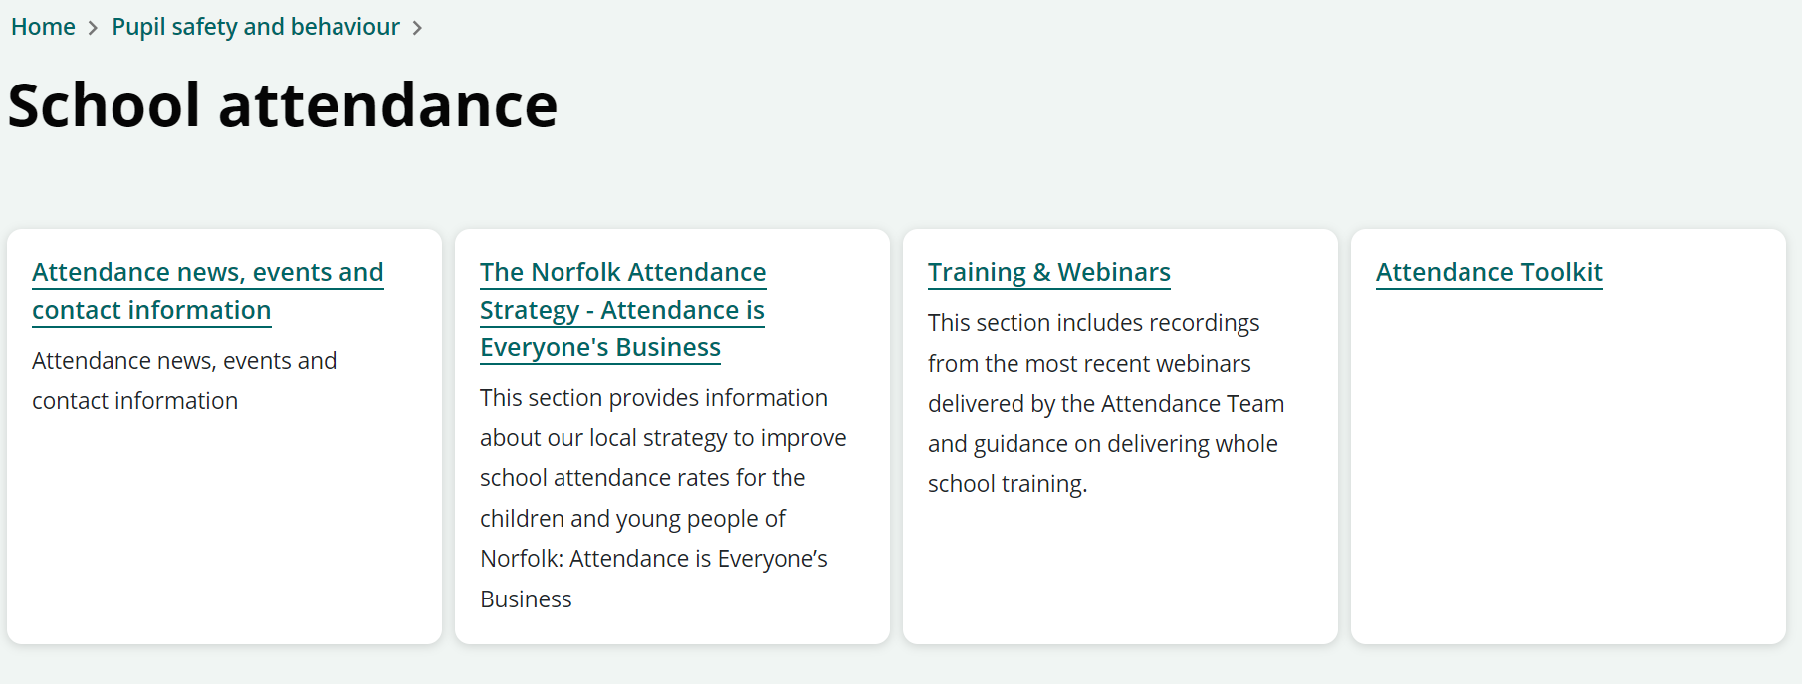

Where to access support
The Attendance Team
We are a statutory service charged with working with schools to promote good attendance and reduce absence. To ensure that every child has access to a full-time education and to ensure that parents perform their legal duty by ensuring their children of compulsory school age are registered and attending school regularly.
Duty number: 01603 223681
Email: csattendance@norfolk.gov.uk
NCC Schools and Learning Providers Website
School attendance pages include an Attendance Toolkit alongside, details on training, webinars and networks. As well as a section on the Norfolk Attendance Strategy – Attendance is Everyone's Business.

Slide 22

Partner Survey
https://forms.office.com/e/La7bMKjBA7
In preparation for the new national framework and to inform the future work of the Attendance Strategy, we would like to hear from a wide range of partners about their experiences of school attendance and invite you to contribute through completing this survey.

