Slide 1

Families First Partnership Programme
Leadership Exchange
October 2025
Miles Fox-Boudewijn

Slide 2




Aims for this morning…
Increase our shared understanding of the Families First Partnership Programme
Identify opportunities to further strengthen multi-agency collaboration
Discuss how we can move towards a multi-agency single assessment and plan approach
Notes:
Key points to reference
We want the morning to be as interactive as possible
Varying levels of knowledge / involvement
Invite people in to add their view / ask questions as we go
Walkthrough aims

Slide 3
Agenda
01 | 09:40 – 10:20 Overview of Families First Partnership Programme and main workstreams Our local vision and how we might take some of these forward
02 | 10:20 – 10:40 Q&A
03 | 10:40 – 11:00 Break
04 | 11:00 – 11:40 Breakout Table Session 1: Transitioning from Multi-Disciplinary to Multi-Agency Working & Feedback
05 | 11:40 – 12:20 Breakout Table Session 2: Multi-Agency Approach to a Single Plan and Assessment & Feedback
06 | Closing Remarks
Notes:
Key points to reference
We have three hours together this morning and we’ll roughly break halfway
First half focused on understanding the programme to date
Second half focused on how we can build our multi-agency approach further across the programme

Slide 4
The importance of co-production…
Our system has strengthened significantly, but parents still experience the system as fragmented, confusing, and sometimes inaccessible.
Multi-agency working is essential to provide holistic, joined-up support.
A single assessment and plan would reduce duplication, improve continuity, and make it easier for families to access the right help at the right time.
Parents value face-to-face support
Navigating services is challenging – especially if new to Norfolk
Schools and GPs need better knowledge of available support
Fragmented support and repeated assessments
Desire for continuity and not having to repeat their story
Notes:
Key points to reference
Very helpfully the national programme is really emphasing the importance of co-production
Giving the time for this in the plans
Time for working with children and families
And time for us as professionals to shape the future model
The slide reference feedback from a co-production with families on the IFD – feel familiar – but reinforces why the reforms resonate with how we want to work

Slide 5

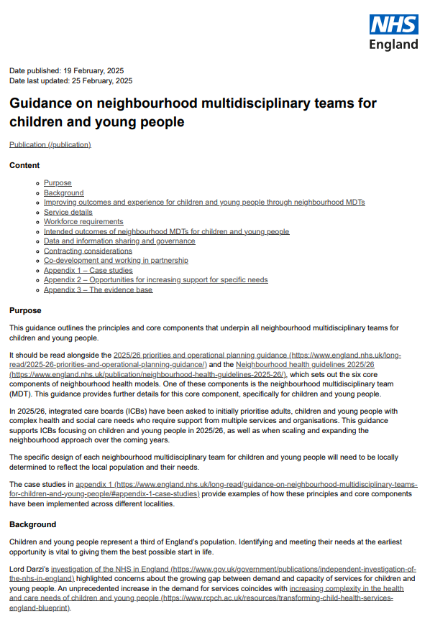


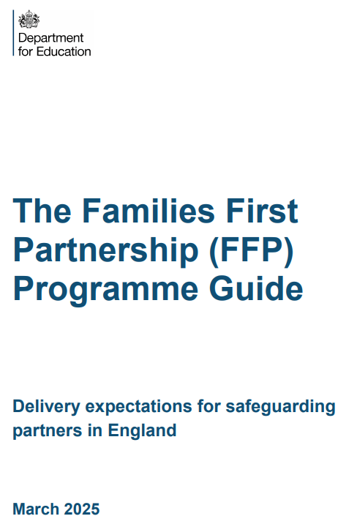
Multiple overlapping national reforms
Notes:
Key points to reference
The direction of travel for the Families First Programme has been clear for the past 2-3 year, since the IRCSC, Panel Report, CMA
The themes in each of the reforms, whether across neighbourhood working in health, across social care, prenvention and early help all very similar
Gov documents actively cross reference each other – but it’s still very much for us to make this make sense locally
As part of this journey there has been an active push to test and take forward reforms
Suite of document, Working Together, National Framework and programme guide that steer the shape of the programme going forward

Slide 6

Reform themes resonate in Norfolk
Shifting from treatment to prevention, hospital to community and analogue to digital
Improving earlier identification and support
Keeping families together and children safe and healthy
Supporting children in the care system to flourish
More children attending mainstream education, more of the time
Removing Barriers to Opportunity in Schools
Working locally through place-based working i.e. zones
Adopting MDT approaches
Enhancing multi-agency collaboration and integration
Developing holistic and sustainable models of support and care
Growing further a self-improving and inclusive education system
Strengthening the role of education
Notes:
Key points to reference
Importantly the aims of the reforms align closely with Flourish ambitions
The key focus of prevention, community based help working in multi-disciplinary / multi-agency ways of working underpin the reform
Reinforces our move to school and community based working
Increased use of technology, improved information sharing resonate across each reform

Slide 7
DfE Vision and Objectives
Vision:
Creating a transformed system of family support operating as a seamless continuum of help, support, and protection to ensure that every family can access the right help and support when they need it, with a strong emphasis on early intervention to prevent crises.
Objectives:
Designed to rebalance the system towards early intervention and support, reducing the need for crisis intervention and child protection investigations.
1. Family Help:
Preventing Escalation
Whole-Family Approach
2. Multi-Agency Collaboration:
Seamless System
Consistent Relationships
3. Family Group Decision Making (FGDM):
Empowering Families
Embedded in Practice
Notes:
Key points to reference
xxx

Slide 8
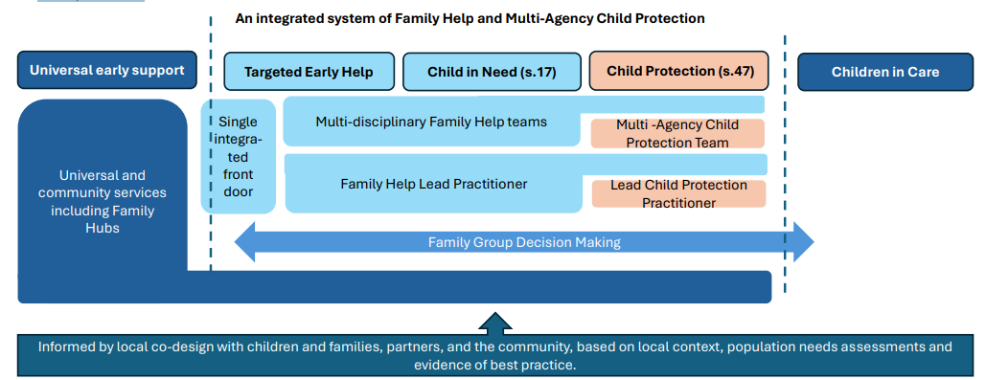
Local design of an end-to-end system of support and protection
Designing a system locally to rebalance the system towards prevention whilst keeping children safe, to meet the needs of the population with effective, integrated and joined up services with partners
Notes:
Key points to reference
To achieve objectives:
This is how DfE describle the system, one that is a local, end-to-end system of support and protection.
The goal is to shift the balance towards prevention while ensuring children remain safe.
It calls for integrated, joined-up services that effectively meet the needs of the local population through strong partnerships.
A key shift reinforced is how our universal, community and family hubs offer runs in parallel with the whole system, moving away from tiers to support wrapped around the child and family
A key part of the programme will be bring this to live for our local system in Norfolk

Slide 9
Developing Programme Governance
NSCP
Programme Oversight and Decision Making
Existing individual agency Governance
Multi-agency FFPP Board
Best Start in Life Governance
Multi Agency FFPP Reference Group
Child and Family
co-design
Multi-agency Project/Workstream Squads
Planning and Delivery
Family Help
MACPT
Family Networking
Notes:
Key points to reference
Formed a multi-agency programme board, but this is growing as the programme develops
Recently made the formal shift to reporting into the NSCP
Reference the three key focus areas of the programme
______

Slide 10
Workstream 1: Family Help
Purpose:
To provide early, integrated, and holistic support to families with multiple or complex needs, aiming to prevent escalation into statutory interventions.
Key Features:
Whole-family approach
Multi-disciplinary and agency teams
Lead Practitioner model
Seamless support
Flexible planning
Expected Impact:
Earlier identification and intervention
Reduced need for statutory child protection
Stronger relationships between families and practitioners
Improved outcomes for children and families

Slide 11
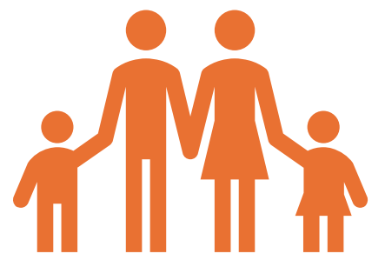
Workstream 1: Family Help
Family Help aims to improve outcomes by quickly addressing needs, enabling children to thrive and stay safely with their families.
Family Help is underpinned by the following key principles:
Wrapping support around the whole family at the earliest opportunity – using the expertise of multi-disciplinary practitioners to provide holistic support.
Ensuring consistency of relationships between children, families and their lead practitioner.
Adopting one plan that will stay with families but adapt as needs change.
Family Help is for children and families with multiple and/or complex needs, including:
Those currently eligible for targeted early help.
Those receiving support and services as a child in need.
Those subject to child protection enquiries and plans.
Merging Targeted Help with Child in Need

Slide 12

Workstream 1: Family Help
Family Help Lead Practitioners (FHLPs) will build relationships with children and families being supported in Family Help, staying with families as much as is practical, even as needs change
What does a FHLP look like?
The right FHLP is based on the child and family's best interests. FHLPs;
may be social work qualified (must be a social worker when a CP plan is in place);
may have alternative appropriate skills or qualifications;
may or may not be employed directly by the local authority;
should be able to build strong and trusted relationships with families;
have the right skills, knowledge and experience to support families, produce a 'Family Help plan' and build a flexible and responsive 'team around the family' (TAF).
FHLPs will be integrated into Multi-disciplinary Family Help teams with appropriate supervision and oversight.

Slide 13
What might this mean for us?
Responding to the reforms we began planning and testing out some elements – MDT models
Piloted a model of multi-disciplinary working in two areas (West and South) to test impact - 2023
Rolled out an early version of Family Help teams county wide - 2024
This means that we can focus our capacity as a partnership at the other areas of this workstream.
Understanding the role of the FH Lead across the Safeguarding landscape – we are starting to hear some interesting examples of how this has looked for national pathfinders eg health professionals taking on this role when they have had the strongest relationship with the family.
Implementation of a Single Plan and Assessment
Development of an integrated front door as a partnership
Notes:
Key points to highlight
In response to the reform we’ve begun planning for and implementing some elements of the reform – integrating team further in Children’s Services to increase multi-disciplinary working through Family Help teams
Pilot and had independent evaluation highlight successes of the pilot and the positive response from staff and families

Slide 14

Workstream 1 - Family’s Plan
Single Assessment and Plan (Extract from the FFP programme guide)
The aim is for one assessment and plan which evolves with the family as needs/circumstances change and can be jointly accessed by all agencies working with the family.
These should cover non-statutory Targeted Early Help and support, and Child in Need services where required and in line with Working Together to Safeguard Children 2023.
DfE are planning to provide technical guidance setting out the changes required to case management systems
Significant opportunities for partnership wide collaboration and access to information to improve practice
Notes:
Key points
Been our aspiration for a long time
Also include a key focus on how we share information easily between organisation and move forward with a unique single identifier
______

Slide 15

Workstream 1: Integrated Front Door
Requirements
Every local area has a front door for determining how to get children, young people, and families the help they need.
Scope for local partnerships should also consider how children and families first engage with services
Move towards an integrated front door for triaging contacts and referrals to the right level of service.
Consider the range of practitioners and agencies involved, including education, police, health, and youth workers.
Local flexibility for triaging at the front door: location, co-location, team composition, and links to Multi-Agency Child Protection Teams (MACPTs).
Promote engagement with services through digital solutions and a relationship-based approach.

Slide 16
Workstream 2: Multi-Agency Child Protection Teams
Purpose:
To deliver statutory child protection functions through integrated teams that respond decisively to significant harm, both inside and outside the home
Expected Impact:
More decisive and forensic responses to child protection concerns
Reduced fragmentation in service delivery
Enhanced safeguarding through shared expertise
Better outcomes for children at risk of significant harm

Slide 17
Establishing Multi-Agency Child Protection Teams (MACPTs)
Multi-agency child protection teams will:
Support the local authority to discharge its duty under section 47 of the Children Act 1989 (duty to investigate)
Bring experts together across agencies to identify actual or likely significant harm
Take decisive action to protect children
Safeguarding partners should:
Nominate a core membership – social workers, police, health, education
Determine other relevant agency involvement matched to local priorities
Determine how MACPTs integrate with and build on existing arrangements whilst retaining a distinct identity and clear focus on child protection
Agree the shared vision, structure and practice framework
Set out access to group and individual training and supervision
MACPT members should:
Promote a sense of collective responsibility across agencies
Provide child protection advice and expertise across the system
Ensure interventions are prompt, evidence-based and tailored to the child and family’s needs
Pool multi-agency expertise and resources and use them efficiently
Facilitate better multi-agency communication and information-sharing
Notes:
Key points

Slide 18
What might this mean for us?
We recognise we already have strong practice in this area
We will have a strengthened Multi-Agency Child Protection offer in Norfolk
There will be a strong emphasis on multi-agency working and multi-agency decision making beyond the initial response to crisis
We already have an effective MASH offer – this is an opportunity to build on this further
A number of workshops are taking place to deliver against co-design principals – strong partnership response and creative thinking
Significant Questions to explore:
Tailoring the solution to our current service models and geography
This could include a tailored approach for specific cohorts? E.g. extra familial risk

Slide 19
Workstream 3: Family Group Decision Making
Purpose:
To empower families to take an active role in planning for their children’s safety and wellbeing, especially before court proceedings are initiated.
Key Features:
Mandated offer: Local authorities must offer FGDM when considering care or supervision orders.
Family-led planning: Families come together to develop solutions and plans that address concerns and support reunification.
Safeguarding integration: FGDM is embedded across the help, support, and protection system, including pre-proceedings.
Flexibility: FGDM may be withdrawn or adapted based on safeguarding needs and family circumstances.

Slide 20
Workstream 3: Family Group Decision Making
Expected Impact:
Increased family engagement and ownership
More sustainable and safe reunifications
Reduced reliance on formal care proceedings
Strengthened family networks and resilience

Slide 21
Questions

Slide 22
break

Slide 23
Table Exercise
Transitioning from Multi-Disciplinary to Multi-Agency Working
On your tables work through these questions:
What benefits could this transition bring to families and professionals?
What strengths do we want to build on?
What are the barriers we need to overcome?
What do we see as our next steps?
Suggested Prompts:
What support would help embed this approach?
What are the major threats that need to be considered?
Impact of significant national and local policy changes

Slide 24
Feedback from tables
Top 2 points

Slide 25
Table Exercise
Multi-Agency Approach to a Single Plan and Assessment
On your tables work through these questions:
What are the benefits that this approach could bring to our respective organisations?
Where are the areas this could have the greatest impact?
What are the significant barriers that would prevent this work being successful? And how could we overcome them?
Suggested prompts:
What would a truly shared plan look like?
How can we bring co-design with families and professionals alive in this space?
Which of the NSCP’s priorities could this help to achieve

Slide 26
Feedback from tables
Top 2 points

Slide 27
Closing Remarks

