Slide 1


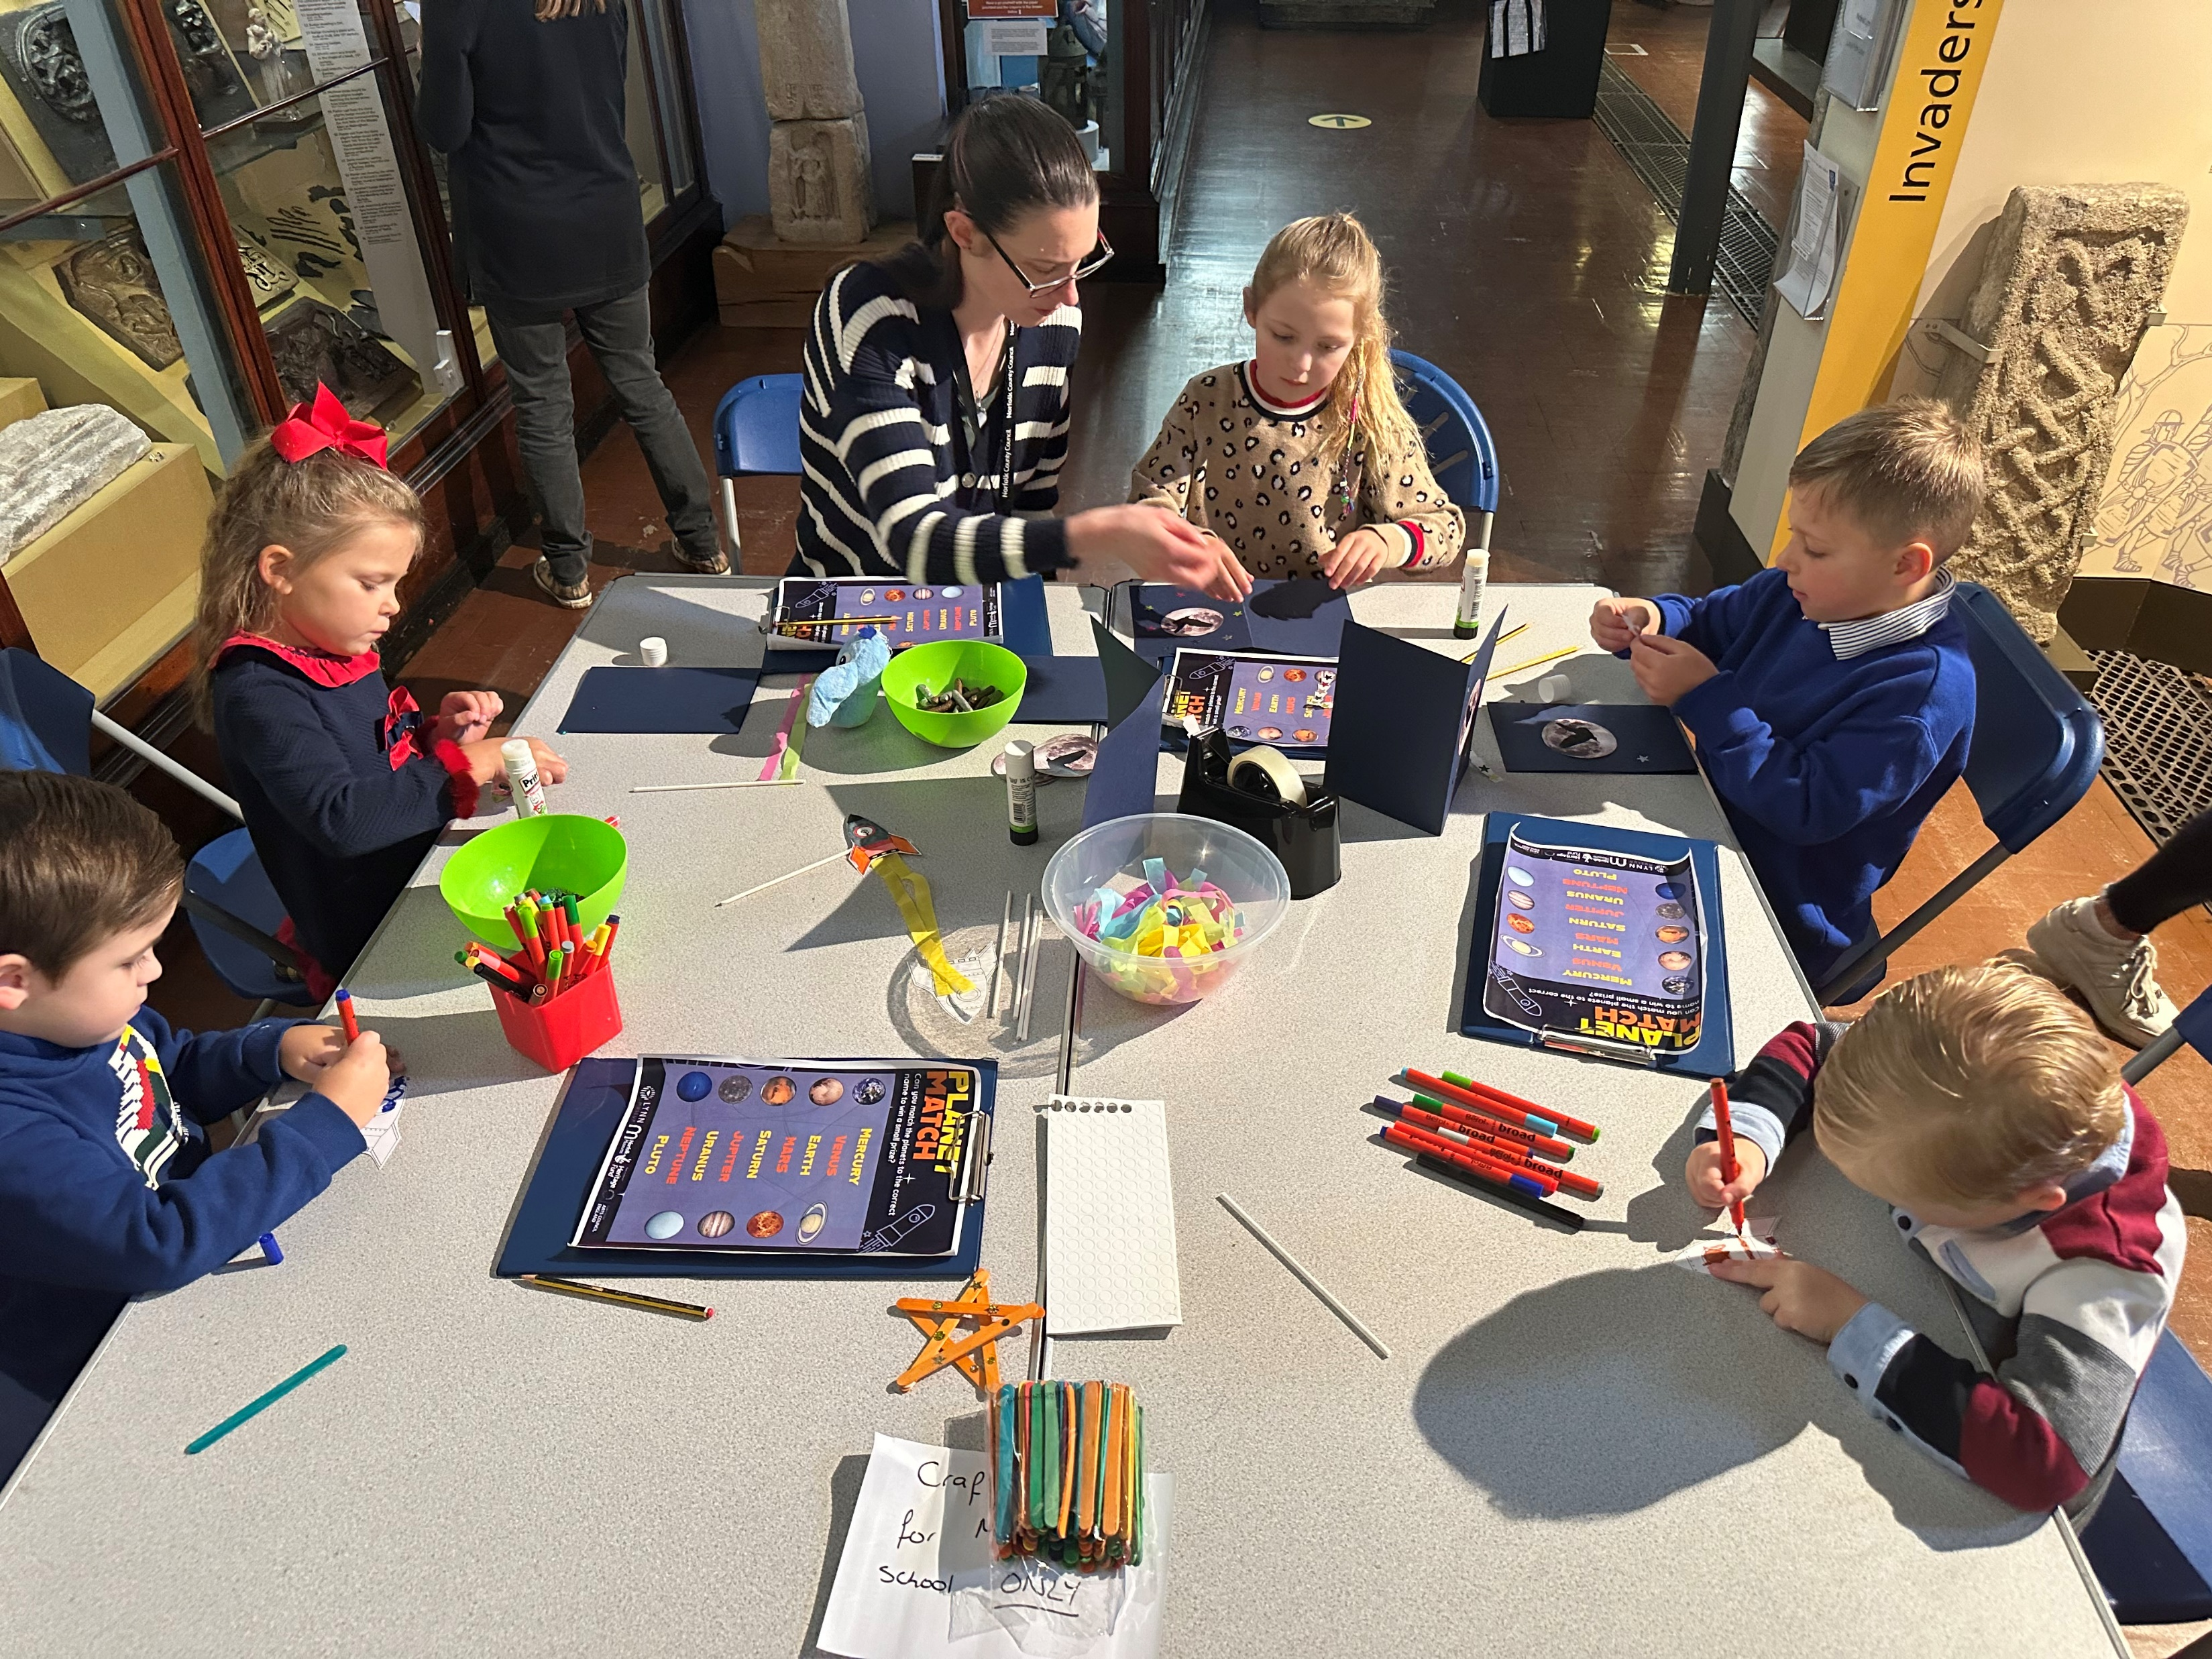
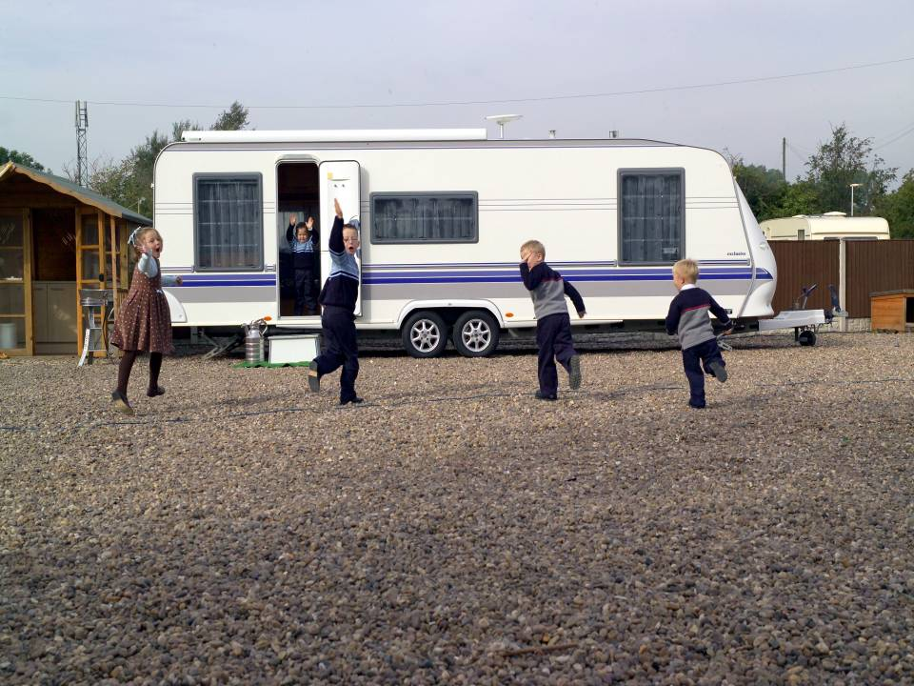

Improving outcomes for GRT children and young people GRT Service Partnerships, Schools and Communities
Hilary Heath, GRT Team Manager
Claire Tattersall, Specialist GRT Practitioner
Rachel Yates, Specialist GRT Practitioner

Slide 2
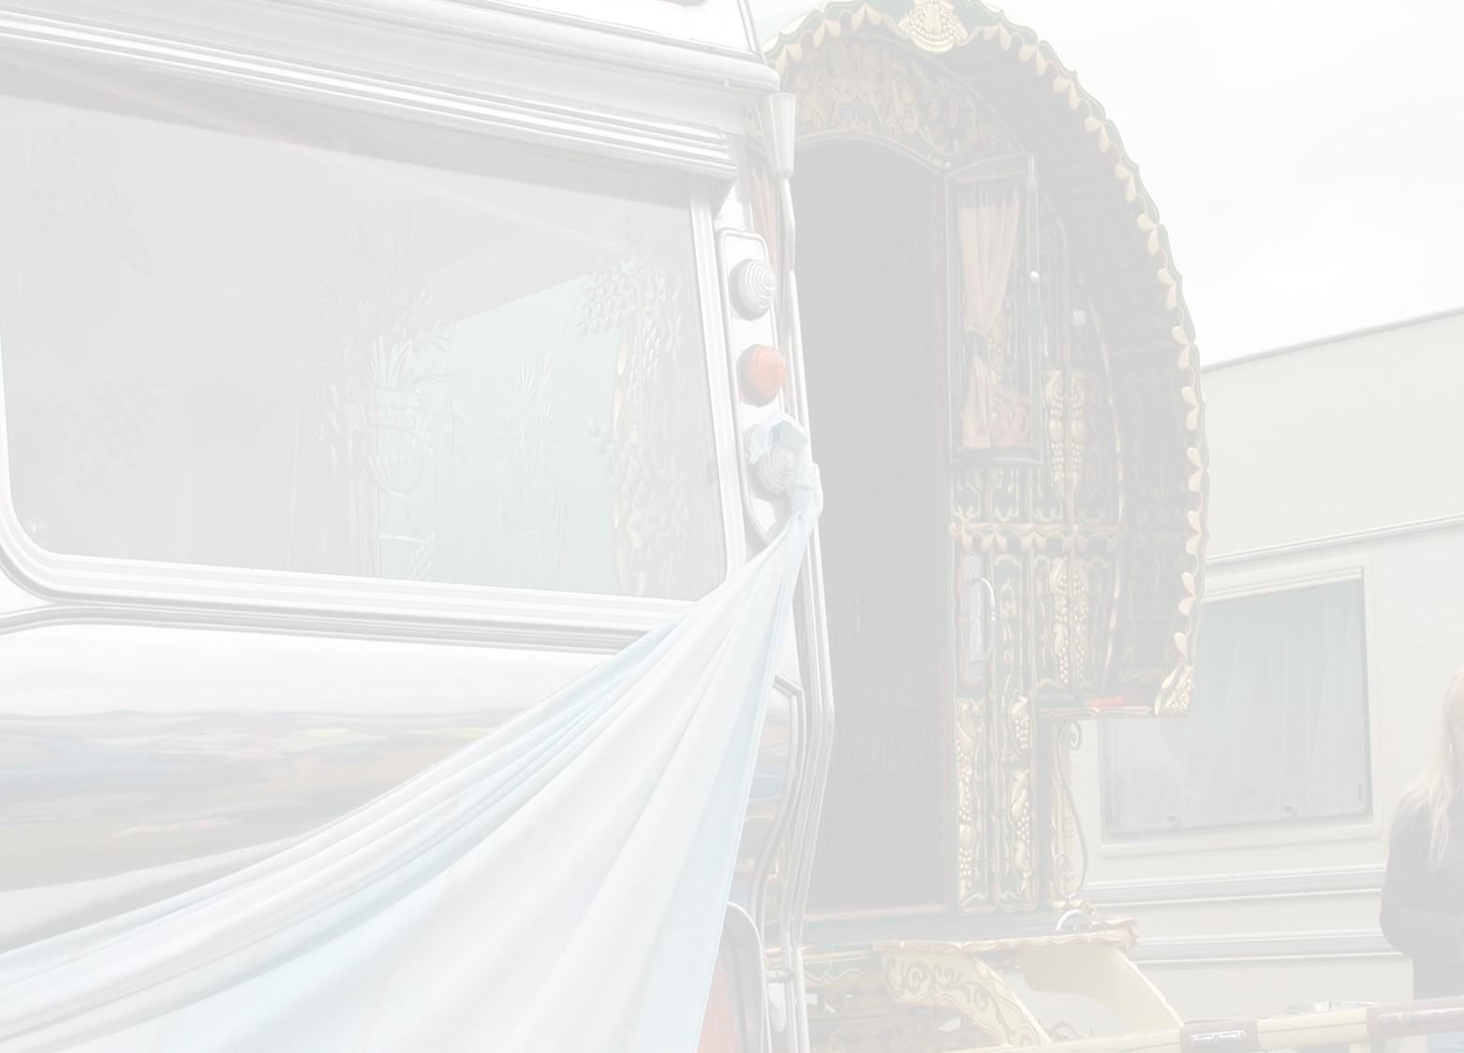
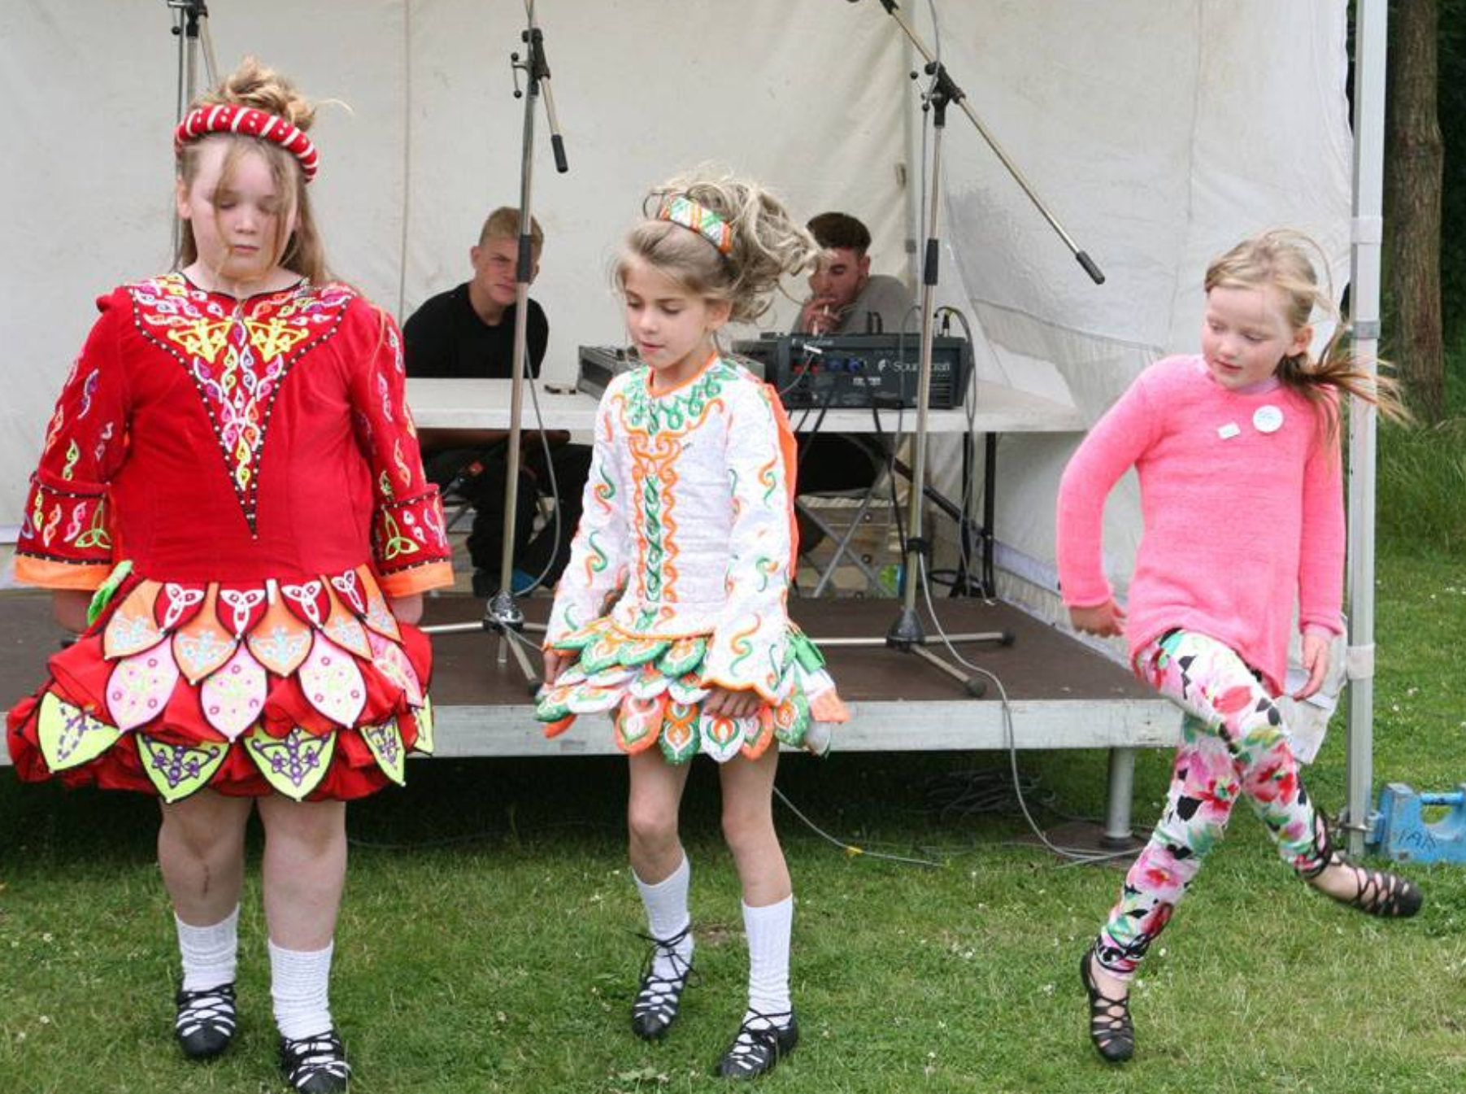
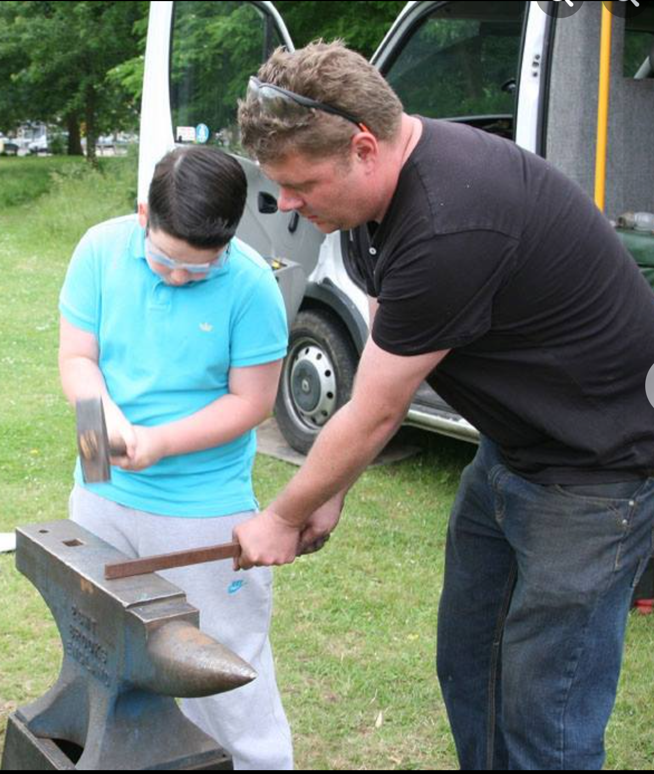
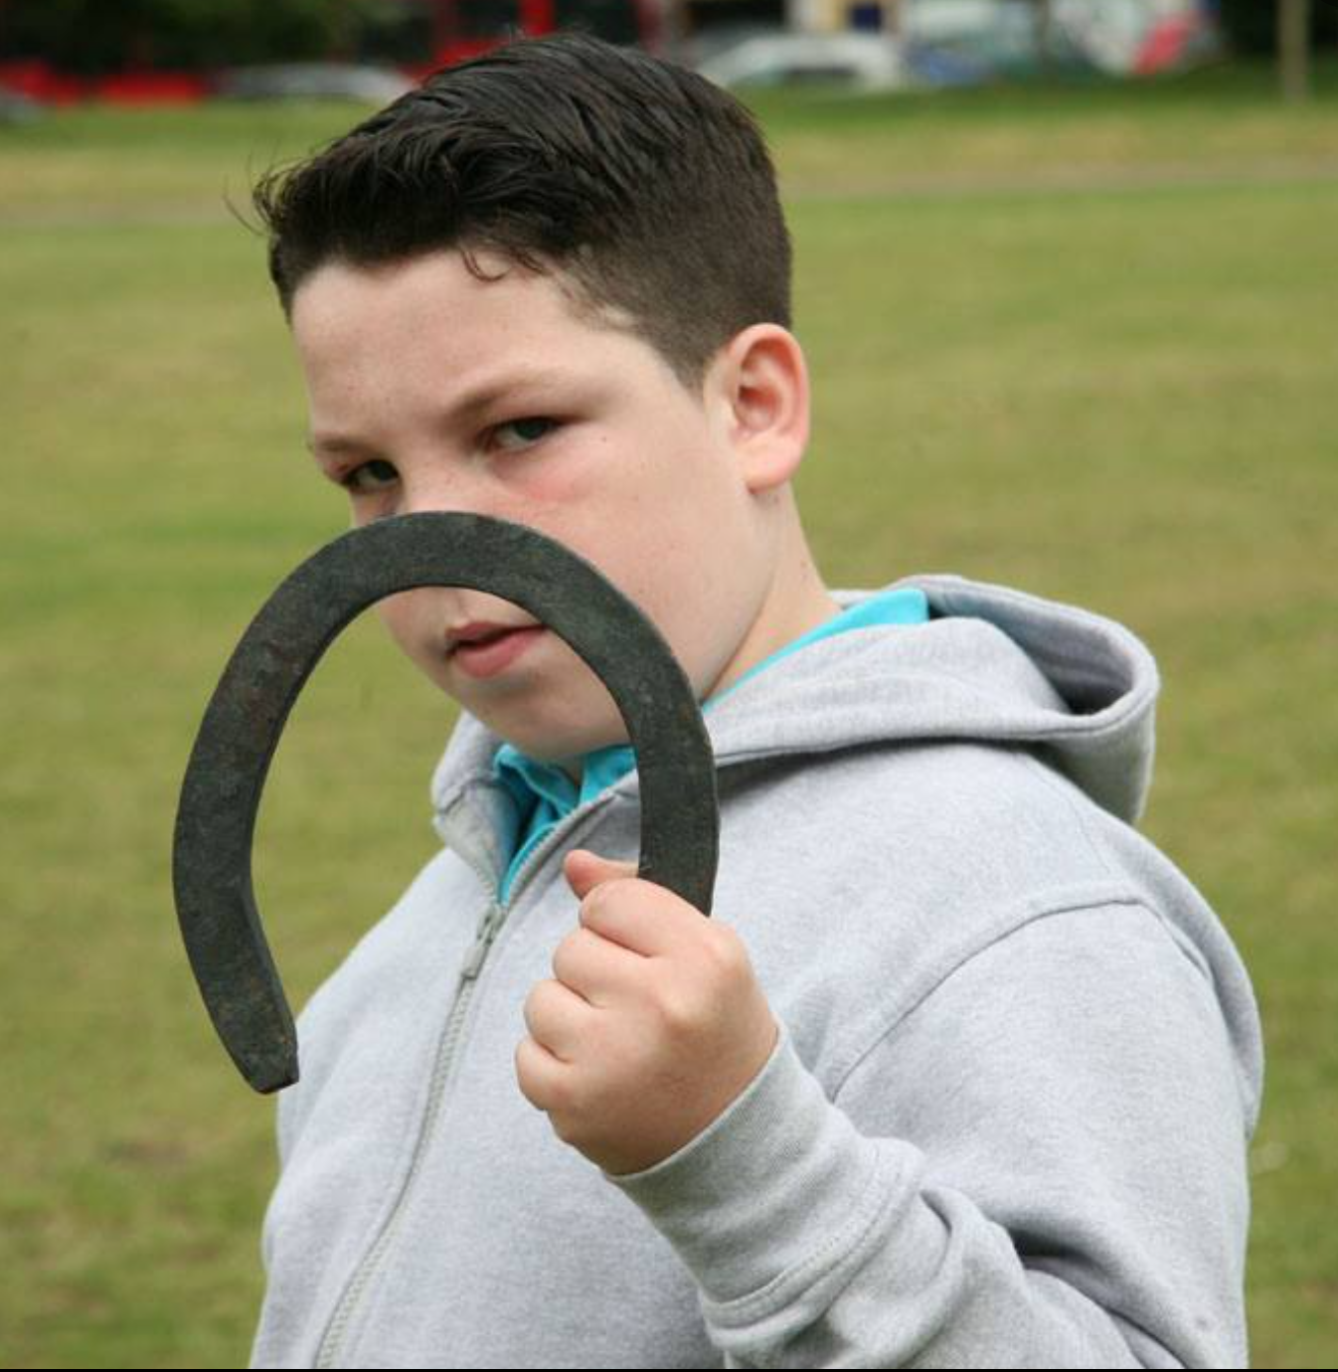
Improving Outcomes for GRT Children and Young People GRT Service Partnerships, Schools and Communities
Gypsy/Roma/Traveller (GRT) children and young people (CYP) have the poorest educational outcomes of any group.
An inclusive ethos and high expectations mean GRT children can flourish and there is no inherent reason why a child from a Gypsy, Roma or Traveller community should not achieve as well as any other child.
The GRT Service works with schools and settings to help close the achievement gap and provide culturally inclusive learning materials so that every GRT child and young person is able to thrive and have a sense of belonging.

Slide 3
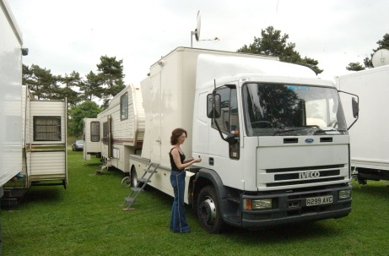
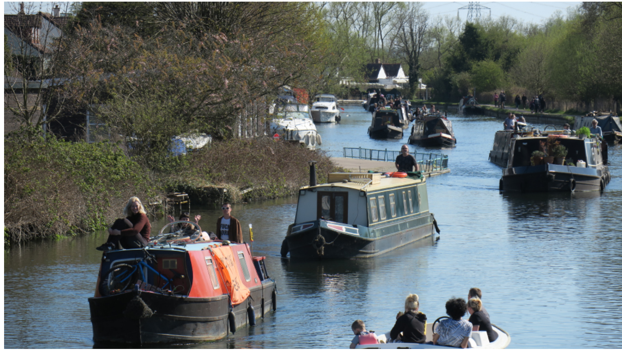
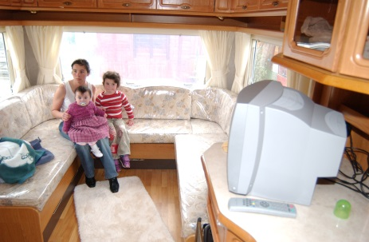
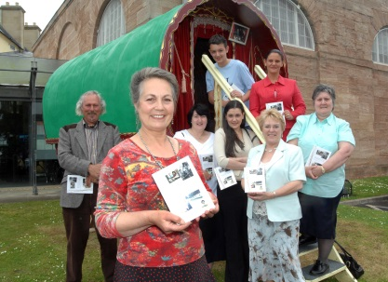
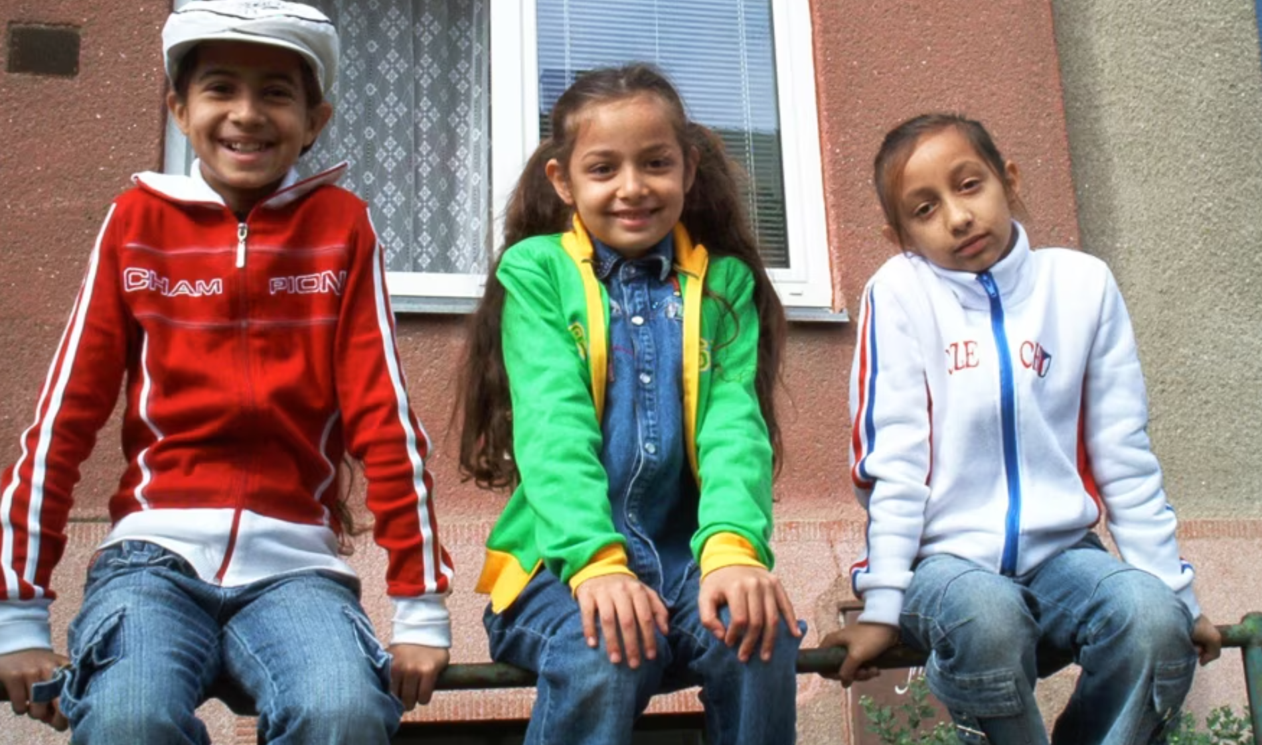

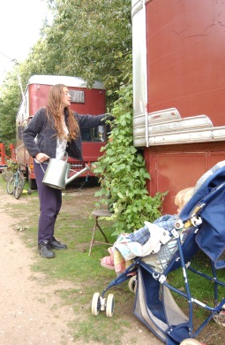
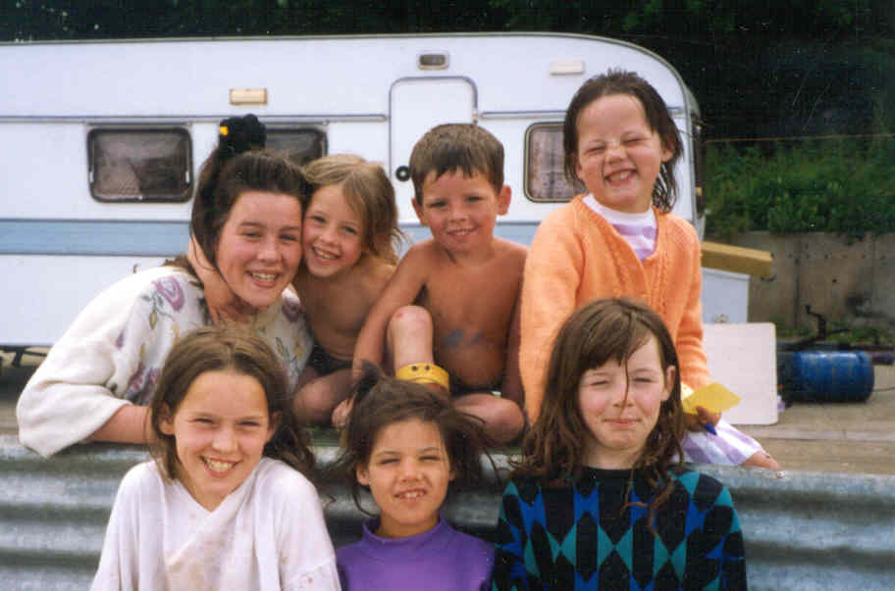
Who are our Gypsy Roma Traveller Children and Young People?
Showmen
Bargee or Boater
Romani Gypsy
Gypsy Roma Traveller
Communities
Scottish
Roma
Circus
New Travellers
Irish Travellers

Slide 4
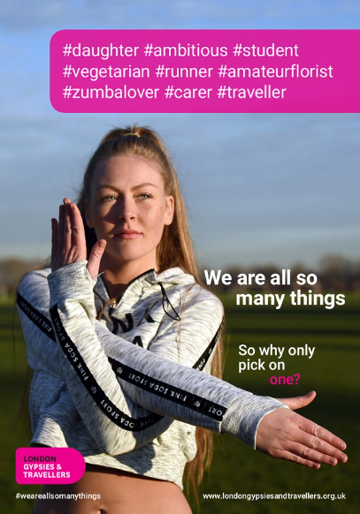
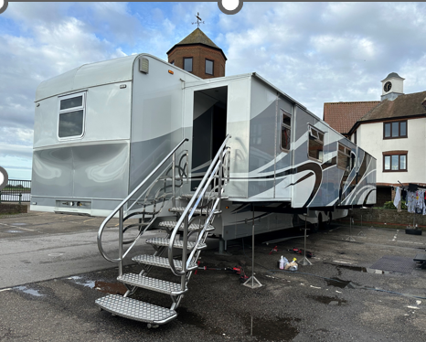
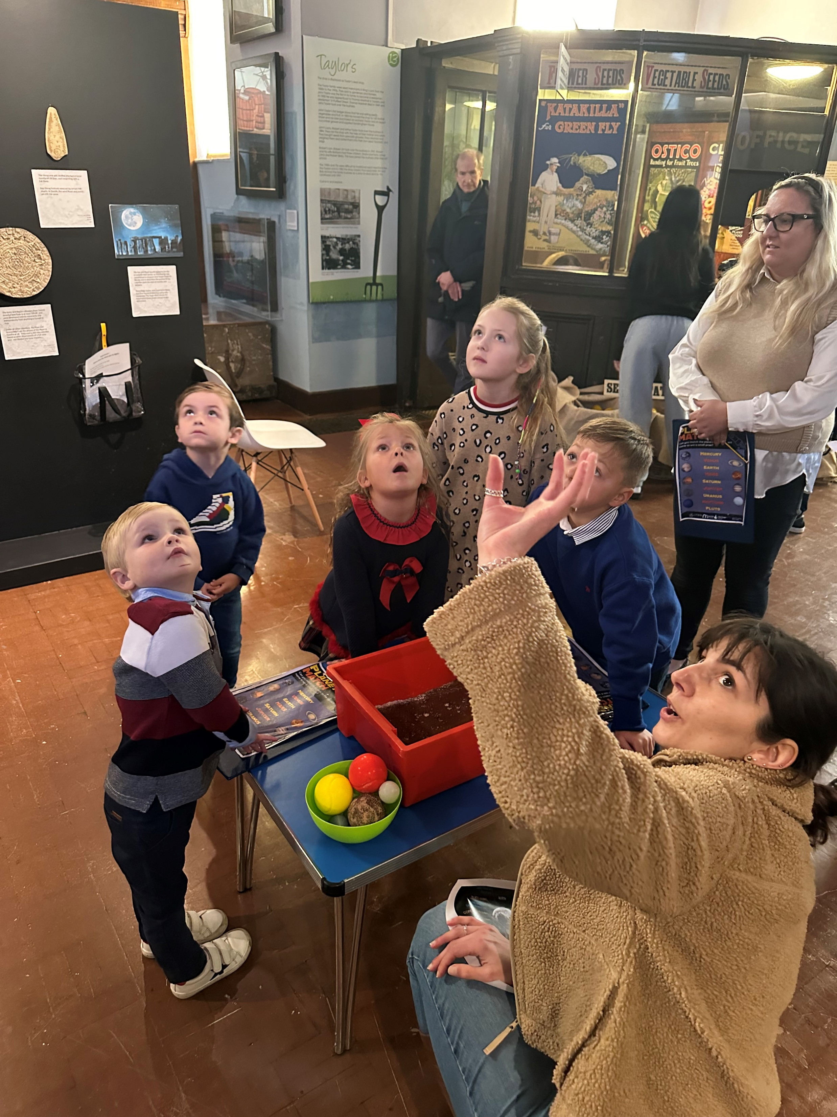
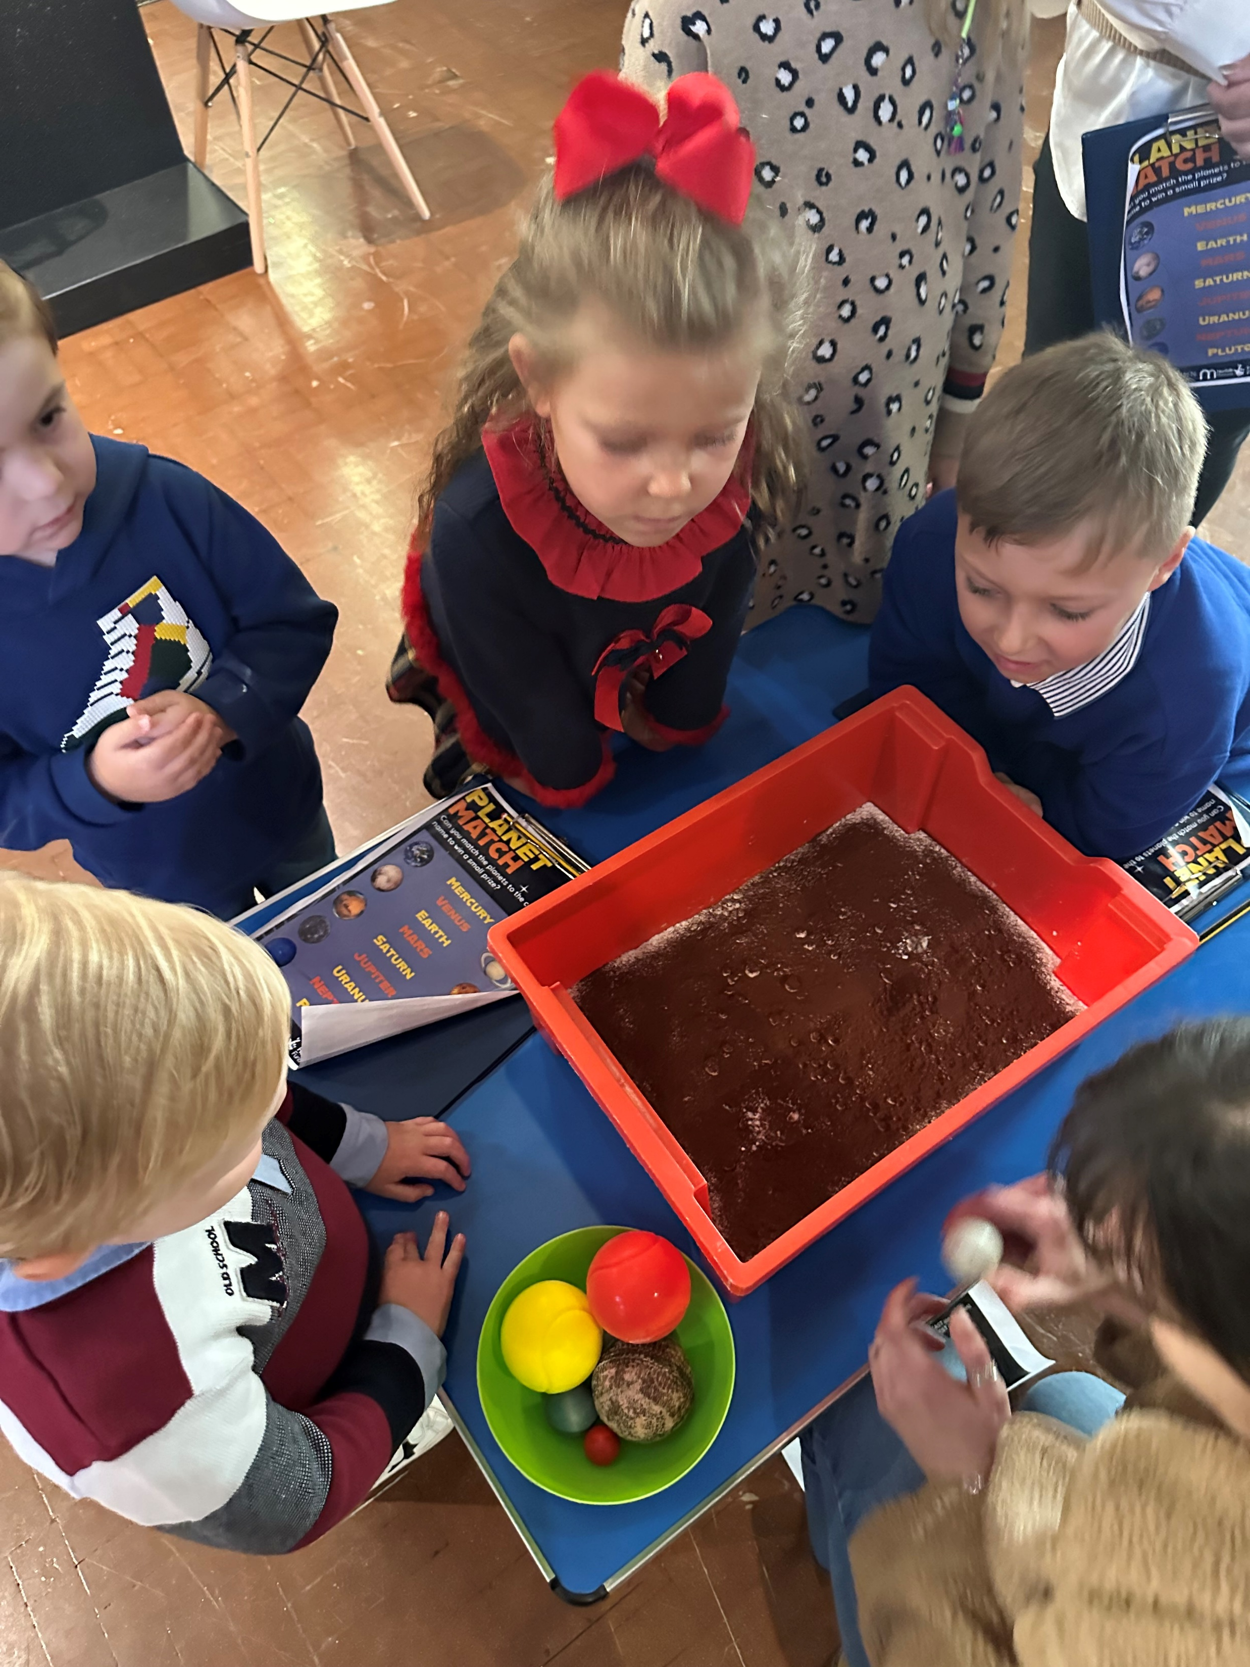
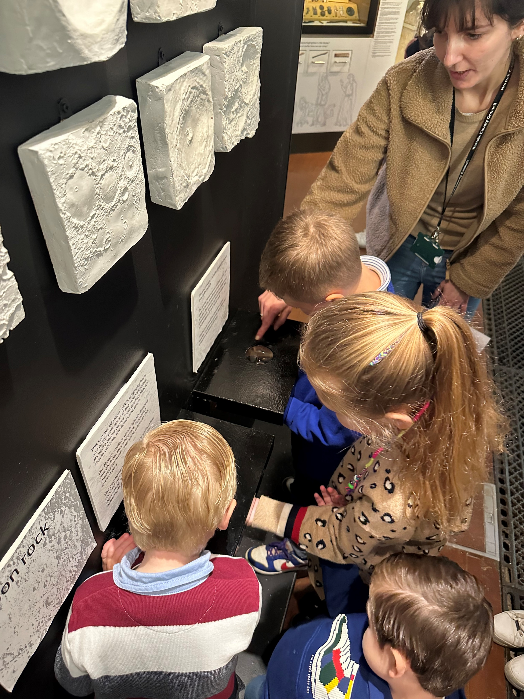
Working Outreach to Improve Outcomes for GRT Children and Young People
Early Years
Community Liaison Officers
Anti-Racism Participation Project
Kings Lynn Mart

Slide 5

Improving Outcomes for GRT Children and Young People in Schools and Settings
1:1 Support in Schools
Qualifying reasons for support
Using PIVATS to help close gaps and support targeted learning
Transitions, focus on Year 6/7
Mental health and well being
Case studies

Slide 6
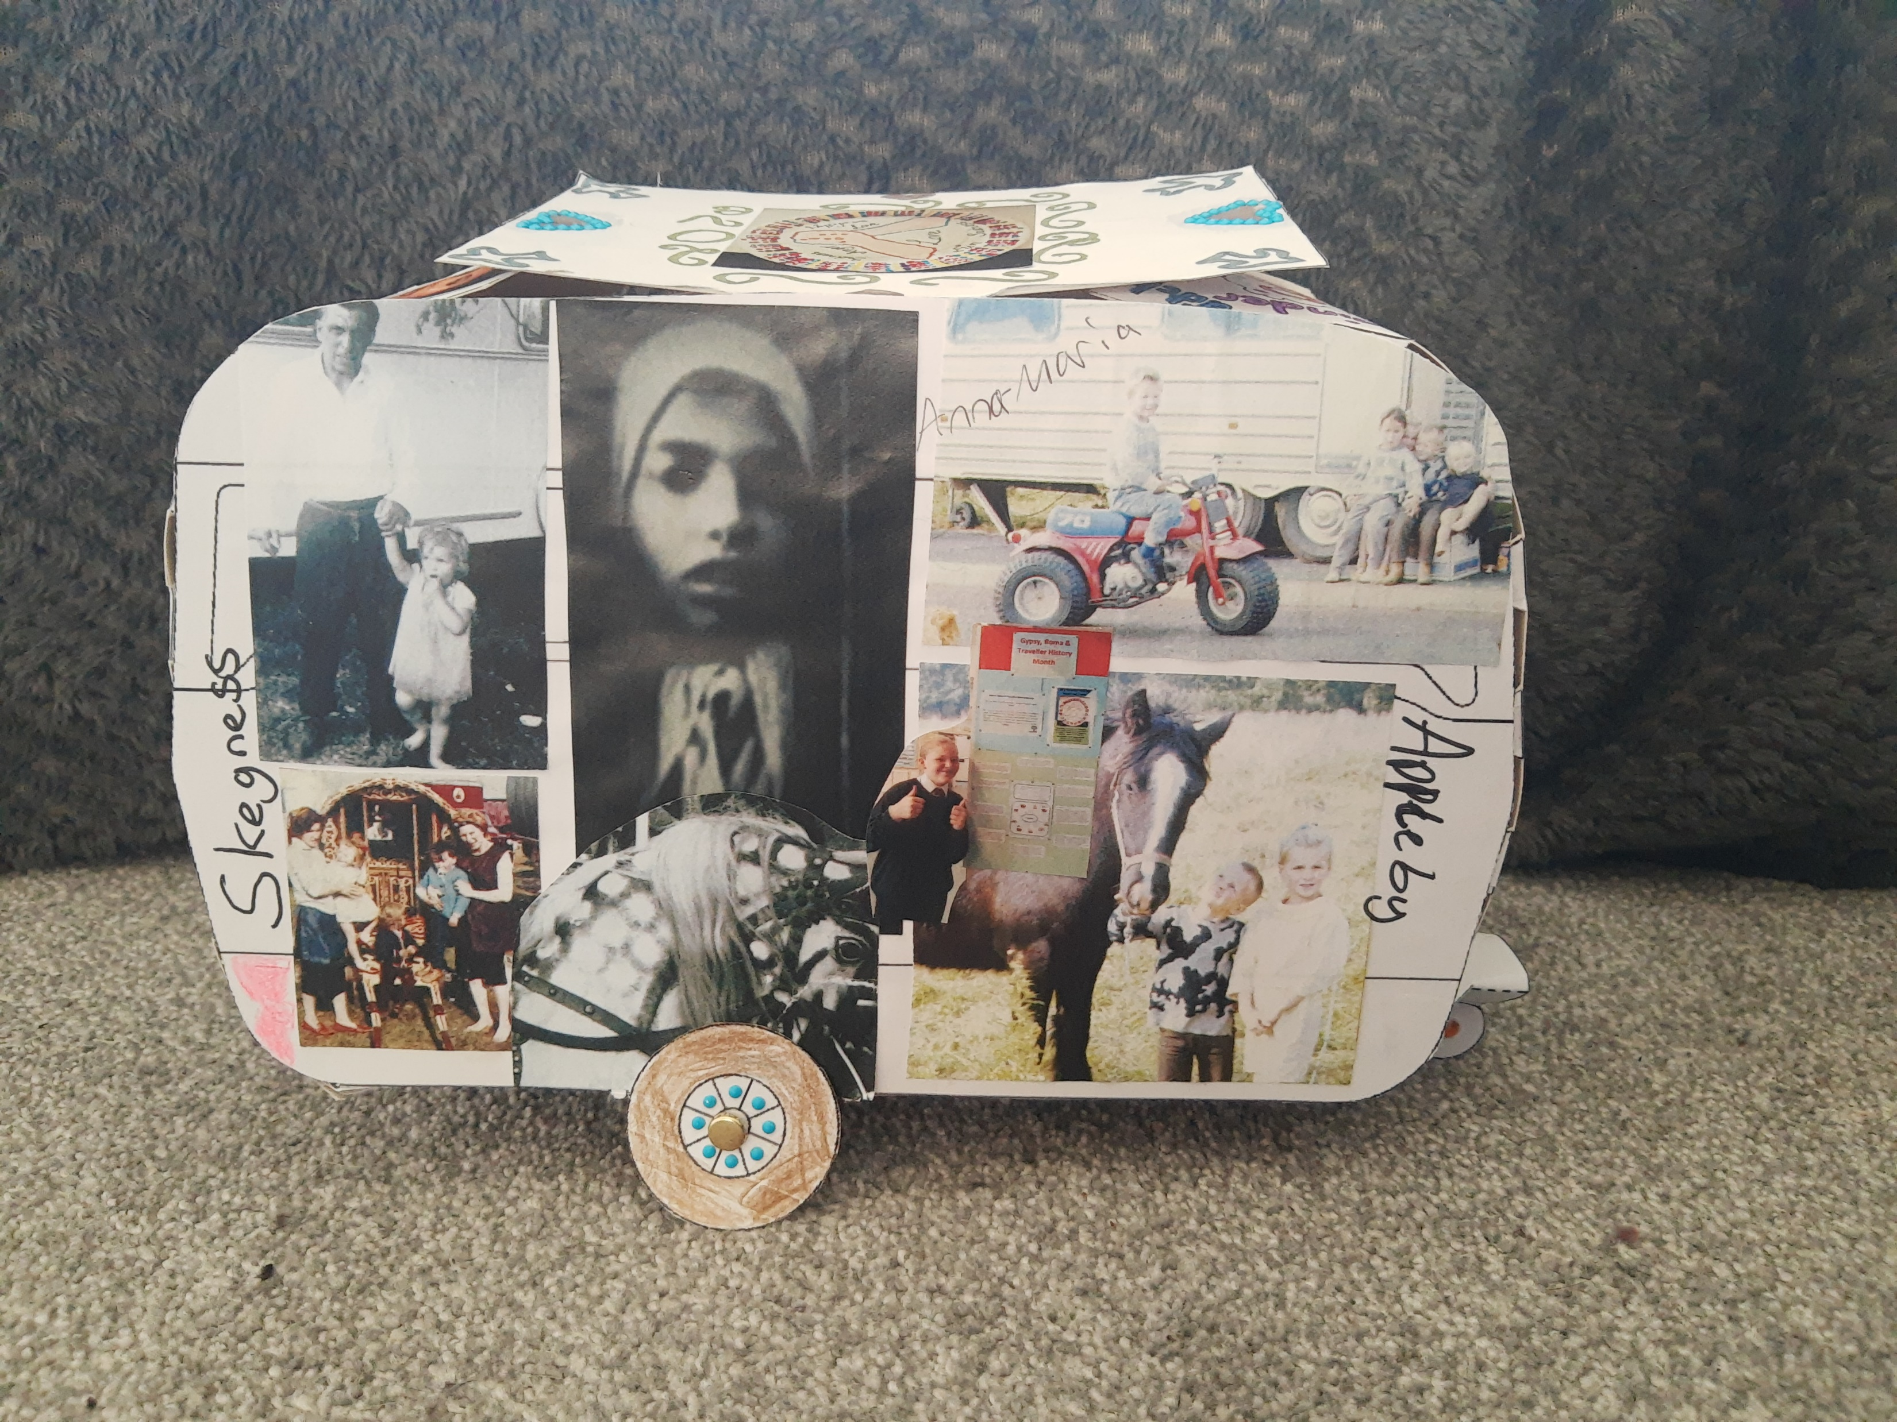
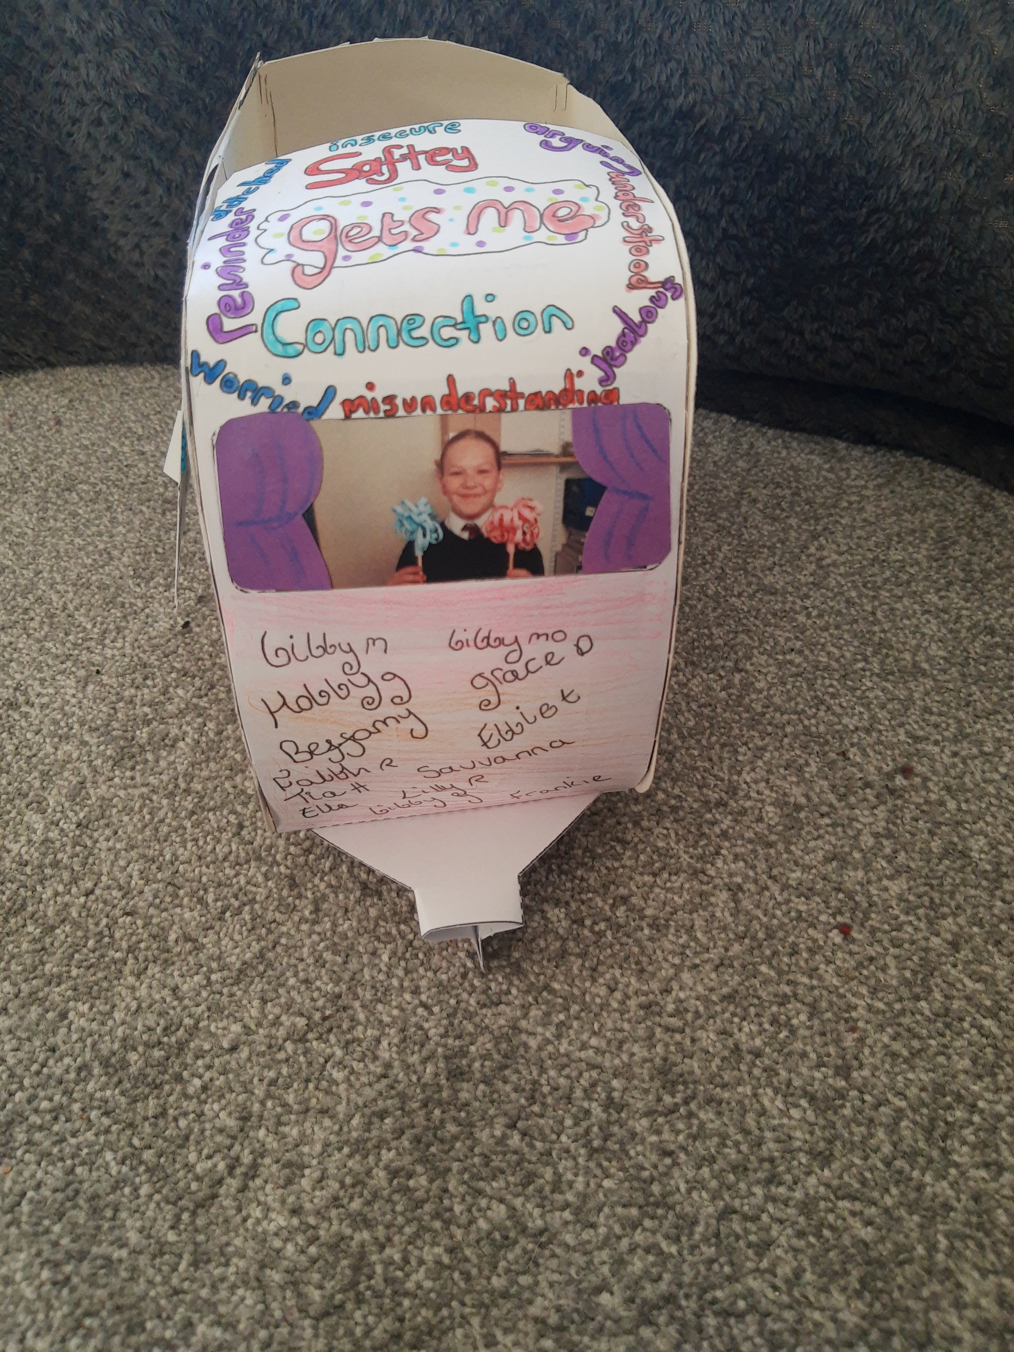
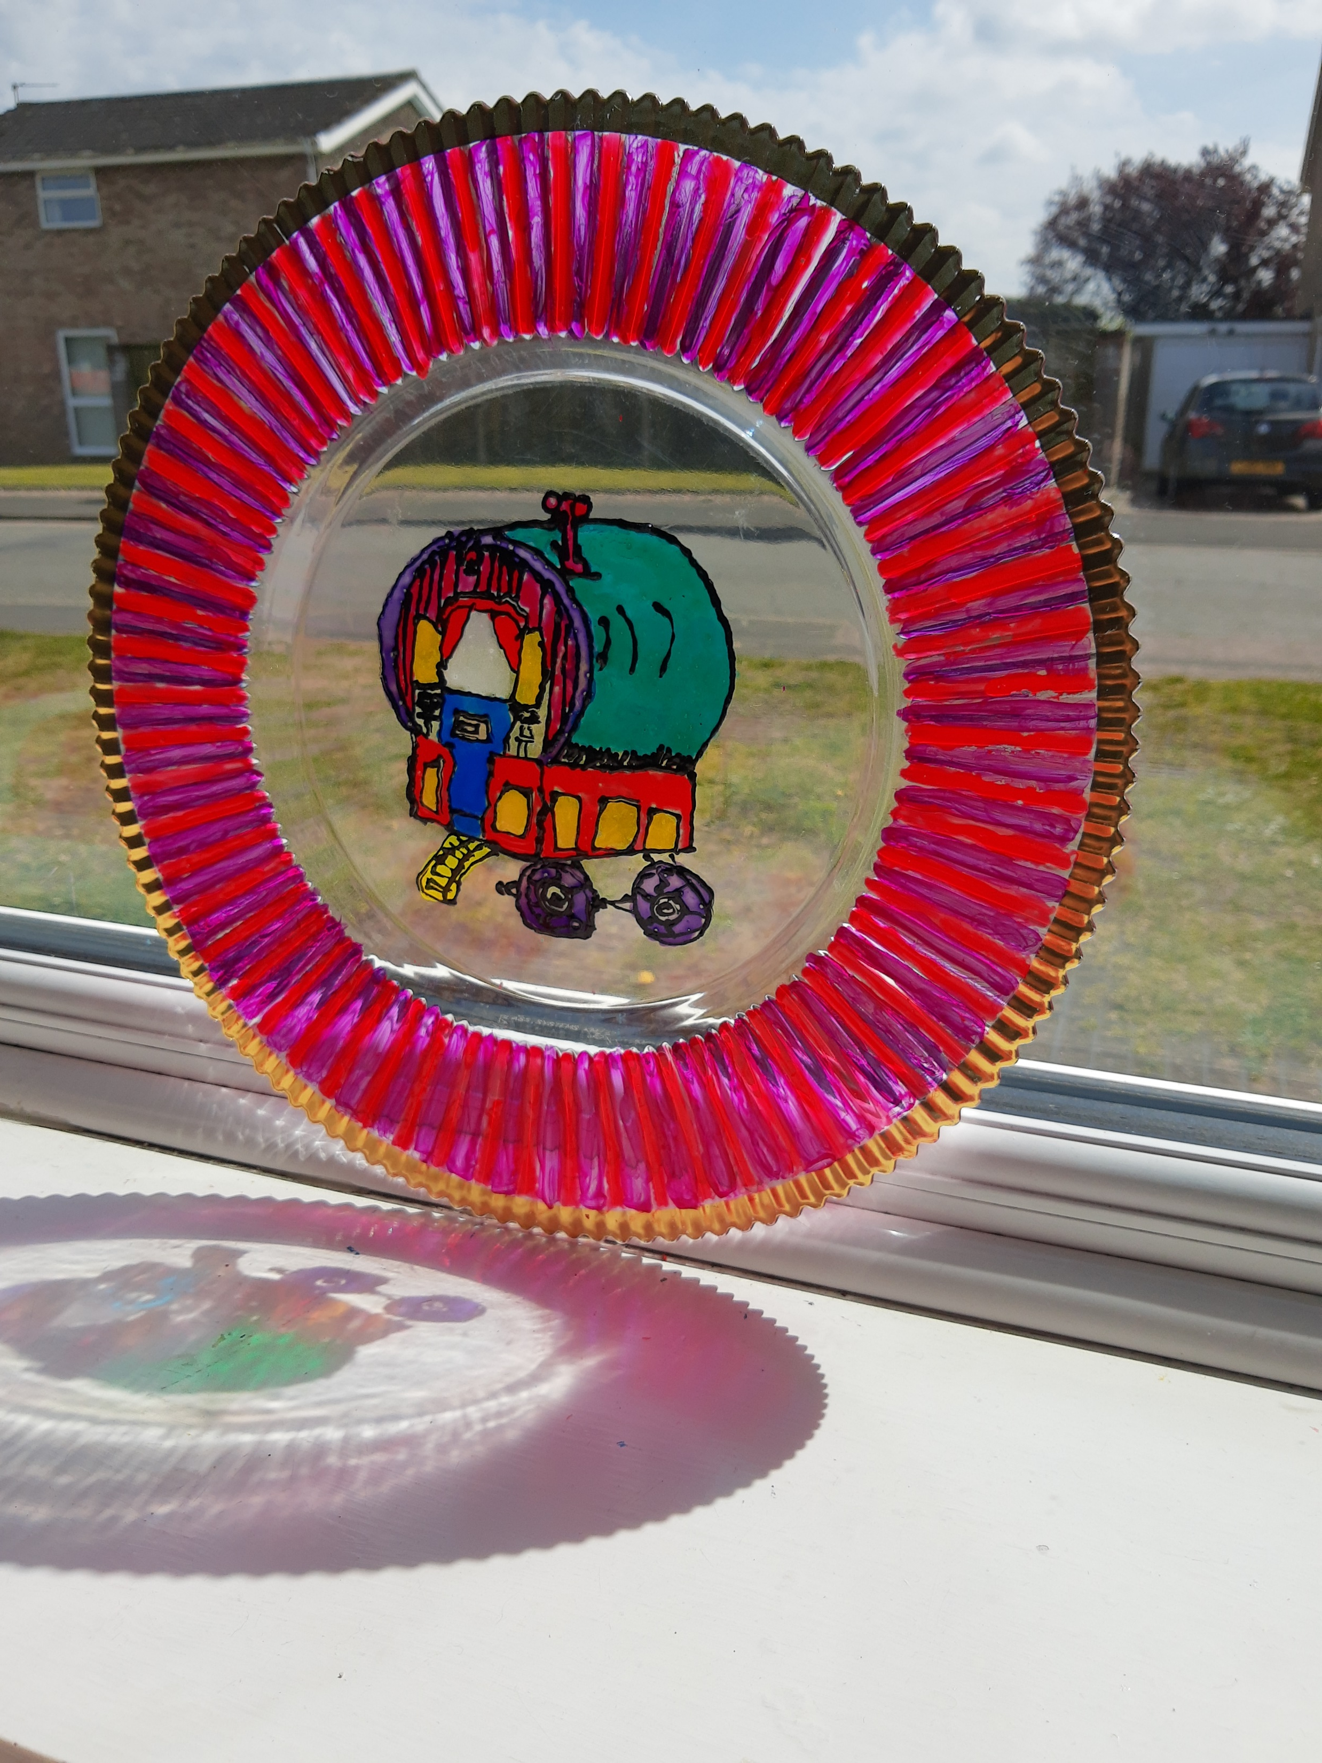
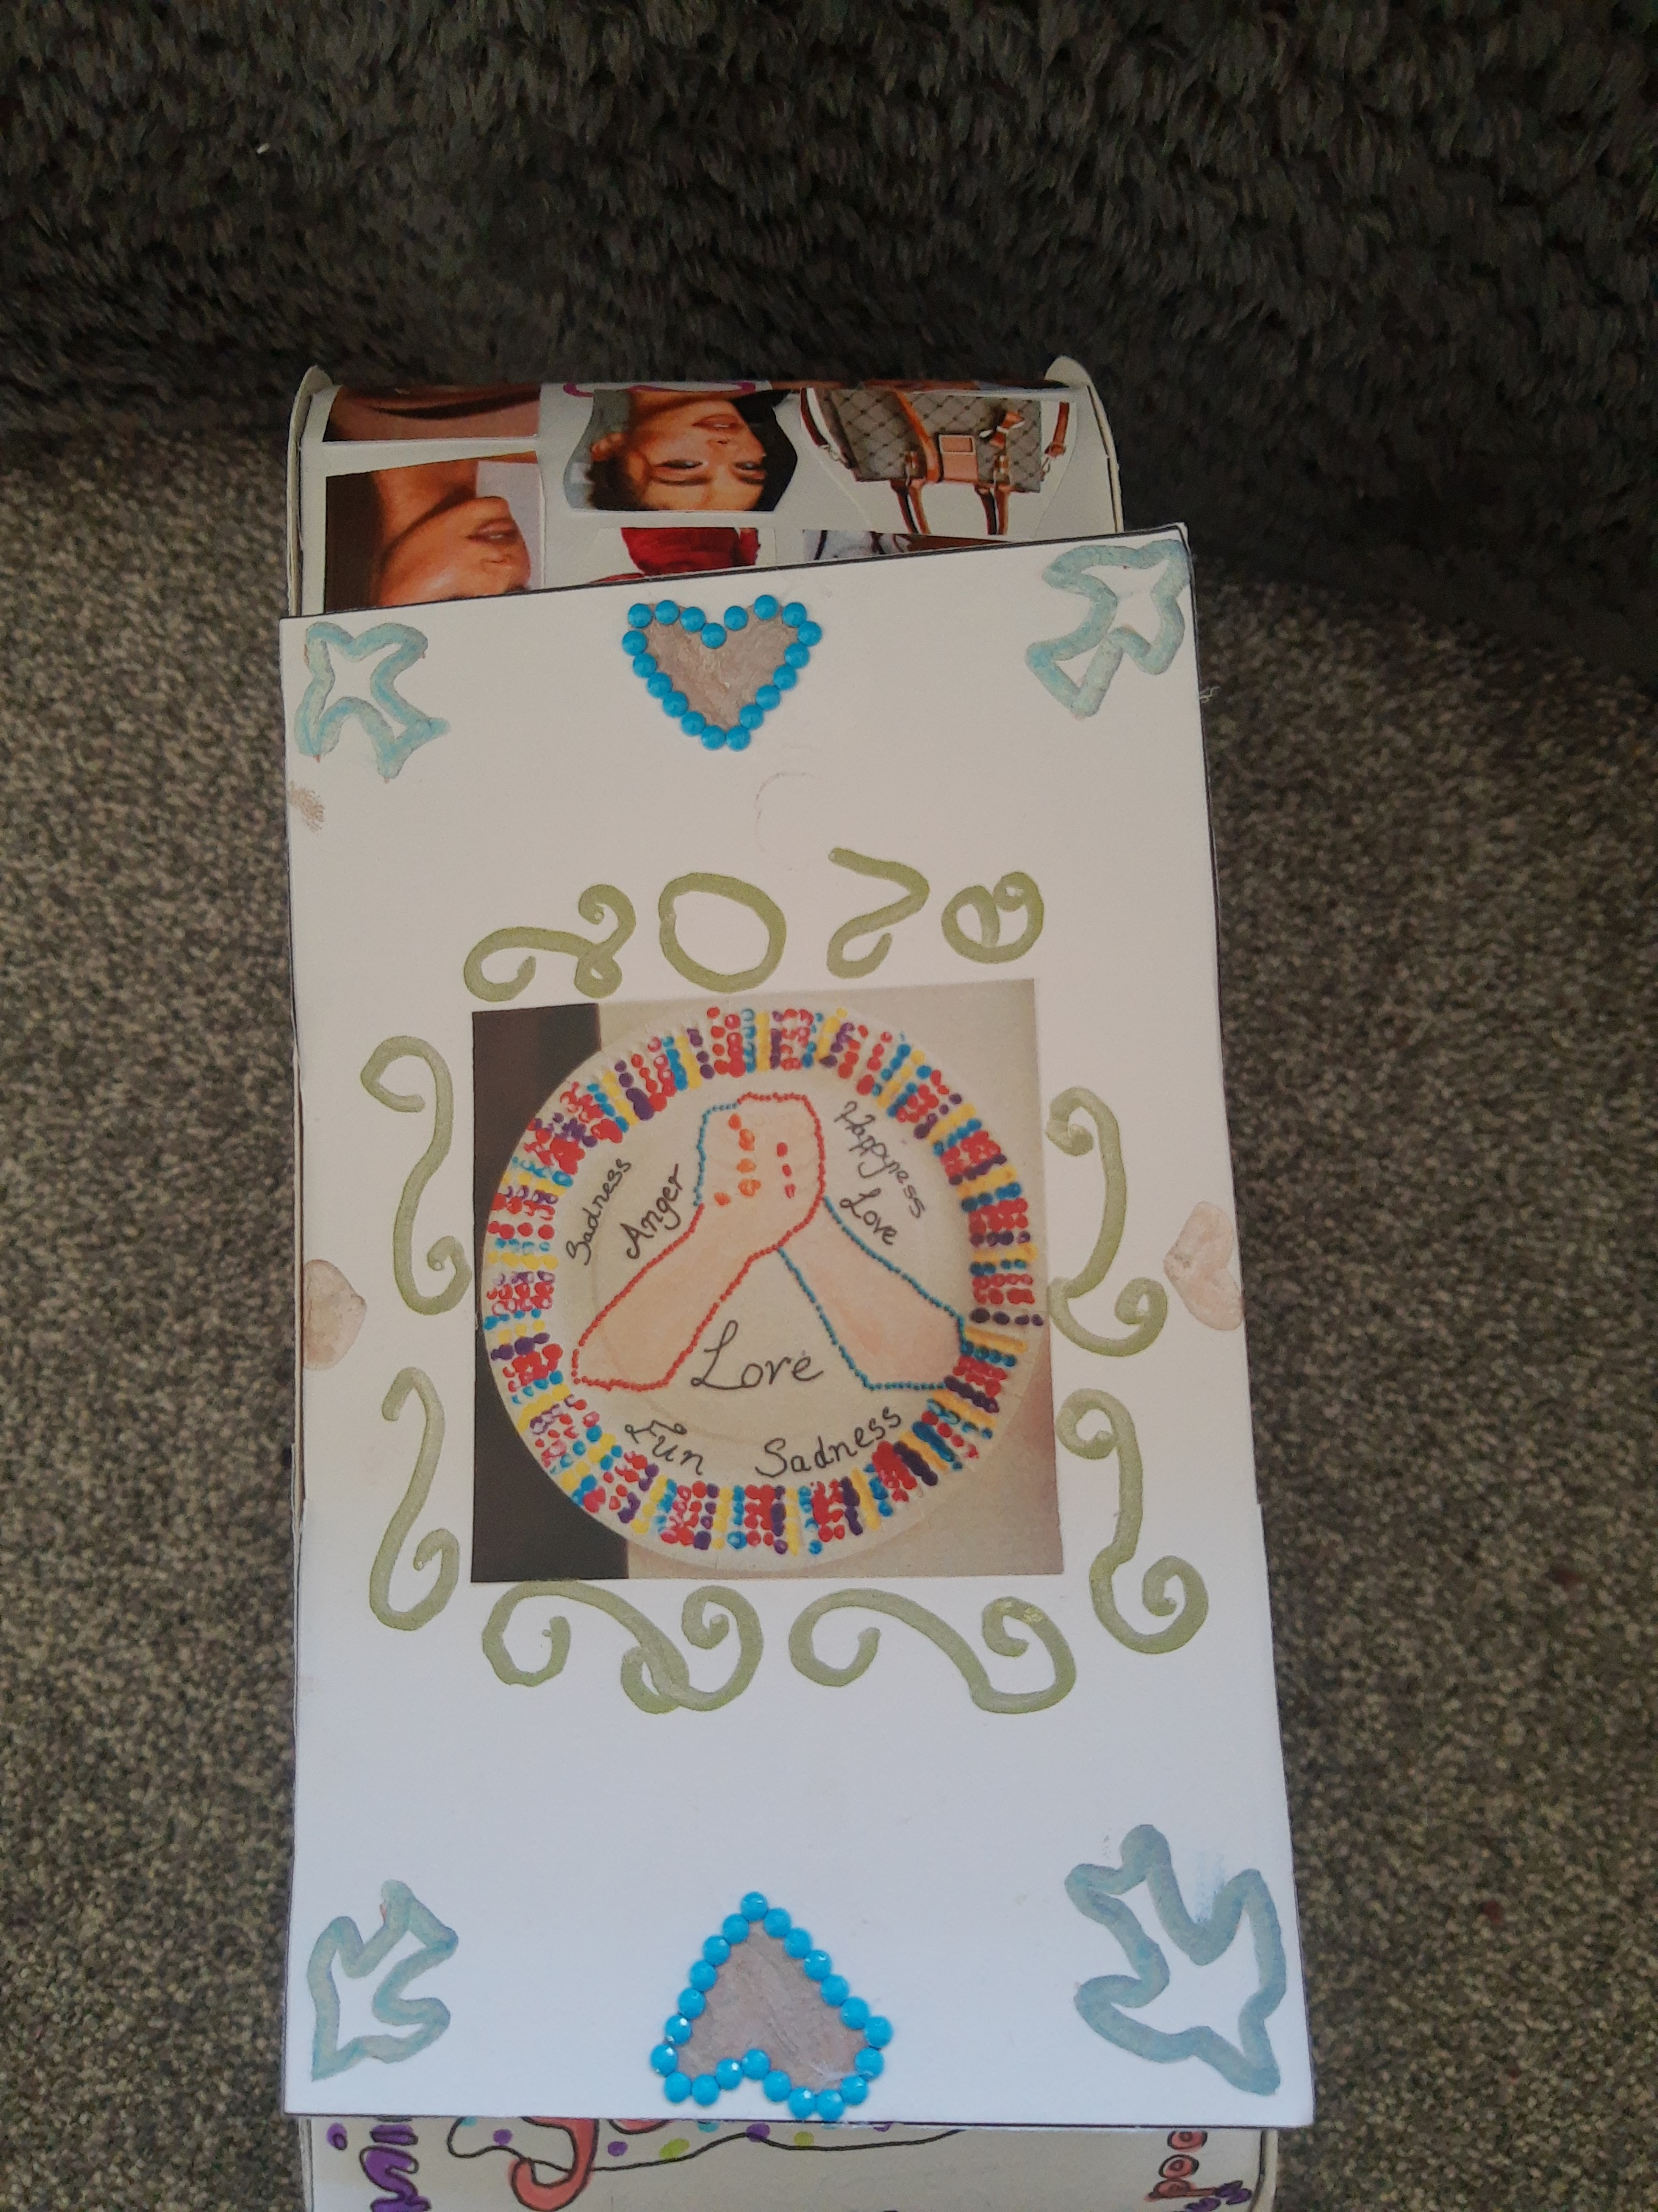
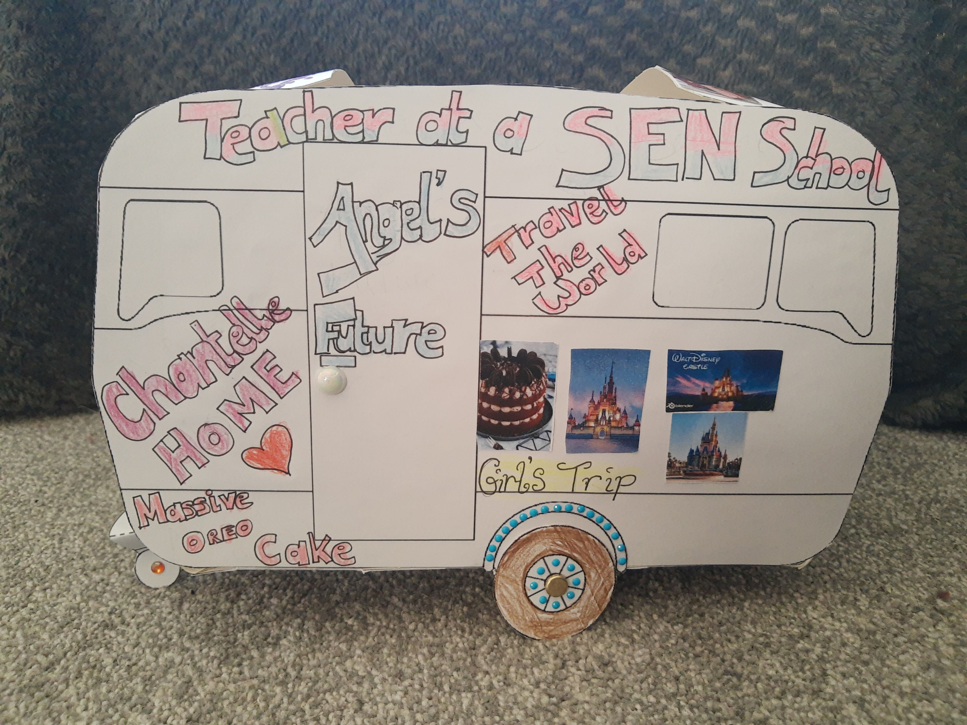
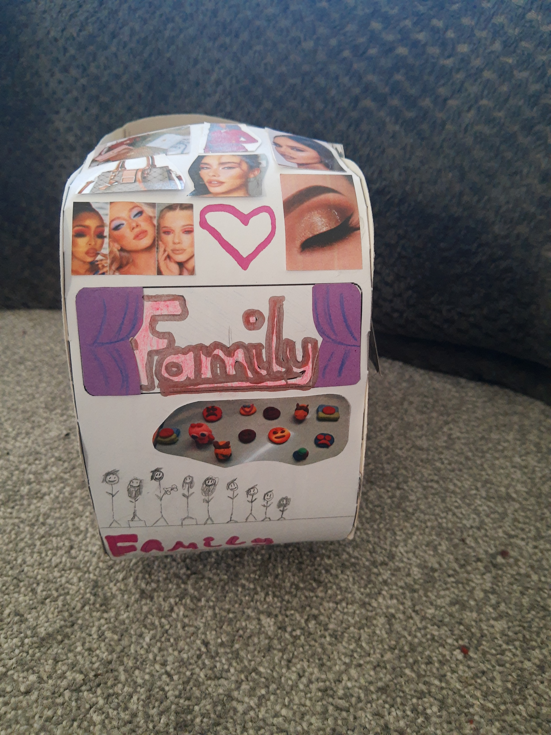
Improving Outcomes for GRT Children and Young People in Schools and Settings
Case Study

Slide 7
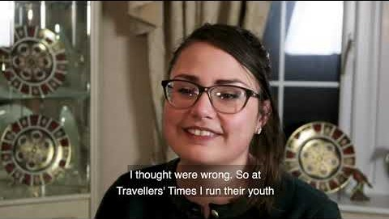
Improving Outcomes for GRT Children and Young People GRT Service Partnerships, Schools and Communities
Notes:
Stop at 2.54 minutes.

Slide 8
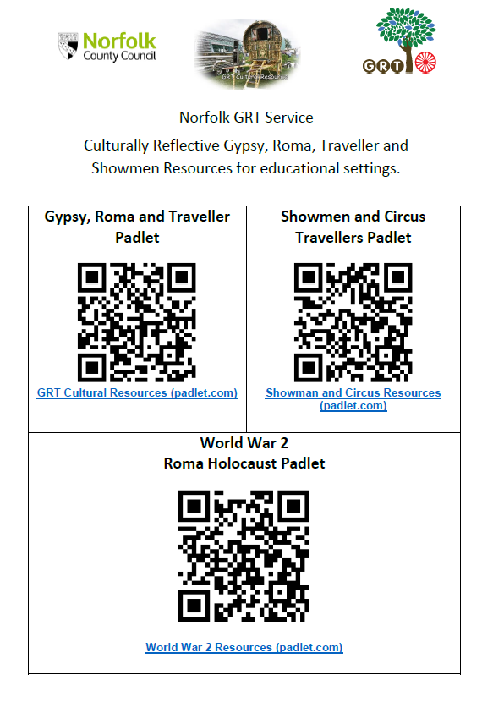
Providing a Culturally Inclusive Curriculum GRT PADLETS
The GRT Service have produced three Padlets with the aim of offering schools the opportunity to enhance the diversity content of their teaching and learning by embedding GRT history and culture into their curriculums.
For more information contact Claire Tattersall:
claire.tattersall@norfolk.gov.uk
GRT Website: https://www.schools.norfolk.gov.uk/pupil-needs/gypsy-roma-traveller
Notes:
The GRT Service have produced three Padlets with the aim of offering schools the opportunity to enhance the diversity content of their teaching and learning by embedding GRT history and culture into their curriculums.

Slide 9
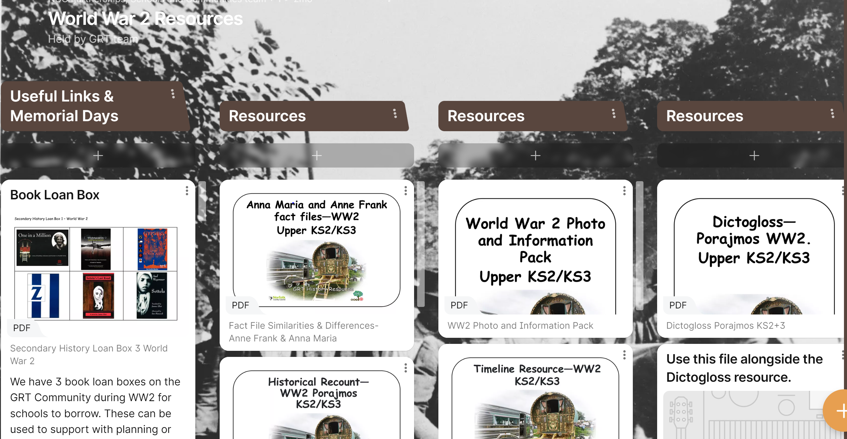
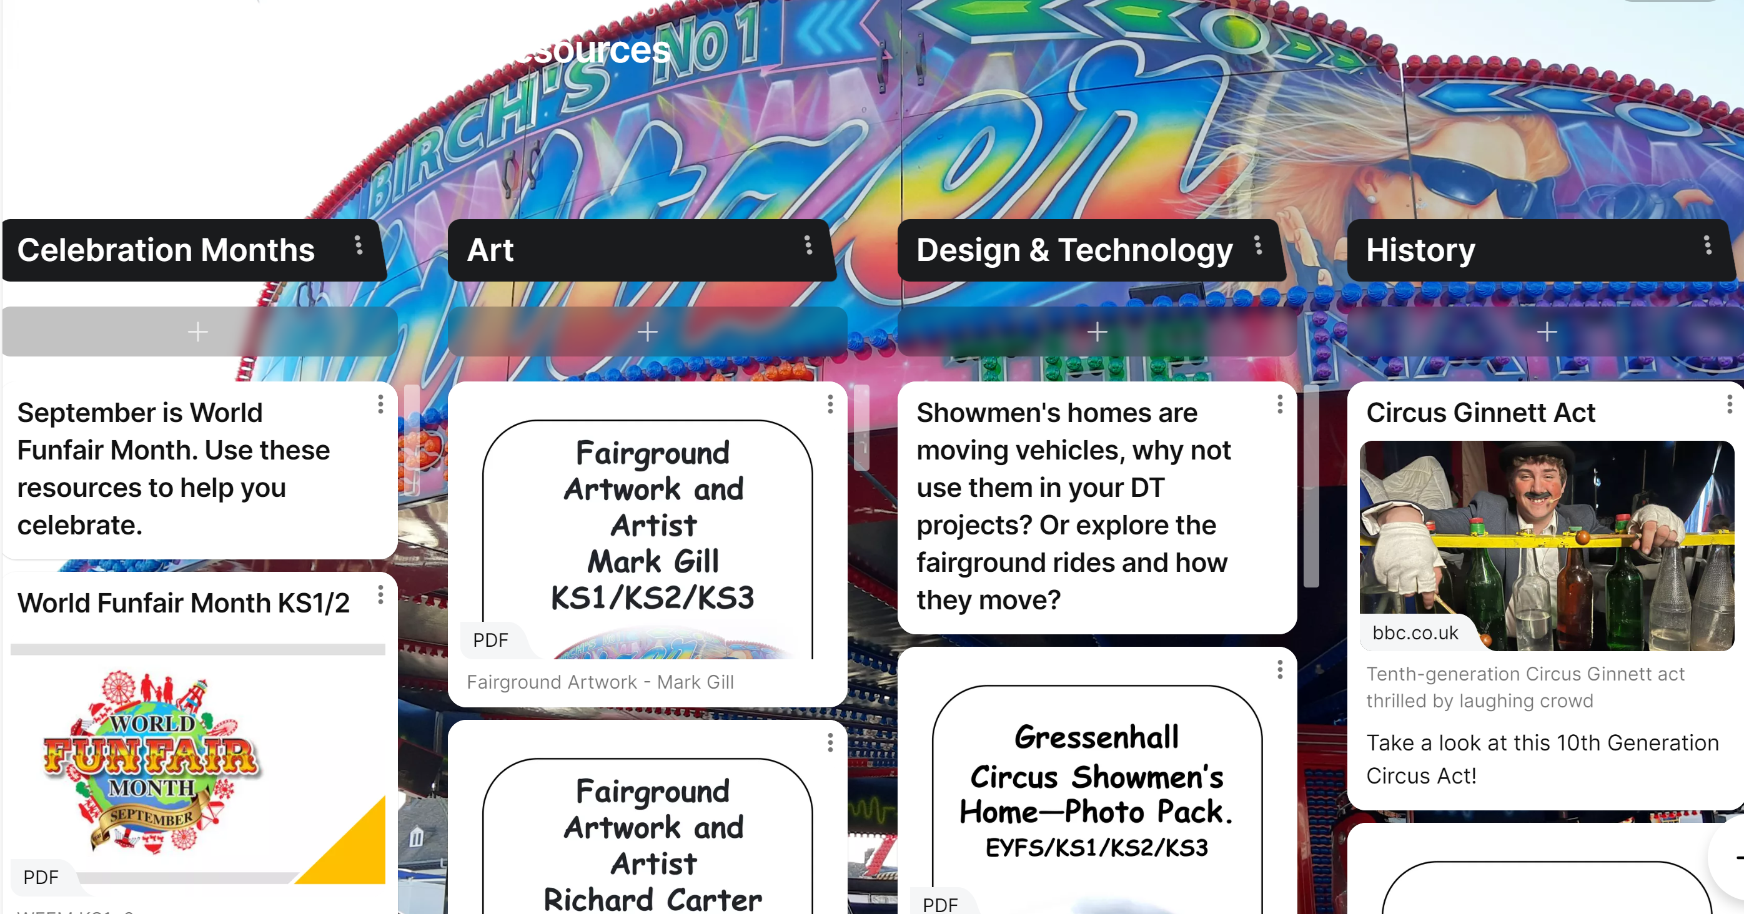
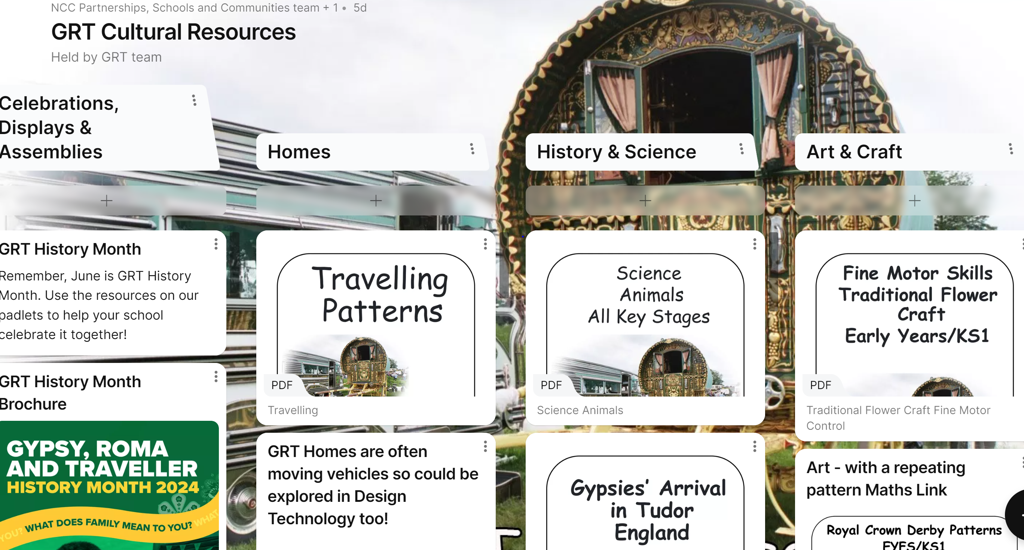
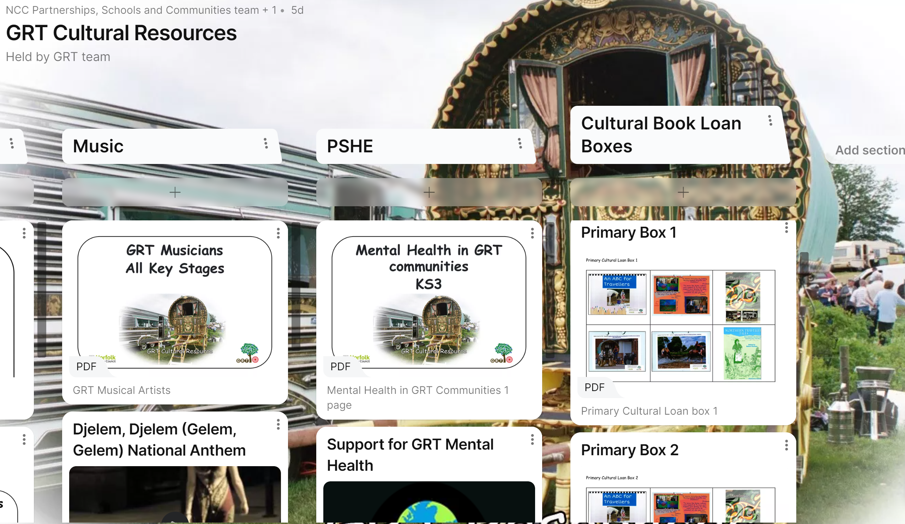
Providing a Culturally Inclusive Curriculum GRT PADLETS

Slide 10
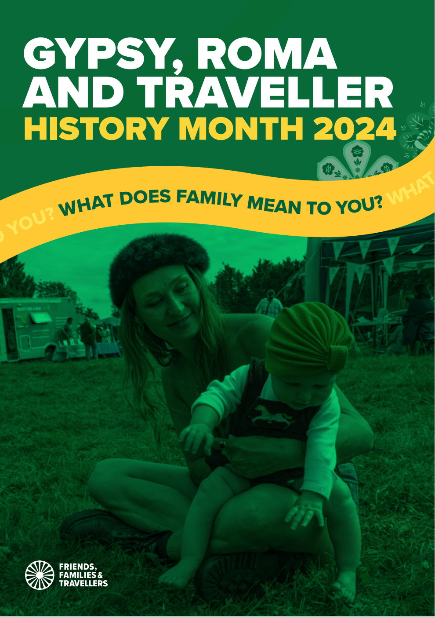
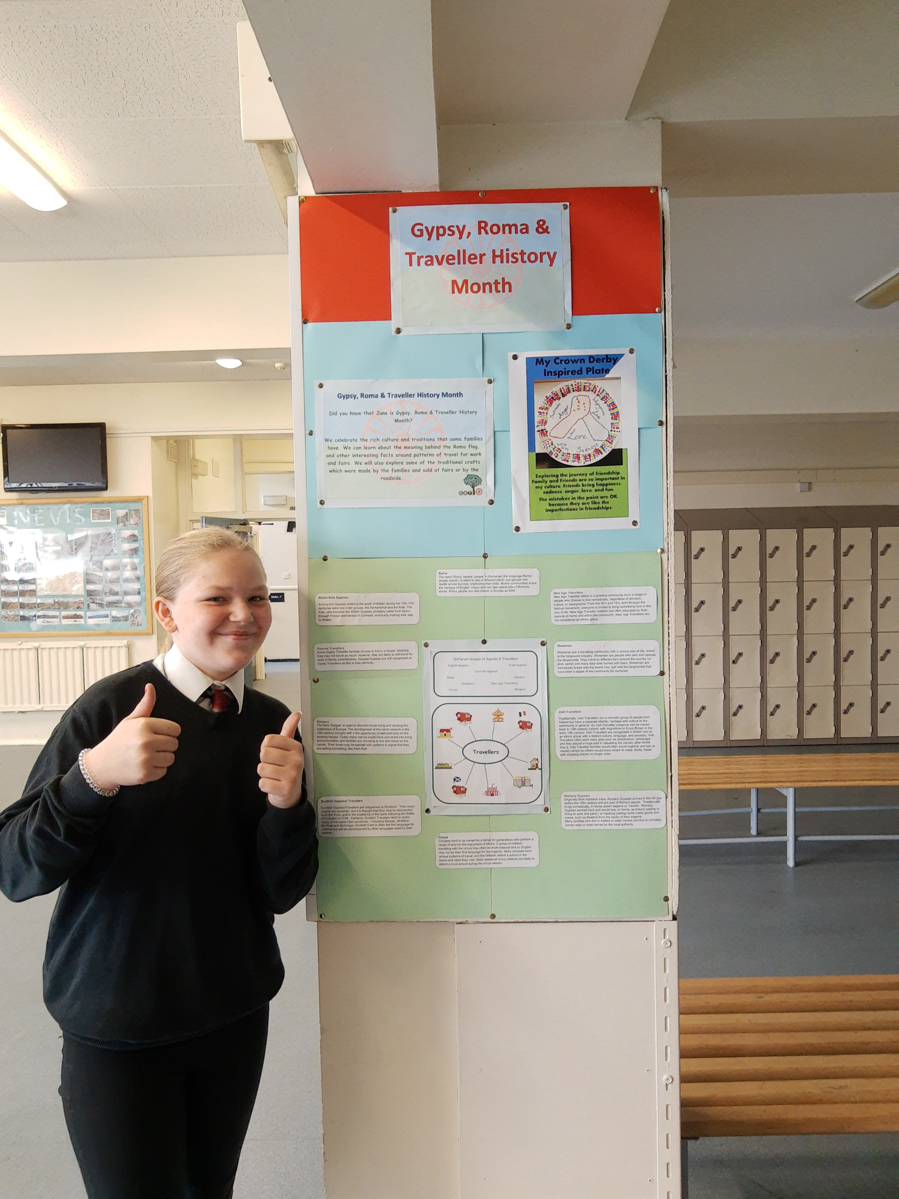
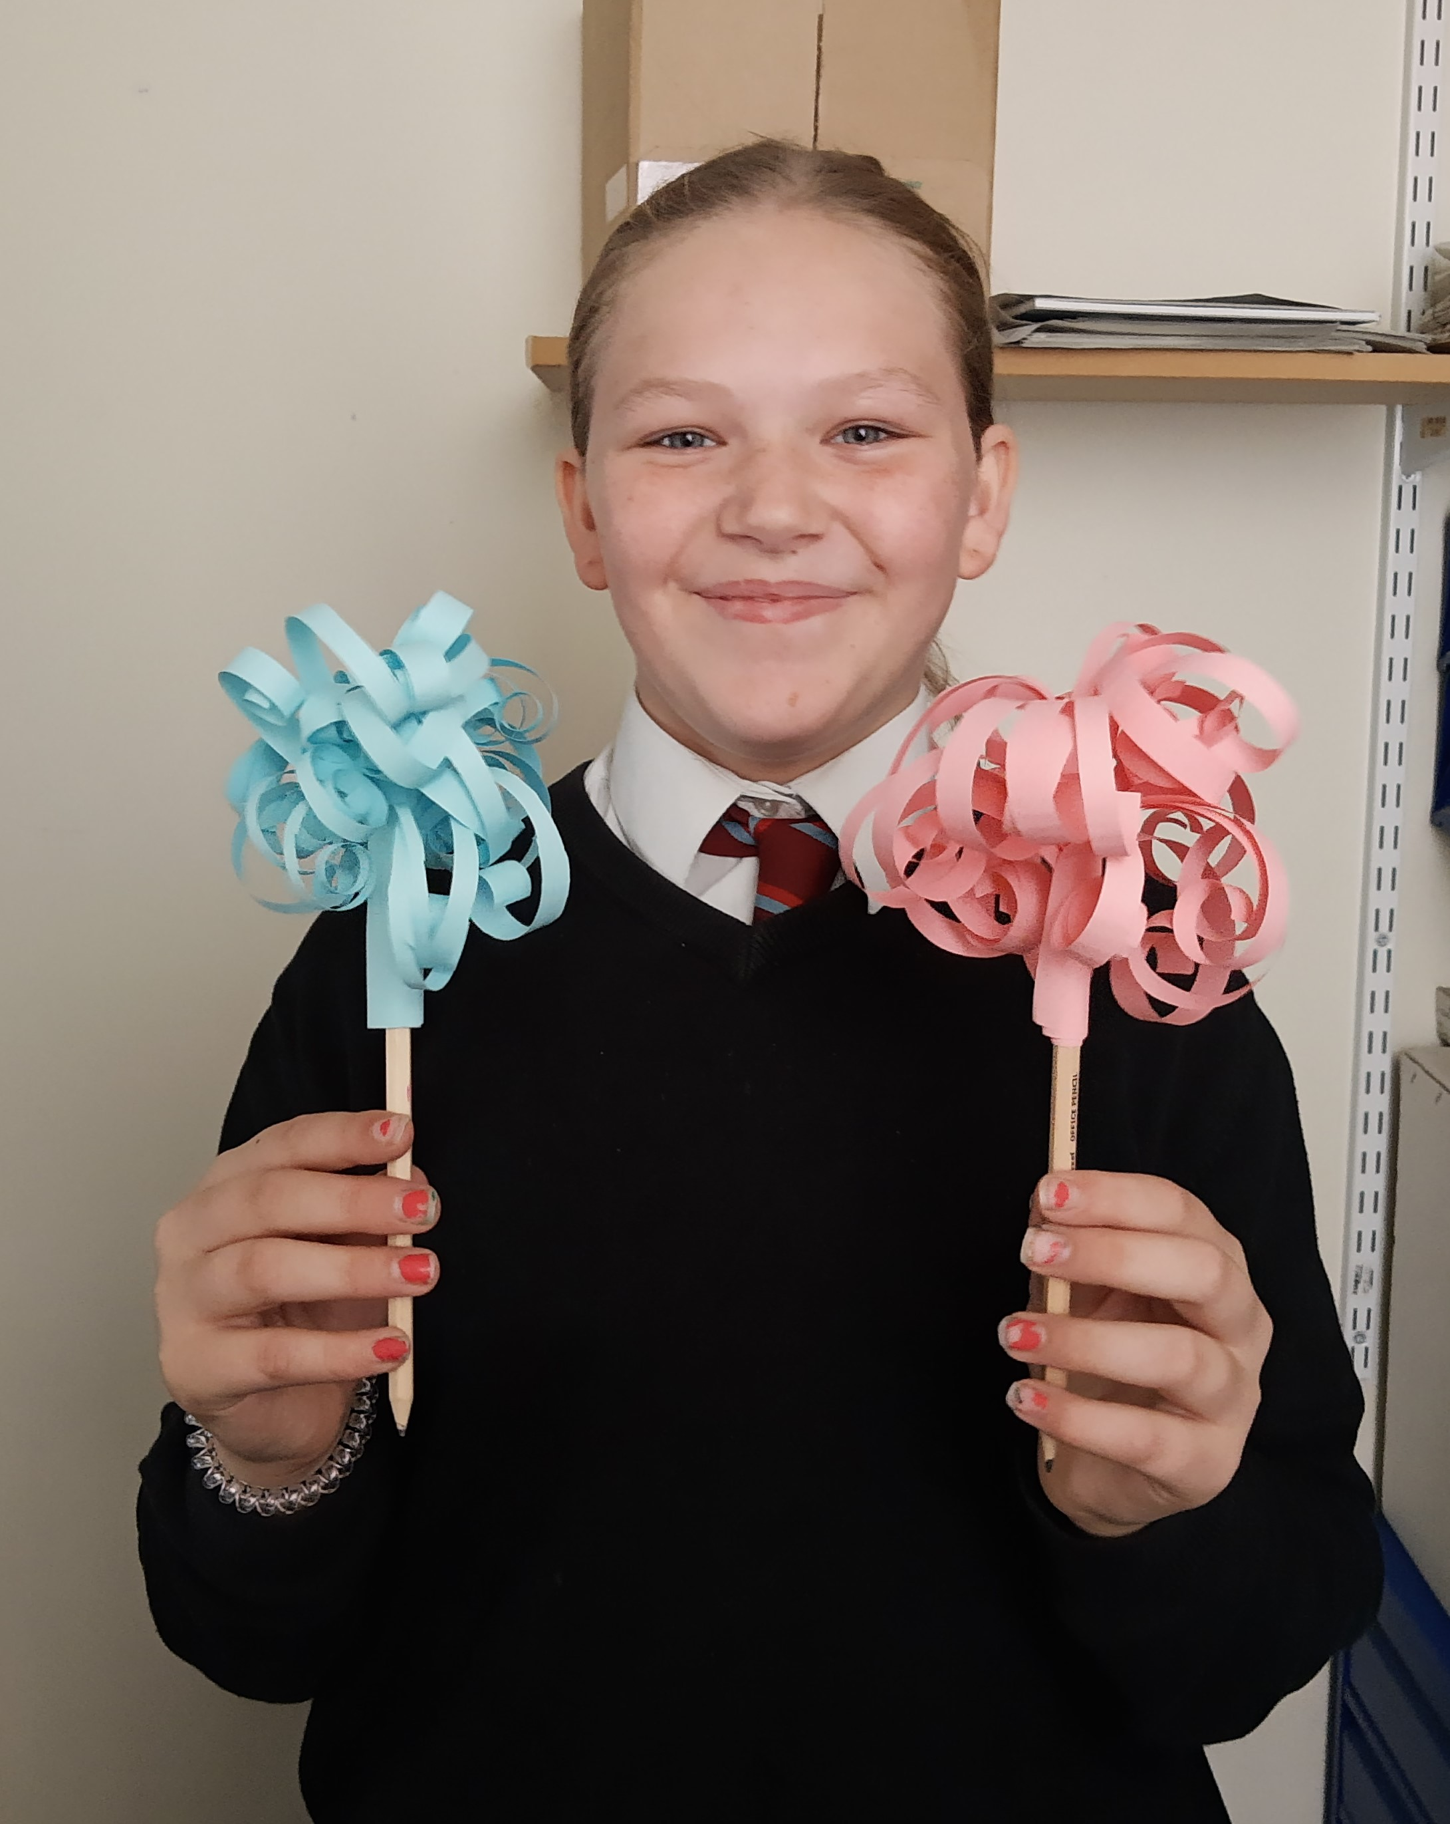
GRT History Month (GRTHM)
Every June since 2008, people from across the UK have celebrated Gypsy, Roma and Traveller History Month.
Through celebration, education and raising awareness, Gypsy, Roma and Traveller History Month helps to tackle
prejudice, challenge myths and to amplify the voices of Gypsies, Roma and Travellers in wider society.
The theme we will be exploring this year is “What does family mean to you?”, looking at the different shapes and forms family can take, the relationships we have with each other, and the importance of family as a support network. By the end, we hope schools and settings will have gained a deeper understanding of the richness of Romany Gypsy, Roma and Irish Traveller people, histories, cultures and traditions.
Notes:
Friends, Families and Travellers are a leading national charity where at least half of the Trustees, staff, interns and volunteers are from Gypsy, Roma or Traveller background.
For the past three years
Friends Families and Travellers have provided themes and resource packs for schools to celebrate GRTHM and the last three years have been:
‘Make some space’
The GRT Service in Norfolk asked schools and settings across the county to 'Make Some Space' for Gypsy, Roma and Traveller people in their curriculums.
‘What makes a home?’
As part of the theme, ‘What Makes a Home?’, we asked our Gypsy, Roma, Traveller CYP to tell us what they think of, when they think of home.
This statement from a Year 11 YP sums it up perfectly:
“Life is hard and keeping your home is hard. But when you are on the road with your family, that’s what makes a home. Home can be anywhere. Some people like certain places to stop, some people like site and houses. With my family is where I like best, it could be anywhere at all but it has to be where we can all be together and live our life.
Teacher(s) can help even the saddest child in school by just treating them like the others and not thinking they are different because they might not be in school that long. They need to listen and believe they are a good person. Not all of us are the same. My ideal home would be a wagon with a horse, red velvet beds and a nice pot over the open fire. I would invite all of my people in and those others who have been good to me so that they can see what our life is really like and how nice it can be. I wish all travellers good luck and hope they have a good life wherever they feel at home”.
‘Weaving Journeys: A celebration of Gypsy, Roma and Traveller lives, histories and cultures’

Slide 11
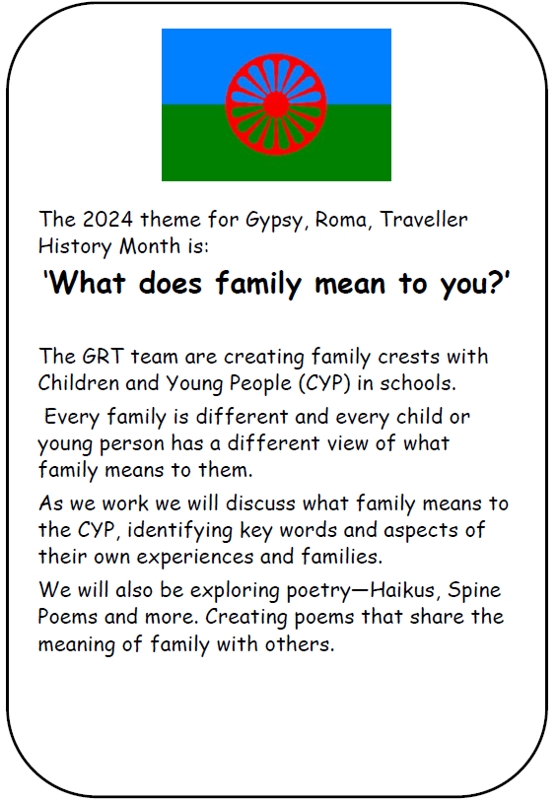
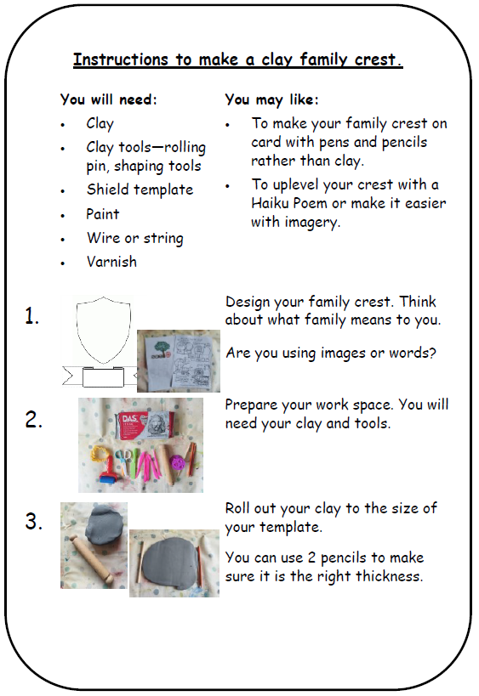
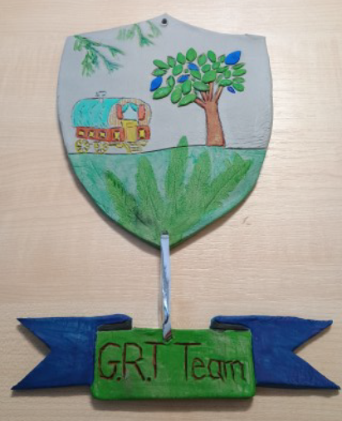
GRT History Month (GRTHM) 2024 What Does Family Mean to You

Slide 12
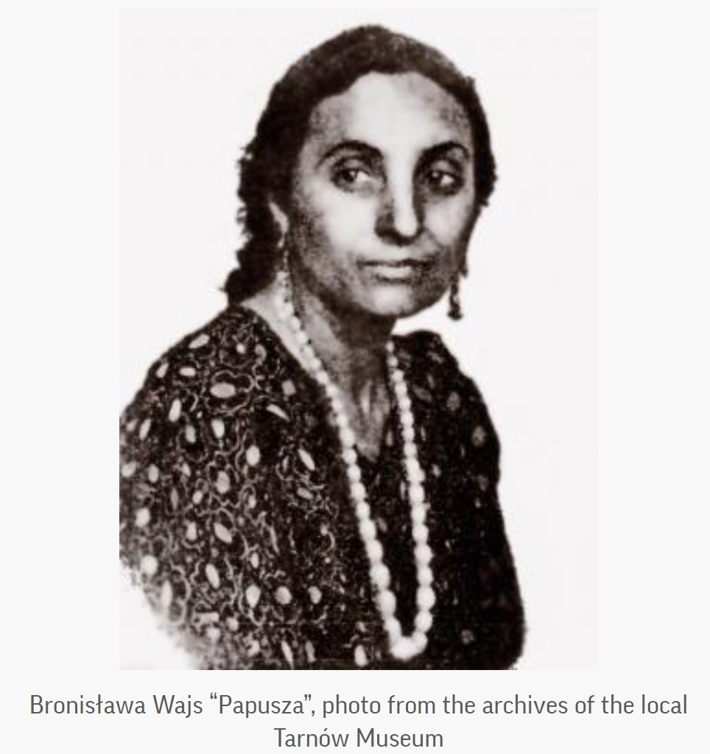
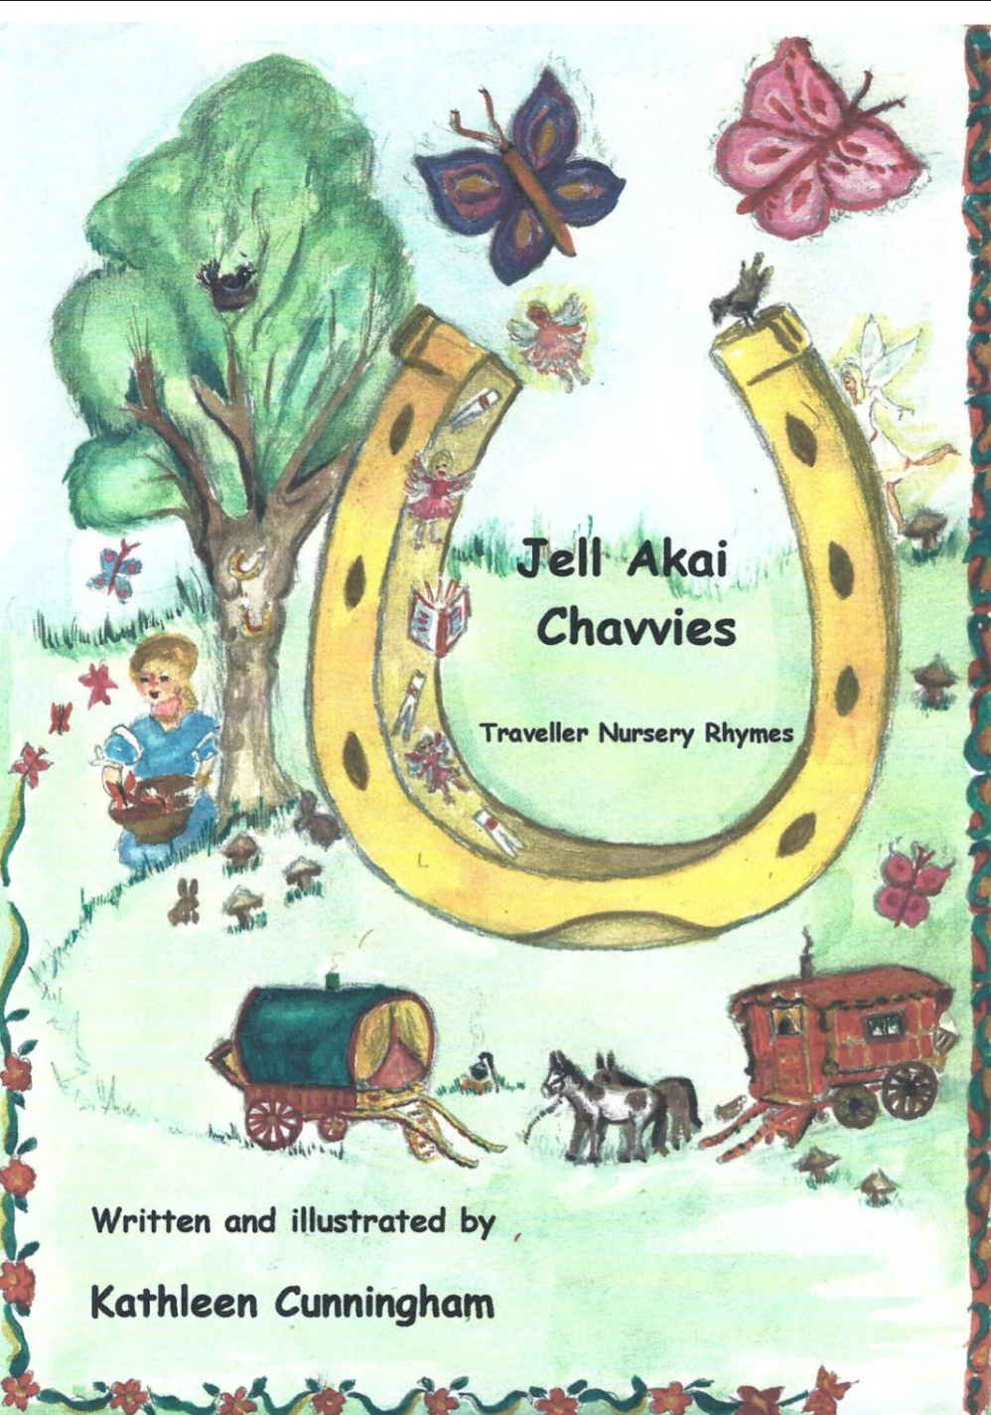

GRT History Month (GRTHM) 2024 What Does Family Mean to You
Poetry (Kathleen Cunningham, Bronislawa Wajs (Papusza), Charlie Barley and all his friends)
Scrollwork (Showmen)
Family Portraits
Selfie Cards

Slide 13
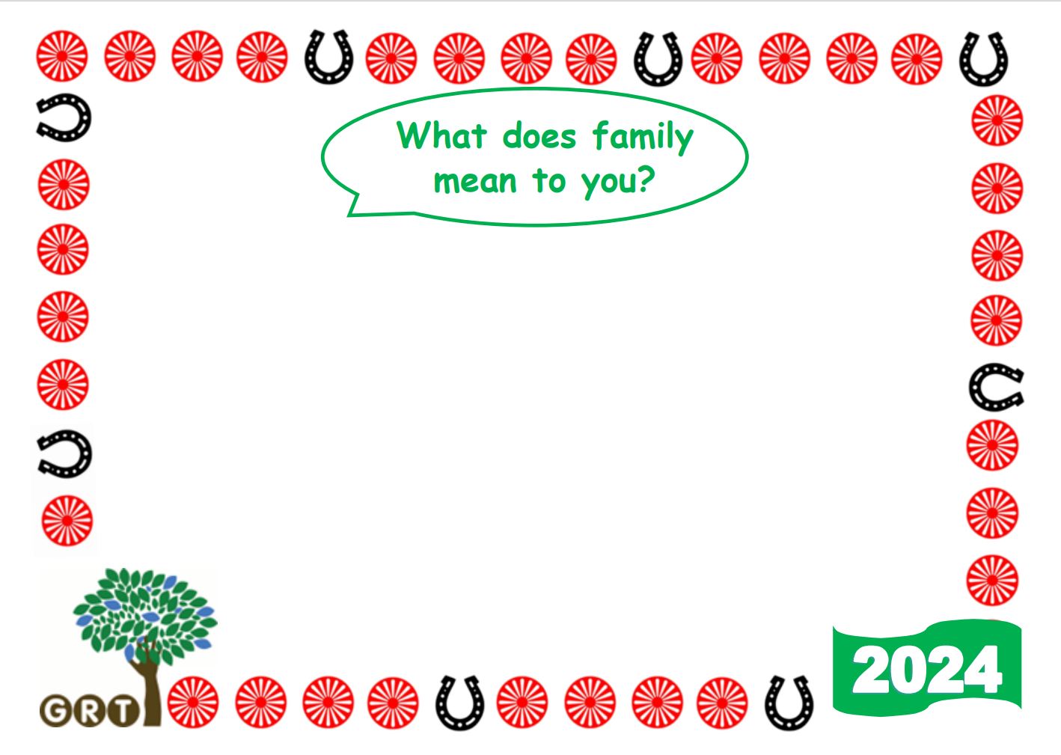
GRT History Month (GRTHM) 2024 What Does Family Mean to You

Slide 14
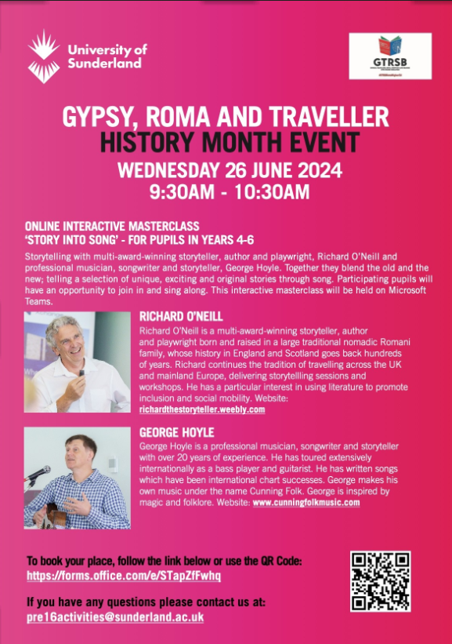
GRT History Month (GRTHM) 2024
Story Into Song Online Free Interactive Event for Pupils in Years 4 – 6
Storytelling with multi-award-winning storyteller, author and playwright, Richard O’Neill and professional musician, songwriter and storyteller, George Hoyle. Together they blend the old and the new; telling a selection of unique, exciting and original stories through song. Participating pupils will have an opportunity to join in and sing along. This interactive masterclass will be held on Microsoft Teams.

Slide 15

GRTHM Meets FLOURISH
child voice
“I live on site, close to others in my family. I love living there because I get to see family every day and I can learn about how we cook and clean and take care of each other ”
L
F
“They used to cook on a fire. You have 3 sticks and a rope or chain. Then you hang your kettle on it and hunt for food.”
“I want others to know about my family and how we live near each other and help. My Mum cares for my Granny and Granddad, just like they did for her grandparents. It’s just the way it is for us”
“'Gypsies can live in trailers, caravans, houses and mobile homes, they will still be a Gypsy because it is their ethnicity.”
“I am proud to be a Gypsy because I am different to non-Gypsy people and I can tell them about my way of life and they can learn we are interesting and nice.”
O
U
R
I
S
H
“Before she used to hide the fact that she is a Gypsy but now she is open and proud.” (teacher)
“I felt really scared to speak but once I got started it was good”
Notes:
Norfolk aims to be a county where all children and young people can flourish.
Much of the work we do in schools supports this ambition and here we have some child voice quotes from our work over history month. We would just like you to take moment to read these and see how you feel they link to the impacts of FLOURISH.

Slide 16
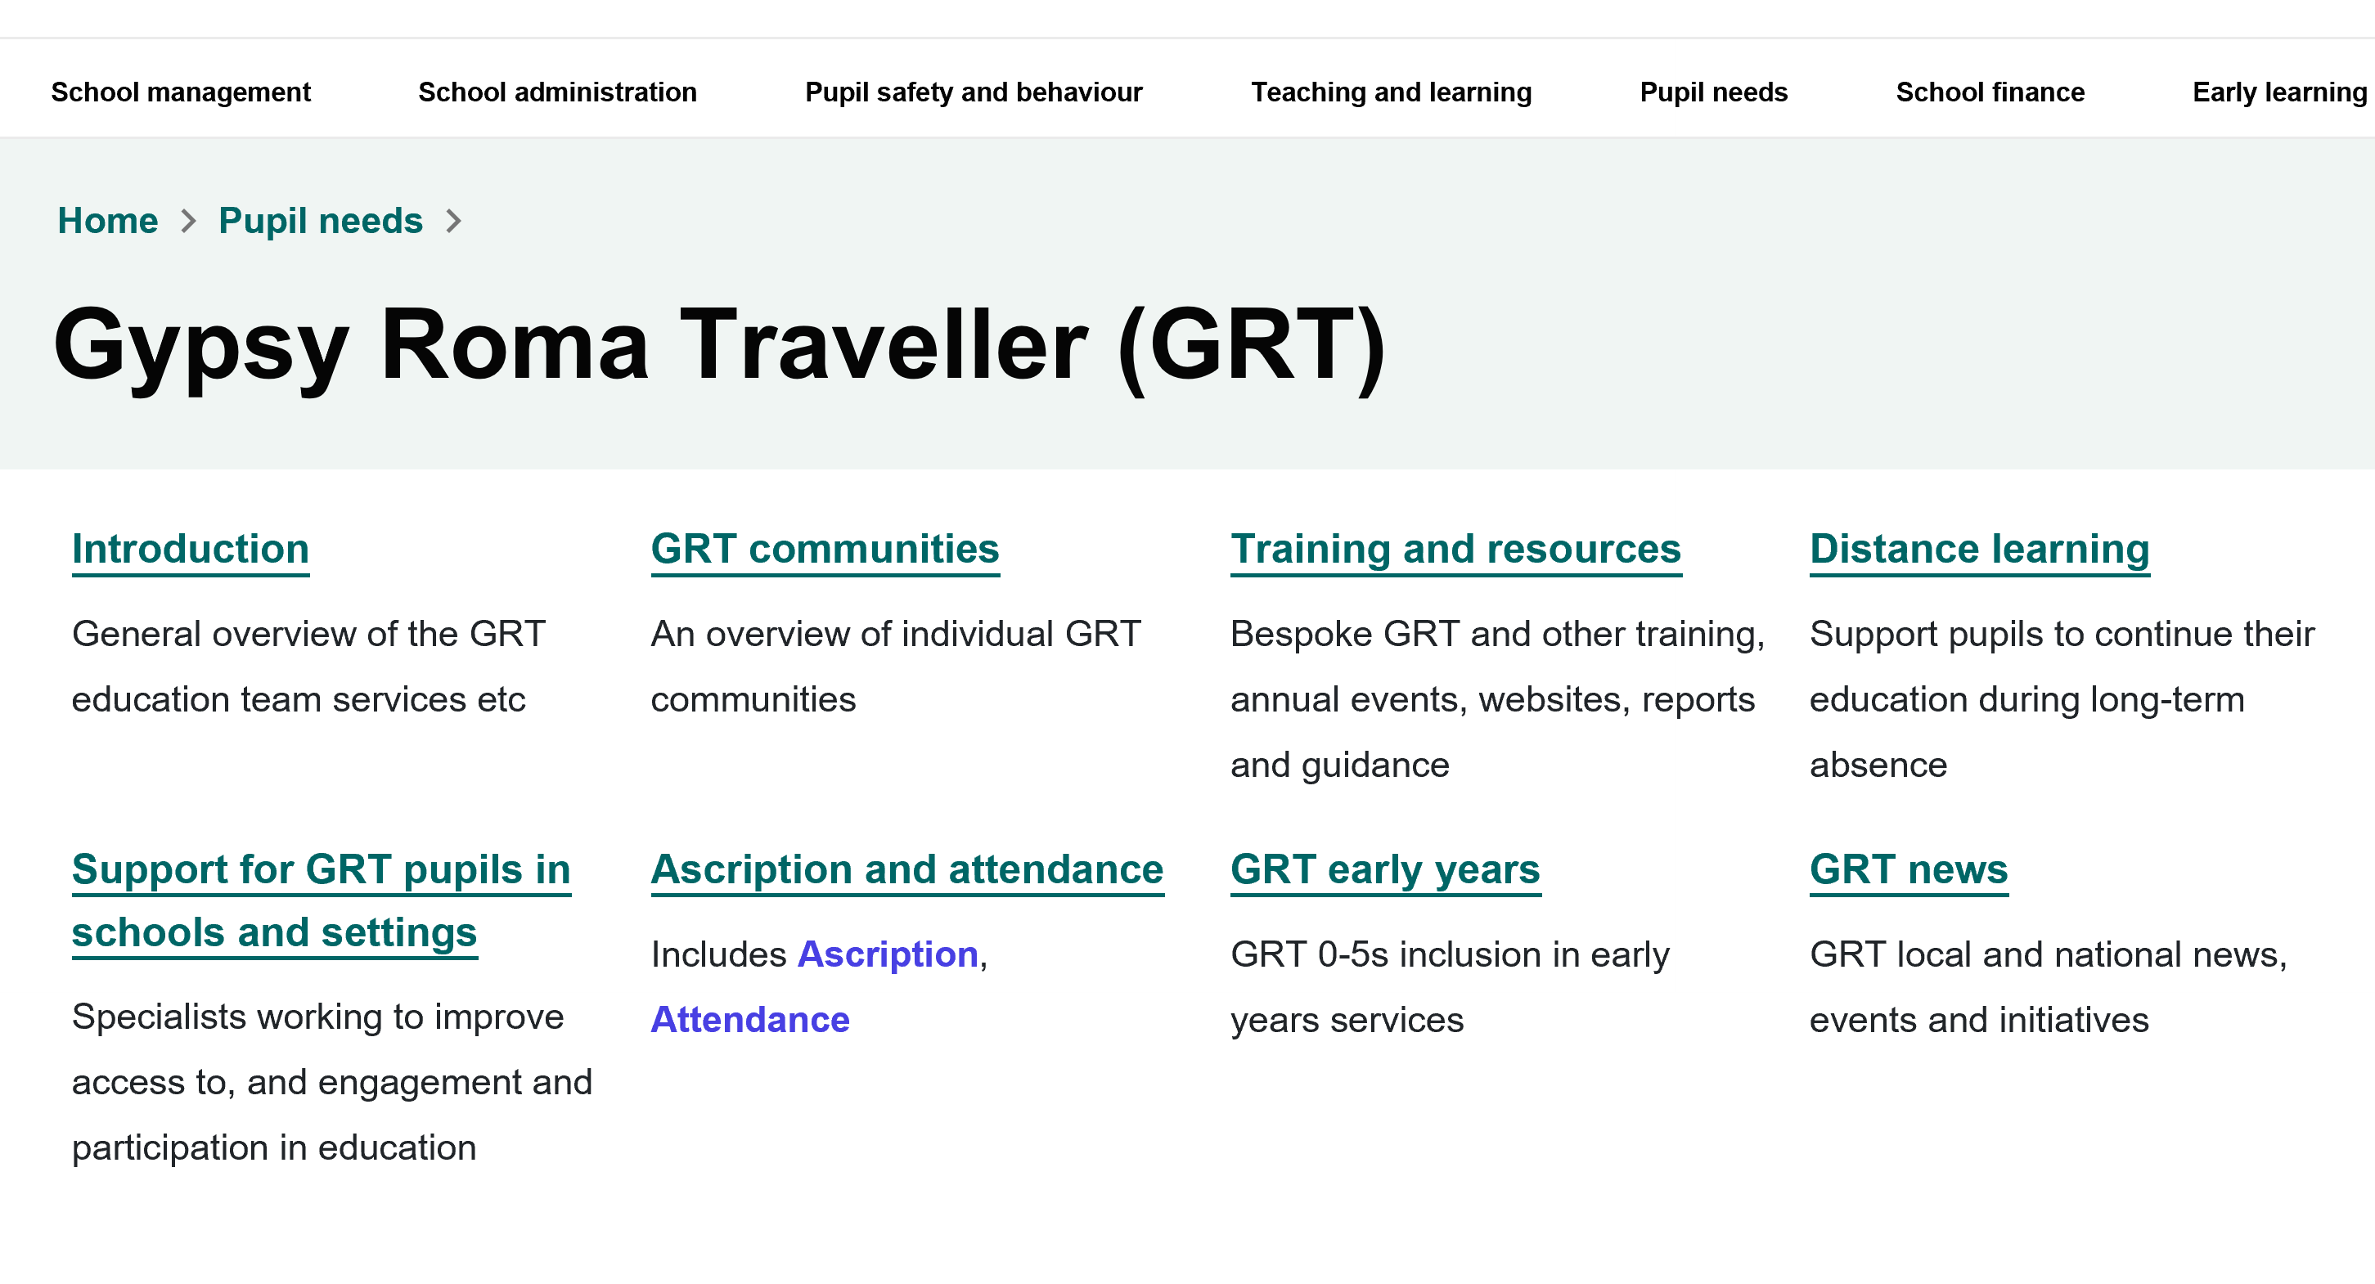
GRT Norfolk Schools Website
GRT Website: https://www.schools.norfolk.gov.uk/pupil-needs/gypsy-roma-traveller

Slide 17
Improving Outcomes for GRT Children and Young People GRT Service Partnerships, Schools and Communities
Any Questions?
GRT Website : www.schools.norfolk.gov.uk/pupil-needs/gypsy-roma-traveller

