Slide 1


Norfolk Multi-Agency Practice Week Conference
Igniting a passion for learning
Wednesday 22 May 2024

Slide 2


Program
3.00pm - Welcome: Sara Tough- Executive Director,
Children’s Services
3.15pm – Nina Jackson, International Education Consultant and author
4.00pm – Break
4.15pm – Nina Jackson with Norfolk in Care Council and Leon Russo, Participation Officer
4.45pm – Sarah Shirras, Executive Headteacher, The Hive Federation
of Brundall and St William’s Primary Schools

Slide 3

Nina Jackson

Slide 4

Igniting a passion for learning
‘Access All Areas'
‘Every Learner Has Magic’
Norfolk Multi-Agency Practice Week Conference
Wednesday 22nd May 2024
Nina Jackson
@musicmind

Slide 5
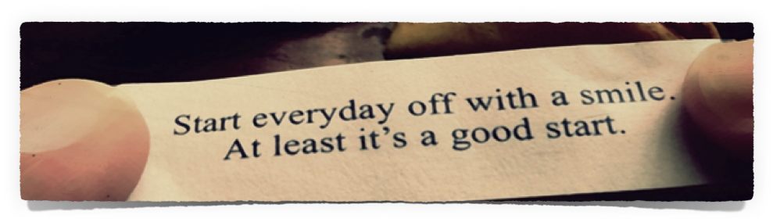

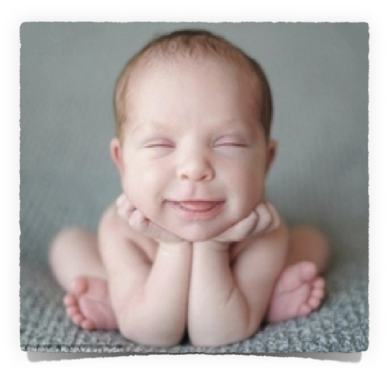
Good afternoon everyone

Slide 6



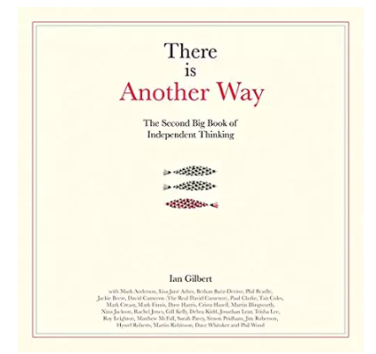



Who am I?
Always a teacher
International Mental Health Advisor
Pastoral & Pedagogical Champion
Independent Thinker
Award winning speaker & author
SEND & CBT, Psychology, Mindfulness & Life Coach
Apple Teacher
Lover of life and laughter!
Always Learning

Slide 7

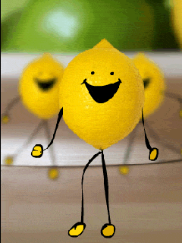

This is how excited I am to be
working with you all!

Slide 8
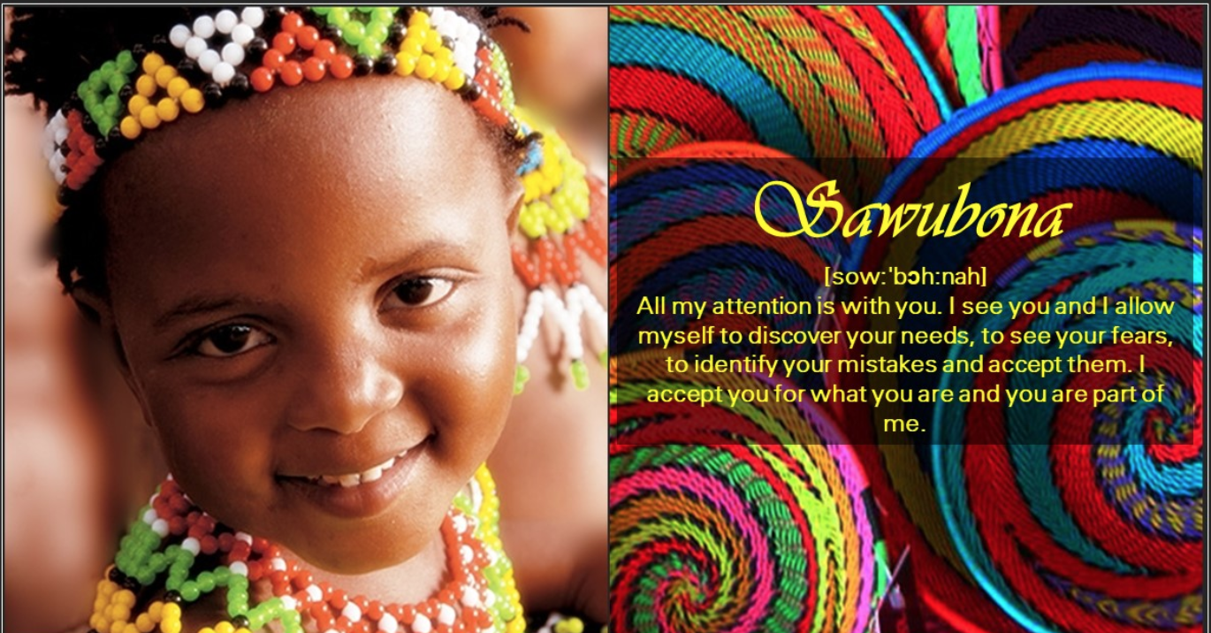
Sawubona
A Zulu greeting - meaning ‘I See You’
More than words of politeness, ‘Sawubona’ carries the importance of recognising the worth and dignity of each person.

Slide 9


Slide 10

Created with Haiku Deck

Slide 11
Overview of Session
Igniting a passion for learning
What
do we need to do
Why
do we need to do it
How
do we do it
Awareness - Understanding
Application - Growth - Hope
Purpose

Slide 12
During our session together I’d like us to:
Interact as much as possible
Make it a safe environment for you to ask ANY questions
Share your own knowledge, skills and experiences
Have a positive learning experience together
👍

Slide 13
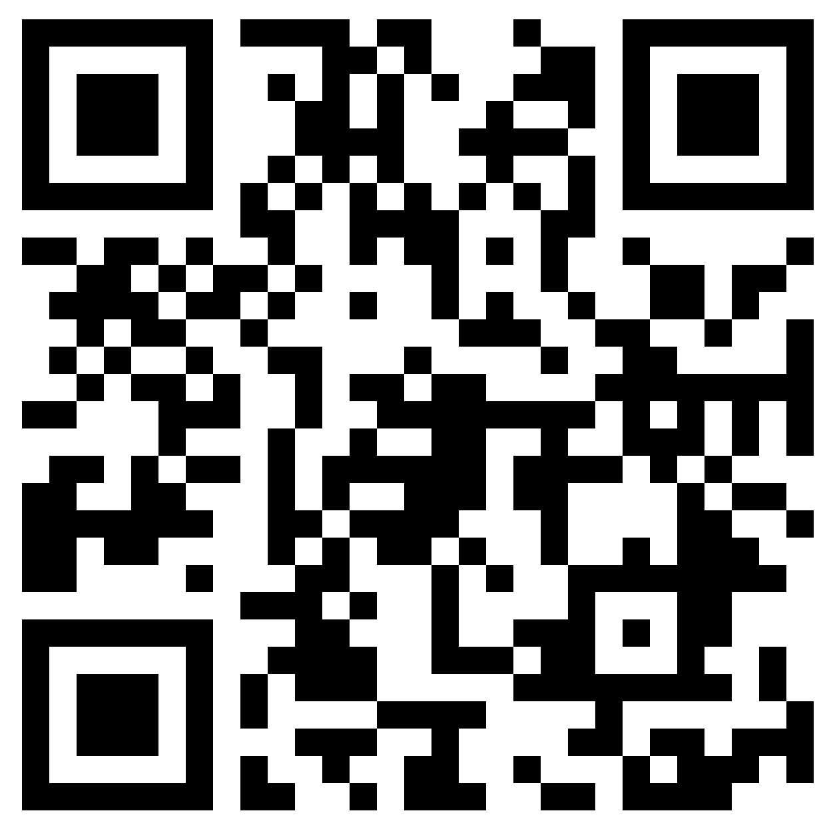
Let’s all join the Padlet Wall
https://padlet.com/tlcninajackson/22ndMay2024

Slide 14
I Care, You Care, We Care
Anything is possible
We focus on the challenge to identify it. Our energy is spent on finding a solution
Every human matters

Slide 15
Does learning only happen in a school?
Does learning only happen when something is taught?
What have you learned this week?
Every day is a learning day. How do we ignite the passion?
Every human matters – every human learns differently

Slide 16
One size does NOT fit all!

Slide 17

Neurodiversity is an inclusive term that acknowledges the fact that people with learning difficulties have a unique experience of the world that can bring many benefits. They may struggle in some areas but excel in others.

Slide 18

Neurodivergant learners…….
interpret, interact and experience the world in different ways
Neurodiversity helps to reduce stigma around how
different people learn and think differently from others.

Slide 19
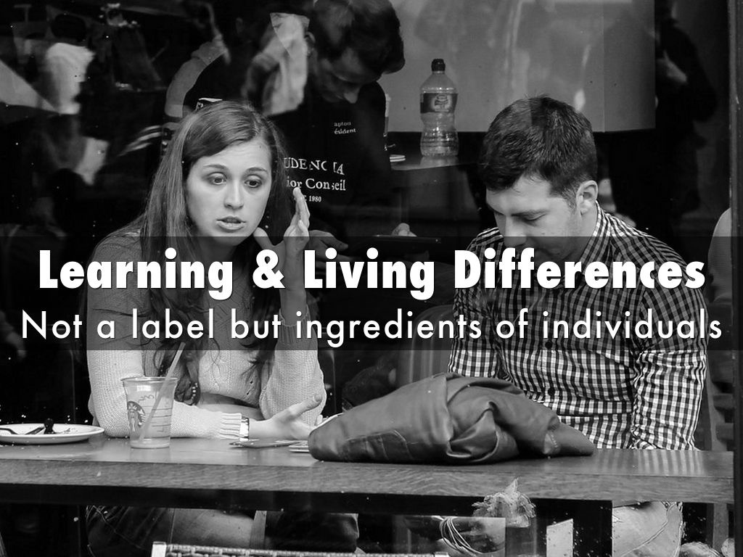

Slide 20
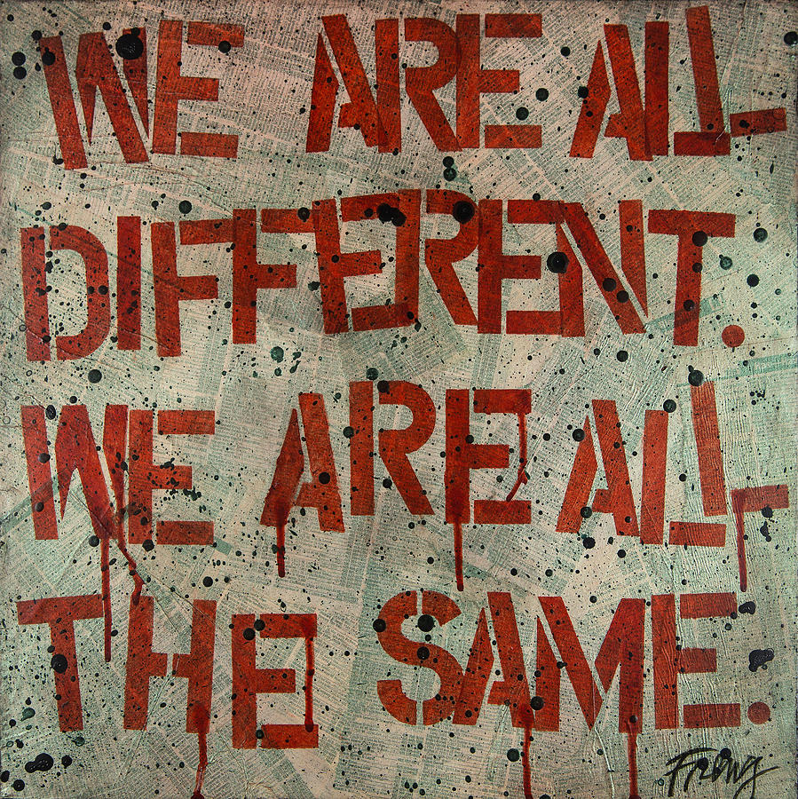

Slide 21
Adaptive Teaching & Practice
Differentiated classrooms and learning spaces support students who learn in different ways and at different rates and who bring to school different talents and interests….
Tomlinson, Carol Ann. The Differentiated Classroom: Responding to the Needs of All Learners, 2nd Edition
Their Magical Ingredients,
Learning and Living Differences

Slide 22


Slide 23
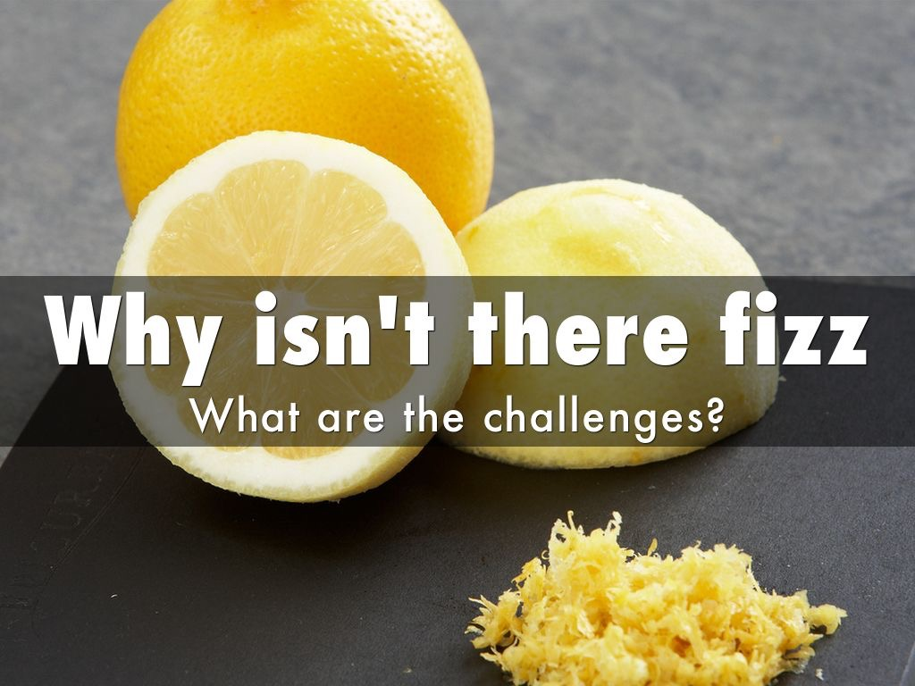

Slide 24
What do we want for our learners?
Outcomes for Learners
Be Healthy
Be Safe
Enjoy & Achieve
Positive Contribution
Well-being
Economic and Self

Slide 25

Setting the
Learning
Temperature
Making learners feel they matter, belong and have a purpose to be there

Slide 26
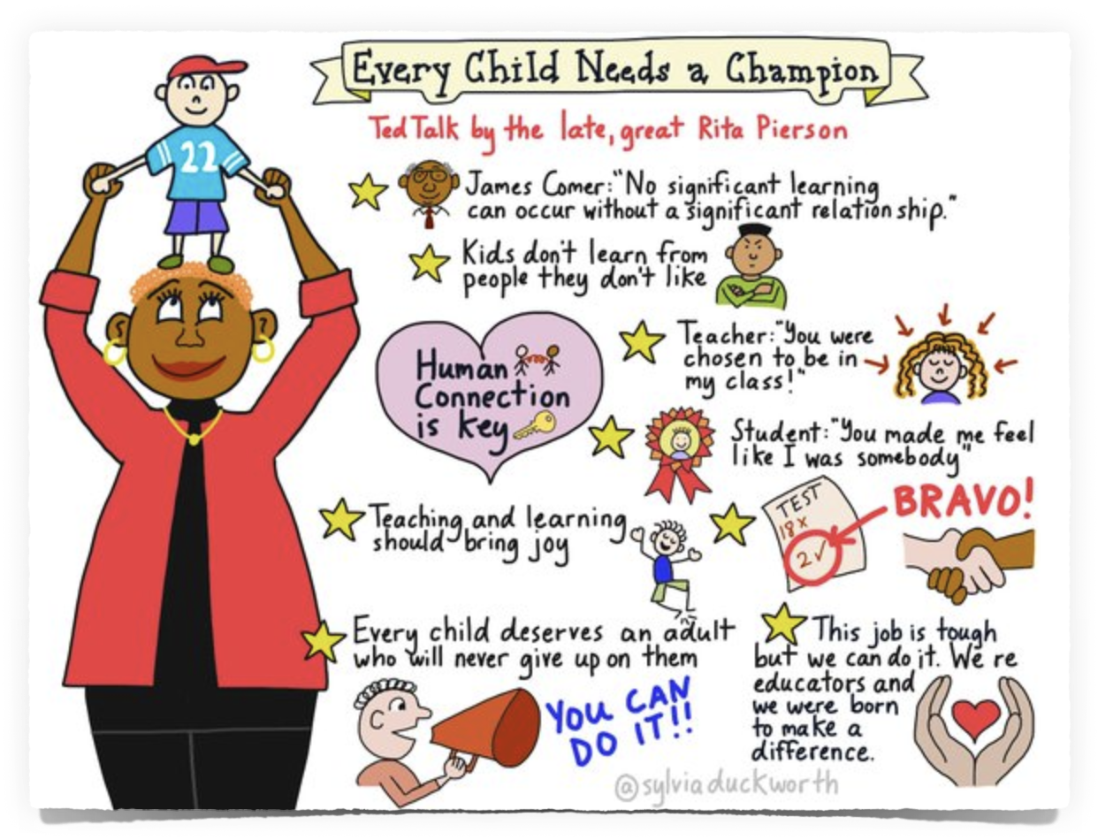

Slide 27

Nina Jackson
@musicmind

Slide 28


Slide 29

A great overview
Information = Great v Visualisation?

Slide 30
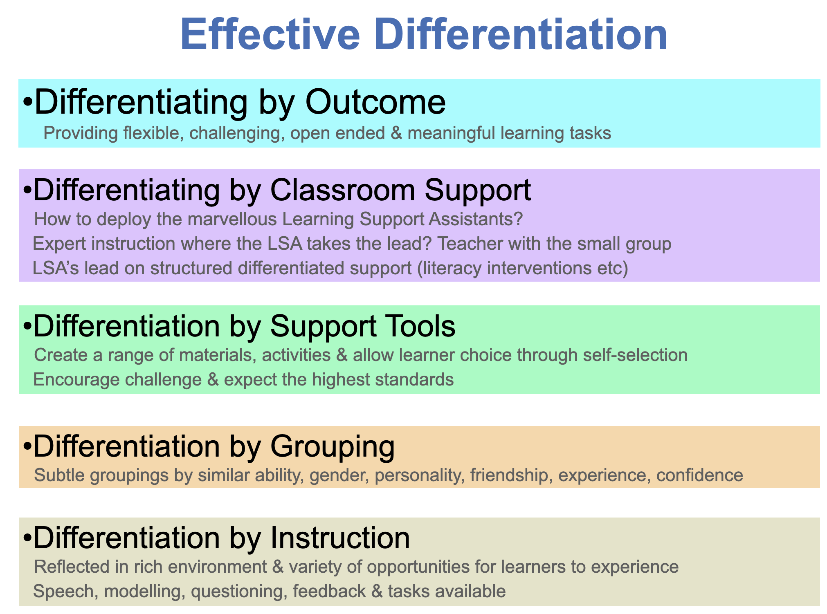
Effective Differentiation

Slide 31

TIME & PACE
The timing of how you release content during the lesson is crucial
Where and when you release it
Time for processing
This will determine the level of engagement from you students

Slide 32

INTERACTION
In order to learn we have to be able to interact with differing tools and learning possibilities aswell as the content
Interact with the information, apply, review and revise
Using adaptive practice is essential

Slide 33
Conclusive Inclusion
Inclusion is:
Celebrate each learner’s individuality
Giving each student flexible learning experiences
Taking into account the views of other and valuing all contributions
Understanding different cultures and communities as well as your own

Slide 34
Conclusive Inclusion
Looking at the needs of the whole learning community
Guarantee the basics and fundamentals of good education for all in terms of teaching and learning
Reflection on educational practice and understanding the context of the learning environment
Knowing and developing effective relationships with each and every student/pupil

Slide 35
Conclusive Inclusion
Making everyone responsible for the needs of individuals
Ebracing diversity in all its forms
Differentiation being at the heart of the school and every learning experience
Constantly reflecting on classroom practice and making adjustments to the learning

Slide 36
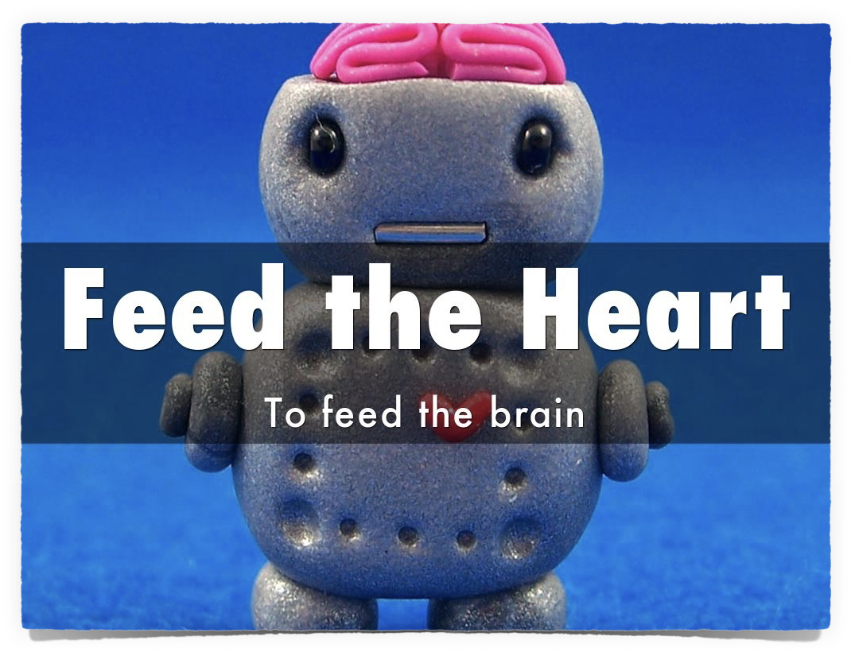
Happy
Healthy
Safe
Secure

Slide 37

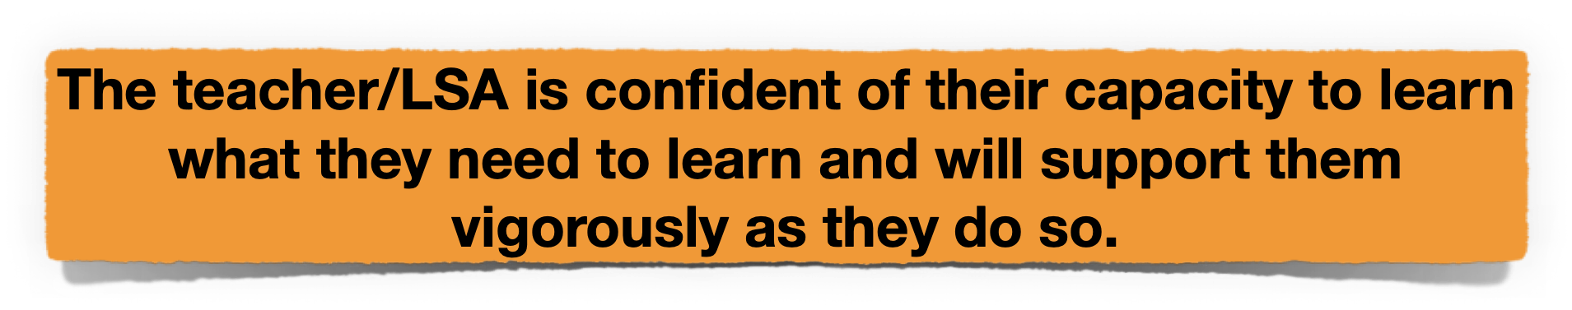

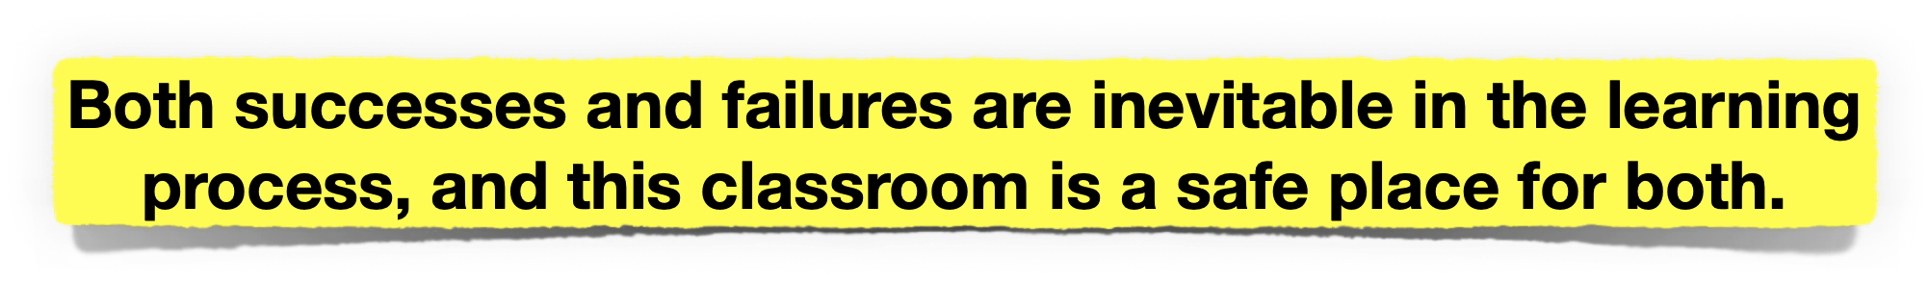
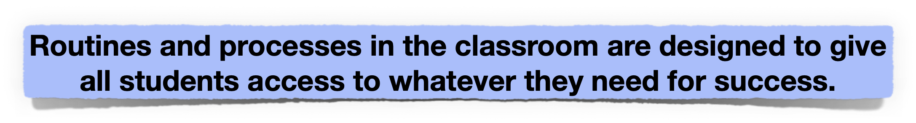
Actively support learners
and learning
It begins with helping students understand that:

Slide 38
Learning
Relationships
Knowing me,
Knowing you.

Slide 39
Happy
Healthy
Safe
Secure

Slide 40
3 Key Aspects to Differentiation
Readiness
to Learn
Learning
Needs
Engagement
Tools

Slide 41

Created with Haiku Deck

Slide 42



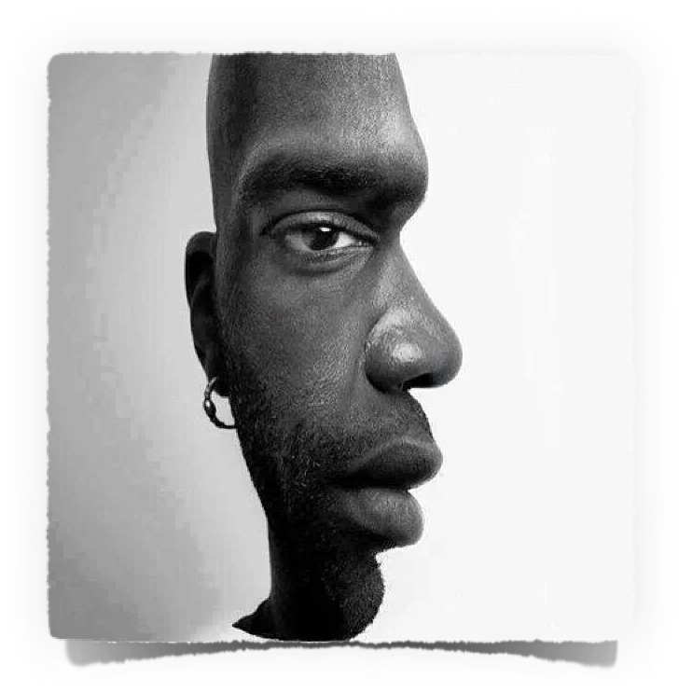
What do you see?
All our brains
are different

Slide 43
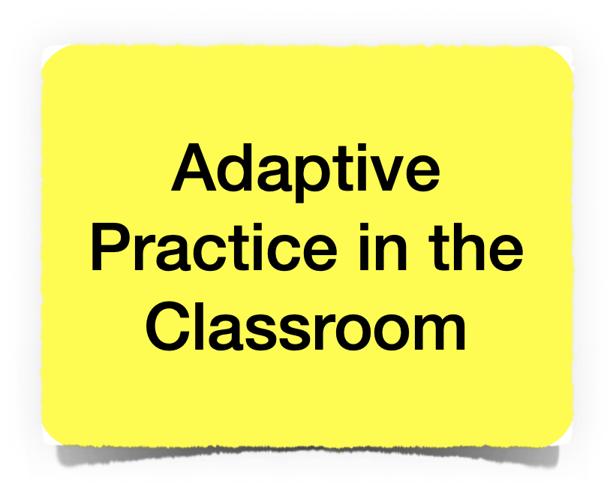
Task
Outcome
Assessment
Resource
Questioning
Support
Pace
Role
Grouping

Slide 44
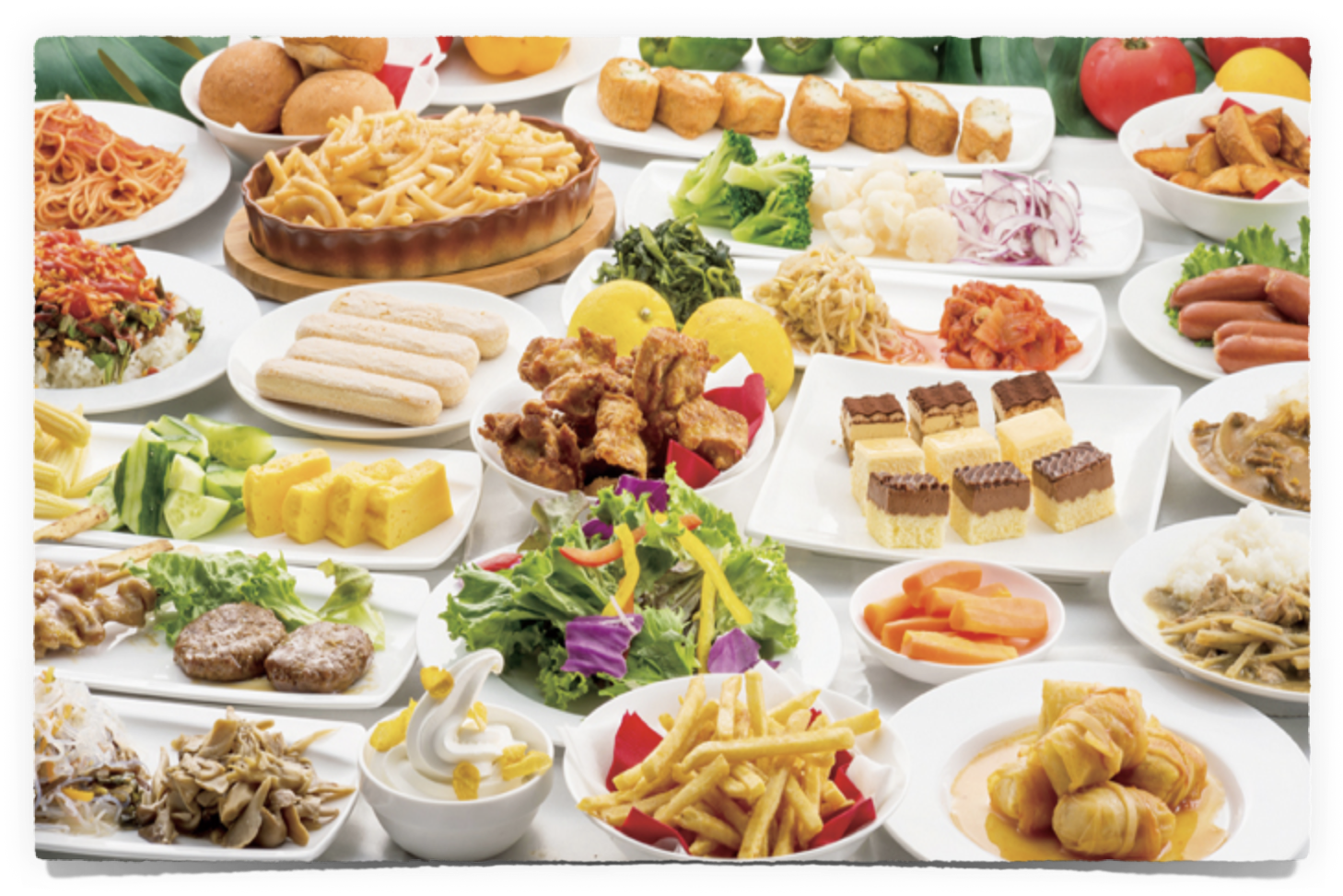
Your Learning Buffet!

Slide 45
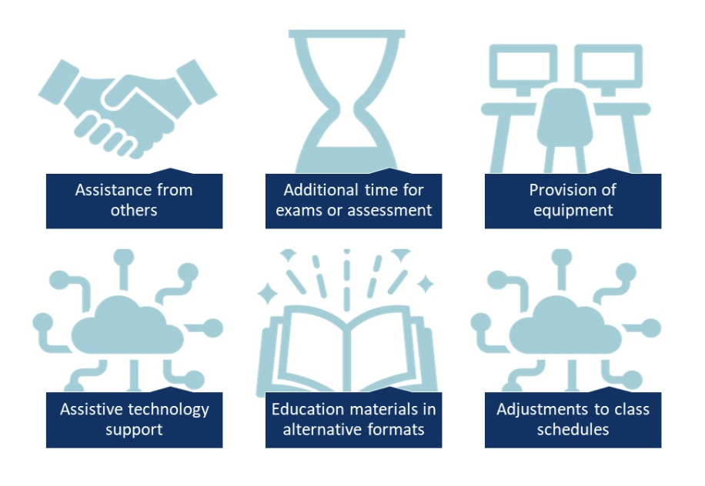
Reasonable Adjustments

Slide 46





Differentiated Learning
Diverse Learning Opportunities & Strategies
Experience learning, thinking, retrieval & reflection.
Give them opportunities to:
Write it….
Speak it….
Record it….
Share it….
Store it….

Slide 47



Differentiation for ALN using
accessible technology
Speech to Text
Instant application
Sharing & Storing

Slide 48

This is Brighton
https://vimeo.com/34381687

Slide 49

Most important consideration
Unconditional Positive Regard

Slide 50
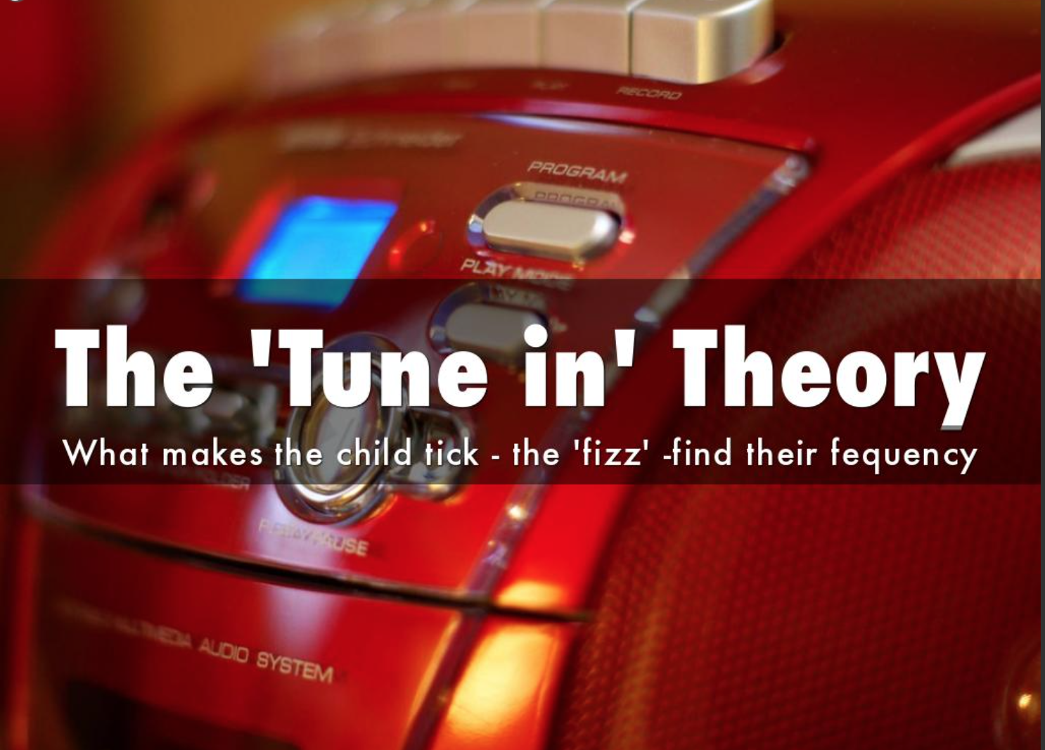

Slide 51
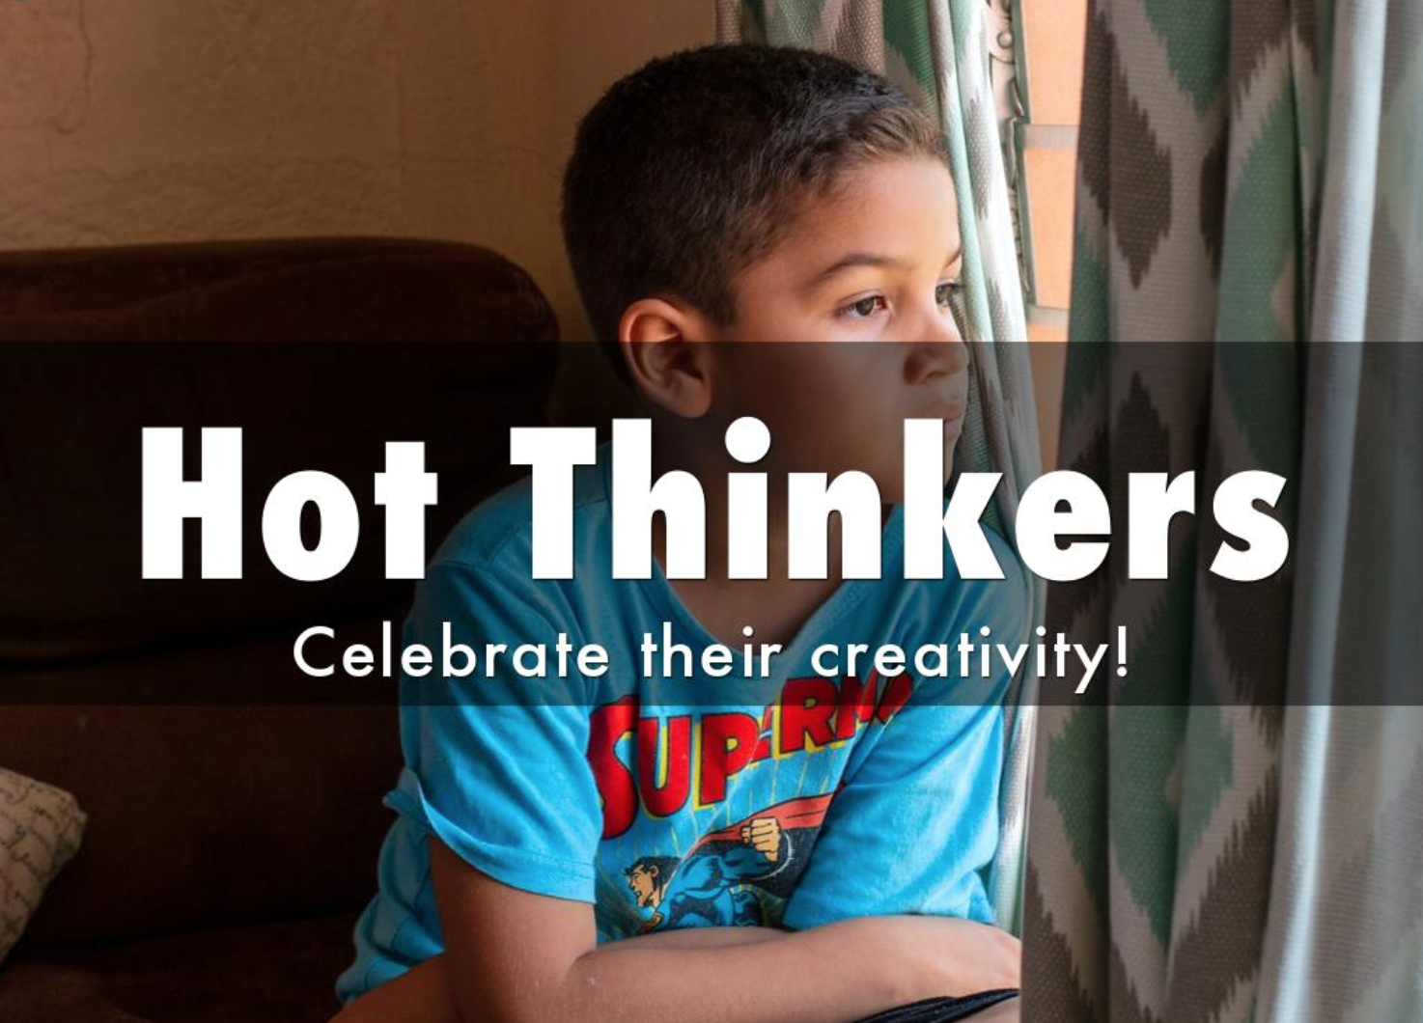

Slide 52
Think of the learning with these?

Slide 53

THANK YOU
for all that you are
and all that you do
for the young people
in your school,
for each other,
and the wider community.

Slide 54

The Starfish Story - A Teacher’s Influence.
https://www.youtube.com/watch?v=uytlJ8urv4I

Slide 55
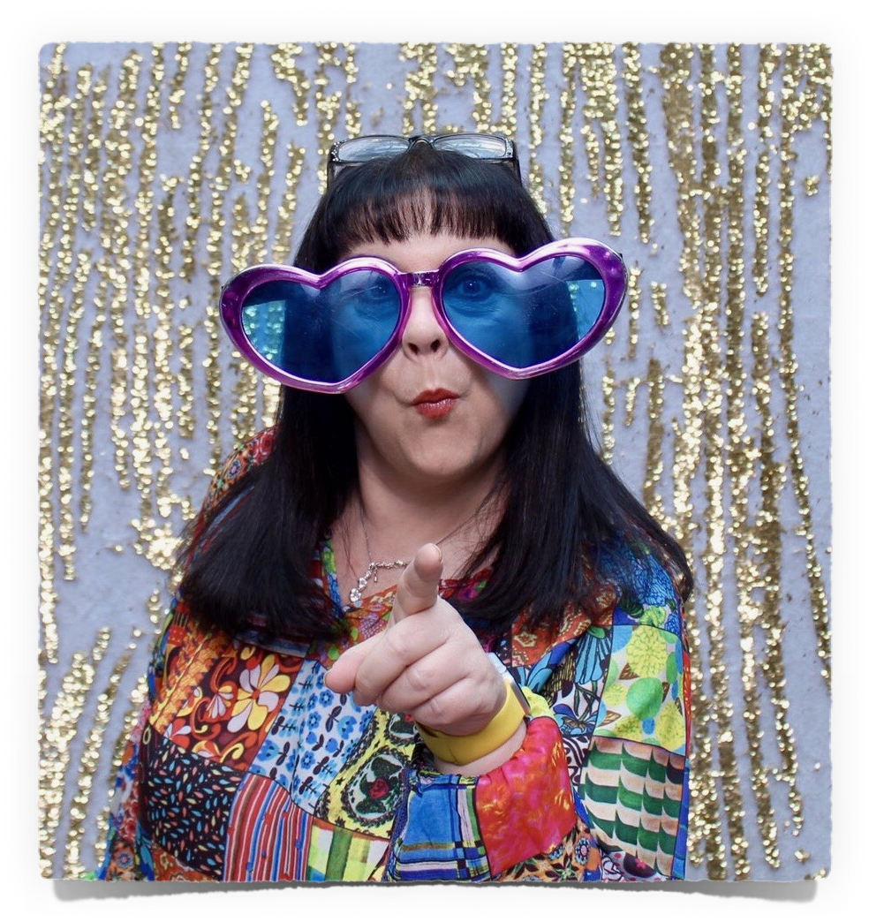
Thank You
Much Love
Nina
@musicmind
Email: tlcninajackson@gmail.com

Slide 56
Nina Jackson with
Norfolk in Care Council
and Leon Russo

Slide 57
Sarah Shirras
Executive Headteacher
The Hive Federation of Brundall and St William’s
Primary Schools

