Slide 1
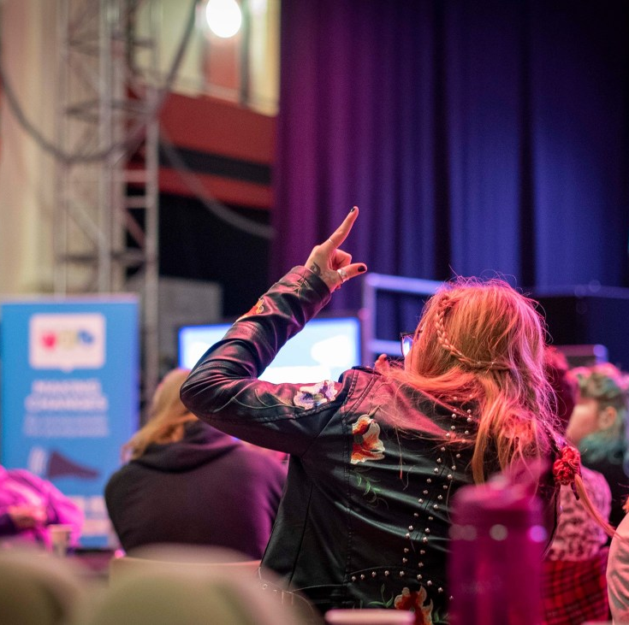

Talking with
teenagers
Supporting adults to feel comfortable engaging with teenagers and supporting young people to have a true voice

Slide 2

Outcomes
Outcomes
Learners will know how to show ‘Positive Regard’ and reciprocity with teenagers
Learners will understand the importance of ‘Reflective Practice and Authenticity’
Learners will develop knowledge of the ‘Legal Rights’ of teenagers in the context of the UN Convention of the Rights of the Child
Learners will understand how to create a ‘Safe Environment’ for communication and participation

Slide 3
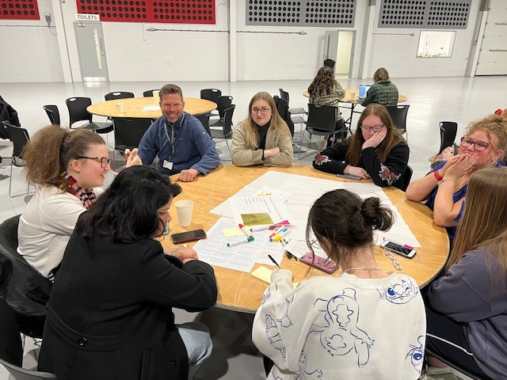
New Course Content
Learners will understand what young people need from adults
Teenage Language
Teenage culture
Meeting the young person where they are at?
Trauma informed
Notes:
Delegates will have a look at the Youth slang and then match it to a meaning on the right

Slide 4
Feedback from Young People – Youth Voice - 3rd April 2024
Answers Q1- What do you think adults need to know and understand about young people in 2024
Our brains don’t work like their’s
Don’t go by stereotypes
Different perspectives
Young people are people too.
That we have knowledge of social & political issues even if they don’t affect us
Ask open questions – don’t expect a typical idea or suggestion, be open minded
We’re not lazy we are tired
We have social intelligence too
Social media and adults supervising more
Mental health isn’t what it used to be
Believe us we are not attention seekers

Slide 5

Feedback from Young People – Youth Voice - 3rd April 2024
Answers Q2- What support might you need as a young person now or in the future from adults?
Teach us about the financial world
Living sustainably
How to save money, time, effort
How to talk to someone else properly
Multi-Tasking
Learn how to live alone as an adult
Mental/physical support
Wellbeing activities
Homework support
Better support in school
Notes:
young people feedback - Search Images (bing.com)

Slide 6
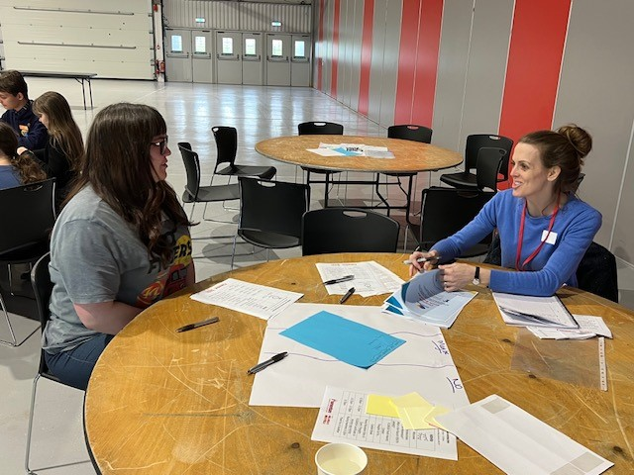
New course content
Learners will know how to show Positive regard to teenagers
Strengths based
Positive re-enforcement / Positive noticing
Seeing the whole person
Empathy

Slide 7
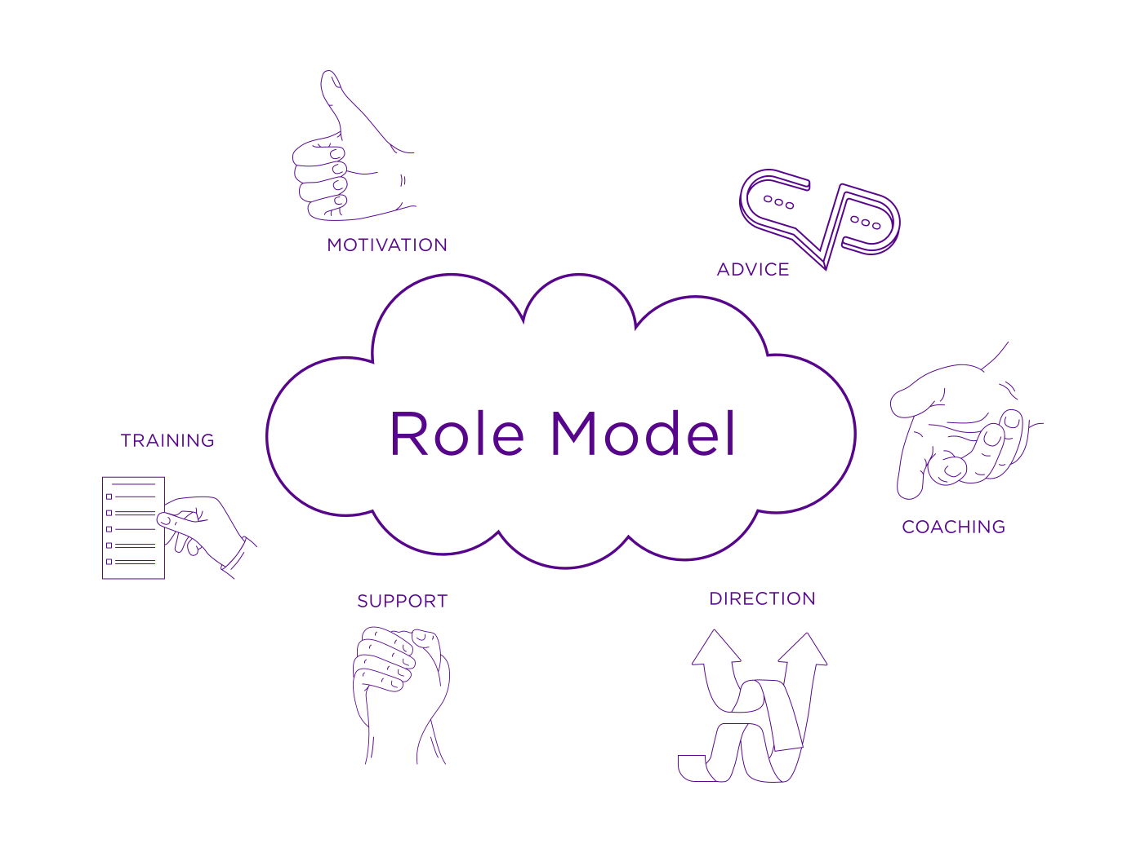
Feedback from Young People Youth Voice - 3rd April 2024
Answers Q1 - How can adults talk with teenagers to build their confidence and self- esteem?
Think before you speak
Don’t be rude, don’t shout
Good body language – Eye contact
Being open, not to full on, not stopping us from being ourselves
Not-patronising, equally don’t talk to complex
Not alienating, like we are adults = Respect
Positive affirmation
Complimentary – Not just looks
Morally & socially correct
Don’t look down on them, respect goes both ways

Slide 8
Feedback from Young People Youth Voice - 3rd April 2024
Answers Q2- Can you tell me about a time when an adult made you feel positive about yourself?
When a teacher in English gave positive feedback
In sport
When feedback is mature and not just negative
Positive re-enforcement
Speaking respectfully, saying nice things to a teenager
Complimenting the little things
Talk about things that their good at or like doing, compliment them on the things they are good at.
I can care for a Youth worker as well as she cares for me.

Slide 9
Positive Regard
What is this?
It is a term used by Carl Rogers to define some key qualities that are needed to support relational practice and to facilitate learning within the context of a positive relationship.
Realness – The worker or facilitator is a real person, sometimes the term ‘Human First’ is used to describe this quality. This is where a worker can enter a relationship with a young person or colleague without presenting a façade. The worker is in touch with their feelings and are conscious of these whilst engaging with others and can communicate them if appropriate.
Prizing, acceptance, trust – This is where a young person or colleague is valued ‘prized’ for their feelings, opinions as a person. It is a caring approach, an acceptance of the individual having worth. It is a trust and belief that this person is trustworthy and that they have many feelings and potentialities.
Empathic – When the worker can understand the young person or colleagues' reactions from the inside and has a sensitive approach to the needs of the young person or colleague to support their participation fully in learning or co-production. To understand and not evaluate, judge and to see the needs or situation soley from their experience and point of view.
https://infed.org/mobi/carl-rogers-core-conditions-and-education/
Notes:
Solihull and Reciprocity – Containment – Behaviour Management
Appreciative Enquiry – Signs of Safety

Slide 10
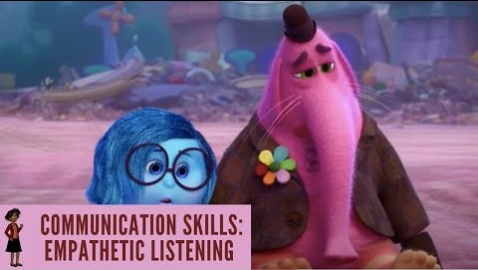
Video
Notes:
Inside out – Clip depicts a scenario when someone is suffering a loss or bereavement of something or someone and how different responses can impact

Slide 11
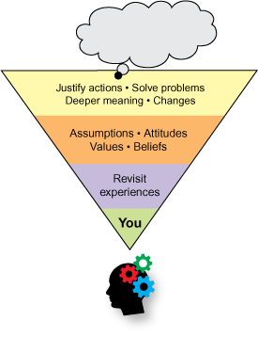
New Course content
Staff will understand the importance of Reflective practice and Authenticity.
Attunement
Authenticity & Vulnerability
Testing
Get comfortable being uncomfortable
The dance of reciprocity (Solihull)
Adapting to young people / Adultification
Learning and communication styles

Slide 12
Feedback from Young People – Youth Voice - 3rd April 2024
Answers Q1- How can you tell when an adult is listening or showing an interest in your wishes and feelings?
Body language
Open responses, keeping the conversation going
Trying to understand each other’s point of view
Trying to meet in the middle in an argument
Full focus, no devices
Time to speak
Not skipping to the point, summarise what’s been said
Explaining things in an easier way
Gentle communication eg not making it seem like its forced or aggressive
Notes:
reflective thinking - Search Images (bing.com)

Slide 13
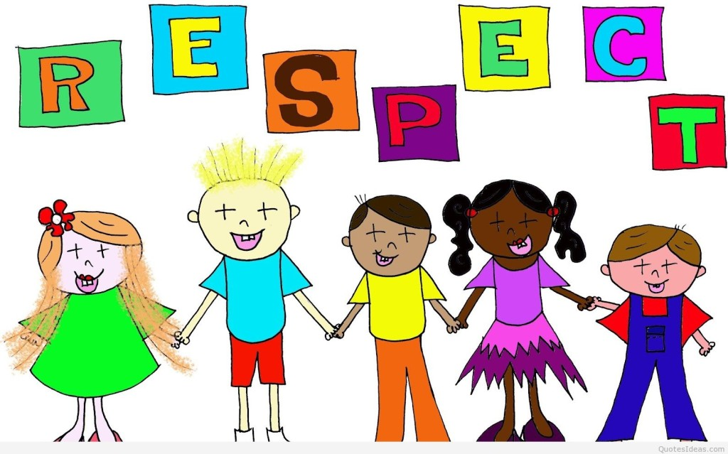
Feedback from Young People – Youth Voice - 3rd April 2024
Answers Q2- How can an adult show they respect you when talking with you?
Gentle honesty
Clearly explaining, openly removing distractions
Not put someone down – debate in an open-minded way
Social awareness – respecting opinions
Show physical signs you care
Tolerance
Respect boundaries
Eye contact
They treat you equally rather than a child
They show interest in what you are saying and don’t ignore you
Notes:
respect - Search Images (bing.com)

Slide 14
Reflective Practice and Authenticity
What is this?
The essence of Authenticity is something being exactly what it claims to be. In relation to us as individuals it is about how we can share who we are professionally and personally in a way that is true, clear and coherent for another person to engage with us, to develop a relationship that is honest, has boundaries and is genuine.
To achieve an understanding of self and develop our authenticity it is important to practice Reflection. This is where we explore how we view the world and others, to then identify how we respond to our experiences, making adaptations to our communication style to meet our needs and those of young people or colleagues.
Notes:
Restorative Practice – Doing with
Reflective Supervision

Slide 15
New Course content
Learners will develop knowledge of the legal rights of teenagers in the context of the UN Convention of the Rights of the Child
Children & Young People and their families are central to the provision being offered to them, being led by CYPF wherever we can.
Inclusivity, Equity and Diversity of the participation offer
Respect – we listen, hear and act on the feedback;
Empowerment – the reciprocal relationship between the young person and decision makers
Power – Self awareness of our own power, biases and agenda. Both consciously and unconsciously!

Slide 16


Feedback from Young People – Youth Voice - 3rd April 2024
Answers Q1- How do you know when your views on the world, your community and culture are heard and respected when talking with adults?
Positive changes are made.
When you are given constructive criticism not just criticism
When others accept what you believe
When you know people are interested in what you are saying
Relaxed and not react badly to a view.
Not influencing or changing views
Not looking at phones – Eye contact
Doing what they say their gonna do.
Listening to young people and help get their ideas out.
Notes:
world culture - Search Images (bing.com)

Slide 17
Feedback from Young People – Youth Voice - 3rd April 2024
Answers Q2- How do you think young people can work with adults to make positive changes in the world?
Stating opinions on both sides
Positive discussions
Adults getting advice from young people.
Adults can listen to what we think and not pretend we don’t exist because we are youth.
They say ‘Children should be seen not heard’ but we are the future and why should we just accept what we don’t agree with?
Mutual agreements
Young Carers awareness
Being in a group with other young people who think like you and have similar experiences.
Educate adults.

Slide 18

UN – Charter of children’s Rights
Respect for children's rights
Consideration of the child's will
Freedom of expression and information
Thoughts - conscience and religious freedom
Access to information

Slide 19


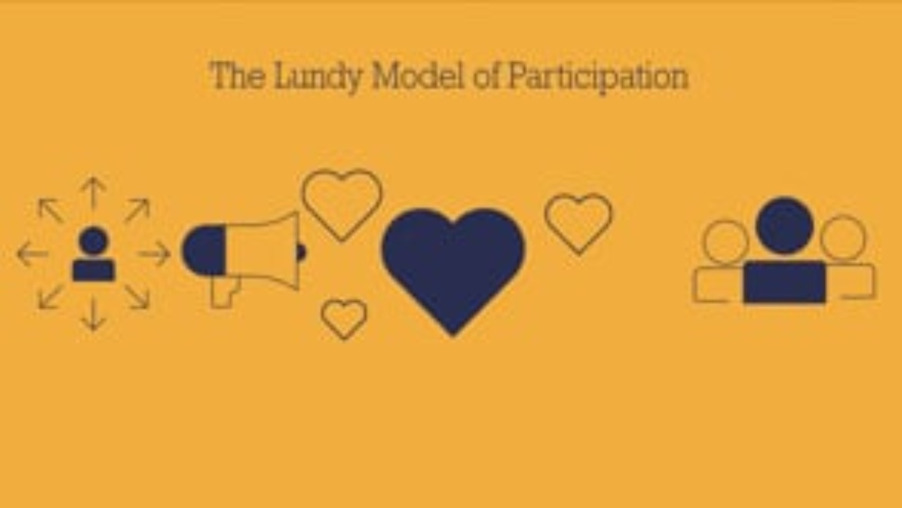
Nothing about us without us!
https://vimeo.com/711137034/0fc0423d36
Notes:
We’d like to share a short video that was coproduced with yp and is part of the system wide participation training. You’ll see that it reflects participation at both an individual and collective / system level

Slide 20
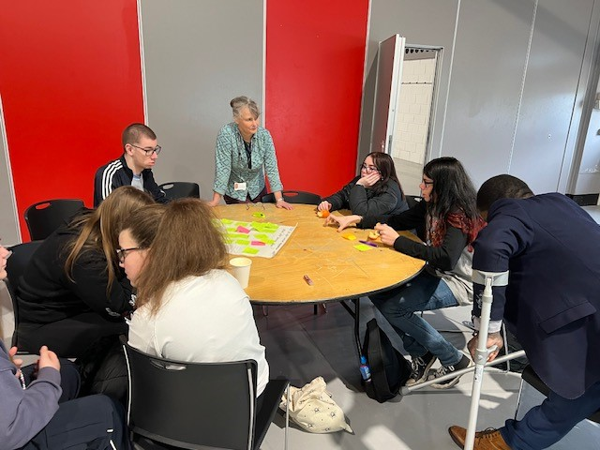
New Course content
Learners will understand how to create a safe environment for communication and participation.
When, where how?
Participation in change or development
Realistic
Framing questions and linking questions
Power of silence – WAIT

Slide 21

Feedback from Young People – Youth Voice - 3rd April 2024
Answers Q1-What do you need to feel safe when talking with adults?
Talking about boundaries
Not being enclosed in a small office
Knowing I can leave if I want
Being cheerful, welcoming
Open body language
Active listening
Don’t blindly nod along
Gentle honesty
Clearly explaining situation – compromising
Notes:
cheerful - Search Images (bing.com)

Slide 22
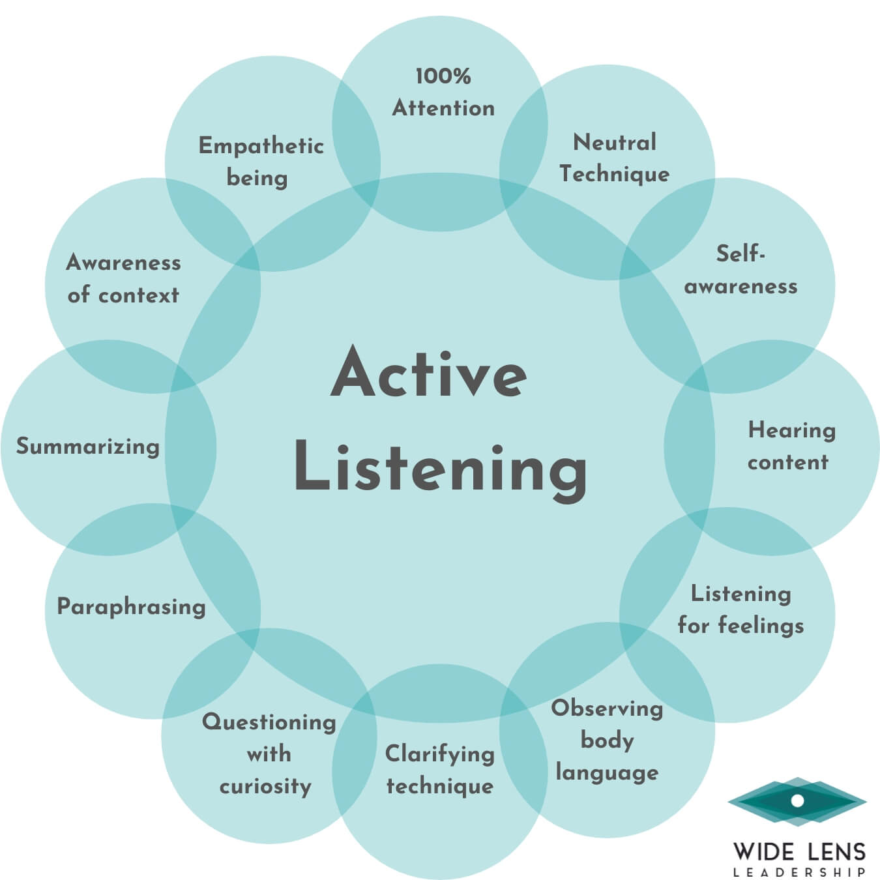
Feedback from Young People – Youth Voice - 3rd April 2024
Answers Q2 - What do you need to feel included when talking with adults?
Free to speak up and not just be spoken to
Don’t feel you have to say anything – Not too much social pressure
Mutual respect
Speak to us how you would like to be spoken to
Listening
Feeling like we are equal
Be present
Use kind words and comments
Notes:
listening - Search Images (bing.com)

Slide 23
Creating a safe environment for communication and participation
Young people have told us that having a place where they feel comfortable to talk with adults is essential.
Time, space and place all play a key role in how a young person responds.
Another key theme has been accessibility, adapting the environment to ensure it is physically accessible and adapting your communication style are also vital to ensure a young person can feel safe and valued.
Tools to Support Children and Adults with Communication Differences
Talking Mats - Children's Services
Notes:
Some communication tools can also be used to support conversations as appropriate such as Talking Mats, Signalong, Lego Play, Arts & Crafts, conversation cards, going for a walk and engaging in an activity that interests the young person. The use of some of these tools will require additional training.
The layout of a room can be adapted to ensure it is more comfortable and accessible, young people have stated that sitting directly opposite someone can be intimidating, or to many questions. Setting boundaries at the beginning of a meeting and being clear about the purpose of the conversation, confirming that a young person can leave or take time out if they feel uncomfortable.

Slide 24

Process for Awarding the ‘ALL Together’ Quality Mark
Criteria for use of the ‘ALL Together Quality Mark’: There is evidence that the voice of children & young people has informed and led to: -
A change in practice
A change in policy
A change in structure
Strategic thinking and outcomes
Service design

Slide 25
Process for Awarding the ‘ALL Together’ Quality Mark
Apply for the ‘ALL Together’ Quality Mark
Applications will be assessed by a young people’s panel. Followed by an informal presentation on your application, enabling you to bring your application to life and young people to ask clarification questions.
Your application will be scored based on the application form and the presentation.
You will find out the outcome and feedback within 5 working days of the meeting.

Slide 26
Questions and ideas for course development

