Slide 1
Group agreement
Welcome!
Please be aware that some of the sessions are being recorded for sharing later.
We want people to participate but please use the ‘raise hand’ facility to ask questions and contribute when others are talking.
Please be considerate to others - together we want to create a safe, open and reflective space to learn.
You can turn on live captions on by clicking on the 3 dots at the top of your screen if you need this.
The link to the feedback form will be put in the chat.
Please do take the time to complete it after the session.
Thank you!

Slide 2
Welcome to Active Norfolk
Emma Drake
Our Flourish Pledge
“Active Norfolk pledge to embed youth voice into our programmes and partnerships, using the power of physical activity to improve outcomes for those YP that can best benefit
We commit to working in partnership with Flourish network, identifying areas to collaborate and using our shared knowledge and expertise to empower the children and YP of Norfolk.”

Slide 3
Who is Active Norfolk?
Part of a network of over 43 county based Active Partnerships
Support the development of sport and physical activity in Norfolk. We are building a future where movement is a normal part of everyday life.
In order to make this vision a reality we have to address some real and persistent challenges.
Notes:
The biggest shift is moving from a curing to a preventative form of healthcare and appreciation that ill health cannot be caused or cured by one thing only.

Slide 4
Latest on tackling health inequalities
Get Active:
Dept Culture and Media 2023
Major Conditions Strategy:
Dept Health and Social Care 2023
‘…we believe that we need to ensure that public funding is targeted at; tackling the structural disparities that exist across society, strengthening the capacity within communities to support people to be active and embedding the agenda of sport and physical activity across a variety of sectors.’
‘The wider determinants of health such as income, education, work, housing, relationships, families, access to nature and our physical environments can have enormous impacts on our health and our behaviours, and impact people throughout their lives and across generations. Research suggests these wider determinants are more important than healthcare in determining health outcomes’.
There is a shift towards prevention of ill health and long term conditions, starting from birth
Notes:
Tackling inequalities is the core strategy of Sport England – our funder.
Happily this understanding of how inequalities directly effects health is starting to be appreciated by central government, as this slide shows.
Children’s activity level is getting back to pre covid level accept in the lowest socio economic groups.
Of these those that most struggle to engage with PA are women and girls and the disabled/long term health conditions
Sport England

Slide 5
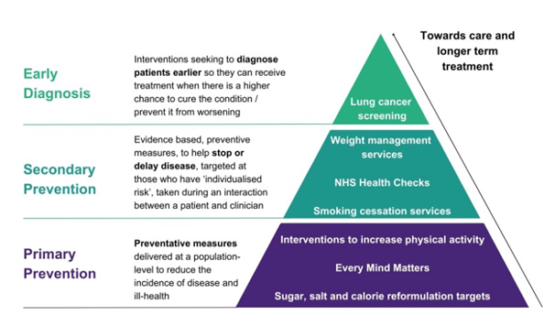
Care and treatment
Notes:
PA is Low cost, and low risk intervention with a potentially high upside.
Should be a part of a holistic approach to any early intervention around health and well being.

Slide 6
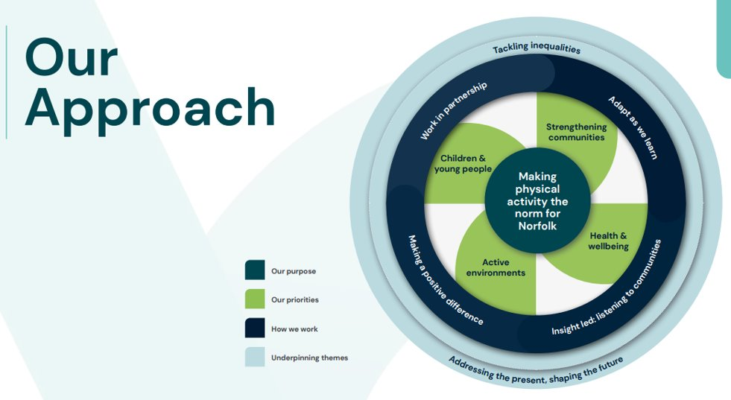
Our approach

Slide 7
Children & Young People Team
CYP Strategic Lead: Joel Matthews - Developing and managing strategic partnerships - Leading on AN CYP strategy
Education: Jo Thompson - Bespoke education setting support to improve their physical activity offer and pupil outcomes
Project Officer: Gemma Wright - Project lead for Norfolk School Games
Families and Communities: Rebecca Elliott - Development of Early Years setting training and support offer - Engagement with family hub partnership groups
Big Norfolk Holiday Fun: Emma Drake & Hollie Shepherd

Slide 8
Key focus
Increasing children’s activity levels to minimum 60 mins a day- this may be with or without families: 1 million more by 2030!
Ensuring partnership work to enable more joined up approaches to tackling the inequalities around engaging with sport and exercise
Developing a collaborative approach with our CYP users to directly impact the direction and delivery of our work
Ensure the findings of the HAF programme around provision, training and capacity are sustainable in future planning
Notes:
Only 41% meeting physical activity guidelines of an hour a day Structured play/clubs does not suit all children
Lowest socio economic bracket, and women and girls are most likely to experience more barriers to participation in any exercise
(BMC Public Health Art 1432; July 2023)

Slide 9
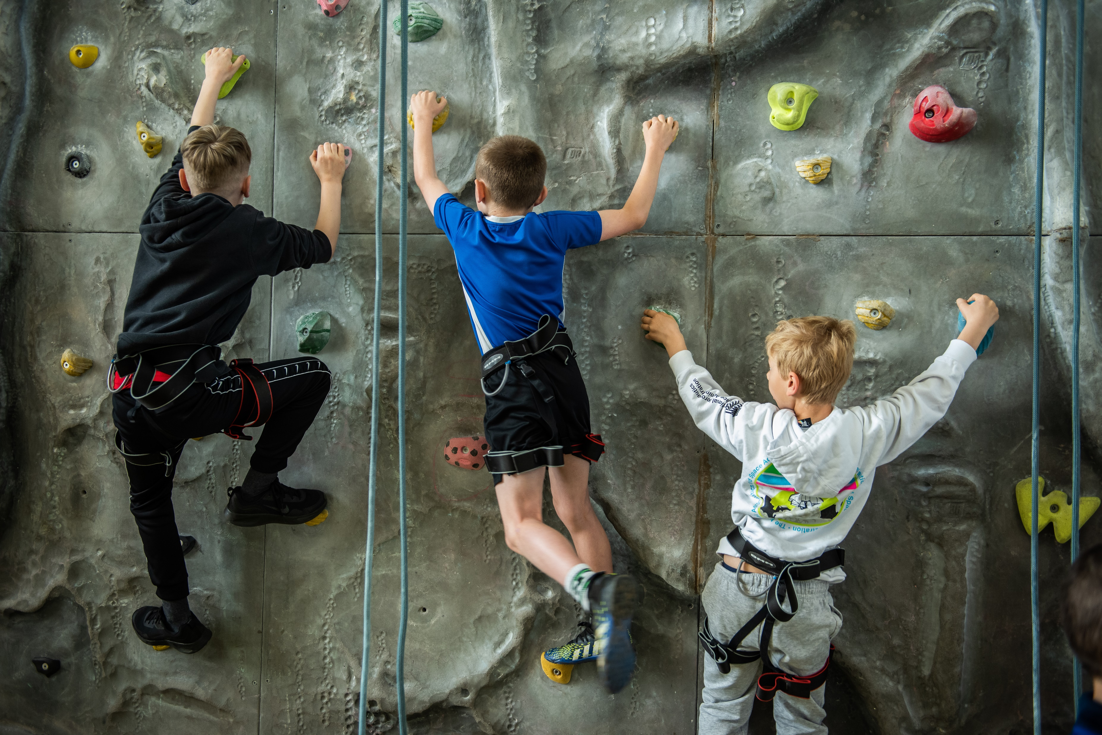
Video
Video

Slide 10
Overview
Overview
3 year Dept of Ed funded national programme
Runs every main school holiday
Ends Winter 2024
CYP aged reception-16 on benefit related FSM
Other vulnerable CYP can take part on referral by a professional
Funding is for 20% of FSM population
Up to 24 free sessions per year per child
Each session is at least 4 hours long and includes healthy meal

Slide 11
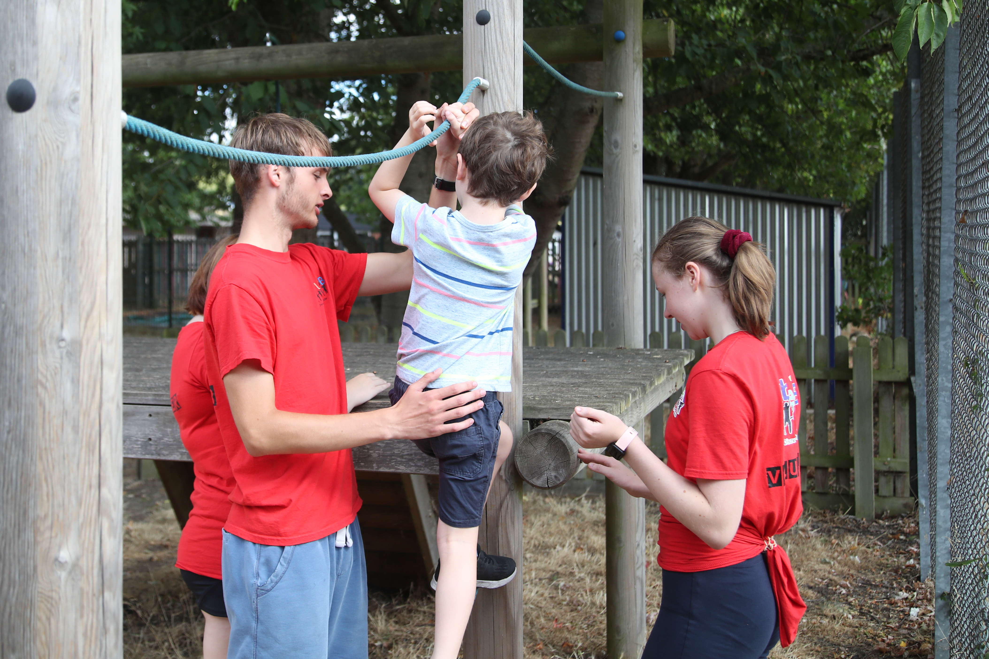
Since 2022
5000+ children participated with 109+ activity providers;
Helped parents with child care and to take a break
Supporting the funding of grassroots CYP organisations
Enabled over 80 providers to be Safer Programme Members
Enhanced training for CYP providers
Worked with multiple agencies and departments in the LA and Public Health

Slide 12
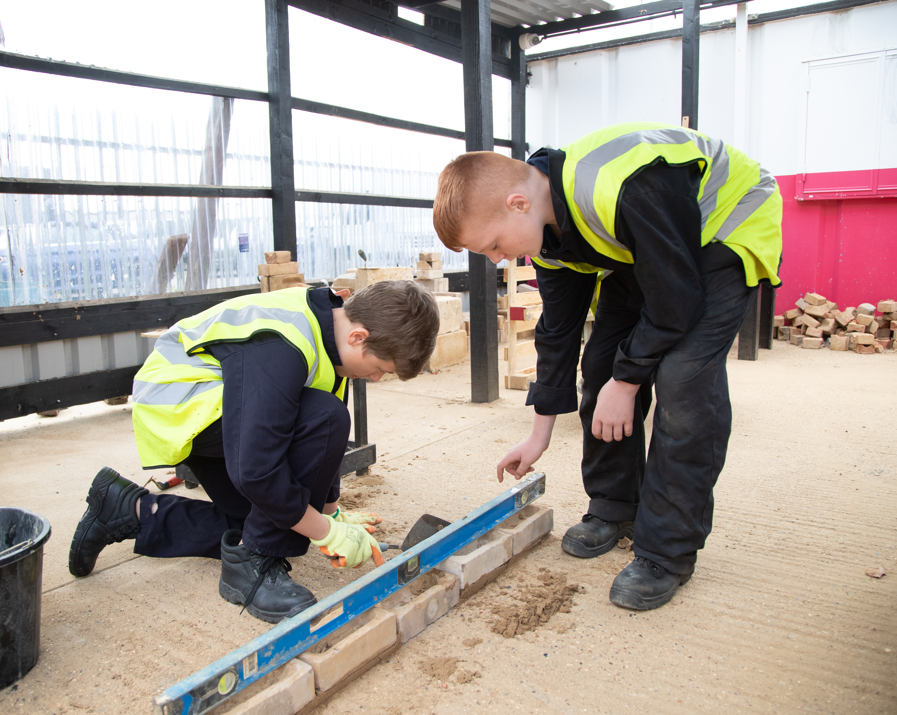
Long Term
Establish legacy of the learning and good practice developed on the programme
Continue to support and develop the provider network
Eg supporting the Alternative Provision offer in the SEND strategy and wrap around care plans
Continue to work with the stakeholders we have made in LA
Advocacy and highlight issues arising from a lack of youth provision in the county
Aim to minimise adverse impact on families when funding ends Winter 2024

Slide 13
Active Norfolk and Families and Friends
Workshop:
We would like you all to go into break out rooms and consider the following:
Have you worked with Active Norfolk before? Could we go further? If not, how?
How might your strategic priorities align with the Active Norfolk CYP team? (tackling inequalities, promoting health and wellbeing, strengthening communities…)
How could you use or embed physical activity within your service to support improved outcomes for the CFYP you work with?
Are there any other links or opportunities across the FLOURISH network?
You have 10 minutes!

Slide 14
Next steps

Slide 15
Get in touch
Emma Drake (HAF Programme Manager):
emma.drake@activenorfolk.org
Joel Matthews (Strategic Lead – CYP):
joel.matthews@activenorfolk.org

Slide 16
Please let us know what you think
https://forms.office.com/e/nFDzqZWk4i
Notes:
Presenters, please copy this link into the chat to request feedback:
https://forms.office.com/e/nFDzqZWk4i

