Slide 1




Young carers in Norfolk – identifying, understanding & supporting them to Flourish
Notes:
Belinda and Philip to jointly introduce

Slide 2


Our focus on young carers
Focus on identifying and supporting children and young people that are young carers at the earliest opportunity
Listening to the voice of children and young people with partners and acting on what they say.
Children, young people and their families can access the support they need that reduces or removes the risk of excessive and inappropriate care being undertaken so they can FLOURISH.
Notes:
Philip

Slide 3





We are young carers -
Norfolk’s young carers speaking out for you! -

Slide 4
Young carer multi-agency priorities
Assessment & Support
Education
Health
Communications & Co-production
Notes:
Philip to highlight working arrangements with partners

Slide 5
Norfolk young carers – co-production
To ensure partners are responding in the way children and young people, that are young carers want, Children’s Services as part of its FLOURISH ambitions are committed to co-producing materials and resources with young people for use by professionals and families.
During 2022 Children’s Services in partnership with Caring Together worked with the County young carers forum to co-produce the first Transition Assessment and Plan called ‘My TAP’ to support young people by the age of 14 be made aware of and access support in their transition into young adulthood from 18+. This has been piloted and will be rolled out more widely in 2023.
Norfolk’s Carers Charter states a number of key commitments to carers including young carers and there are plans to co-produce communications materials that will help raise the profile of the Carer’s Charter across Norfolk, including ensuring more young people are aware of what the Charter can do for them.
Notes:
Philip/Claire

Slide 6

Norfolk young carers – My TAP

Slide 7





My education, training and employment plans
I like?
My future
What I am considering for my future…
I don’t like?
I need some help with?

Slide 8



My health and wellbeing…
My future
I like?
I don’t like?
I can stay healthy and well with…
I need some help with?

Slide 9



My social life, interests and activities?
I like?
My future
My life is better because…
I don’t like?
I need some help with?

Slide 10
My priorities for the year ahead?
My future
1)
2)
3)
What do I most want to focus on…
Guidance to practitioners -

Slide 11
My plan to adulthood?
Date: | My TAP Who is going to do what to help me into adulthood?
What needs to happen? |  | Who will help with this? | By when? |  | Achieved?
My future
What I need to succeed as an adult…
Above plan to be reviewed at age 16 and before age 17.5 –
with review reminder dates set agreeing who will complete the review with the young person.

Slide 12

Co-production and promotion is with young carers
Our progress across Norfolk –
School census returns, good practice
and always more to do!
1548 CYP identified & 789 had YC needs assessments
Engaging wider partners to ensure the cared for person’s needs are being met earlier
3rd best LA for primary and 7th for secondary YC identification
42 + Norfolk schools with Caring Together tick friendly award status
Notes:
Belinda (blue and orange) and Philip (yellow, red and green) to highlight the data and progress circles!

Slide 13
What you can do to make a difference – pledge your support
Assessment & Support -
Ask the children and young people you are working with about possible caring responsibilities – they may not tell you!
Support them or request on their behalf a young carer needs assessment from NCC Children’s Services.
Young carers and families - Norfolk County Council
Be informed –
Read the toolkit for professionals
Toolkit for Professionals - Carers Matter (youngcarersmatternorfolk.org)
Health –
Ask health professionals to add the child as a young carer using the SNOMED carer code (224484003) to System-One, so all health professionals can recognize their carer status.
Being a young carer: your rights - Social care and support guide - NHS (www.nhs.uk)
Email: carersidentitypassport@carersvoice.org
Education & Social Support –
Consider whether the current plan (e.g. EHAP, My TAP, CIN, CP, SEND support etc) of support is meeting the child/young person’s needs and what may need to change for them as a young carer. Consider the young carers passport.
Education | Carer Passport Schemes (carerspassports.uk)
Notes:
Philip to highlight working arrangements with partners

Slide 14

Thanks for listening and happy to take questions…
Philip Beck -
Head of service & lead for young carers – Norfolk Children’s Services
Philip.beck@norfolk.gov.uk
Belinda Jones and Claire Rogers –
Caring Together
Belinda.Jones@caringtogether.org
Claire.Rogers@caringtogether.org

Slide 15
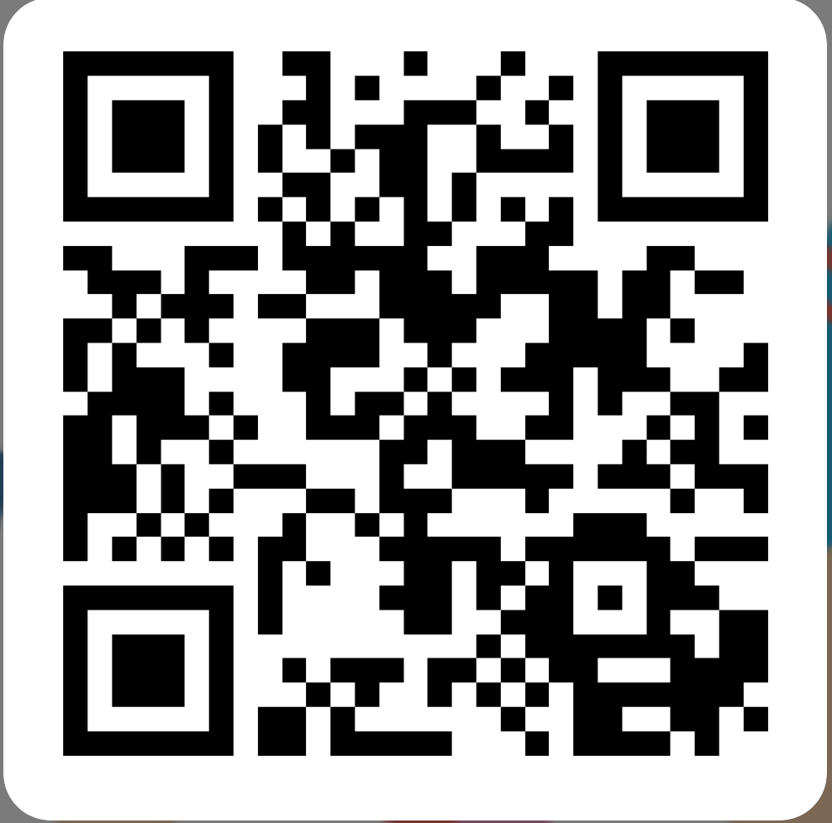
Please let us know what you think
https://forms.office.com/e/nFDzqZWk4i
Notes:
Presenters, please copy this link into the chat to request feedback:
https://forms.office.com/e/nFDzqZWk4i

