Slide 1

16-25 Learning and Employment Pathways
Thursday 23 May 2024

Slide 2

How many 16–18-year-olds are there in Norfolk?
(A) 12,112 (B) 18,710 (C) 25,000
Question

Slide 3
Answer - B
12,112 | 18,710 | 25,000

Slide 4
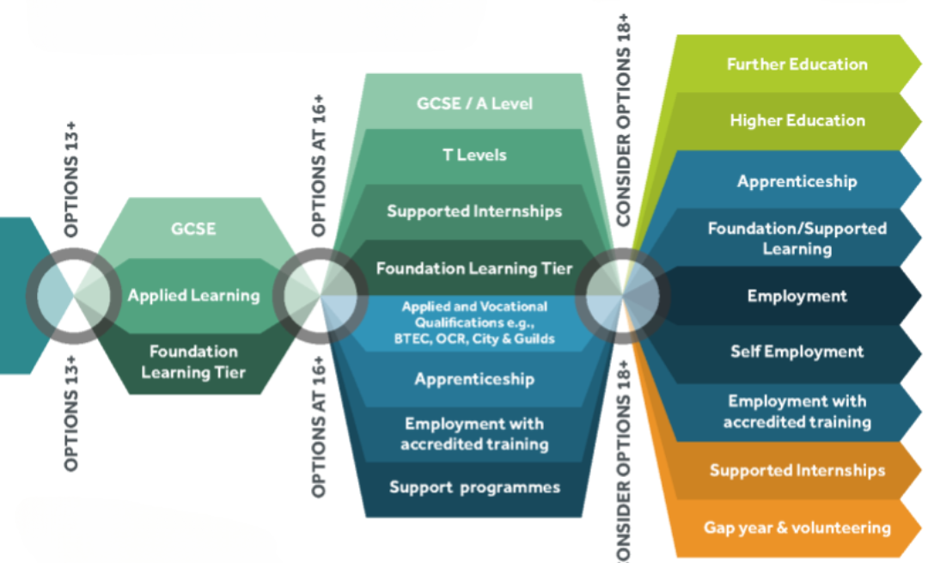
13-25 Learning and Employment Routes

Slide 5
Participation of young people in education, employment or training – Raising Participation Age
What are the main options available for young people aged 16-18 years old?
Study full time at school, college or post-16 provider. The definition of full-time participation is at least 540 hours a year, this is around 18 hours per week.
Full-time employment or volunteering (full-time is counted as more than 20 hours a week) combined with part-time study or training.
Apprenticeship or a supported internship
Participation of young people in education, employment or training - childlawadvice.org.uk

Slide 6
Qualification Types
Qualifications fall into three main types:
Academic - subject based, for example, A levels & GCSE, usually assessed by exams, study subjects in-depth.
Applied general - Broad vocational areas. Introduction to an industry, such as travel and tourism, engineering, health and social care. Academic study with practical learning. Usually assessed by a mixture of coursework and exams. Include BTEC and OCR qualifications.
Vocational or technical - Focus on a specific industry or occupation. Usually assessed by a mixture of coursework and practical, work-based tasks. Provide skills and knowledge to do a particular job. They include T Levels, NVQs, some BTEC and OCR qualifications. Certificates and diplomas for City & Guilds.

Slide 7
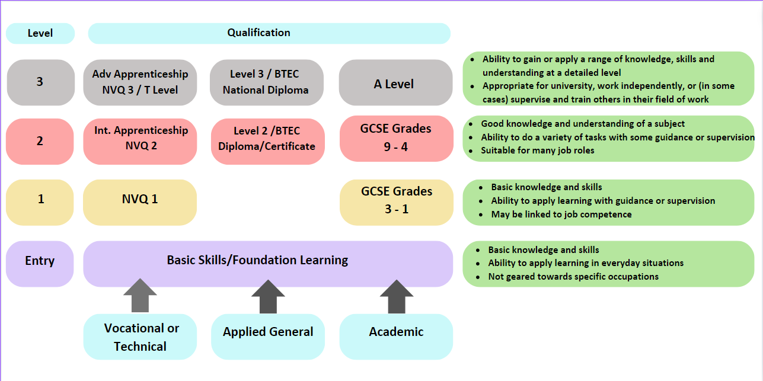
Different Levels

Slide 8
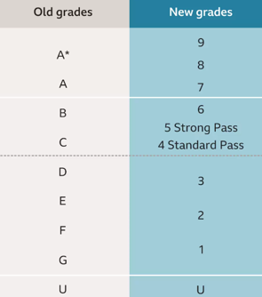
GCSE Grades

Slide 9
Question
How many places for 16–19-year-olds did City College Norwich have in the 2023/24 academic year?
(A) 8300 (B) 5474 (C) 3200

Slide 10
Answer - B
8300 | 5474 | 3200

Slide 11

Support for Young People Not in Education Employment or Training (NEET)
Apprenticeships
Sean Ojeniyi

Slide 12
Question
How many of Norfolk’s 16–18-year-olds are not in any education, employment or training?
(A) 915 (B) 515 (C) 375

Slide 13
Answer - A
915 | 515 | 375

Slide 14
NCC Guidance Advisers
NCC Advisers offer a countywide service to 16–19-year-olds who are Not in Education Employment and Training (NEET) and who need support to progress into Further Education, Employment or Training
Guidance Advisers and Young Person's Advisers can offer information, advice and guidance to NEET young people from Year 12 upwards to access Post 16 options
SEND Advisers offer support to NEET 16- to 25-year-olds who have EHCPs and wish to continue in further education or training

Slide 15

A journey to Post 16 Provision
Destination
Applications
Transition plan
Barriers
Aspiration

Slide 16
A journey to Post 16 Provision
•Courses vary from Entry Level to higher Level qualifications in line with young people’s aspirations and needs.
•In some circumstances Inclusive courses may support young people to sustain learning and resilience to transition into vocational courses.
•Full-time College timetable is normally for 3-4 days per week subject to the level of qualification and course young person is pursuing.
•Supported Internships and Apprenticeships
•Get to know educational providers in your locality

Slide 17







A journey to Post 16 Provision
Inclusive Courses
Phoenix Purple – It offers autistic students the opportunity to develop confidence, communication and qualifications to progress onto future study options or employment.
Progression – This is a vocational specific programme offering support, skills and confidence in moving to catering, retail, creative, hospitality and practical skills.
Fresh Start in Construction – It is suitable for young people who have been out of education and are keen to learn a trade.
Creative Courses

Slide 18
Question
What percentage of young people in Norfolk are on an Apprenticeship?
(Core+ Date: March 2023)
(A) 10% (B) 22% (C) 6%

Slide 19
Answer - C
10% | 22% | 6%

Slide 20





A journey to Post 16 Provision: Apprenticeships
An apprenticeship is a pathway to a paid job which offers hands-on work experience alongside off-the job training
Throughout the apprenticeship, most of the apprentice’s time will be spent in the workplace gaining real experience with an employer. This time is called ‘on-the-job training’
Some of this time will also be spent with a training provider, who will help apprentice to learn and achieve their qualifications. This time is called ‘off-the-job’ training
20% of the apprentice's time is spent off-the-job learning.

Slide 21






The levels of Apprenticeships
Intermediate Level 2
Advanced Level 3
Higher apprenticeship Level 4- 7
Degree Apprenticeship Level 6 & 7
Level 2 apprenticeships provide basic knowledge and skills for specific jobs and are equal to GCSEs
Level 3 apprenticeships offer more specialised knowledge and skills for specific jobs and are equal to A levels
Levels 4 to 7 apprenticeships focus on higher-level professional skills and can be equal to a foundation degree, a Higher National Certificate (HNC), or a Higher National Diploma (HND).
Levels 6 to 7 apprenticeships lead to either a full bachelor's or master's degree.

Slide 22
Participation of young people in education, employment or training
What are the options available for young people in participation age group 16-18 years old?
Option one is to study full time at school, college or with a training provider. The definition of full-time participation is at least 540 hours a year, this is around 18 hours per week.
Option two is full-time employment or volunteering (full-time is counted as more than 20 hours a week) combined with part-time study or training.
Option three is to enrol in an apprenticeship or a supported internship
Positive Activity is to support the interests and wellbeing of young people who are not ready to pursue education, employment or training options.

Slide 23
Supported Internships
A government backed initiative that supports young people with disabilities to develop the skills and qualities employers value through a combination of workplace experience and classroom-based learning.

Slide 24
Question – Supported Internships
When were Supported Internships introduced for young people with SEND?
2003
2013
2023

Slide 25
Answer B
2003 | 2013 | 2023

Slide 26
What is a Supported Internship
They are a partnership between an education provider and an employer with the aim that the young person will be ready to take on paid employment.
A young person with SEND who has an EHCP is placed in an agreed role with an employer for a period of six months to a year.
Both the employer and the young person have the support of a Job Coach before, during and after the internship.
The young person continues with English, Maths & employability skills.
The job coach will if needed assist with any adaptations.

Slide 27
The Job Coach
Is provided by the education provider
Works with the employer to identify the appropriate role within the business
Learns the role ready to train the intern using TSI (Training in Systematic Instruction)
Identifies and addresses skills development and works on these with the intern
Is easy to contact for both the intern and the employer
Visits regularly, before the internship starts and all through internship period
Ensures interns are meeting workplace standards, liaising with the workplace mentor
Addresses any issues that may occur either with the intern or with the employer

Slide 28
The Intern
Must want to work
Must have an EHCP
Must have a high attendance record at college
Must enjoy practical learning
Must be an enthusiastic, reliable & safe worker
Must continue to learn English/maths and or employability skills at college
Will receive on-the-job coaching in the workplace to hone skills
Will need to be prepared to adhere to time keeping, shift patterns, dress code etc
Is not paid because they are a student.

Slide 29
Progression
The supported internship is designed to ensure the young person has all the skills they need to gain employment.
There is no expectation that the host business will employ the intern at the end of the internship.
If there are vacancies the intern will be encouraged to apply.
The intern will continue to be supported to gain employment following the end of the internship.
The young person should not return to college following the end of a supported internship, the aim is employment.

Slide 30
Past Present and Future
In the recent years interns have gained employment including
Café assistant, retail assistant, admin assistant, kitchen porter, domestic, health care assistant, pharmacy assistant, visual imaging assistant, waste porter, train catering operative to name but a few.
Working mainly in the three large hospitals and with Norse
Internships secured for September 2024 we have opportunities including
Hatcheries operative, document control, general operative with responsibility for industrial cleaning, security and weigh bridge operations, social media officer including marketing and video editing.
Continuing to work with the hospitals, GYBC and Norse we are now working with P D Hook, Emcor UK/British Sugar, Armultra Engineering and 7 Days Performance.
Going forward
The sky is the limit, we have talented young people just waiting to demonstrate their talents and employers becoming more aware of supported internships and willing to host a young person.

Slide 31
NCC and CCN Pilot Project
Previously to access a supported internship a young person needed to have an EHCP, with this pilot it is not required.
There are many young people with SEND who could benefit from a supported internship but are unable to access them.
The aim of this pilot is to reach out to this group of young people.
A job coach has been allocated from CCN who is ready to work with you and identify any roles that may be suitable and would benefit the department and the staff working within it.
The aim is the intern works within the department, learns valuable employability skills whilst not drawing on the team's time.
One department has agreed to host an intern and the job coach is now looking for a young person who matches the requirements laid down by the department manager.
We are working with the NCC's Skills and Employment Team to ensure the opportunity is open to as many young people as possible.

Slide 32
Supported Employment
Roger Allen

Slide 33
Question
Which sector employs the most people in Norfolk?
(A) Health (B) Retail (C) Accommodation & Food

Slide 34
Answer A
Health (59,000 employees) | Retail (42,500 employees) | Accommodation & food services (34,000 employees)

Slide 35
Principles of Supported Employment
The supported employment approach has at its heart the notion that anyone can be employed if they want paid employment and sufficient support is provided.
Key principles:
Wages are paid at the going rate for the job.
The employee enjoys the same terms and conditions as all other employees.
The job helps the person to meet their life goals and aspirations.
The role is valued by managers and colleagues.
The job has similar hours and working conditions as other employees.
Support can include vocational profiles, job-matching, employer engagement and in-work support.

Slide 36
Post 16/18 Employment Support Pathways
Working Well Norfolk – 16 plus employment support for people with moderate mental or physical support needs (inc in-work).
Local Supported Employment – job coach support for 18 plus for Autistic people or who have a Learning Disability to get in to paid work.
ASSD Norfolk Employment Service - for people 18 plus who have eligible needs and a Care & Support plan to be supported into a range of paid and non-paid outcomes.

Slide 37
Post 16/18 Employment Support Pathways
MIND Routes Inclusive Employment​ - for people 18 plus with more complex MH needs to access paid work
Access To Work​ - grant to pay for practical support in work for people 16 plus.
Adult Learning - wide range of Post 19 learning courses

Slide 38

The information, advice and careers guidance website for young people in Norfolk
Home (helpyouchoose.org).

Slide 39
Links from the presentations
Raising Participation Age Requirements – Information about the law for young people aged 16 and 17
Home (helpyouchoose.org) - Home page of Help You Choose
Choices at 13/14 (helpyouchoose.org) - Helping students select their GCSE subjects in Year 9
Choices at 16 (helpyouchoose.org) - All options for young people after Year 11
Which qualification? (helpyouchoose.org) - Academic, applied vocational qualifications, and the different levels
Education & Learning (helpyouchoose.org) - All about education and learning
GCSE Brush-up and Revision (helpyouchoose.org) - Free materials to help pupils study different GCSE subjects. (if at school check the exam board the school is using)
Course Opportunities (helpyouchoose.org) - Compare courses at providers throughout Norfolk
Careers Information (helpyouchoose.org) - Fun quizzes and websites to help young people find out about different jobs and careers
Voluntary work (helpyouchoose.org) - Links to volunteering opportunities
Apprenticeships & Training for Work (helpyouchoose.org) - Apprenticeship and work opportunities
NEET Support (helpyouchoose.org) - Help and support for young people not in education, employment or training (NEET)
SEND (helpyouchoose.org) - The Special Educational Needs and Disabilities section for young people
Work Experience (helpyouchoose.org) On-line and in-person work experience information
Health & Wellbeing (helpyouchoose.org) - Support lines and websites for young people needing help with a range of different issues that might be worrying them.
Become an apprentice (apprenticeships.gov.uk) - Apprenticeship information
Careers advice - job profiles, information and resources | National Careers Service - National Careers Service
icanbea... (Careers & Ideas in Norfolk & Suffolk) | icanbea... A free resource for careers and ideas in Norfolk and Suffolk
Children with special educational needs and disabilities (SEND): Extra help - GOV.UK (www.gov.uk) - The government SEND support section
https://www.norfolk.gov.uk/42124 - Working Well Norfolk
https://www.norfolk.gov.uk/40929 - Norfolk Employment Service
https://www.norfolk.gov.uk/42757 - Local Supported Employment
https://www.gov.uk/access-to-work/eligibility - Access To Work
https://www.norfolk.gov.uk/38136 - Adult Learning
https://www.norfolkandwaveneymind.org.uk/routes-ips - MIND Routes Employment
Supported internships - GOV.UK (www.gov.uk) - Government link page to Supported Internships
Supported Internships (helpyouchoose.org) - Supported Internship information on Help You Choose

Slide 40

Thank you for listening from all of us
if you would like more information, please contact us
mark.horton3@norfolk.gov.uk
ademola.ojeniyi@norfolk.gov.uk
pamela.birt@norfolk.gov.uk
Roger.allen@norfolk.gov.uk

