Slide 1

Neurodiversity &
Promoting Positive Communication
Practice Week May 2024,
Presented by Greg and Zelah, Development Coaches for Children’s Services

Slide 2


Checking in
Please contact us via developmentcoach@norfolk.gov.uk for any additional questions
Check in with your own biases and where you might make positive or negative assumptions in relation to the social GGRRAAACCEEESSS (Gender, Geography, Race, Religion, Age, Ability, Appearance, Culture, Class, Education, Employment, Ethnicity, Spirituality, Sexuality & Sexual Orientation).

Slide 3

Aims for this Session
Exploring communication
What does it look like?
Exploding the myths
Some suggestions
Further reading

Slide 4
Defining Communication
The imparting or exchanging of information by speaking, writing, or using some other medium
What different types of communication can you think of?

Slide 5
Most common ways to communicate
The ten most used forms of communication at work are as follows:
1. Face-to-face verbal communication
2. Emails
3. Telephones
4. Written reports
5. Group meetings
6. Announcements
7. Texting
8. Listening
9. Formal communication
10. Presentations

Slide 6

What does good communication look like for you? How does it feel?
What makes good communication difficult? How does it make you feel?

Slide 7

Video

Slide 8
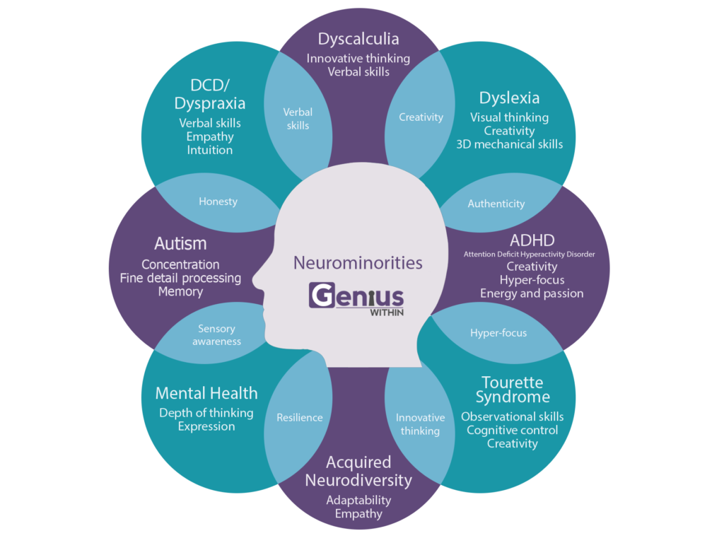
Neurodivergence in the population
At least 700,000 autistic adults in the UK of which only 15% are in employment.
(Source:National Autistic Society)
Individuals with dyslexia in the UK is around 10% with 4% of population at the severe end of the dyslexia continuum. (British Dyslexia Association)
(Source: Local Government Association) info@local.gov.uk
Estimate of 2.6 million people with ADHD in the UK, 1.9 million of them adults.
(Source: https://adhduk.co.uk/about-adhd)
Also, consider those who are undiagnosed or waiting for a diagnosis

Slide 9
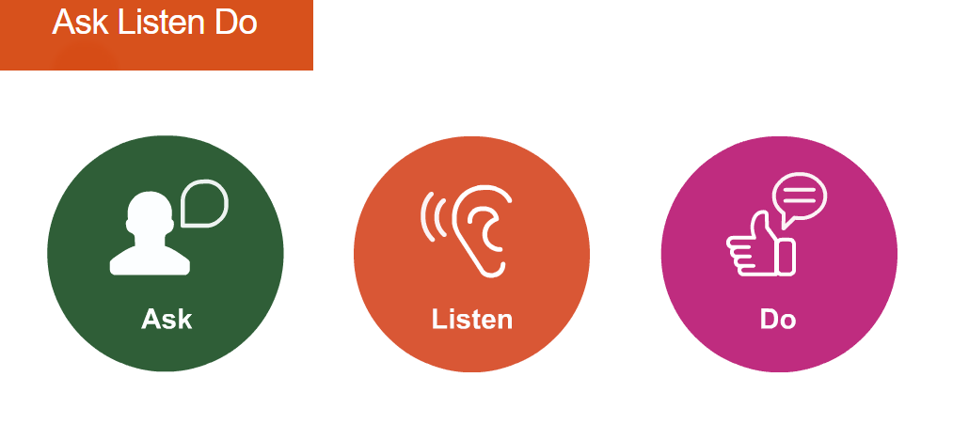
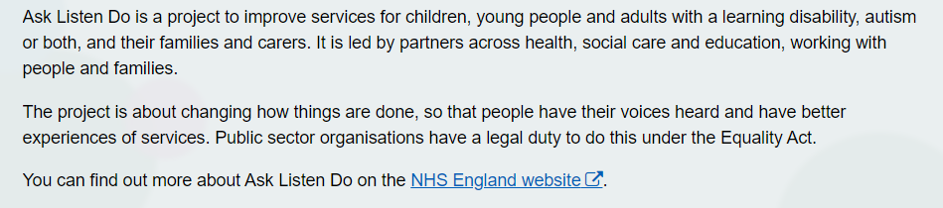
Ask Listen Do

Slide 10
Myths about communication
Communication is a natural ability
The more we communicate the better
Once mastered, communication can be used everywhere
Great vocabulary is a must for great communication
Talking clearly and confidently is the secret of communication

Slide 11
Be mindful of
Body language
Tone of voice
Facial expression
Environment
Not having the full story
Assumptions
Prejudgements

Slide 12
Try these
Ask the other person what works best for them
Ask for feedback to find out how you are being received
Offer check ins, offer empathy rather than sympathy
Be mindful and consider your responses
Ask yourself- is this the right place and time?
Is this a supportive helpful intervention?
Consider the possible outcomes

Slide 13










Further reading:

