Slide 1


DWP supporting families
– enabling skills and employment opportunities

Slide 2






Introducing Phil Beck
Notes:
Philip Beck Head of Partnerships, Schools and Communities (& ERMiN) – Every Relationship Matters in Norfolk
Likes ACDC, is a drummer and Sounds Bath practitioner, a volunteer mountain leader. Is a keen Beekeeper and has completed Bush Crafts/Survival skills training

Slide 3






Tracy Tanner
Notes:
Tracy Tanner – Team Leader for the Supporting Families Employment Advisors and Disability Employment Advisor for Norfolk – Department of Work and Pensions
Beyond a professional commitment to strong partnership working and assisting families in Norfolk Tracy is a qualified Zumba and movement to music fitness instructor, keen singer of musical numbers and laughing yoga practitioner. A dancer and sailer she is someone of many talents.

Slide 4






Norfolk Supporting Families Employment Advisors (SFEAs)
Angela Bowles
Great Yarmouth, North Walsham, Cromer & Fakenham JCPs
Broadland, East & North Norfolk Districts
Emma Wingrove
Thetford, Dereham & Kings Lynn JCPs
Breckland & West Districts
Sian Stanley
Norwich & Diss JCPs
City, Broadland & South Districts
Melanie Woodrow-Iles
Database & markers
SFEA Inbox:
norfolkjobcentres.sfeateam@DWP.GOV.UK
Notes:
SFEA Team is an integral link between the Jobcentre and yourselves.
Our aim is to help remove employment barriers impacting families and make steps forward in a way and a pace that best suits them. We cover all Norfolk Job Centres and Local Authorities; we offer personalised one to one support to families who are working with Norfolk Early Help or Universal Services. By joining services, we help ensure families get access to early, coordinated support.
How we can help • Support to source Childcare • Benefit queries • Rent arrears and debts • Confidence building • Voluntary/work experience placements • Help with funding towards Employment • Training • CV and interview preparation • Support once in work.
We are available to attend community projects, clinics workshops, EHAPs and home visits. We aim to be a ‘friendly face from the Job Centre,’ to build links, provide support with benefit, into training .

Slide 5



Supporting families
Supporting Families
Employment Advisers
Norfolk Team
Multi-agency collaboration and wrap-around support to enable Norfolk Families to flourish
Working directly with Parents and Carers to access training, learning, increase their skills, claim benefits and support them towards work
Establishing and growing Partner relationships
Outreach within Family settings and joint visits to families' homes
Improving visibility within the Community and Jobcentres
Recording outcomes to support Local Authority PBR
Upskilling and sharing of benefits and signposting knowledge to Partners
Raising awareness of the SFEA Programme to support our most vulnerable families
Notes:
The Supporting Families programme is driven and built on core principles: whole family working; multi-agency collaboration; and measurable impact. These are some of the things we do to enable families to flourish. Working in collaboration with our Partners to improve the lives of children, young people and families across Norfolk.

Slide 6
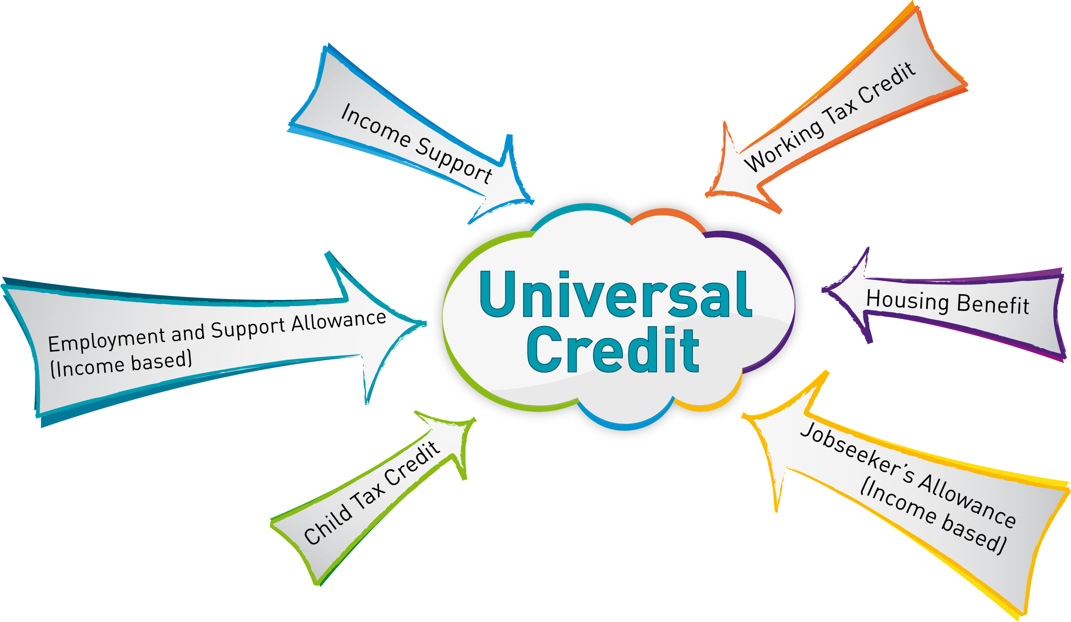
Universal Credit Overview
Universal Credit childcare costs - GOV.UK (www.gov.uk)
Upfront Childcare Costs
Universal Credit is replacing 6 other benefits with a single monthly payment if some-one is out of work or on a low income –
Income Support. ESA, JSA, Tax Credits and Housing Benefit
Universal Credit is a payment to help with living costs. It’s paid monthly - They may be able to get it if they are on a low income, out of work or cannot work.
https://www.gov.uk/universal-credit
https://www.gov.uk/universal-credit/what-youll-get
Benefits calculators - GOV.UK (www.gov.uk)
Turn2us Benefits Calculator
Notes:
Benefit checks, signpost to benefit calculators, support with finding work, support to stay into work, additional elements within UC, Carer’s Element, Disabled Child element etc
If you have a disability, health condition or have children
You can earn a certain amount before your Universal Credit starts to be reduced if you or your partner are either:
responsible for a child or young person
living with a disability or health condition that affects your ability to work
This amount is called a ‘work allowance’. How much you can earn before your Universal Credit payment is reduced depends on whether you get housing costs.
If you get help with housing costs, your payment will start to reduce when your monthly wages reach £404.
If you do not get help with housing costs, your payment will start to reduce when your monthly wages reach £673.

Slide 7
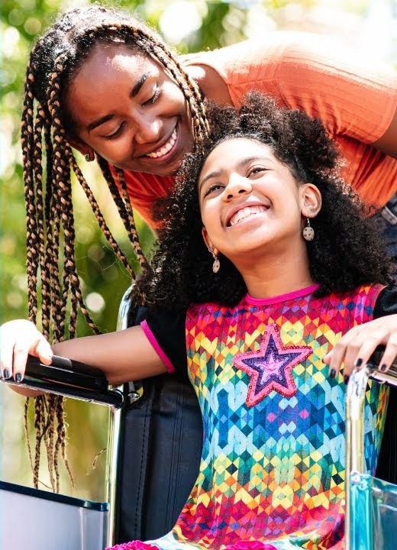
DLA for Children
Disability Living Allowance (DLA) is extra money to help with everyday life if they have a child under 16 who's disabled or has a health condition.
To claim DLA for a child they need to be their parent or look after them as if they are their parent. This includes step-parents, guardians, grandparents, foster-parents or older brothers or sisters.
The DLA rate is between £28.70 and £184.30 a week and depends on the level of help the child needs.
https://www.gov.uk/disability-living-allowance-children
https://www.gov.uk/help-for-disabled-child
https://www.gov.uk/carers-allowance
Notes:
Welfare Rights - Help and advice with benefits (Speak to your Line Manager for internal referrals to Welfare Rights within NCC)
If you receive a social care package from us or are a care leaver, you can contact our Welfare Rights Unit for benefits advice. They offer free specialist help and advice over the phone, or face-to-face in your own home if you prefer.
The Welfare Rights Unit can support you by:
Completing checks to make sure you are receiving all the money you are entitled to
Helping you with your application
Helping you with appeals if your payments have been stopped
Representing you at tribunal hearings
Contact the Welfare Rights Unit by calling 01603 224447 or emailing us at welfarerights@norfolk.gov.uk
Other places to find help
The GOV.UK website has more information about benefits and how to claim them
Citizen's Advice has information about benefits, tax credits, council tax and housing costs
Age UK offers free, confidential advice if you are over state pension age
The Money Advice Service has further information and advice about the benefits system

Slide 8

Carers and Disabled Child Element on UC
They will also get an extra amount if any of their children are awarded DLA (Mid/High-rate care.) They are eligible for this extra amount no matter how many children they have. This is called Disabled Child Element.
£156.11 for mid-rate care DLA award
£487.58 for high-rate care DLA award
If they provide care for at least 35 hours a week for someone who gets a health or disability-related benefit £198.31 This is called Carer Element.
This is on top of any extra amount they get if they have a disabled child.
Universal Credit: What you'll get - GOV.UK (www.gov.uk)
https://www.gov.uk/carers-allowance

Slide 9



Additional support overview
Additional support overview
Get support from Jobcentre Plus to help you prepare for, find and stay in work, including:
training, guidance and work placement programmes
work experience, volunteering and job trialling schemes
help with starting your own business
help combining work with looking after children or caring responsibilities
extra help for specific problems
You may also be able to keep getting some benefits once you start working.
Benefits and financial support if you're caring for someone - GOV.UK (www.gov.uk)
Carer's Allowance: How it works - GOV.UK (www.gov.uk)
Benefits and financial support for families - GOV.UK (www.gov.uk)
Childcare Choices | 30 Hours Childcare, Tax-Free Childcare and More | Help with Costs | GOV.UK
Personal Independence Payment (PIP): What PIP is for - GOV.UK (www.gov.uk)
Further education courses and funding: Financial help - GOV.UK (www.gov.uk)
Free courses for jobs - GOV.UK (www.gov.uk)
Norfolk Library and Information Service | Norfolk Community Directory
Notes:
Flexible Support Fund – support to purchase interview clothing, travel to interview expenses, upfront childcare costs etc.
Specialist roles ie. DEA’s, Complex Needs, Domestic Abuse (J9) SPOCS etc.
Attendance in JCP’s from Support Organisations like CAP, Wellbeing Service, National Career’s Service etc.
Jobs Fairs, mentoring Circles, Work Experience Opportunities, Volunteering, Move to Work
Funded training and upskilling opportunities

Slide 10

Migration to UC
https://www.understandinguniversalcredit.gov.uk/tax-credits-customers/tax-credits-are-ending/
Tax credits and some benefits are ending: claim Universal Credit - GOV.UK (www.gov.uk)
The following benefits are ending and are being replaced by Universal Credit:
Child Tax Credit
Working Tax Credit
Housing Benefit
Income Support
Income-based Jobseeker’s Allowance (JSA)
Income-related Employment and Support Allowance (ESA)
Notes:
Since first being introduced in 2013, Universal Credit (UC) has streamlined and simplified the benefits system to better support those in work on low incomes, as well as those who are unemployed or who cannot work.Natural migration has been in place since the introduction of UC. If claimants experience a change in circumstances while on legacy benefits which previously required a new claim to another legacy benefit replaced by UC, they will need to make a claim to UC. They would then naturally migrate to UC and any legacy claim will be closed. Legacy claimants can also choose to move by making a claim for UC (and by default closing their legacy claim) but should only do this if they think they will be better off on UC.
We want to encourage people who could be better off financially to consider moving to UC. We estimate more than half of current claimants will be better off. In this document, we set out our modelled analysis on estimated benefit entitlements and employment outcomes between UC and legacy benefits, including the types and numbers of claimants who could benefit financially by moving to UC.
We set out examples of claimants’ circumstances for those likely to have lower or higher UC entitlements than they receive now with illustrative case studies. With work at the heart of UC, we also include some case studies showing how claimants can increase their disposable income by entering or extending work. We are mindful that working tax credit recipients would no longer be constrained by the 16-hour cliff edge.
To further support claimants in making an informed choice about moving to UC a range of information is available. This includes factual information on the ‘Understanding Universal Credit’ homepage, impartial advice from independent organisations, and independent benefit calculators which allow claimants to get an indicative estimate of what their UC award might be. At a minimum, claimants should consider the following before choosing to move to UC:
Check that you are eligible to claim Universal Credit; Search ‘Universal Credit eligibility gov.uk’ to find out more.
Check your savings. Anyone with over £16,000 in savings or capital is not eligible for Universal Credit and should not apply. If you or your partner have over £6,000 in savings or capital, your UC payments will be lower.
Check how UC recovers any outstanding debts you may have. Search ‘debt and deductions gov.uk’ to find out more.
Use one of the independent benefit calculators to see if your entitlement to Universal Credit could be higher than the money the government pays you now. Search, ‘benefit calculator gov.uk’ to find out more.
For those claimants who do not choose to move and have not migrated naturally following a change of circumstance, we will need to manage their migration to UC. Managed migration is a significant undertaking and requires the department to design and build an end to end service that safely supports claimants to make the Move to UC. This includes being able to confidently identify and contact eligible claimants, appropriately support claimants through their claim and accurately calculate transitional protection for eligible claimants, to ensure their entitlement on UC at the point of managed transition is not below that of legacy benefits.

Slide 11
Myth Busting & Case Studies-
Examples of some underpayments of benefits identified for some of our most vulnerable families due to SFEA involvement and support:
Family A- Jobcentre referral - Verified additional children after becoming main carer to them and entitled to additional Universal Credit (UC) child element, child details verified with support from SFEA , UC payment issued for £937.95
Family B - ECFS referral. Referred them to Welfare Rights to help with DLA. Child awarded High-Rate Care and Disabled Child and Carer Elements on UC – backdated payment issued for £2426.39
Family C- Work Coach referral to SFEA -Carer element identified as not having been declared on UC – SFEA supported with uploading information- £929.30 back payment issued – signposted to local Library for support/upskilling to access the Internet and improve confidence on-line.
Family D - Family Hub community referral- Benefit payment had gone to old bank account. Worked with Case Managers at UC and sorted payment into the correct account ready for the family for the weekend.
New referrals at Festival of Opportunity and new links made with Earlham Nursery and Shelter - Family E - Underpayment of £1358.05 for Disabled Child and Carer element and Family F - Underpayment of £1660.85 for Disabled Child and Carer element
Norwich (Supporting Families Employment Adviser (SFEA) attended Family Fun Day in NR4
Email received from a family after the Fun Day event:
Hi Sian,
Thanks for your email, I greatly appreciate your time and responding to me and discussing my worries with my coach.
I will have a proper read and look through once kids are in bed tonight, that way I can research links etc where needed and email you if a telephone call is needed.
Again, thank you so much for your time, patience and help, it honestly means a lot to me for the support.

Slide 12
Case studies
Hi Emma (SFEA)
Just had Lloyd* on the phone telling me a very nice lady called and has helped him with the carer elements and requesting a back-date. He was very pleased to hear from you 😊
Just wanted to let you know
Welfare Rights Officer
Frank * (not claiming UC)- referral from Edith Cavel school supporting an EHAP. He is now main carer for his daughter. Self Employed painter/decorator but the stress of adhoc contract work (which has been drying up) was impacting his wellbeing. Very worried about providing for his daughter. Met to support with a benefit calculation, discussed work preferences, emailed details of Job Fairs, I can be a (Norfolk/Suffolk career advice site), Green Light Trust for wellbeing and link to local employers and agencies within the field including Norwich City and County Council job pages.
Frank emailed this week to say that he’s starting a new job with an agency working for Norwich City Council and that if all goes well it could lead to direct work for City Council.
In the meantime, he is continuing to look at alternatives and attend Job Fairs.
Sian (SFEA)
Just to let you know **** has been issued payments of backdated UC from 18/4/21 to 17/12/22 totalling £19820.98. Housing element has been removed from 18/7/22 until a decision is made on this but potentially another 5 months of backdated money is due from this pending decision makers report.
Hopefully, this will enable **** to clear her debts and provide some stability for herself and her children.
Angela (SFEA)
Referral from Jobcentre Work Coach to local SFEA – Lone-parent named Kim* needing support to improve financial stability – referred to National Careers Service to look at courses, training and update her CV – started Customer Service course, and an English course to improve her Literacy skills, completed and passed both course, SFEA found a local job within Poundstretcher, Kim applied for the job and was offered a part-time position, Kim received Flexible Support funding via her UC claim for interview clothing and 1st 2 weeks of travel expenses – she also applied for and was awarded upfront childcare costs – she has been in her new job for over 18 months now and doing well – Emma (SFEA)

Slide 13


Norfolk Supporting Families Employment Adviser
Norfolk Supporting Families Employment Adviser (SFEA) recognised that customer was very distressed during their appointment at the Jobcentre, she invited customer in to have a chat and discuss what was going on for the family. Family unit was made up of Mum, Dad and two teenage sons. Dad had been made redundant and was struggling to secure work, son had multiple learning difficulties and an autism diagnosis, really struggling with all aspects of college. Mum was practically homeschooling son due to his anxieties and was really stressed about money. Explained that she was not receiving money for her eldest son and finances were extremely tight.
We went through the case together and I explained that even though her eldest had left school, she was still entitled to Child Benefit and the child element due to the fact he was still in FTE. I also noted that mum had not reported that her son received the highest rate of DLA and that she was a carer for him. I supported mum to report the changes and I fast tracked the late reporting to a Decision Maker for consideration.
We then discussed what was going on with dad in terms of work and identified that having a certain ticket to use in the trade would allow him to accept a job offer. I discussed this with mum and his Work Coach and suggested that we funded and supported Dad to obtain this ticket to enable him to start work.
We also discussed the issues that her youngest was having at his current College and transport. I was able to put her in touch with a couple of really helpful organisations and discussed a College with extra support for students with additional needs.
Ultimately this led to the family receiving over £4000 in back payments for Carers and Disabled Child Element, support for mum from the College and SENDIASS to empower her to support her son and also a huge confidence boost for dad, now he had the correct tickets in the trade of work he needed and was then able to start work.
The family were over the moon and so grateful for all the support and advice received from Emma (SFEA)

Slide 14

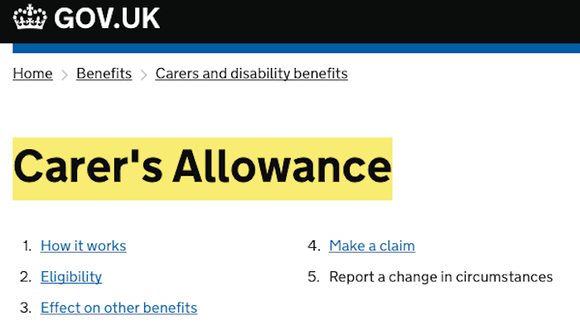


Access support to learning, training and upskilling
When you are having conversations with families, please support them to notify us of ALL change of circumstances ASAP, signpost to Gov.uk Welcome to GOV.UK (www.gov.uk) Support them to make informed choices - Benefits calculators - GOV.UK (www.gov.uk)
https://www.gov.uk/carers-allowance-report-change
Universal Credit: Report a change of circumstances - GOV.UK (www.gov.uk)
Disability Living Allowance (DLA) for children: Changes you need to report - GOV.UK (www.gov.uk)
Norfolk Library Service (justonenorfolk.nhs.uk)
Skills assessment | National Careers Service
Skills for Life: it all starts with skills | Skills for Careers (education.gov.uk)

Slide 15




Thanks for letting us share with you!
Tracy Tanner – Supporting Families Employment Adviser Team Leader for Norfolk & Disability Employment Adviser
TRACY.TANNER@DWP.GOV.UK
Philip Beck - Head of Service for Communities, Schools and Partnerships
Philip.beck@norfolk.gov.uk

