Slide 1

Working effectively with Interpreters
&
Cultural adjustment
Enabling Effective Social Work Interventions
with Migrant Families
Simon Shreeve, Service Manager for the People from Abroad Team (Norfolk County Council)
Yvonne Tyree, Practice Consultant Social Worker at the People from Abroad Team (Norfolk County Council)
Valerie Gidney, Partnership Manager (INTRAN)

Slide 2

Cultural adjustment
Adapting to change is key to becoming independent and resilient.
Maladjustment to the new environment when a person gets “stuck”
Period of confusion or frustration (incl. for those migrants who chose to move)
People forced to migrate often have little or no preparation time to adjust to the new place.
Being able to understand the new culture, systems and language is important
Inclusion and involvement will help to increase the likelihood of success.
Think of that small seedling being planted in your garden, it will need to be watered, fed, nurtured and cared for until it establishes itself and starts to grow and flourish. When it is newly-planted it can so easily wither and die, or it could be attacked by predators or trodden down. Once it can grow fresh roots and adjust to its new setting it will develop
into a beautiful plant.

Slide 3
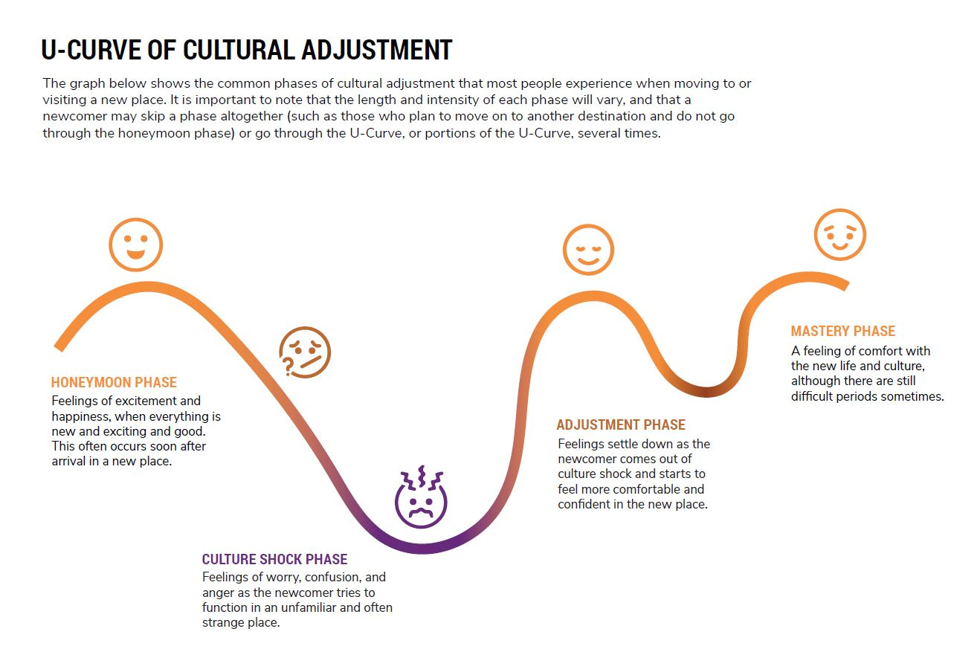
U-Curve of cultural adjustment

Slide 4
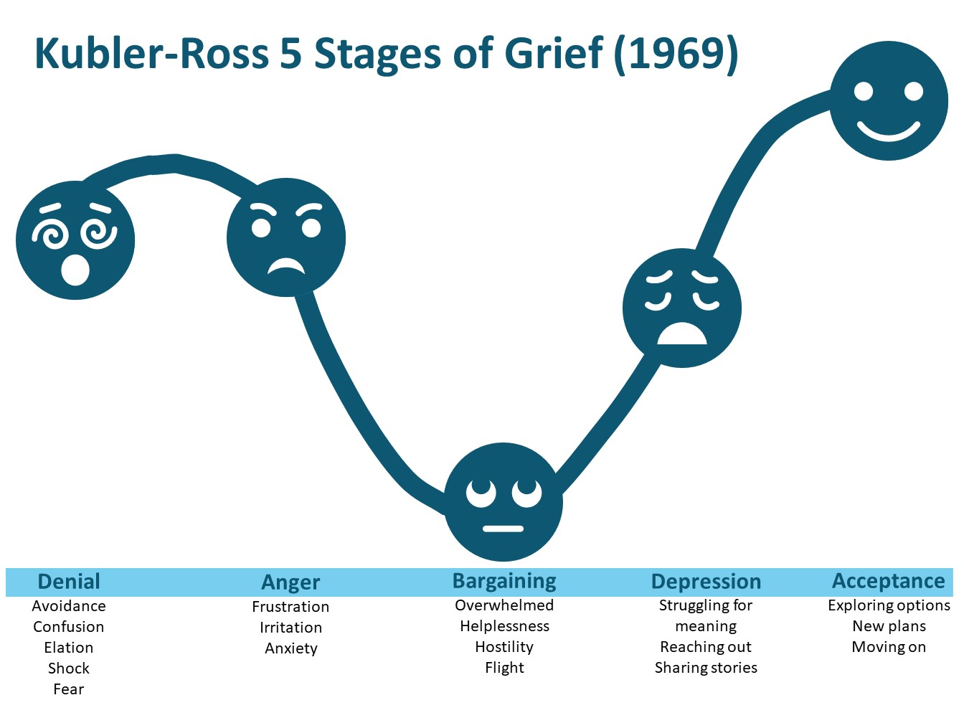
When someone has had to flee their country they often simultaneously battle with grief

Slide 5
Cultural adjustment – two letters home

Slide 6

Postcard 1
15 September 2022
Dear Haadiya,
I am so happy to be in the United Kingdom, it’s a great place. Everything is so clean and orderly, even if it is cold! Norwich is fascinating, full of old buildings, nice parks, and two modern shopping centres. Everything is very efficient; so many things get delivered straight to your door, and the people and even city buses are always on time! Everyone is friendly and polite; there were even people waiting to greet me at the airport. I feel for the first time in ages that I am alive!
Yours,
Ameer

Slide 7
Postcard 2
15 March 2023
Dear Haadiya,
I do nothing but cry all day. All I can think about is my friends and family that I left behind. I can’t understand anything that is going on around me. I feel like such an idiot, and people treat me like a child. I can’t even go to the shops and ask a simple question. Last week I took the wrong bus and got lost. I couldn’t ask anybody for help, and just stood there and cried on the street. Things that were so easy back home are so difficult here. The people are strange; they smile at each other but are always in a hurry; they walk fast, they talk fast. Nobody has time for each other. And yet things happen slowly, like finding a job, or even seeing a doctor. My English is so poor; there are so many things I want to say, but I can’t say them. It’s so cold, and Norwich is dark and grey. I’m always so tired.
Your friend,
Ameer

Slide 8
Cultural adjustment – how can you help?

Slide 9
Engaging with your clients

Slide 10

What are your thoughts and next steps?
A midwife consults CADS to report her concerns about a new woman in her unit. Almani has been there for nearly three days and gave birth 24 hours ago. She does not speak English.
The midwife is concerned that Almani is acting oddly, refusing all food and drink, and not picking up or feeding her newborn baby.
Almani's notes state that she comes from the Democratic Republic of Congo and speaks French and a local language.
The midwife has a colleague who works in the cardiology department who speaks French. He could interpret, or perhaps you could use Google Translate and translate your questions and the discussion.
What are your thoughts?

Slide 11

Risks of ‘substitutes’ options
Cancelling or postponing engagement or/and proceeding in English
    Delays causing negative consequences including some very serious
    Making decisions based on incomplete or incorrect information
Using machine translation tools like Google Translate
    Variable accuracy between texts and languages.
    Failing to bring empathy and cultural awareness
    Not compliant with Data Protection when containing personal information.
    Not risk-assessed by NCC, so not approved.
Inappropriate use of children, relatives, friends or untrained ‘interpreters’
    Negative impact on the children – they should never be used as interpreters.
    Incomplete or incorrect information, caused by biases and/or lack of interpreting skills.
    Not providing the client with a safe space to disclose personal information.
    Safeguarding – Could they be the perpetrators of abuse, or misinterpreting deliberately to cover up illegal activity/abuse? Are they DBS checked?
    Data breach – breaking confidentiality
    Not covered by their own or employer’s professional indemnity insurance to interpret.

Slide 12

Why professional interpreters are needed
Use professional interpreters in all situations where mutual understanding matters.
Reduce risks.
Deliver better outcomes!
Demographics - 300+ in the UK, 100+ in Norfolk
Not everyone speaks English fluently
Managing public resources effectively – It will usually cost you less to use an interpreter than to pay for the cost of not getting it right first time.
Many potential risks when not providing an interpreter – it can sometimes be a matter of life and death.
There is legislation in place.
To ensure informed consent has been sought
To deliver your duty of care to all your clients

Slide 13

Top 10 languages required in Norfolk
100+ languages spoken in N.
INTRAN requests in a range of 91 different languages
Including rare, harder to source languages such as Mien, Hmong, Karen, Dinka, Igbo, Fulla
Lithuanian
Arabic
Portuguese
Polish
Russian
Romanian
Bulgarian
Pashto
Kurdish-Sorani
Dari

Slide 14
Top languages per local area
Norwich | West Norfolk | East Norfolk | South Norfolk | North Norfolk | Broadland
ARABIC | LITHUANIAN | PORTUGUESE | POLISH | LITHUANIAN | LITHUANIAN
POLISH | RUSSIAN | ROMANIAN | LITHUANIAN | POLISH | ARABIC
LITHUANIAN | BULGARIAN | LITHUANIAN | PORTUGUESE | KURDISH- SORANI | PORTUGUESE
KURDISH- SORANI | POLISH | POLISH | ROMANIAN | TURKISH | PASHTO
ROMANIAN | ROMANIAN | BULGARIAN | RUSSIAN | VIETNAMESE | POLISH
PORTUGUESE | PORTUGUESE | RUSSIAN | BULGARIAN | ARABIC | UKRAINIAN
BULGARIAN | TURKISH | KURDISH- SORANI | ARABIC | MANDARIN | KURDISH- SORANI
RUSSIAN | UKRAINIAN | TURKISH | UKRAINIAN | PASHTO | TURKISH
BSL | LATVIAN | ARABIC | LATVIAN | PORTUGUESE | FARSI
UKRAINIAN | SPANISH | SLOVAK | TURKISH | RUSSIAN | ROMANIAN

Slide 15

Legislation & Public Recommendations
Equalities Act 2010
Human Rights Act 1998
Health and Social Care Act (Apr. 2015)
Accessible Information Standard (SCCI1605) 2016
Mental Health Act 1983
BSL Act (2022)
Lamings’ report 2003 (Recom. 18/65)

Slide 16
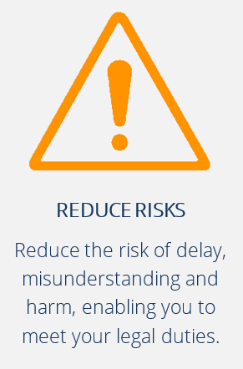
No Interpreters were used
Victoria Climbie 2000 (aunt was used by professionals)
Daniel Pelka 2012 (sister was used by professionals)
Rana Adbelkarim 2021 (simple words and hand gesticulations were used)
The Healthcare Safety Investigation Branch (HSIB) reviewed all investigations from 2018-22 that involved cases of babies dying or being diagnosed with severe brain injury in the first seven days of life.
80 cases were identified where language difficulties, inadequate interpretation and communication problems were seen as contributing factors (2023).

Slide 17
Interpreters help
IMPROVE UNDERSTANDING
Improving
Access to care, protection and preventative services
Assessments (needs/risks)
Client’s adherence to plans
Promoting
The welfare of children and vulnerable adults, protecting them from harm
Client’s independence
PREVENT MISUNDERSTANDINGS
Preventing
Escalation of needs and risks unnecessary diagnostic tests, admissions, inappropriate interventions
Inappropriate use of emergency services
Inefficiencies and higher service delivery costs
Critical issues including deaths or liability costs

Slide 18
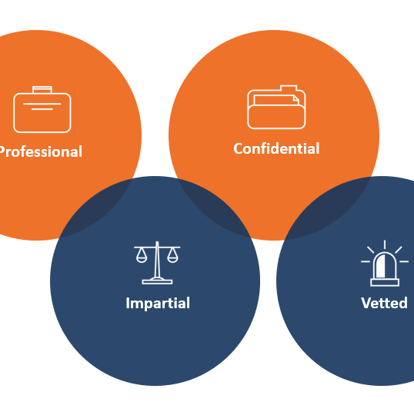
Public Service Interpreters
Are suitably trained, qualified, experienced in Public Sector interpreting.
They are vetted professionals who follow a strict Code of Conduct guiding their profession (e.g. NRPSI, NRCPD).
Interpret truly and faithfully what is said, without adding, omitting or changing anything.
May use consecutive, simultaneous whispering interpreting and sight translation.

Slide 19
Making an effective use of interpreting services

Slide 20
in person or remotely
Telephone Interpreting
Face to Face Interpreting
Video
Interpreting

Slide 21
Booking Requirements
ON APPOINTMENT SERVICES
Date, time (X2), location
Contact details on the day
Client’s name (to ensure interpreter’s compatibility)
Special requirements (e.g. gender, potential risks)
Purpose of the interview
ALL SERVICES
INTRAN ID code
Name of your organisation
Contact details
Language required
Context

Slide 22
Identify the right language

Slide 23

Video

Slide 24

Briefing, Engaging and Concluding
Briefing
Introductions
Context
Purpose
Process
Risks
Terminology
Engaging
Introduce
Communicate directly
Regular pace
Direct speech
Eye contact
Plain English
No jargon
Check understanding
Regular breaks
Concluding
Recap and conclude
Need follow-up appointment?
Client leaves
Debrief face
to face
interpreters
Notes:
On this slide we will summarise things you need to know when working with an interpreter – we’ve broken these down into the before, during and after stages.
Some things to consider BEFORE you meet with your client.
Ensure you give the interpreter some brief background information. This can include sharing the purpose of the meeting, explaining what you want to accomplish from the meeting, and any other information you feel is important.
You may inform your interpreter of any potential risks which could arise – for example does this person have a dementia diagnosis where there is a risk of a sudden change in behaviour (In these circumstances you may share any contingency plans with your interpreter).
OR does this person experience hearing difficulty where the interpreter will need to speak at a higher volume.
Luke actually has a couple of his own real-life examples here, which he is happy for me to share with you all:
He was previously a practitioner within Adult Social Services, and as part of his role he had to complete mental capacity assessments. He had to do a home visit with a client who spoke Portuguese, so he briefed the interpreter that he will be repeating lots of his questions at various stages throughout the meeting, to get a sense of how the client is impacted by short-term memory loss.
Another example, he booked an interpreter for a gentleman who was recovering from a stroke. He developed a speech disorder which would delay his responses - so prior to the meeting Luke emphasised that it may take a long time for this person to respond, also we will be taking regular breaks.
There are lots of examples of the contextual information an interpreter will need to know before the meeting starts, if you can think of any more, perhaps from your own experiences of using an interpreter, please feel free to share your experiences in the chat.
Essentially, ensure you give the interpreter some brief background information. This can include sharing the purpose of the meeting, explaining what you want to accomplish from the meeting, and any other contextual information you feel is important.
If you intend to use specialist or complex terminology it is useful to share the meaning with the interpreter – this can help them keep what they’re saying as accurate as possible.
If you really want to go the extra mile, you can ask your interpreter for their advice about rules of politeness / how to be respectful when greeting your client as there are lots of different cultural norms and expectations. You can also ask for help in how to pronounce your clients name so you can say it correctly the first time.
And remember, if your meeting is a home visit, the interpreter will always wait outside for you to arrive. If it's the other way around and you arrive before the interpreter, please wait outside for them. They will never enter someone’s home without you present.
Now during the meeting:
Most of the points here will come naturally to you, introduce your interpreter, be conscious of the way you communicate (use direct speech, plain English –avoiding jargon, and often humour sometimes doesn’t always translate well)
One of the main things to remember is communicate and give eye contact DIRECTLY to your client. This is a mistake so many people make, and it can take time to get used to because most people would naturally give eye contact to the person talking.
Try to also break down what you are saying in a logical way to avoid long sentences ——
If you try to say too much all at once it will just risk inaccuracy - and the interpreter will need you to repeat what was said
Throughout the conversation make sure you check the understanding of your client whilst you have the interpreter there to help. And ensure that if the meeting is long that you take regular breaks.
And finally, the best practice at the END of the meeting.
Make sure that you recap everything that has been covered in your conversation today, and provide further opportunity for any additional clarification needed or questions asked. Especially with telephone interpretation, there is a risk that is can be quite structured (this person talks, then that person talks) which prevents people from asking questions - so allowing opportunities for questions is very important – it will help your client understand what you are saying.
If you need to have a future appointments with your client, you can check and agree availability with the same interpreter – for continuity.
Also - if it's a telephone call and your call is cut off during the meeting - or you end the call and realise OH NO I forgot to ask this really important question - you should have been given an ID number at the beginning of your call, if you quote this to language line they should be able to reconnect you with the same interpreter - this will make things consistent and limit any confusion.
If it's a face to face booking, be conscious that lots of people will want to have a more informal conversation with your interpreter, they might not have had many opportunities to do this. This is not their role and may have other appointments, there could be safeguarding risks emerge from this too. I appreciate this can be difficult to avoid, but wherever possible allow the client to leave first.
If relevant, debrief the interpreter - you might want to discuss any complexities faced during the interview to check whether possibly linked to language and culture or not.
Finally, this isn’t something YOU will need to remember – just something to be aware of ---- if it’s a face to face booking you will need to sign interpreter’s form to confirm the conversation actually took place (or they won't get paid!)

Slide 25

Recap
Be aware of the challenges faced by people from diverse ethnic and linguistic backgrounds.
Use INTRAN early in the process to ensure mutual understanding, and sound decision-making.
Be set up to use INTRAN now - not when you need it for the first time! (ID codes, booking information on My Net, registration to access on-demand VI).
Assess the situation to select the most suitable interpreting service.
Allow more time (X2).
Do not assume understanding. Establish trust. Be clear, explicit and ask questions to enable people to share their perspectives.
Apply the ‘good practice’ tips. If face to face, brief the interpreter. It matters!
You are in charge. Not the interpreter.

Slide 26
Further information

Slide 27
People from abroad team- what, when & how to contact
Specialist integrated health & social care team supporting migrants, refugees and asylum seekers.
‘First Responder’ under the Modern Slavery Act 2015 – Able to make referrals into the National Referral Mechanism.
Can provide guidance and advice to social work practitioners
Use LiquidLogic to start an Information Report (on EHM or LCS) for all children in the household
Complete all the following fields (both adults & children):
  Ethnic Origin
  Language Spoken
  Nationality
  Date of birth
  Upload copies of passports, ID cards and/or other immigration-related documents
Explain what guidance or advice you are seeking, and if you are also asking for immigration-status checks to be carried out.
Then submit your form.
Do not use emails, phone calls or Teams message!

Slide 28
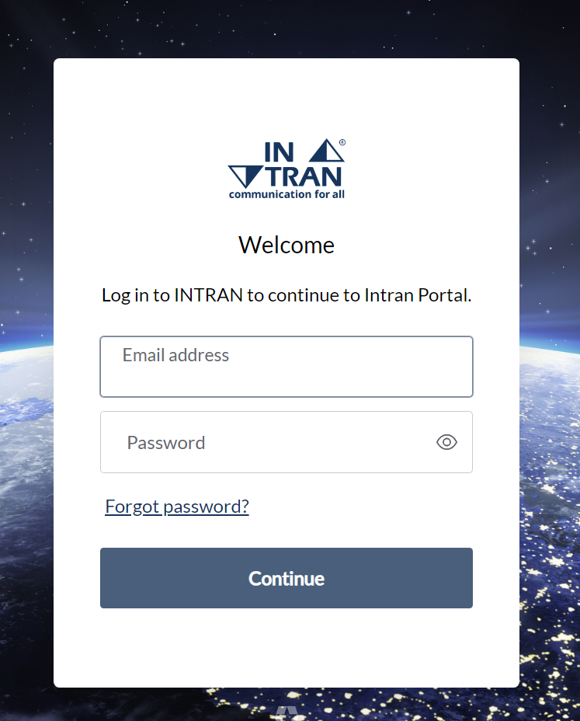
INTRAN Learning Portal
Send a request to intran@norfolk.gov.uk
Include your Email Signature and the following information:
  Full Name
  Job Role
  Organisation
Notes:
You will need to register to join the learning portal - don't worry though this is super quick and easy.
All you need to do is send an email to us with your name, job role and organisation. Our email is intran@norfolk.gov.uk. We'll remind you to do this at the end of this training session so no need to do this immediately.
We need to make sure your organisation is a member of INTRAN prior to signing you up (and if you’re here today you probably are a member!) – so emailing from your work account is the easiest way to validate this.
Shortly after you’ve sent us the email, you'll receive a link to sign into the portal - it's a nice and simple process.

Slide 29
Contact Details
PEOPLE FROM ABROAD TEAM
Norfolk & Norwich Millenium Library, Millenium Plain, Norwich NR2 1AW
Tel: 01603-222111
nrpf@norfolk.gov.uk
Referrals about children must be made to CADS on 0344 800 8021
INTRAN
www.intran.org.uk
MyNet: search ‘using INTRAN’
Contact: intran@norfolk.gov.uk or
intrantraining@norfolk.gov.uk
Or your departmental champion on NCC’s intranet
Your INTRAN champion - Intranet - Norfolk County Council

