Slide 1


A Public Health focus on Children's Nutrition and Learning
21st May 2024

Slide 2

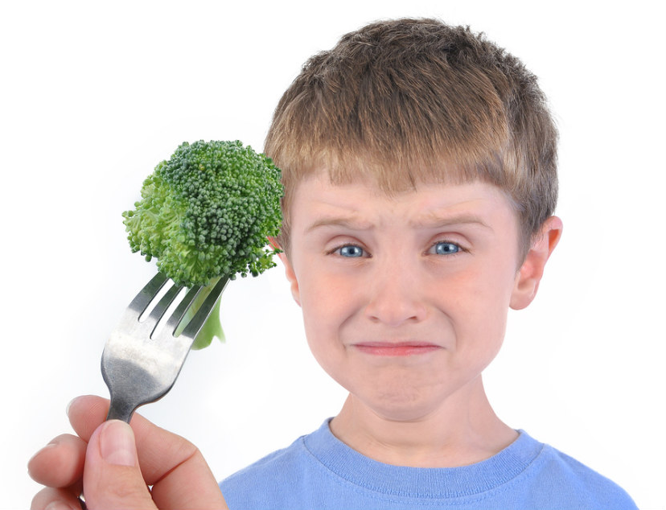
Session Aims
Provide insight into the current patterns of children and young people’s nutrition as this relates to health.
Provide information on the impact of poor nutrition on wellbeing and learning.
Provide information on what you can do to further understand children’s nutritional needs and how educational establishments and wider services can support this.
www.unlockfood.ca

Slide 3
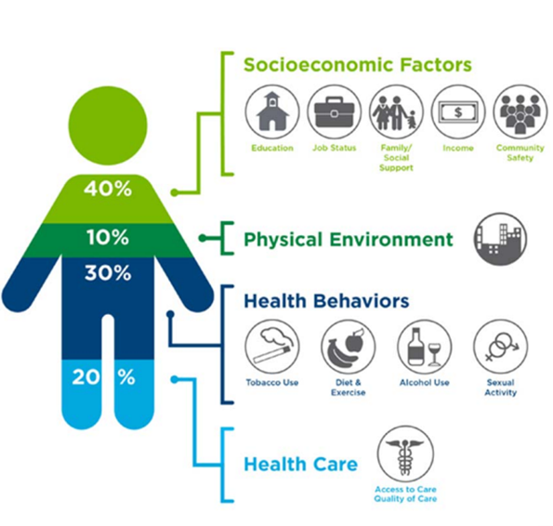
Key Points:
There is a complex interrelationship between nutrition, social and economic factors and health and education.
The human brain requires all essential nutrients, including protein, fats, carbohydrates, vitamins, minerals, and water, to form and maintain its structure. Therefore, adequate nutrition is essential for brain development and function
Children who do not receive sufficient nutrition are at high risk of exhibiting impaired cognitive skills.
Hungry children are less able to cope with the challenges of each day and more likely to struggle emotionally. This being likely to impact on behaviour in school, attendance and a child's ability to engage in learning.
Source: Institute for Clinical Systems Improvement, Going Beyond Clinical Walls: Solving Complex Problems (October, 2014). The Bridgeton Group

Slide 4
Key Terms:
Nutrition - the process of providing or obtaining the food necessary for health and growth.​
Malnutrition, in all its forms, includes undernutrition (wasting, stunting, underweight), inadequate vitamins or minerals, overweight, obesity, and resulting diet-related noncommunicable diseases. Fact sheets - Malnutrition (who.int)
Food Insecurity - is defined as the state of being without reliable access to a sufficient quantity of affordable, nutritious food - (Food Foundation, 2022)
Ultra Processed Foods: a category of foods described within the NOVA classification system by the ‘extent’, ‘purpose’ and ‘nature’ of food processing, within national dietary guidelines. ​
HFSS - is a shortened term for food and beverage products which are high in fat, salt, or sugar or ‘less healthy’.
Classification of overweight: For population monitoring purposes, a child’s body mass index (BMI) is classed as overweight or obese where it is on or above the 85th centile or 95th centile, respectively, based on the British 1990 (UK90) growth reference data.
Free sugars – sugars added to food or drinks, and sugars found naturally in honey, syrups, and unsweetened fruit and vegetable juices, smoothies and purées.

Slide 5
Current patterns of children and young people’s nutrition.

Slide 6
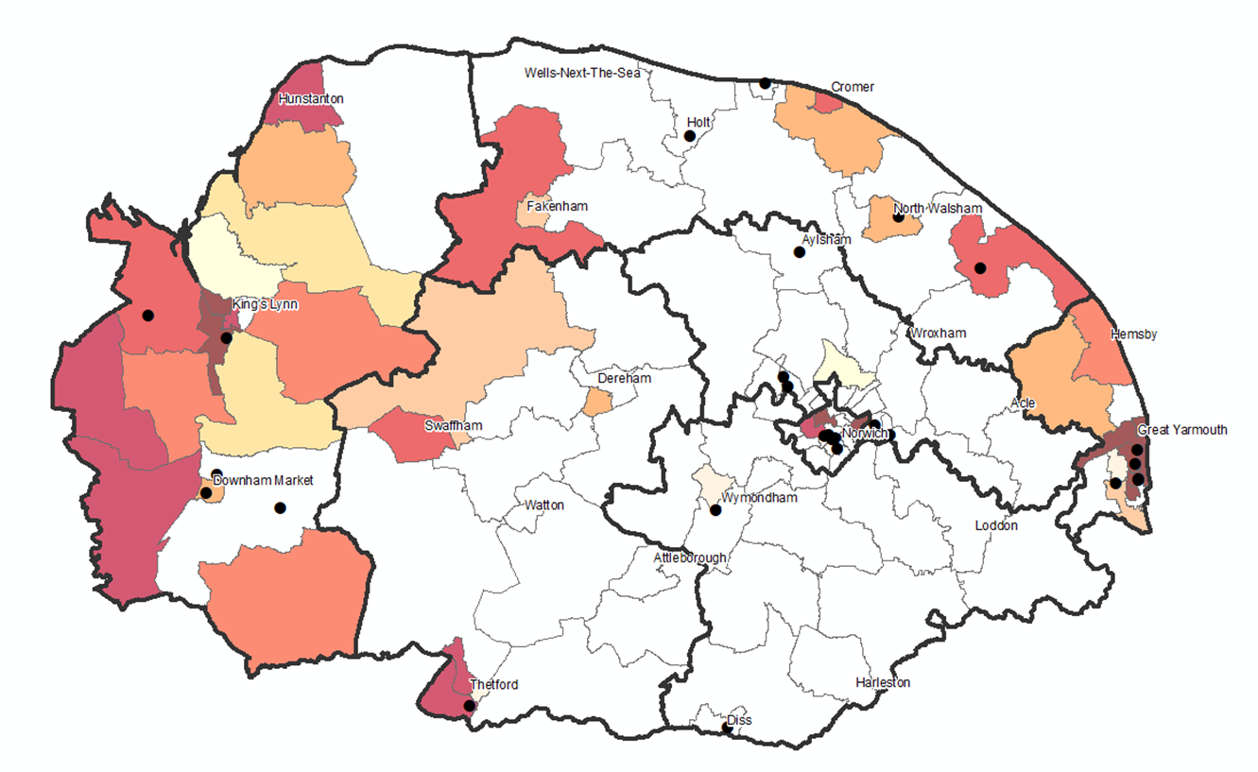
What do we know about children’s nutrition and weight in Norfolk?
Infancy and early childhood is perhaps the most critical time for establishing food preferences and dietary patterns.
The shaded MSOAs are those with significantly lower rates of breastfeeding (compared to national) with shading according to deprivation decile; unshaded areas are similar or lower than national.
National evidence base identify key nutritional deficits in children under the age of 5 in the UK with the current diet of young children not meeting dietary recommendations. This included:
High rates of free sugar consumption
Below recommended rates of fibre
High rates of salt intake
Large portion sizes
Feeding young children aged 1 to 5 years - summary report - GOV.UK (www.gov.uk)

Slide 7
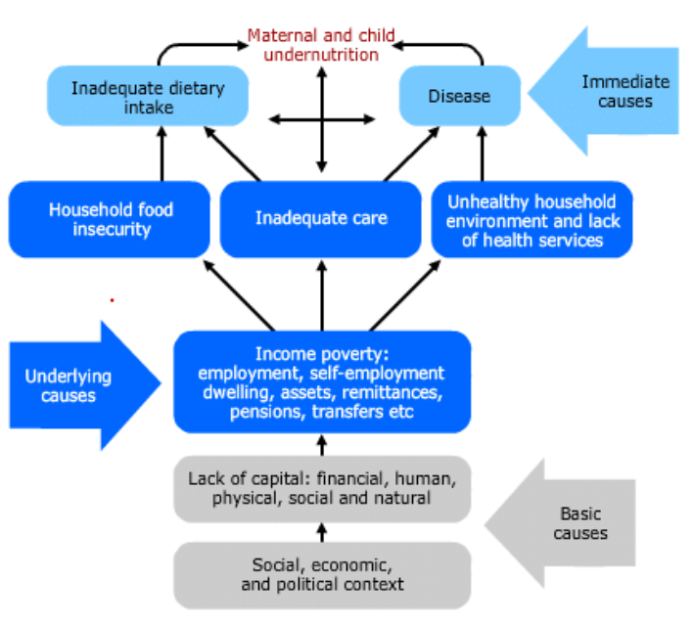
What do we know about children’s nutrition and weight in Norfolk?
    Women, infants, children, and adolescents are at particular risk of malnutrition. Optimizing nutrition early in life—including the 1000 days from conception to a child’s second birthday—ensures the best possible start in life, with long-term benefits. Fact sheets - Malnutrition (who.int).
    In 2022/23, an estimated 17% of children were in food insecure households nationally. Rates of food insecurity are higher for people in Black/African/Caribbean/Black British ethnic groups and from mixed multiple ethnic groups.
    Food insecurity is higher in those living in social rented sector housing (27%) and the rise in food insecurity has been mirrored by a rise in foodbank use. Who is experiencing food insecurity in the UK? (parliament.uk)

Slide 8
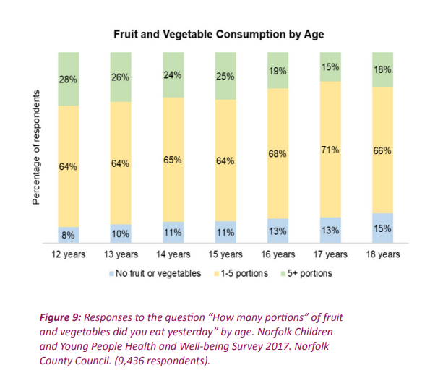
What do we know about children’s nutrition and weight in Norfolk?
Healthy calories are nearly three times more expensive than unhealthy calories. Highly processed food high in fat sugar and salt and low in nutrients per calorie are proportionately cheaper
The poorest fifth of UK households would need to spend 40% of their disposable income on food. This compares to just 7% for the richest fifth.
In Norfolk there are currently around 30,000 children who access means tested free school meals. This is in addition to all children in Year Reception, 1 and 2 who automatically receive free school meals. Malnutrition - Cabinet Statement.docx (norfolkinsight.org.uk)
Households with children are at increased risk of food insecurity compared to those without.
Director_of_Public_Health_Final.pdf (norfolkinsight.org.uk)

Slide 9
What do we know about children’s nutrition and weight in Norfolk?
The prevalence of malnutrition on admission to hospital is estimated to be around 15% for children under the age of 18, lower than other age groups (1).
However, Norfolk has very few admissions to hospital for children under the age of 18 recorded with malnutrition, scurvy or rickets (around 10 per year).
Limited information in children receiving social care nationally suggests that malnutrition (excluding overweight or obesity) affects only a small proportion (estimated to be 3%). For looked-after children, overweight and obesity are common and underweight distinctly uncommon (1)
This theme is consistent with the findings from the Government's National Child Measurement Programme (NCMP) for the general population in Norfolk, 2022/23 school year.
1. https://www.bapen.org.uk/pdfs/economic-report-full.pdf

Slide 10
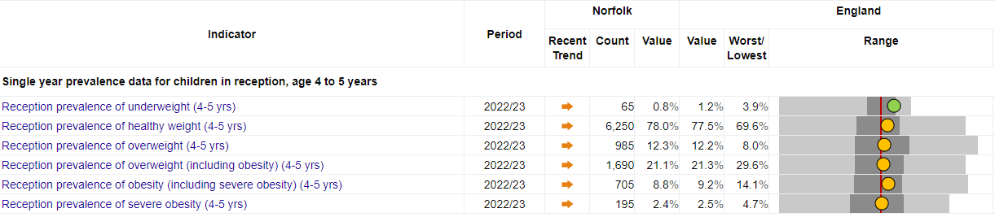
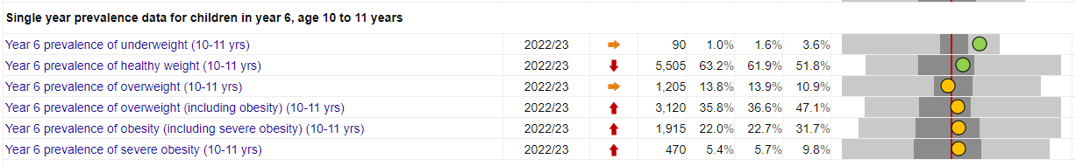
What do we know about children’s nutrition and weight in Norfolk?
The below shows a breakdown of National Childhood Measurement Programme (NCMP) categories for 22/23 (Norfolk values highlighted). In both years, most children are in the healthy weight category and in Year 6, this is above the national rate.
Underweight is similar for both year groups and is significantly lower than national for both year groups. For Year 6, obesity and severe obesity is more than double that of reception.
All other indicators in both years are similar to England and in reception show no significant change in trend. In Year 6, overweight and obesity, obesity and severe obesity are all increasing and getting worse.

Slide 11
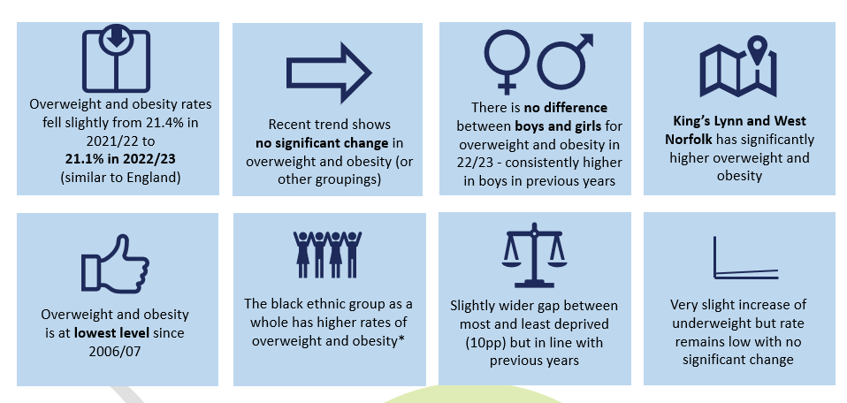
National Childhood Measurement Programme: Reception 2022/23
Ethnicity data to be treated with caution due to the small numbers in each ethnic minority group.

Slide 12
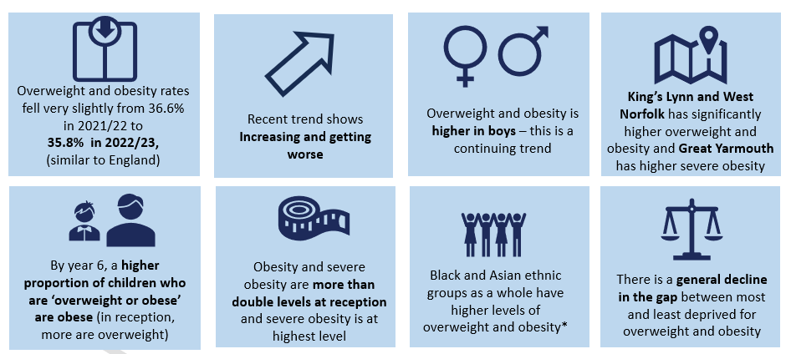
National Childhood Measurement Programme:
Year 6 - 2022/23
Ethnicity data to be treated with caution due to the small numbers in each ethnic minority group.

Slide 13

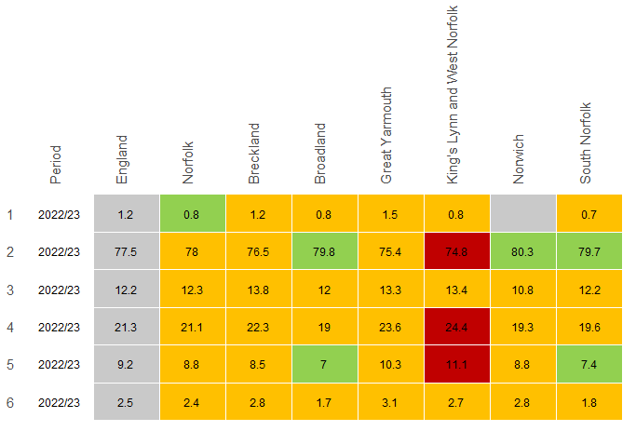
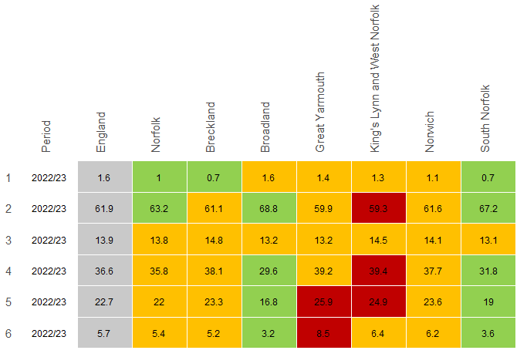
By District
Most districts are statistically similar or better than national rates
For years R and 6, King’s Lynn has significantly higher overweight and obese children and for year 6, Great Yarmouth has a higher rate of severely obese children; these are both districts with higher levels of deprivation
Reception
Year 6
underweight
healthy weight
overweight
overweight (including obesity)
obesity (including severe)
severe obesity

Slide 14
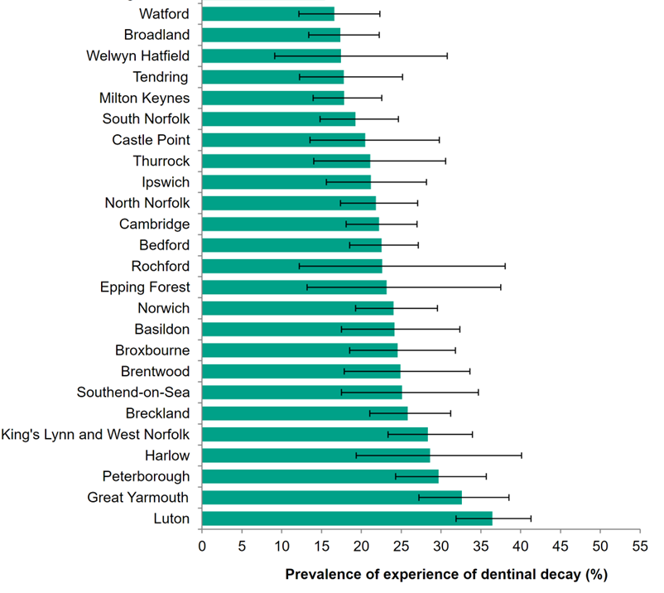
What do we know about children’s nutrition and weight in Norfolk?
Top 25 highest lower tier authorities in the East with experience of dentinal decay in five-year-olds:
In 2019 the prevalence of tooth decay in England in five-year-olds was 23.4%.
The most deprived communities of Norfolk experience higher rates of tooth decay than this.
The districts in Norfolk with the highest percentage of children with tooth decay are Great Yarmouth and Kings Lynn and West Norfolk.( Norfolk JSNA, 2022).

Slide 15
Impact on Wellbeing and Learning

Slide 16

Quiz

Slide 17

Quiz Summary
There are many opportunities throughout the day to support a child’s learning and overall wellbeing through nutrition
  Things to consider:
  Blood sugar regulation
  Adequate protein
  Healthy fats
  Complex carbohydrates
  Hydration
  The food environment
  A child’s unique circumstances

Slide 18
Quiz Information – National Context
Placement of less healthy products in store and online have been restricted.
From October 2025:
Multibuy promotions like BOGOF on less healthy food will be banned.
The advertisement of less healthy products on many forms of media and online before the watershed will be banned
Evidence shows exposure to adverts for unhealthy foods can affect when people eat and when the eat, leading to excess calorie consumption over time.
https://healthmedia.blog.gov.uk/2023/06/07/government-plans-to-tackle-obesity-in-england/
Other potential solutions include:
Expanding the sugary drinks tax and taxing high salt.
Implementing a pre-watershed ban on junk food advertising as soon as possible (to include digital platforms).
Reducing cartoons on packaging to minimise Children’s exposure to unhealthy food.
The Times Health Commission’s 10 recommendations to save the NHS
Notes:
Reducing the likelihood of impulse purchases

Slide 19
Good practice and Resources

Slide 20



National Resources and Help
Healthier Families - Home - NHS (www.nhs.uk)

Slide 21


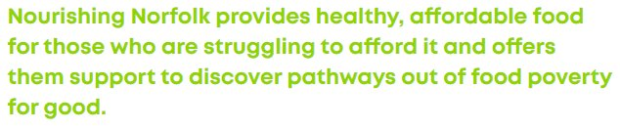

Norfolk Support and Services
Healthy Child Programme Services, Just One Number and Just One Norfolk including:
Healthy eating in pregnancy, infant feeding and diet and healthy weight support
Oral Health Information
National Childhood Measurement Programme and universal support
Tier 2 weight management for children and young people (new commissioned service from October 24)
Healthy Start Vitamins (extended groups from October 24)
Adult Healthy Weight Services and Ready to Change
Promotion of take up of free school meals, maintain strong links with local food banks and community groups to ensure that wider support that families might need is available.
Apply for free school meals: search result - GOV.UK (www.gov.uk)
Nourishing Norfolk | Norfolk Community Foundation (norfolkfoundation.com)

Slide 22
Early Years and Schools Information
Nutrition Matters for the early years 0118.pdf (hscni.net)
Healthy eating | Overview | PHE School Zone
Schools and Early Years - Food for Life
Free education resources for teaching young people aged 3-16 years about where food comes from, cooking and healthy eating, and teacher training. - Food A Fact Of Life
School food standards practical guide - GOV.UK (www.gov.uk)
Information for healthcare and childcare professionals - Start for Life - NHS (www.nhs.uk)
Robust evidence shows that interventions taking a ‘whole school approach’ have a positive impact in relation to outcomes including body mass index (BMI), physical activity, physical fitness, fruit and vegetable intake, tobacco use, and being bullied. Whole-school approaches have been associated with improvements in children’s diets and their food choices.
HT_briefing_layoutvFINALvii.pdf (publishing.service.gov.uk)

Slide 23
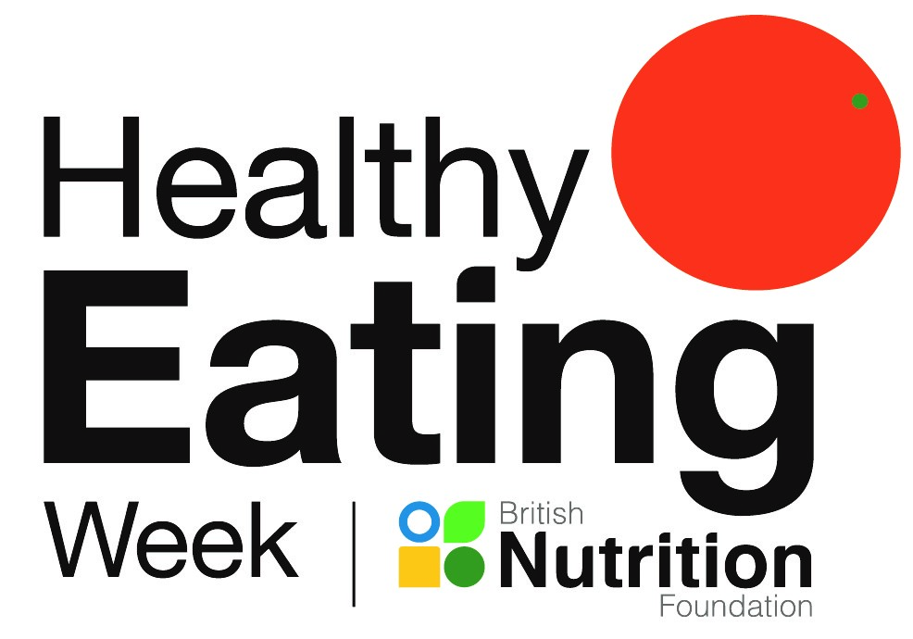
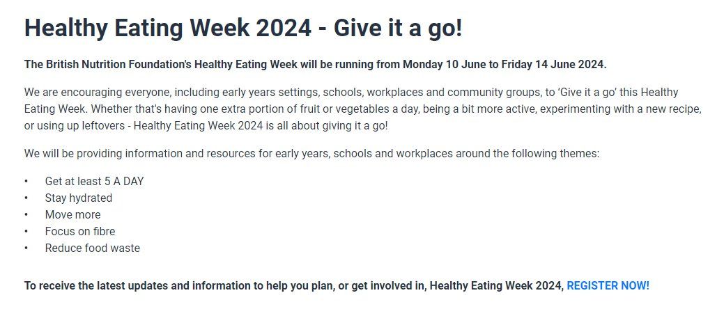
Healthy eating week
Healthy Eating Week 2024 - Monday 10 June to Friday 14 June (nutrition.org.uk)

Slide 24
National and Local Policy

Slide 25
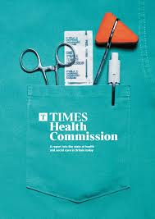
The Times Health Commission Report​
(February 2024) ​​
Aims to address the most urgent challenges facing health and social care in Britain, via a 10-point plan.
Recommends reductions in the dominance of unhealthy food to protect future health and calls for expansion on taxes on sugar and salt. ​
Recommendations​
8th focuses in on prevention of diseases relating to diet and obesity.​
​
Solutions include:​
Expanding the sugary drinks tax and taxing high salt.​
Implementing a pre-watershed ban on junk food advertising as soon as possible (to include digital platforms).​
Reducing cartoons on packaging to minimise Children’s exposure to unhealthy food.​
According to their YouGov polling groups - solid public support for expanding levies on unhealthy food and addressing misleading packaging
74% want a ban on food high in fat, salt and/or sugar (HFSS) from using packaging designed to appeal to children​
59% support a ban on advertising of HFSS food and drink before 9pm​
times-health-commission_report_2024.pdf (documentcloud.org)
The Times Health Commission’s 10 recommendations to save the NHS

Slide 26
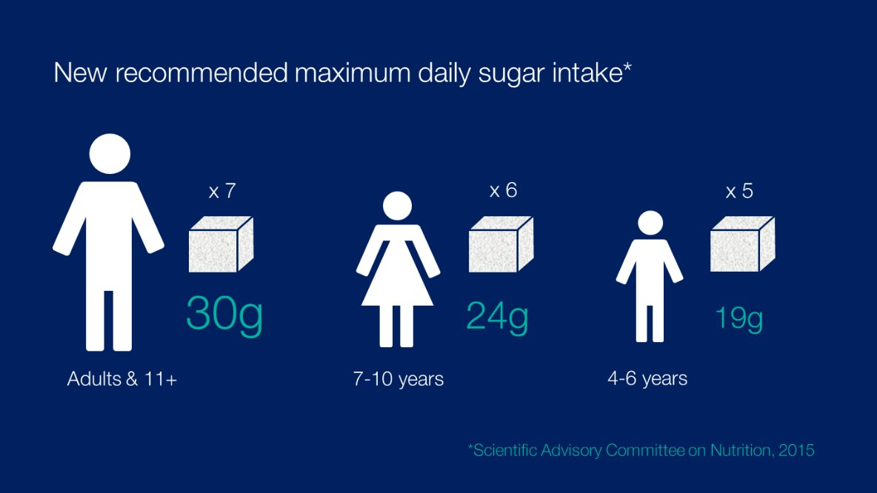
Reducing the nation’s sugar consumption
Reducing the Nation's Sugar Consumption
PHE recognise the profound changes in our relationship with food over the 30/40 years prior to 2015. Food had become much cheaper, more readily available, more heavily marketed, promoted and advertised.
Sugar intakes of all population groups were found to be above the recommendations, contributing between 12 to 15% of daily energy intake. Sugar reduction: from evidence into action - GOV.UK (www.gov.uk)
WHO issued updated guidelines in March 2015 strongly recommending a reduced intake of free sugars throughout the life course.
Guideline: sugars intake for adults and children (who.int)
SACN review - SACN's recommendations were accepted, resulting in the biggest change to Public Health guidance surrounding sugar consumption since 1991.
In 2016 the sugar reduction initiative aimed for all segments of the food industry to voluntarily decrease sugar levels by 20% by 2020 in the food groups most influential in children's sugar consumption up to the age of 18 etc.
Key nutrition policy instruments e.g. Change4Life and the Eatwell Plate were updated to reflect the messages

Slide 27
Notes and References

Slide 28

National child measurement programme
The data in this report show findings from the Government's National Child Measurement Programme (NCMP) for Norfolk, 2022/23 school year
Data for 2022/23 was released in November 2023 and is the second year of data collection unaffected by Covid 19.
Participation for 22/23 was 96.3% for Year R and 93.7% for Year 6
In 2020/21, Year 6 data was particularly impacted by Covid 19 with participation much lower; in this collection year, the Norfolk NCMP provider was asked to focus on schools where obesity was a problem. Whilst this skewed data collection, more children got referred to services. However, this should be considered when interpreting data.

